Slide 1
Session 2: Funding
26.11.24

Slide 2
What works well?
What works well for your organisation in terms of funding?
Work on tables

Slide 3
What are the challenges?
What are the challenges for your organisation in terms of funding
5 minutes on your table

Slide 4
How can we work better together to improve funding/sustainability across the sector?
Is there a role for VRSG in this? Example of Cumbria Youth Partnership Programme, funded by National Lottery.
Who are your competitors and who aren’t?
Notes:
Remember to pull out impact and measuring need – how is that contributing to our collective voice?

Slide 5
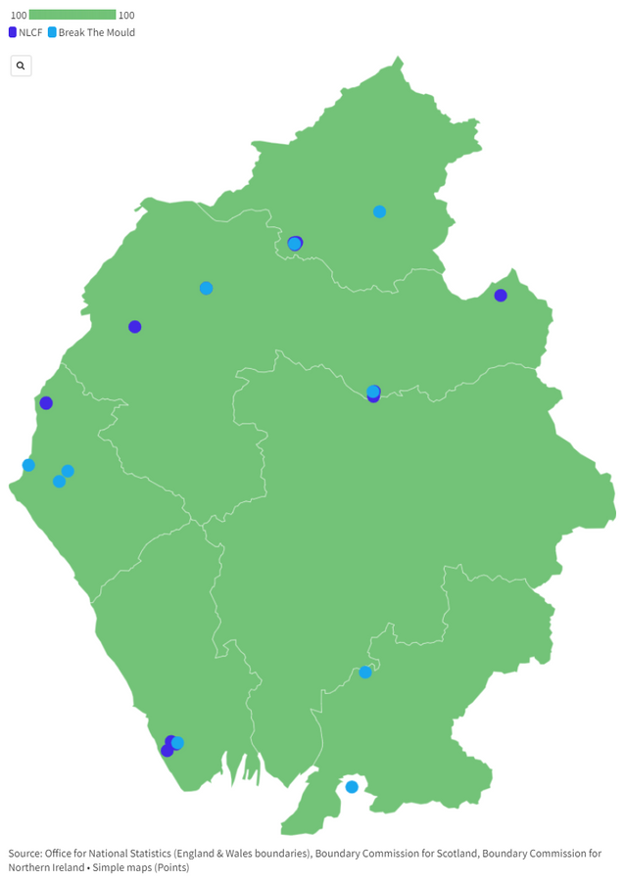
Strengthening Communities
29 Projects Funded
15 - Cumbria Youth Partnership
14 - Break the Mould
Brampton and Beyond
Community Trust
Safety Net
We Are People First
Aspatria Dreamscheme
iCan
NADT
CADAS
Alston Recreation Ground
Together We
Stomping Ground
A Step Ahead
Whitehaven Harbour Youth
BlueJam Arts CIC
Another Way
Always Another Way
KEY
Phoenix Youth Project
Kendal Brewery Arts
Women’s
Community Matters
Walney Community Trust
SAFA
Addictions
Rurality + Isolation
Horizon Studios
Furness Broadcast Media CIC
Mental Health + Wellbeing
Poverty
Aspirations + Transitions

Slide 6
Next steps?
Where do we go from here?

