Slide 1
Early English Wickendens
1550 - 1900

Slide 2
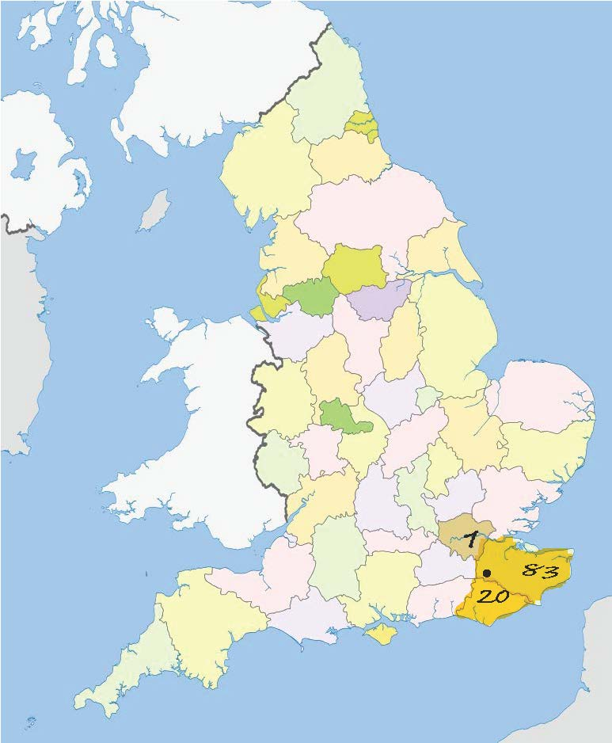

Slide 3
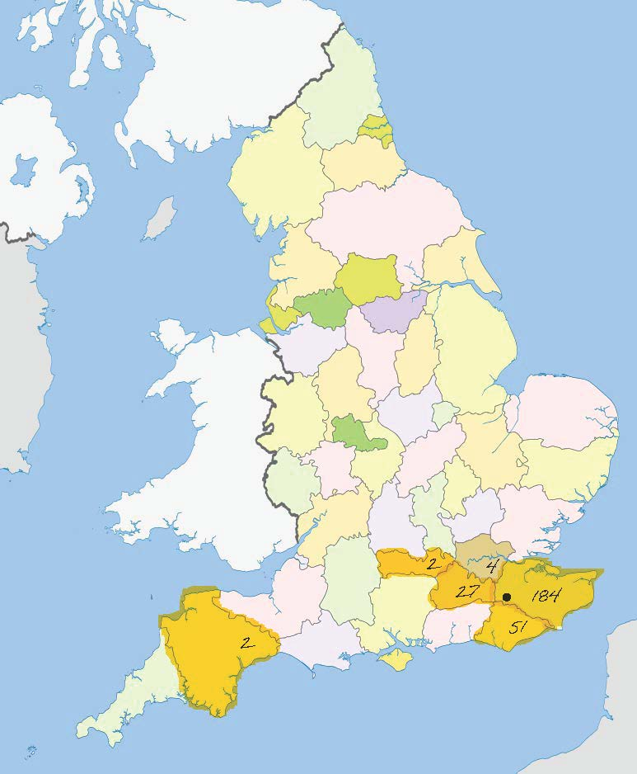

Slide 4
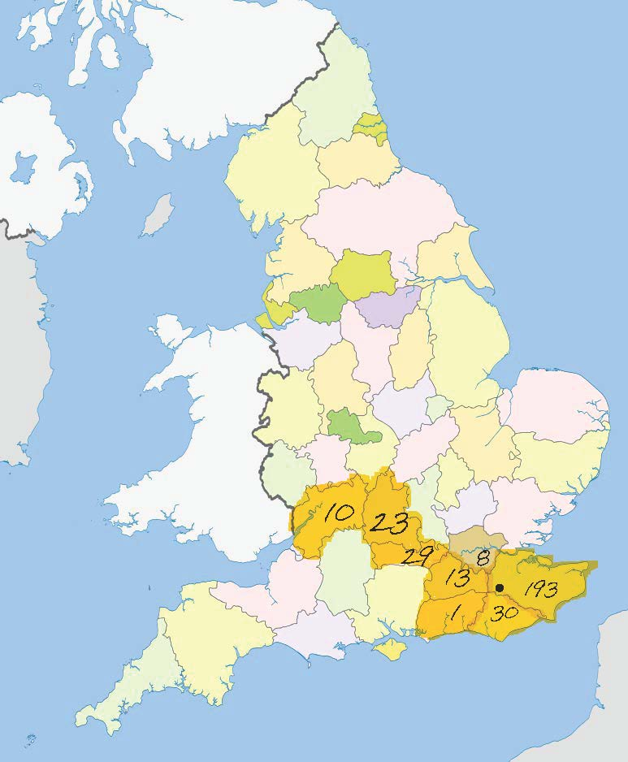

Slide 5
