Slide 1
Name Change and the
Construction of Tribal Identity
A Multi-Stage, Multi-Level Model
Presentation by
Thomas Wickenden, Ph.D.
Notes:
Good day.
My name is Tom Wickenden.
This presentation is about name change,
specifically, about the construction of tribal identity through name change.
I’ll be describing a model for analyzing the process of name change
and applying this model to an Anglo tribal group in medieval Britain.
The purpose is to better understand the origin of the tribe,
but the model should have broader applicability as well,
both to other tribes, medieval as well as modern,
and to the process of identity construction in general.

Slide 2
NAME CHANGE AND THE CONSTRUCTION OF TRIBAL IDENTITY
OUTLINE
Introduction to The Problem
A Theoretical Model
Application to the Hwicce
Assessment of the Model
Notes:
I’ll be covering 5 topics in some detail.
1^{st.} The problem of understanding the identity of a tribal group and how it is constructed,
especially when it involves a change in the name of that group.
2nd. A theoretical model for addressing that problem – a model based on previous work by several others
but adding to it a description of name change at various levels within and beyond that of a tribe.
3rd. An application of this model to a tribe called Hwicce, who developed a kingdom in medieval Britain.
4th. And we’ll conclude with an assessment of the applicability and utility of the model.

Slide 3
I. INTRODUCTION TO THE PROBLEM
Tribal group names are important.
Their origins and changes are not well understood.
Models exist for analyzing personal and place-name changes.
We will apply these models to names of tribal groups.
The model will be tested against the Hwicce, a tribal group in medieval Britain.
Notes:
It goes without saying that tribal names are important to the identity of a tribe. The origin and change of a name can reveal a great deal about the identity of the tribe and about the history of the period.
There is a large and growing body of research about the development of ethnic identity for an individual, especially within multi-cultural environments. However, not much is known about the construction and development of ethnic identity for a community, especially as it pertains to the origin and change of a tribal name.
There are also several models in the literature for analyzing changes in names – changes in personal names and changes in place names – but not changes in tribal names.
This presentation will build upon these models and apply the result to the process of name change for a particular tribal group.

Slide 4
II.1. THE THEORETICAL MODEL
Five stages of ethnic identity development (Cross)
Ethnic identity development through name change
  Change in a personal name (Xu)
  Change of a place name (Macha)
  Cross, Jr., William E. 1971. „The Negro-to-Black Conversion Experience.“ Black World 20, no. 9:13-27.
  Xu, Xing. „Exploring the Logic of Name Changes and Identity Construction: A Reflective Self-Narration of Assimilation Expectations.“ Names 68, no. 1: 32-41.
  Premysl Macha. „The Symbolic Power of Place Names: The Case of the River Olse/Olza/tolza in Northeasern Czechia.“ Names 68, no. 3: 169-184.
Notes:
Numerous researchers have for many years viewed identity development as a modality of sequenced stages.
For example, William Cross, Jr., proposed a five-stage model for the development of racial identity within a multi-cultural society.
Xing Xu has built on this work by focusing specifically on personal name change as a nexus for identity development within the process of assimilation.
Premsyl Macha examined the differential politicization of place names and the relationship between toponomy and power, a subject that has become known as the “critical toponomies approach.”
Since the individuals upon whom Cross and Xu focused also make up these larger communities and groups, and
since these communities may give rise to the names of larger places like the river upon which Macha focused but including territories and kingdoms, we propose to extend their work by
adding these larger communities to the model of a sequence of stages through which individual ethnic identity is constructed.

Slide 5
II.2. THE THEORETICAL MODEL
Five stages of ethnic identity development
  Stage 1 – Pre-encounter
  Stage 2 – Encounter
  Stage 3 – Immersion/Emersion
  Stage 4 – Internalization
  Stage 5 – Commitment
Expanding the model to include three higher levels
  Micro level (Stages 1 - 5) – The Individual
  Meso level (Stage 3 - 5) – The Immediate Community
  Macro level (Stage 4 - 5) – The Tribal Community
  Global level (Stage 5) – All Tribal Communities
Notes:
William Cross, Jr., proposed a five-stage model for the development of racial identity within a multi-cultural society.
These five stages include those listed on the slide: READ
In this presentation, I will utilize and extend this theoretical framework by explicitly incorporating different levels of community into the model. These levels will be referred to as micro, meso, macro, and global.
The micro level involves individuals and describes them in all stages of the model .
The concept of kinship group leader is introduced to identify the specific individuals who, in a collective process such as establishing control, are involved in organizing and managing activities ,
such as extracting food rent, recruiting and training soldiers, constructing roads and communal facilities, and providing protection from aggression by other tribal groups. These leaders are the individuals who are most exposed to the trauma and most actively involved in the communication process that results in the involvement of larger communities and, ultimately, in a tribal name change.
The meso level is reached in stage 3, as leaders explore the problem and share possible name changes within their immediate communities.
The macro level is reached in Stage 4, as leaders from one or more tribal communities share the name change with other communities across the territory and promote the name as an identifier not just for the members of a specific tribe, but for all the peoples within the territory, that is, for the polity known, say, as a kingdom.
The global level is reached in Stage 5, as leaders of the kingdom, with support from the peoples within the territory, promote the name of the Kingdom with leaders of other kingdoms across the country.
Since the individuals upon whom Cross and Xu focused include individual leaders and they also make up these larger communities and groups, and since these communities may give rise to the names of larger places including territories and kingdoms,
adding these various levels to the model is a logical extension. It should be noted, however, that at each level, the locus of ethnic identity has , shifted – from the individual at the micro level, to the immediate community at the meso level, to the larger tribal group at the macro level, to the country as a whole at the global level. So an individual may participate in ethnic identities at multiple levels and even in different identities at different levels. Specifically, this implies that in general, considering all the ways in which ethnicity may be manifest in a person, a particular individual may identify as a member or example of a particular ethnicity, whereas an immediate community may be said to identify with that ethnicity if a majority of its individual members agree with this proposition. The same can be said for the ethnic identity of the community as a whole, if a majority of its immediate communities agree, and finally, at the global level, if all or most of the tribal groups in a country agree, then a particular tribal group may be said to identify with that ethnicity.
Of course, since the development of ethnic identity is an ongoing process, and since ethnicity itself is a constructed concept, the model depends upon the perspective of the observer, both in terms of how to describe a particular ethnicity and how and when to measure identification with that ethnicity. Also, all the tools of the psychological and social sciences can be utilized with living individuals or existing groups. However, this is obviously not possible with historical subjects, which is why the name used by a group and recorded either in a document or in the derivation of a place name is such an important piece of evidence regarding ethnic identity.
The various stages and levels of this model will be described in more detail when they are applied to a particular tribe known as the Hwicce.

Slide 6
III. APPLICATION TO THE HWICCE
The Hwicce established a kingdom in medieval Britain.
Notes:
This model will be applied to an Anglo kinship group known as the Hwicce. This tribal group established the Kingdom of Hwicce in the Western Midlands of medieval Britain.
However, they appear to have burst suddenly upon the scene in the last quarter of the 6th century, because little is known about their origin.
Most scholars believe that the Hwicce were an Anglo group who migrated from the Continent and across Britain to the Western Midlands, but the identity and origin of this group has never been described.
There is one obscure Anglo group identified as Wicingas by Eilert Ekwall in his Concise Oxford Dictionary of English Place-Names, and there are other places in the Eastern Midlands whose names may also have derived from this tribal group. These places are located to the north and east of the Hwiccian territory, and because there are similar place names to be found in the Western Midlands, this tribal group appears to have moved into that territory.
The question, then, is whether the Wic-ingas could have changed their name to become the Hwicc-e. And if so, why and how?
Perhaps our new model can help to answer these questions.

Slide 7
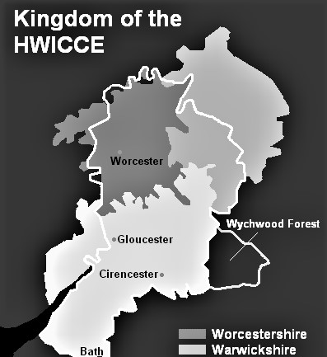
          Figure 1. Kingdom of Hwicce: 577–780
Attribution: TharkunColl at English Wikipedia

Slide 8
III. APPLICATION TO THE HWICCE
The Hwicce established a kingdom in medieval Britain.
Little is known about the origin of the group.
Most scholars believe they were Anglo immigrants
The Wicingas were an Anglo group who migrated from East Anglia to the Western Midlands.
Notes:
This model will be applied to an Anglo kinship group known as the Hwicce. This tribal group established the Kingdom of Hwicce in the Western Midlands of medieval Britain.
However, they appear to have burst suddenly upon the scene in the last quarter of the 6th century, because little is known about their origin.
Most scholars believe that the Hwicce were an Anglo group who migrated from the Continent and across Britain to the Western Midlands, but the identity and origin of this group has never been described.
There is one obscure Anglo group identified as Wicingas by Eilert Ekwall in his Concise Oxford Dictionary of English Place-Names, and there are other places in the Eastern Midlands whose names may also have derived from this tribal group. These places are located to the north and east of the Hwiccian territory, and because there are similar place names to be found in the Western Midlands, this tribal group appears to have moved into that territory.
The question, then, is whether the Wic-ingas could have changed their name to become the Hwicc-e. And if so, why and how?
Perhaps our new model can help to answer these questions.

Slide 9
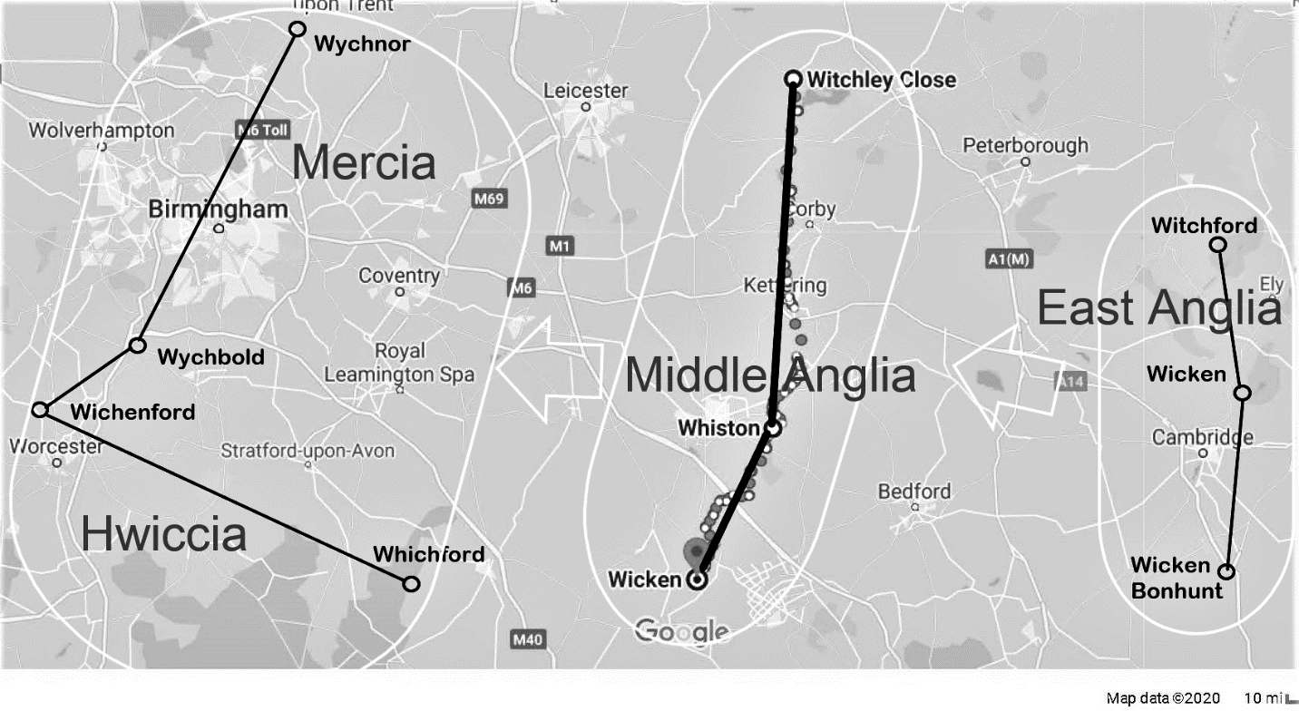
Notes:
The Wicingas tribe was identified by Eilert Ekwall as the source for the place name Whissendine, one of several names close to Witchley in Rutland.
There are other place names derived from the name of the tribe that define territories in East Anglia, in Middle Anglia, and in the Western Midlands.

Slide 10
III. APPLICATION TO THE HWICCE
The Hwicce established a kingdom in medieval Britain.
Little is known about the origin of the group.
Most scholars believe they were Anglo immigrants
The Wicingas were an Anglo group located in Rutland
Could the Wic-ingas have changed their name to become the Hwicc-e? If so, why and how?
Notes:
This model will be applied to an Anglo kinship group known as the Hwicce. This tribal group established the Kingdom of Hwicce in the Western Midlands of medieval Britain.
However, they appear to have burst suddenly upon the scene in the last quarter of the 6th century, because little is known about their origin.
Most scholars believe that the Hwicce were an Anglo group who migrated from the Continent and across Britain to the Western Midlands, but the identity and origin of this group has never been described.
There is one obscure Anglo group identified as Wicingas by Eilert Ekwall in his Concise Oxford Dictionary of English Place-Names, and there are other places in the Eastern Midlands whose names may also have derived from this tribal group. These places are located to the north and east of the Hwiccian territory, and because there are similar place names to be found in the Western Midlands, this tribal group appears to have moved into that territory.
The question, then, is whether the Wic-ingas could have changed their name to become the Hwicc-e. And if so, why and how?
Perhaps our new model can help to answer these questions.

Slide 11
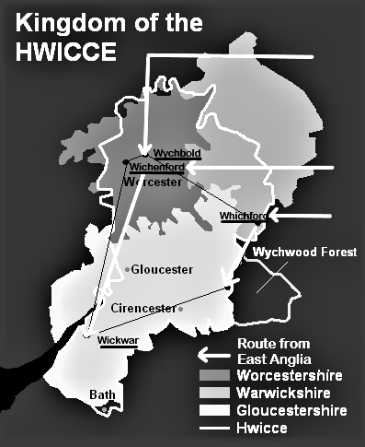
Notes:
The place names derived from Wicken align with the eastern, western, and southern borders of the Hwicce territory.
The name of the royal center of the Hwicce in the north-central part of the kingdom is also derived from the Wicken.
So How and Why did they change their name from Wicken to Hwicce?
We’ll turn to the model for an explanation.

Slide 12
IV. THE DEVELOPMENTAL STAGES OF ETHNIC IDENTITY
Pre-encounter (unaware and disinterested)
Encounter (traumatic event galvanizes ethnic awareness)
Immersion/Emersion (explore ethnicity,embrace in-group)
Internalization (strong sense of ethnic identity)
Commitment: (Positive group esteem and joint commitment to elevate ethnic status as a whole)
Notes:
The general meaning and the key criterion for applying each of the five stages in the model of ethnic identity development are as follows:
PRE-ENCOUNTER – At the beginning of the process, the individuals in the group (micro-level) are unaware of any problem regarding their ethnic identity and therefore are disinterested in any changes.
ENCOUNTER - At some point, the individuals encounter some kind of event that is traumatic for them. This trauma motivates them to become aware of ethnicity, and of the relevance of their ethnic identity to the traumatic event. Without trauma, there is no motivation for name change.
IMMERSION/EMERSION – Following this event, the individuals begin to explore the nature of ethnicity. These individuals, and particularly the group leaders immerse themselves in the issue, analyze their problem and discuss possible solutions to it with their immediate community (meso level). They emerge from this process by embracing their ethnic in-group.
INTERNALIZATION – The individuals and their immediate communities develop a strong sense of ethnic identity that is internalized, discussed within the joint tribal community, and shared with other tribal groups within the same territory (macro).
COMMITMENT – The positive results of this strong ethnic identity leads the individuals, their immediate communities, and the tribal group as a whole, with the support of others within the same community, polity or kingdom, to actively support this ethnic identity and to communicate the identity of their kingdom to the other kingdoms in the country (global level).

Slide 13
STAGE 1. PRE-ENCOUNTER
Some awareness of homophonic toponyms
  WIC, a village located near a Roman-era vicus
  WYCH, a village located near a grove of elm trees
Minor modification of tribal name at some sites
Confusion is incidental. It can be clarified by conversation
No permanent change in name of tribe
Notes:
PRE-ENCOUNTER: We will now apply the different stages of the theoretical model to the example of the Wicingas, to see if the evidence supports the theory that the Wicingas changed their name to become the Hwicce.
The first stage is Pre-encounter. This presupposes the next stage, Encounter, which for the Hwicce occurred in the Western Midlands. The encounter, defined as a traumatic event caused by or directly related to ethnicity, was qualitatively different from any incidents that may have occurred before that time, so the concept of pre-encounter clearly applies to the Wicingas.
Prior to reaching that territory, the Wicingas may have experienced some occasional problems with the pronunciation of their name, since the potential for confusion was created by other place names that sounded similar to the root word WIC-.
One was WIC, a common appellation for a small village that was on or near the site of a Roman villa, called a vicus.
Another was WYCH, a name often applied to a small village that was near the site of a grove of Wych Elm trees.
Differential spellings of place names derived from the Wicingas appear to indicate that some attempts were made to disambiguate the name of the group and their settlement by modifying the pronunciation of their name. Perhaps not on the Continent, but certainly on the Isle of Thanet and perhaps in the Weald of Kent, up in East Anglia, and as the Wicingas moved across the midlands.
However, the confusion between homonyms occurred
only at a few locations
and only for a few groups of Wicingas
and because the context was not particularly politicized and may even have been welcoming, it appears that they could have been clarified simply by explanation,
so while variant spellings of certain place names remain, the tribe is documented as Wicingas, indicating that permanent change to the name of the tribal group does not seem to have been necessary at this stage.

Slide 14
STAGE 2. ENCOUNTER
Multiple homophonic toponyms are found for places located near each Wicing settlement
The name is politicized as Wicingas begin to take control
Notes:
ENCOUNTER – While place-name and documentary evidence exists to support the application of Stages 1 and 5, the evidence for Stages 2, 3 and 4 is more indirect and inferential. The evidence for the encounter stage is as follows:
First, each of the four major settlements of the Wicingas in the Western Midlands is located very close to several other settlements whose names derive from the homophones of Wic. This has never occurred during any of their other migrations. There are existing records of fourteen other wic-related places in the area, four places surrounding each of three Wicingas settlements and two very close to the remaining one.
Since wicing , the nominative singular of Wicingas, was also a quite general term that might have been used colloquially to refer to the people living in a wic, it would be natural for one local resident to ask of another, “Which wicing are you?” Or, perhaps, “Which wic are you from?”
Second, the Wicingas had settled a territory in the Midlands as a staging area in preparation for moving into the of the Western Midlands, which was a demilitarized zone existing in a relative power vacuum created by the defeat of three kings of the Britons at the Battle of Deorham (Dyrham) in 577. They may have coordinated with the Iclingas and planned to settle and establish control of these areas that become the Kingdoms of Hwicce and Mercia. So the context was very fraught, and any questions or comments related to the identity of the tribal group which was seeking to establish control would obviously have been heavily politicized. Any questions about their identity, whether intentional or not, would have been traumatic, as they raised the existential issues of why the Wicingas were there in the first place and what did they think they were doing?

Slide 15
AN EXAMPLE OF THE CLOSE ENCOUNTER OF WICINGAS WITH THOSE FROM OTHER WICS
Notes:
Here is one example of the close encounter of the Wicingas with other Wicing.
The Wicingas settled Wichenford on the western boarder of the Western Midlands, just outside of Worcester. The four other settlements whose names derive from homophones of Wic, are shown on this map.
Upperwick
Powick
Rushwick, and
Knightwick.
They are all10 miles or less from Wichenford.

Slide 16
STAGE 2. ENCOUNTER
Confusion is traumatic because it is existential.
The plan, the purpose, the peace, and perhaps even the safety of the Wicken hang in the balance.
It can NOT be clarified by conversation when it is exploited to undermine control.
New pronunciations are tried (at micro level) in order to disambiguate
Notes:
The Wicingas would inevitably have encountered some resistance to their attempt to take control of processes such as collecting food rent or managing trade. That resistance probably began with questions regarding their:
Identity - Which Wicing are you?
Origin - Which Wic are you from?
Authority/Status - What right do you have to control us when you are newcomers compared to all the other wicing?
Legitimacy – Who appointed you to be in control of us?
Power - What power do you have to control us when there are more wicing from other wics than there are Wicingas?
All these questions of identity, origin, authority, status, legitimacy, and power are raised and amplified by any confusion about who the Wicingas were.
This confusion would have been existential, because the ability of the Wicingas to remain in the area and to exercise control depends upon their ability to answer these questions.
However, a clear, unambiguous identity, as signified by a distinctive name, would forestall many of these questions and therefore cut short the ability of the locals to undermine the progress of the Wicingas in taking control of the territory. For this reason, the leaders in particular must have begun to consider how to disambiguate their name.
So this is WHY the Wicken might have changed the pronunciation of their name, WHY they would have modified their ethnic identity - to distinguish themselves from all the other wics.
By changing the way their name was pronounced, a strategy that had been used successfully in the past, they could provide the needed clarity. Moreover, by modifying each of the phonemes in the name, rather than by replacing them all with a completely different name, they could create a distinct ethnic identity through a pronunciation that differentiated their original name from its homonyms, on the one hand, while not completely entirely disowning that original name, on the other.

Slide 17
STAGE 3. IMMERSION/EMERSION
Motivated by homophonic clash, leaders engage in struggle to assert their ethnic status
Leaders explore new types of the tribal name change
The most efficacious name is identified and shared within communities (at meso level)
Notes:
IMMERSION/EMERSION –
The homophonic clash encountered by the Wicingas in the Western Midlands was not an entirely new problem, but the political context made the consequences traumatic - far more severe than they had ever been before.
There were several Wicingas communities which included the sphere of influence surrounding each of the major settlements at Wichenford, Whichford, and Wychbold. The only evidence that the indivduals within these communities began to explore solutions to the problem of tribal identity are the prior examples of Wicingas settlements whose names include minor alterations in spelling that may indicate minor differences in pronunciation.
At Wingham the place name may have been modified from Wicham, and at Witchford (and subsequent settlements at Witchley, Wychnor and Wychbold) the prefix Witch- or Wych- may have been modified slightly from Wic-. However, despite this slight palat-alization of the ending, the words are all still fairly similar since they all begin with a voiced <w> sounding like the <uu> in vacuum, followed, presumably, by a long <i> sounding the ee in week.
In the Western Midlands, the Wicingas may have also considered modifying the pronunciation of each phoneme in their root name. From a psycholinguistic perspective, the most prominent aspect of a word that sounded like week is the long vowel /i/, which is very high on the sonority scale relative to the loudness of other sounds. So, the most likely focus of the process probably would be a change to shorten or clip the vowel, which would then sound like the /i/ in sit or wick rather than the /ī/ in machine or marine. For various reasons, this change was quite common in Old English.
This change would in turn have led through assimilation, both anticipatory and preservative coarticulation, to two other somewhat less noticeable changes – (1) the devoicing of the /w/ and (2) the doubling (gemination) of the /c/.
As a result, the name would then
begin with an unvoiced /w/,
followed by a shortened the pronunciation of the /i/, and
Then followed by a slightly palatalized /c/.
Once the vowel was shortened, the other changes would have followed naturally, because according to the Sonority Sequencing Principle, the sonority of both the preceding and following segments would also be lowered to preserve the phonotactic structure of the syllable.
Without changing the basic phonemes of the name, these changes in pronunciation would have resulted in a change in spelling from <Wic> to <Hwicc>.
Significantly, these changes would have modified the most prominent vocal aspects of their name, resulting in the clearest disambiguation. There are analogues for each of these specific phonemic changes in Old English, so they would not have been too unusual. Moreover, the modified pronunciation, especially of the /w/, would later become so standard across so many other words in the language, that the original pronunciation would be abandoned along with the resulting changes in spelling, which were thereby rendered unnecessary. This linguistic change is now known as the Wine-to-Whine merger, since words spelled with a <w> that was unvoiced, would now sound like words that were once spelled with a <hw> (which later transitioned to <wh>). So the Wic-to-Hwicce modification was perhaps an early example of (or a precursor to) the phonological change through which the voiced <w> was dropped from Old English, the transformation that became known as the Wine-to-Whine merger.
It is not unlikely that creative thinkers among the Wicingas, or perhaps the group leaders, who would have been most severely affected by the problem, shared this kind of change and suggested it as a modified ethnic identity for their community to adopt and for the individual members to embrace.
This, then, is HOW the Wicken became the Hwicce.

Slide 18
STAGE 4. INTERNALIZATION
Wicingas Leaders use name in promoting control
Leaders share their success among Wicingas communities
Individuals internalize the new ethnic identity
Wicingas communities develop strong ethnic identity
Wicingas tribe develops strong identity as Hwicce
Other local tribal groups accept Hwiccian tribal identity
Notes:
INTERNALIZATION
Although there is no direct evidence regarding the actual process of internalization, there is ample evidence that the name Hwicce began to be used by each of the Wicingas communities throughout the territory. By inference, some such internalization process must have taken place at the individual, community, and tribal levels.
For example, prominent landmarks were given names derived from Hwicce, including Huiccewudu, meaning "Wood of the Hwicce" and the source for the surviving toponym "Wychwood", and
Mons Hwicciorum, in Latin, meaning "Hill of the Hwicce" and a location referred to in the Anglo-Saxon Chronicle.
Wychbury Hill , site of the Wychbury Ring and the Wychbury Obelisch, is also a location whose name is thought to derive from Hwicce.
The different Wicingas communities in the Western Midlands had been established by kinship groups which had for generations been part of larger Wicingas territories in the East Midlands and in East Anglia. So, there were established ties between them which would have facilitated the spread of a new, more efficacious ethnic identity. Moreover, leadership in this process most likely would have emerged from Wychbold, which was both a royal center and a center through which trade in commodities such as salt would have been controlled. These established structures for decision-making and for communication make it highly likely that the construction of ethnic identity of the Hwicce was coordinated throughout the larger tribal organization.
Absent any evidence of major internal conflicts, it is also likely that non-Wicingas groups accepted the leadership of Hwicce. Moreover, since it provided them with protection from disturbances, they may also have been willing to identify themselves as members of the territory and then kingdom of the Hwicce. Their adoption of this new tribal identity would have been facilitated by the fact that Hwicce could be viewed as a new pronunciation, not only of the root , singular form of Wicingas, but of the term Wic, an appellation for the settlements with which they all might identify. Of course, their particular tribal identification and the place-names derived from those unique tribal names would remain unchanged, but at the larger, territorial level, they may have willingly joined in the newly constructed identity as Hwicce.

Slide 19
STAGE 5. COMMITMENT
Leaders promote new name outside of tribe (global level)
Religious and other leaders begin to refer to the territory as Hwicce.
Notes:
COMMITMENT
Evidence is available that leaders of other tribes and cultures began to refer to the territory by the name
Hwicce. Perhaps the earliest example is when, around 600 AD, explicitly arranged and St. Augustine of Canterbury attended two meeting with religious leaders of the Britons at locations that bordered the territory of the Hwicce, presumably to be facilitated by the Hwiccian leaders.
Around 680 the Diocese of Worcester was established. The early bishops of the diocese bore the title Episcopus Hwicciorum , indicating the overlap between the diocese and the territory of the Hwicce.

Slide 20
ASSESSMENT OF THE MODEL
Applicability of the model
  Stages
  Levels
Benefits of the model
  Analytical
  Comparative
  Explanatory
Notes:
There is ample evidence that the model with its stages and levels can be applied to the process through which the name of the Wicingas tribe changed to that of the Hwicce.
One of the benefits of this model of identity construction is that it focuses analysis upon the various stages of a developmental process, which lead logically to the construction of a tribal identity. It specifies the specific criteria that must be met for this developmental process to occur. It also provides a framework within which to integrate the psychological process taking place at the level of individuals (and individual leaders) with the political process taking place within each of the various tribal communities, among those communities at the tribal level, and between the Wicingas tribe and other tribes and ethnicities within the kingdom across tand across the country.
Another benefit is that it allows for comparison between identity formation and name changes for a medieval tribe ,trying to assert control over a multi-ethnic territory, and those of individuals, such as those studied by other researchers, as they acculturation within or assimilate into multi-racial or multi-national communities.
Finally, it helps to fill gaps in the direct evidence with potential and plausible inferences concerning any missing pieces of process.
Given the evidence pulled together within the framework of this model, it seems not only plausible but also highly probable that the Wicingas encountered an existential challenge to their ambition to control a territory. The challenge arose from the homophonic clash between various toponyms surrounding each of the places in the Western Midlands where they settled. As a result, they most likely built upon previous experiences in varying the pronunciation of their name and developed a modification which maximized the differentiated phonology of the name, resulting in a new orthography. Communication between individuals, leaders, communities and tribes led to internalization and active commitment at all levels to a strong ethnic identification as the Hwicce.

Slide 21
Name Change and the
Construction of Tribal Identity:
A Multi-stage, Multi-level Model
Thank you for listening and for any comments
Thomas Wickenden, Ph.D.
thwconsultingllc@gmail.com
Notes:
I would welcome any comments you might have about this model and its application to the Hwicce. Please feel free to email them to me at:
thwconsultingllc@gmail.com.
Thank you.

