Slide 1
Hashemite Kingdom of Jordan Ministry of Water and Irrigation
Water Security and Protection
Water in Jordan: Water security and protection
Secretary General Assistant
Ministry of Water and Irrigation
Eng. Ali subah
June 2012

Slide 2
Water Security and Protection
Context:
The UNDP Human Development report classifies Jordan as one of the 10 most water-poor countries in the world with an annual per capita water availability of 120 – 145 m3/per capita/year (far below the international water poverty line of 500 CM/a/cap).
In 2010, water demand exceeded water supply by roughly 200%. 10 out of the 12 groundwater aquifers are over-exploited.
Agriculture is the largest water consumer with 56% of the water use in Jordan in 2010.
Notes:
The Jordan is heavily dependant on groundwater resources (57% of supply)
The water supply-demand deficit lies at 652 million cubic meters.

Slide 3
Water Security and Protection
Challenges:
High population growth (2.5%/year) and large refugee influxes.
Rising water needs for expanding economic sectors, such as industry and tourism. By 2030, water demand will double and reach 1,550 MCM, 650 MCM more than currently funded supply.
Limited funding and private sector participation for the implementation of water projects .
Limited energy sources available for water projects and Jordan is highly dependent on foreign energy sources (96% of energy comes from imported oil and gas ).
Lack of coordination with neighboring countries regarding the management of water resources (surface and groundwater) .
The impact of climate change will lead to precipitation variability and an increase of summer temperatures.
Notes:
Climate change: A temperature rise of 2º C would increase irrigation demand by 18%, while a 10% reduction in precipitation is projected to increase irrigation demand by approximately 5%.

Slide 4
Water Security and Protection
What is water security?
Accessibility to water resources is ensured for today’s and future generations.
The quality and quantity of water resources is sufficient for the socio-economic development needs and future goals of the kingdom.
The allocation of water among sectors (such as irrigation, domestic water supply and sanitation, tourism, industry, environmental requirement etc.) is carried out taking into consideration hydrological, environmental and socio-economic factors.
Long term water sharing agreements with full participation of all stakeholders are achieved.
The environment is protected from pollution and degradation.

Slide 5
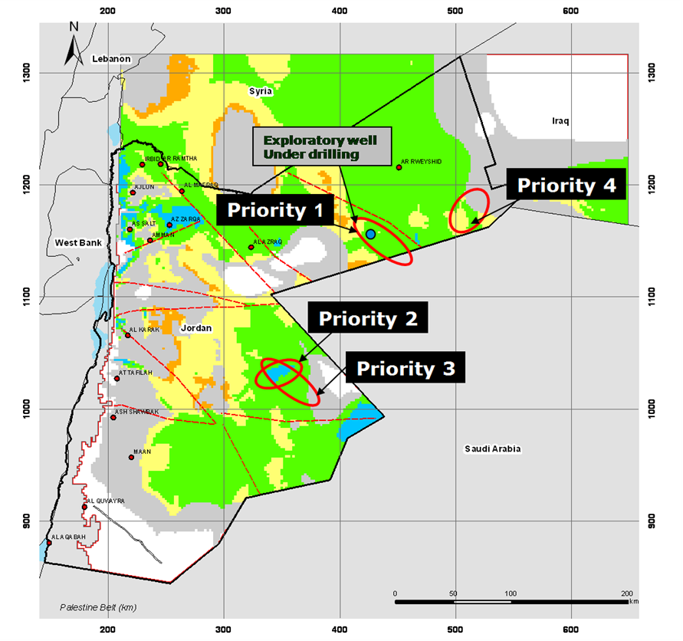
Water Security and Protection
1. Accessibility to water resources is ensured for today’s and future generations.
Conventional water resources:
Surface:
Jordan is collecting 360 MCM/year of water flow through dams and ponds (360 and 30 MCM/year respectively) out of a potential 500 MCM/year of rainfall.
Exploitation of aquifers:
DISI Project is being implemented on a BOT 25 years contract, and aims to pump 100 million cubic meters of water annually to Amman from 2013 .
The potential of deep aquifers is being assessed.
Red-Dead Sea Conveyance project (RDSC):
250 MCM of desalinated seawater are expected to be produced by the year 2020.
Feasibility Study & the Environmental and Social Assessment are finalized.
We are currently selecting the Project Master Developer.
Notes:
Exploitation of aquifers:
DISI:
Transmission line length of 320 km to Amman.
55 potable water production wells in the Disi-Mudawarra area in southern Jordan, near border with Saudi Arabia (fossil aquifer)
Total construction cost: US$ 1.1 billion with the support of DIWACO, EIB, AFD, OPIC, PROPARCO.
Transboundary water resources:
Water allocations can easily cause tensions between countries with shared water sources. However, efforts in the region show that water management can also provide potential for enhanced cooperation.
It is important to not only focus bilateral negotiations on water sharing rights but to shift cooperation to a general policy making related to common interests and needs in water resources management.
Examples of projects : regional sustainable management tools with Glowa, exchanges of water databases and projects with EXACT, work with local communities of the Jordan valley as Friends of the Earth Middle East, SWIM Project

Slide 6
Water Security and Protection
1. Accessibility to water resources is ensured for today’s and future generations.
Improved Water services & sanitation services:
Improvement of the performance of regional water authorities by establishing public water companies for the management of water and wastewater services.
Pursuing private sector partnerships through certain business units of the decentralized structures were outsourced to private companies.
These actions have lead to the reduction of operational water losses, the reduction of customer complaints and an increase in water supply efficiency for 80% of the population.
Upgrading and restructuring of water networks and system in the big cities with the support of international donors.
Improving energy efficiency in the water sector with the support of GIZ and JICA: The Water Authority of Jordan is the largest electricity user in the country (18% of the national energy consumption). Based on a successful PPP to increase the energy efficiency of a pumping station, Energy Contracts are being commissioned to the private sector.
Rehabilitation and expansion of sewage networks.
Notes:
Improvement of the performance of regional water authorities :
The Jordanian water sector is reliant on foreign investments to improve its dilapidated infrastructure.
The public companies are already in place; Aqaba Water Company (AWC), Amman Water Company (MIYAHUNA) and North Governorates Water Company (Yarmouk).
Other examples of impacts:
Reduction of operational water losses of 44% within a 4 year period in the Northern Governorates and 25% within a 3 year period in the Zarqa Governorate.
The Water Authority of Jordan now works via decentralized and commercially-run local water entities in 8 out of 12 governorates.
Customer care was improved, which is indicated by the 75% reduction in customer complaints in the pilot area of Al Koura.
Upgrading and restructuring of water networks and system
(Zarka and Rusaifeh with MCC, Ma’an with AFD, KfW, GAM and Zarka with JICA, etc.)

Slide 7
Water Security and Protection
2. The quality and quantity of water resources is sufficient for the socio-economic development needs and future goals of the kingdom.
Non-conventional water resources:
Desalination of brackish groundwater:
In 2010, Jordan’s desalination capacity stood at 86 MCM. Small scale desalination plants are currently being operated by the private sector, mainly for irrigation purposes.
There is a scope for expansion of desalination practices. However, there are numerous technical and economic barriers.
Water reuse:
Reclaimed water will be used for industry and agriculture in order to save freshwater for domestic uses.
In 2010, 24 operational wastewater treatment plants (WWTP) were operational in Jordan, treating 110 MCM of water, of which 97 MCM/year are treated by the main WWTP (As Samra) which runs on a 25-year BOT contract. Its expansion by 45 MCM/y has been committed for 2015.
Jordan is developing decentralized wastewater treatment plants for small communities.
In the future, the construction of new WWTP should provide an additional 31 MCM of freshwater.
Notes:
Desalination of brackish groundwater:
from 3 main sources: Abu Zeighan in the Jordan Valley (10 MCM/y), Zara Ma’in with the support of USAID (50 MCM/y) and Mushtal Fasal (3 MCM/y).
A study carried out by JICA indicates that by the year 2040 up to 70 MCM/y could be developed in the central Jordan Valley.
Water reuse:
In Jordan, the effluent from WWTP is blended with other water sources to provide water for industrial and irrigation (99%) uses, especially in the Jordan Valley (54% of the reuses treated wastewater).
The As Samra plant is almost self-sufficient and requires very little power from the grid as it generates up to 95% of the WWTP electrical consumption from renewable energy sources (biogas from the sludge digesters).

Slide 8
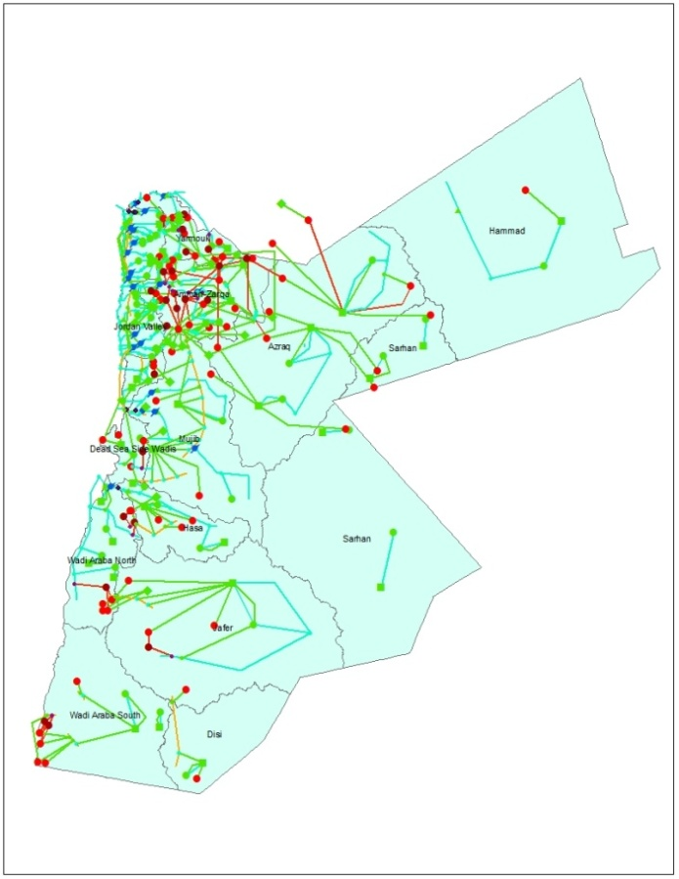
Water Security and Protection
3. The allocation of water among sectors is carried out taking into consideration hydrological, environmental and socio-economic factors. Improve water governance
Establishment of a multi-stakeholder Water Council headed by the Ministry of Water and Irrigation to increase accountability and transparency.
Enhancement of policies and tools:
Improvement of long term planning and allocation of water resources through the update of the National Water Master Plan (NWMP) and the application of decision-support tools such as WEAP (Water Evaluation and Planning Tool).
Water valuation study carried out in order to bridge the gap between expenditures and incomes.
Notes:
Tools of the National Water Master Plan :
The Project Information System (PIS): provides user-friendly and platform independent access to relevant historical and topical data for Project Cycle Management (PCM)
The Evaluation Tool for Investment Planning (ETIP) allows the MWI to prioritize projects and policies for effective water resource management.
The Water Evaluation and Planning (WEAP) tool develop groundwater models and scenarios for strategic planning and decision-making.
The Telemetric National Water Resources Observation Network allows for a regular and reliable data collection from climate stations and observatory wells.

Slide 9
Water Security and Protection
3. The allocation of water among sectors is carried out taking into consideration hydrological, environmental and socio-economic factors.
Efficient water demand management
Participatory demand management:
22 Water User Associations have been established, covering ca. 80% of the irrigated area in order to make irrigation water distribution more efficient.
Development and implementation of an Action Plan for sustainable groundwater management together with all stakeholders, namely from the agricultural sector
Water efficient practices:
Promotion of efficient water using practices in all sectors (households, irrigation, tourism, industry, hospital, offices) to reduce the gap between available water supply and water demand (rainwater harvesting, the reuse of greywater, assistance for low income consumers, training programmes, etc….).
Heightened public awareness:
Awareness campaigns with school students, women as main water users at household level, religious sector using media outlets (radios, TV, newspapers, publications, etc.) and ‘water clubs’ in schools.
Promotion of water savings at the household level through the establishment of Water Wise Women groups.
Notes:
Water demand management policy:
Standards, Codes and Regulations :
Development of Water Efficiency Standards,
Update of the National Water and Sanitation Plumbing Code,
Establishment of a testing lab.
Tools and technologies were also developped:
Water use audits and pilot programs,
Best management practices guides,
Water use efficient tracking tool with the water utilities,
Water demand management database with the water utilities,
Financial mechanism with the establishment of the first public-private partnership on promoting water use efficiency between a bank and a water utility
Enforcement of the Water Users Associations (WUA’s) in the Jordan Valley
Rationale efficient practises:
Reuse in several pilot projects (in mosques, in schools, at a tourit resort hotel at the Dead Sea through a private sector partnership) are underway and are showing promising and encouraging results.
Elaboration of a guideline for the safe and efficient use of greywater (mosques, hotels, schools). A private sector partnership project at the hotel at the Dead Sea allowed the hotel to save up to 1/3 of its habitual water consumption.
Reclaimed water for agriculture in the Jordan Valley with adapted crops with an elaboration of a guideline and a best practices manual with support of GIZ.
Regular training programmes and the elaboration of technical and comprehensive risk monitoring and management standards with the support of GIZ ensure the safe and efficient use of treated wastewater and brackish water for irrigation practices.
MWI is facing technical and financial challenges.
Heightened public awareness:
Newspapers: publish facts and figures on water, conduct a monthly competition through newspapers, etc.
Radios: organize discussions with experts, disseminate daily calls on water rationalization and means of rationalization, etc.
Television: conduct slogan concerning water saving disseminated through local TV’s, report on water, energy, etc.
Publications: development of student guide on water and energy issues distributed through water clubs in schools , reprinting water and Islam book, printing brochures in different languages spoken by foreign maids, etc.
Lectures and seminars (in cooperation with Amman Trade Chamber): in Universities, targeting women, hotels managers, water clubs coordinators, chambers of Trade, etc.

Slide 10
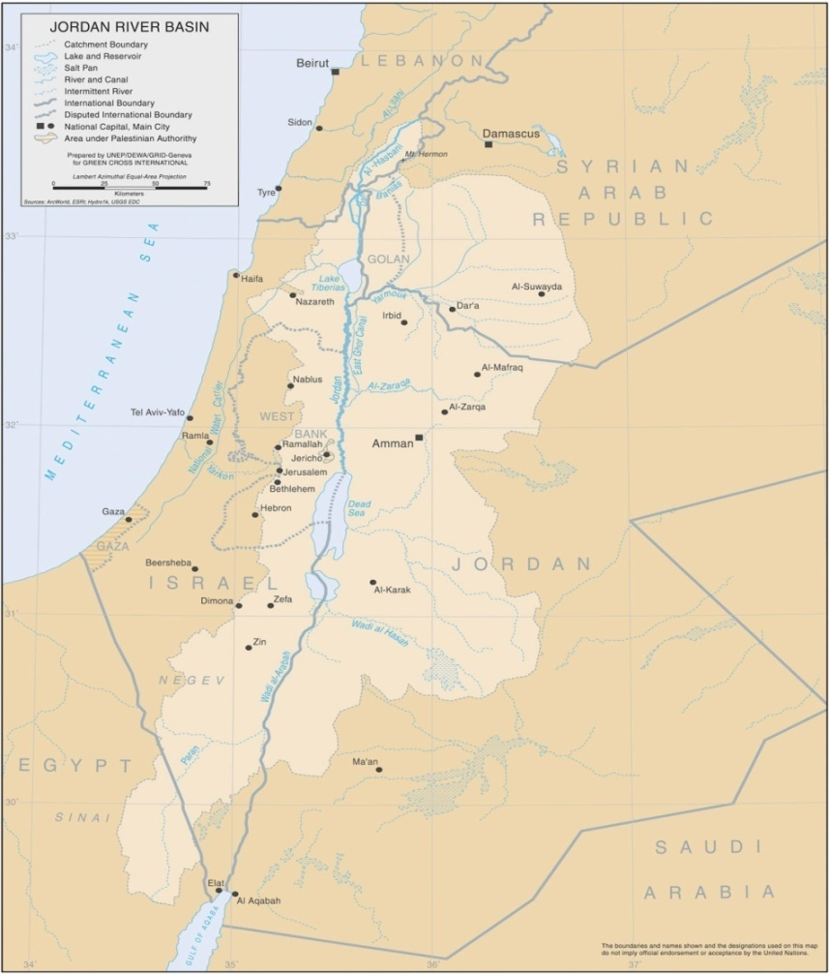
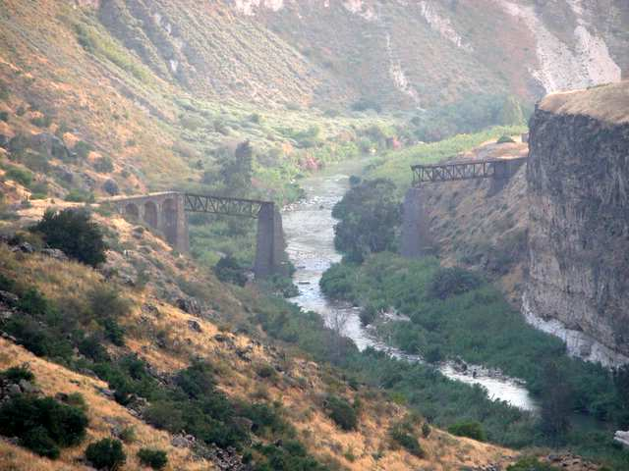
Water Security and Protection
4. Long term water sharing agreements with full participation of all stakeholders are achieved.
About 40% of water in Jordan comes from shared water resources.
Jordan has embarked on transboundary water resources projects (RDSC, GLOWA, EXACT, etc.), together with its neighbors.
Jordan has agreements on water sharing rights with Israel, Syria and a Memorandum of Understanding (MoU) with Saudi Arabia.
Notes:
Introduction of water protection zones in the Land-use maps of relevant ministries and also in their regular planning procedures.
Support for the National Water Master Plan.

Slide 11
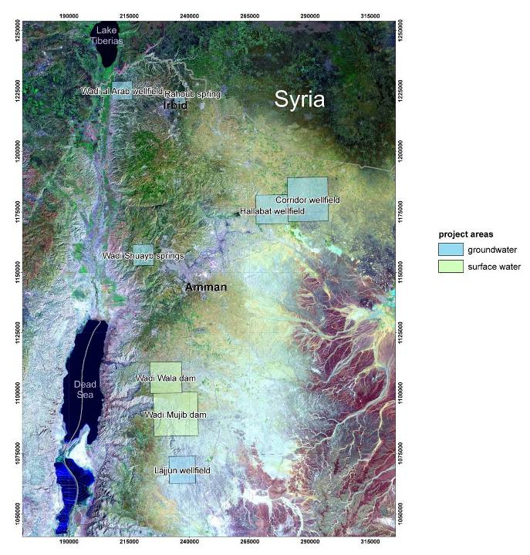
Water Security and Protection
5. The environment is protected from pollution and degradation.
Implementation of water protection zones in cooperation with decision-makers and local stakeholders.
Strengthen skills and know-how on water protection at household levels in cooperation with JOHUD and the Water Wise Women Initiative.
Control the protection areas with support from the Environmental Rangers.
Reach out to the population of Jordan via awareness campaigns.
Notes:
Introduction of water protection zones in the Land-use maps of relevant ministries and also in their regular planning procedures.
Support for the National Water Master Plan.

Slide 12
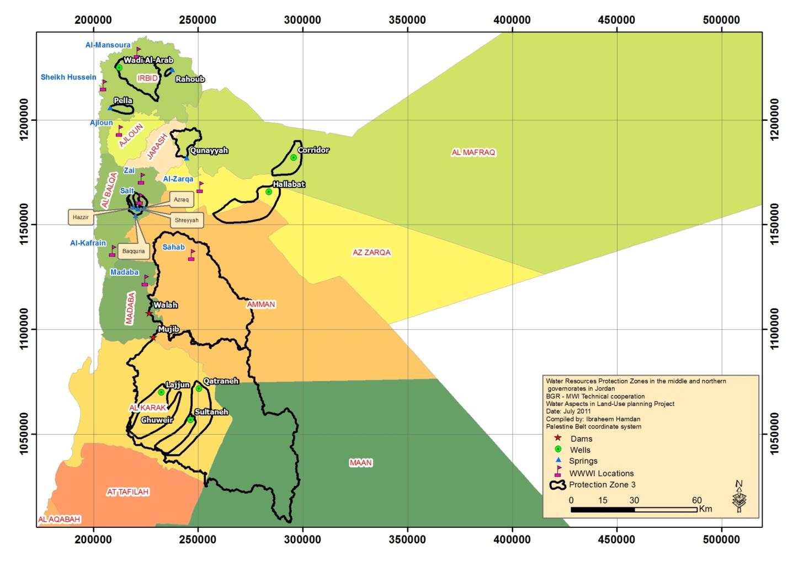
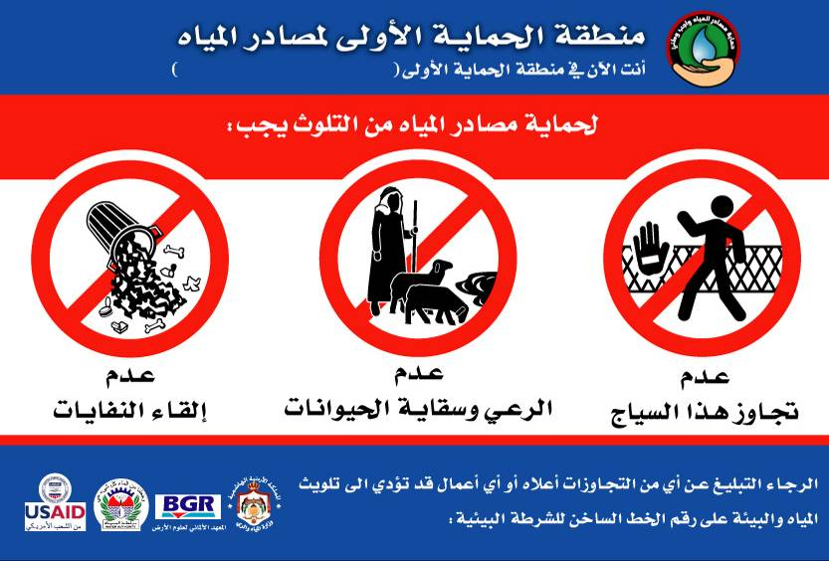
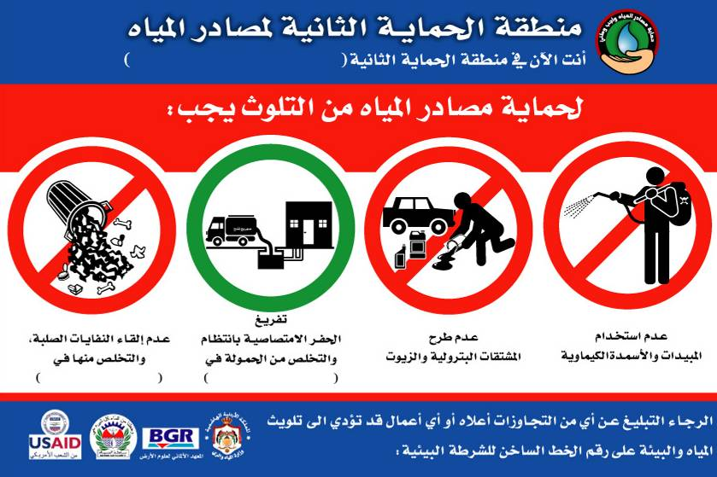
5. The environment is protected from pollution and
degradation.
Protection Zones
Zone 1:
Zone 2:
Protection Zones delineated:
Wellfields: Hallabat, Corridor, Wellfields of Lajjoun area
Springs: Ain Rahoub, Pella, Wadi Shuayb Springs, Qunnayah
Dams: Wala Dam, Mudjib Dam
Protection Zones in preparation:
Al-Awsa wellfield (Azraq)
Hidan wellfield (Wadi Wala)

Slide 13
Water Security and Protection
Next steps:
MWI will continue and strengthen actions in the field of:
1. Conventional water resources:
Upgrading networks to reduce non-revenue water and rehabilitation and expansion of sewage systems (63% of households are currently connected to the sewage system).
Enhancement of energy efficiency of water utilities and pumping stations and up-scaling nationwide Energy Contracts with PPP.
Development of water harvesting through recharging dams.
Regional cooperation for shared water resources.
Development of the protection of the water resources and catchment areas.

Slide 14
Water Security and Protection
Next steps:
2. Non-conventional water resources:
Development of desalination treatment plants using renewable energy with the priority of implementing the first phase of the Red-Dead Sea Conveyor Project.
Heighten wastewater treatment capacities, to reach the objective of 250 MCM/year of treated wastewater in 2025, and capture treated effluent for reuse. We seek further cooperation with the private sector world wide to be able to expand these best practices nationwide.
3. Water demand management:
Continue to promote efficient water demand management and up-scaling best practices in all sectors (rainwater harvesting, greywater, reuse, irrigation efficiency at farm level, etc).
Improve awareness of water scarcity and the importance of conserving and protecting our limited water resources.
4. Strengthened water institutions:
Updated strategy has to be endorsed by the Water Advisory Council and applied.
Establishment of a reliable and dynamic databank helping the decision-making process through the automation of the water resources monitoring system.
Improving local capacity building to enhance the quality of water planning (information base, modeling capability, etc.) and desalination techniques.
Notes:
In terms of water demand management:
Promote irrigation efficiency at farm level (high value crops with market opportunities, efficient irrigation system, etc.)

Slide 15
Water Security and Protection
Thanks you for your kind listening.

