Slide 1
Environmental Implications of Climate change
Participatory Workshop on Environment and Security Issues
in the Sothern Mediterranean Region
Rania Abdel Khaleq
Director, Environment Directorate
Ministry of Water and Irrigation, Jordan
18-22 June 2012

Slide 2
Climate change in MENA
The Situation Today
Extreme climate has shaped parts of the MENA region
Most parts of the MENA region are located in arid to semi-arid areas
High water scarcity, drought and desertification in many areas
High Population growth increases the stress environment and water in particular
Climate Change Impacts
Increasing temperatures, more frequent and intense heat waves
Changes in patterns volumes and precipitation intensity
More extremes floods and droughts
Sea level rise

Slide 3
Projected changes in the hydrologic cycle

Slide 4
Changes in extremes

Slide 5
Environmental Implications of Climate Change
Temperature increases in MENA region is about 50 percent higher than global mean increases. During the last 30 years, temperatures in the region have increased between 0.5 and 1.5 degrees Celicius. Recent research shows that temperatures in the Arab region may increase by 6 degrees by the end of the century. This will be approaching the limits of habitability of some areas. By mid-century, water availability is predicted to decrease by 20-30 percent in most of MENA region

Slide 6
Environmental Implications of Climate Change
As a consequence, drinking water will become scarce, long-term efforts to combat desertification will be endangered, and ecosystems will be permanently damaged or even destroyed
Storms and floods are spectacular consequence of climate change which are immediately apparent. However, it is the more gradual changes of temperature and precipitation patterns which will probably be more significant in the long run

Slide 7
Environmental Implications of Climate Change
Climate change impacts on agriculture in the region are projected to be particularly strong.
A changing climate risks further depressing the agricultural sector’s economic performance through accelerated Desertification and yield reduction and increased volatility (especially in cereals), which threatens rural jobs, and increase the fiscal burden of government intervention

Slide 8
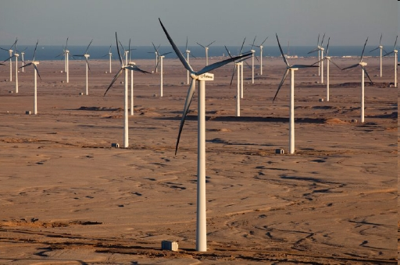
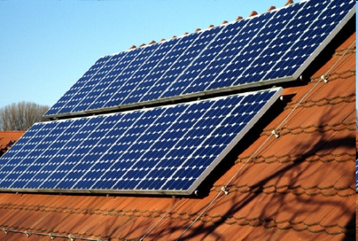
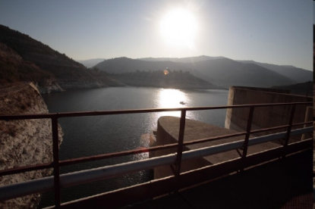
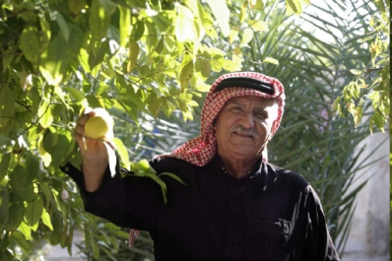
What can we do about climate change?
Climate
change
Mitigation
Reduction of Greenhouse Gases like CO₂ and CH₄
Objective: Reducing Climate change
Adaptation
Activities which reduce the vulnerability to Climate Change
→ Objective: Coping with the impacts of climate change
Notes:
8

Slide 9
Climate Change Adaptation
The aim of adaptation measures is to limit the consequences and risks associated with climate change and also take advantage of any opportunities which present themselves. In essence, the primary concern is to protect the life and health of people, safeguard the economic and socio cultural basis of livelihoods as well as preserve the ability of ecosystems to function effectively, thereby contributing to sustainable and long term development. The diversity of the goals is matched by the diversity of concrete approaches and possibilities for adaptation.

Slide 10
Climate Change Impact on JordonClimate Change Impact on Jordon
        Jordan is one of the most water-scarce countries in the world
        Almost all fresh water recourses have been tapped and the present water budget has a deficit of 20%, which is substituted by over pumping from the aquifers, causing negative impact on the environment and sustainability in the medium and long term
        The problem severity will increase in parallel with the increase of population, living standards, economic development and potential impact of Global Warming.
        Climate change is expected to primarily affect precipitation, temperature and potential evapotranspiration, and, thus, is likely to effect the occurrence and severity of droughts and flash flood resulting in severe economic and environmental conditions.

Slide 11
Climate Change Impact on Jordon
Although Jordan does not contribute to more than 0.1% to the causes of global climate change, its effects on the country will be very severe. In fact, Jordan is particularly vulnerable given already scarce water resources and high levels of aridity
Natural and physical systems in Jordan are already facing heavy pressures, and these will only be intensified as temperatures in Jordan get higher and/or precipitation gets lower.
The Jordan’s Second National Communication suggests that the rising temperatures will lead to a decrease in surface runoff. Climate Change is likely to effect the occurrence and severity of droughts and flash floods.

Slide 12
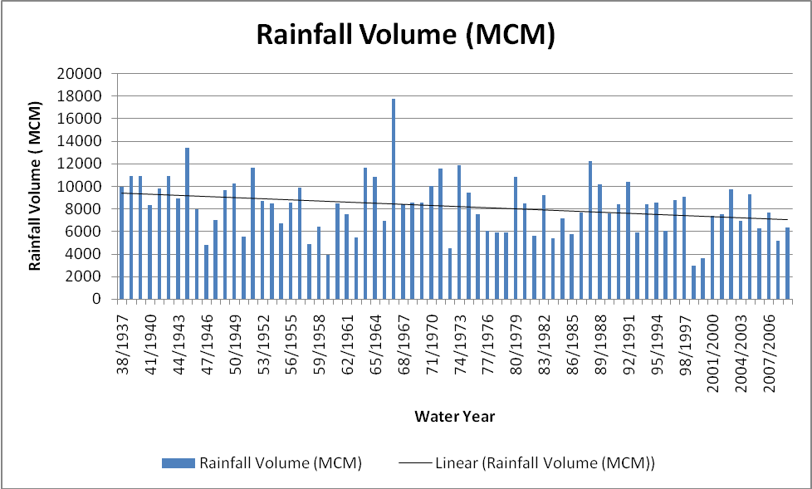
Rain is the main water resource
Records also confirm the declining rainfall trend in the recent past.

Slide 13
Impacts of Climate change onWater Spplies
Increasing
water demand
Less
water
quantity
Less raw
water
Increasing
evapo-
transpiration
Higher
temperatures
Melting
ice and snow
Seasonal
changes in raw
water
availability
Proliferation
of algae
Raw water
quality
deteriorates
Water
quality
threatened

Slide 14
Activities in Jordon
Jordan ratified the UNFCCC in 1993 and the Kyoto Protocol in 2003. It submitted its Initial National Communication to the UNFCCC in 1998.
Climate change committee reestablished in 2010. This committee includes representative from different governmental institutions, NGOs and academia with the mandate
The Second National Communication to the UNFCCC was released by the Ministry of Environment (MoEnv) jointly with UNDP in 2009. The Third National Communication to the UNFCCC is currently under preparation.

Slide 15
“Adaptation to Climate Change to Sustain Jordan´s MDG achievements” Project
Assessment of Direct and Indirect Impacts of Climate Change scenarios on water availability and quality in the Zarqa River Basin
Precipitation, maximum temperature, minimum temperature and mean temperature time series at selected six climatic stations were examined.
Trend analysis revealed obvious decreasing trends in the precipitation time series of most of the stations, the decrease in precipitation started in the decade 1970’s. While temperatures showed increasing trends, the minimum temperature has increased more than the maximum temperature.

Slide 16
PRECIPITATION TRENDS
MAXIMUM TEMPERATURE TRENDS
MINIMUM TEMPERATURE TRENDS

Slide 17
“Adaptation to Climate Change to Sustain Jordan´s MDG achievements”
The following important results were derived:
The maximum, minimum and mean temperatures reveal significant warming trends at most of the stations. The warming trends of minimum temperature are greater than that of maximum temperature. As a result the mean temperature shows warming trends in all stations.
The temperature increase ranges from 1-4 °C.
The temperature increase is greater in the winter months.
The temperature increase is greater in the period 2060 – 2099.
The precipitation climate change scenarios are highly variable.

Slide 18
Impact of climate change on surface water availability
ArcSWAT was used as described earlier to build up the hydrological model for ZRB. The model was used to simulate surface runoff for the period 1970 -2009. The model perform well in simulating the surface runoff as indicated by the high coefficient of determination (R2 = 0.95) and the good agreement between the observed and simulated flow.
HadCM3 downscaled scenarios A2 and B2 applied to show the impact of climate change on the surface runoff of ZRB. These scenarios were used as inputs of the SWAT to assess the impact of future climate changes on water availability at ZRB. The simulation was run from year 2011 until 2096.
One of the important results: The maximum peak flow will drop from about 50 m³/s recorded in the baseline scenario to less than 35 m³/s in the future scenarios.
Assessment of Direct and Indirect Impacts of Climate Change scenarios on water availability and quality in the Zarqa River Basin Report

Slide 19
Impacts on Irrigated Agriculture
A temperature rise of 2ºC would increase irrigation demand by 18%, while a 10% reduction in precipitation is projected to increase irrigation demand by approximately 5%.
Water shortages may lead to increasing food prices and reduce th availability of fodder, due to increased production cost, with adverse economic consequences for farmers.

Slide 20
Jordan Water Strategy (2008-2022)
The National Water Strategy “Water for Life 2008‐2022” was released in 2009 and runs along the following themes:
WATER SUPPLY
INSTITUTIONAL REFORM
ALTERNATIVE WATER RESOURCES
WATER DEMAND
WATER FOR IRRIGATION
WASTEWATER

Slide 21
Jordan Water Strategy
(2008-2022)
Jordan’s vision for a water strategy is one whereby 2022, we have
“Though the impact of Climate Change yet is generally unknown, its assumed impacts will most probably put additional stress on the water resources”
Preparedness and adaptation towards upcoming, mostly unknown challenges triggered by Climate Change

Slide 22
Thank you

