Slide 1
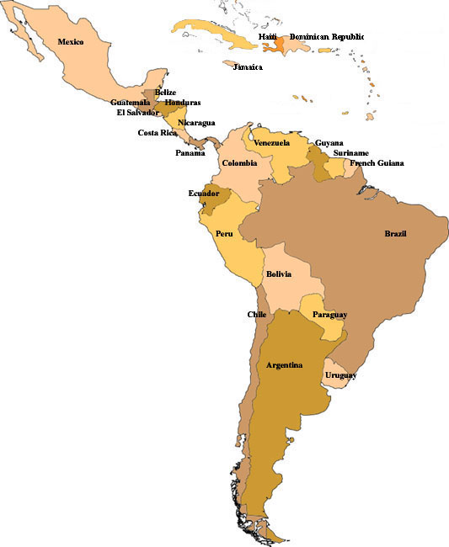
THE SECURITY IMPLICATIONS OF CLIMATE CHANGE
With particular reference
to
THE CARIBBEAN AND SOUTH AMERICA
Major General (retd)
Joseph G Singh
(GUYANA)
IES - Climate Change & Security at Copenhagen - II
The Contribution of the Global Security Community to Success
Brussels, 7 -8 October 2009

Slide 2
There are several reasons why unmitigated Climate Change can be considered as potential sources of conflict and disruption of peace (IGPCC)
Several extreme events are becoming more frequent and more intense-including extreme precipitation events, heat waves, floods and droughts.
Sea level rise which threatens several low lying islands as well as coastal areas
Melting of glaciers across the globe and impacts on human health and biodiversity will become more serious over time.
Irreversible changes such as threat to extinction of species-20 to 30 % were seen to face the threat of extinction with temperature increases of over 1.5 to 2.5˚
Impacts on agriculture and decline in productivity

Slide 3
There are several reasons why unmitigated Climate Change can be considered as a potential source of conflict and disruption of peace (EU paper S113/08)
Conflict over resources
Economic damage and risks to coastal cities and critical infrastructure
Loss of territory and border disputes
Environmentally- induced migration
Situations of fragility and radicalization
Tension over energy supply
Pressure on international governance

Slide 4
Potential for Instability and Conflict
Environmental issues, such as resource access and quality, are now recognised as a major variable in regional instability and conflict
The can exacerbate tensions resulting from ethnic, religious and other local differences such as socio - economic disparities between urban and rural areas, rapid economic development and border disputes.

Slide 5
Potential for Instability and Conflict
All this means that human society could suffer serious consequences as a result of climate change which could only result in conflict over resources such as water and displacement of populations.
The reconceptualisation of security has resulted in a widening of dimensions of security from the narrow political and military focus towards an inclusion of economic, societal and environmental dimensions
These are some of the reasons why Climate Change was put on the agenda of the UN Security Council in 2007

Slide 6
Caribbean, Central and South America

Slide 7
Assessment of Climate Change impacts for Caribbean and South America ( European Council-S113/08)
Changes in rainfall pattern
Extreme events associated with El Niño cycle-major hurricanes
Rising Sea levels and erosion of shorelines and beaches
Increase in sea surface temperature-bleaching of coral reefs
Salinisation and desertification of agricultural land
Glacial melting in the Andes-in Chile, Bolivia and Peru
Decreasing productivity of important crops and livestock
Loss of biodiversity in South America-in particular, Amazonia, Mesoamerica –in particular, Belize (Barrier Reef) and Costa Rica (cloud forest)
Notes:
WWF’s Climate Change Coordinator for LA recently observed that “climate change impacts are being felt across LA, ranging from drought in the Amazon to floods in Haiti, vanishing glaciers in the lower Andes to hurricanes …..across the region, the capacity of natural ecosystems to act as buffers against extreme weather events is being undermined.Some of the greatest threats to the environment lie in deforestation, overfishing, water pollution, mining, inadequate coastal development and chemical management.

Slide 8
Implications of Climate Change Impacts : Caribbean and South America (S113/08)
Adverse effects on coral reefs and shifts in location of fish stocks
Decreasing productivity of important crops and livestock with dire consequences for food security
Loss of biodiversity (the region has half of the world’s plants and animal species) and destruction of freshwater, marine and forest habitats
Increasing incidence of diseases
Increased risk of flooding in low-lying areas
Restricted availability of water for human consumption, agriculture and energy generation
Damage to economic and social infra-structure
Increasing poverty, hunger and living standards
Social and political tensions in a region with often weak governance structures

Slide 9
Security Implications of Climate Change Impacts on the Caribbean and South America
Conflict over resources-arable land, fish stocks, fresh water and other natural resources e.g. hydropower potential
Border disputes
Environmentally-induced cross border migration
Humanitarian crises
Frustration, Social unrest and Radicalisation
Pressures on national, regional and international governance

Slide 10
The Opportunities that must be seized
Climate Change negotiations are vital-cannot be business as usual
Aim must be to commit to an ambitious global climate agreement under the UN
Early warning systems put in place for preparation and planning to respond to disasters
Implement Mitigation and Adaptation measures, including by the Military, to address climate security
International, regional and trans-boundary collaboration-satellite imagery, remote sensing and ground truthing
Inter and Intra State Contingency planning, involving Civil Administrations and the Military, to deal with security implications of Climate Change.
Transparent consultations with and involvement of communities in the processes

Slide 11
Conclusion
The consequences of ‘business as usual’ in relation to Climate Change will have disastrous results on the Planet and on civilisation as we know it
There is no place for intransigence, cynicism, and arrogance
The grave problems that confront us will generate issues that have widespread security implications if anticipatory action is not taken
The International Community, Regional and National governments have a sacred responsibility to acknowledge the gravity of the situation and act collectively and in a sustained manner to mitigate and adapt in the face of Climate Change
The Military has to display leadership in support of civilian administrations and put in place institutional arrangements that would result in genuine collaboration, synergies and the achievement of deliverables, that are in consonance with peace building, peace enforcement and contingencies to deal with humanitarian disasters
The Military has to put its own house in order to reduce its carbon emissions and boot print and play a leadership role in synergetic relationships to save the Planet and to influence the pursuit of sustainable development strategies that are based on universally accepted environmental benchmarks

