Slide 1
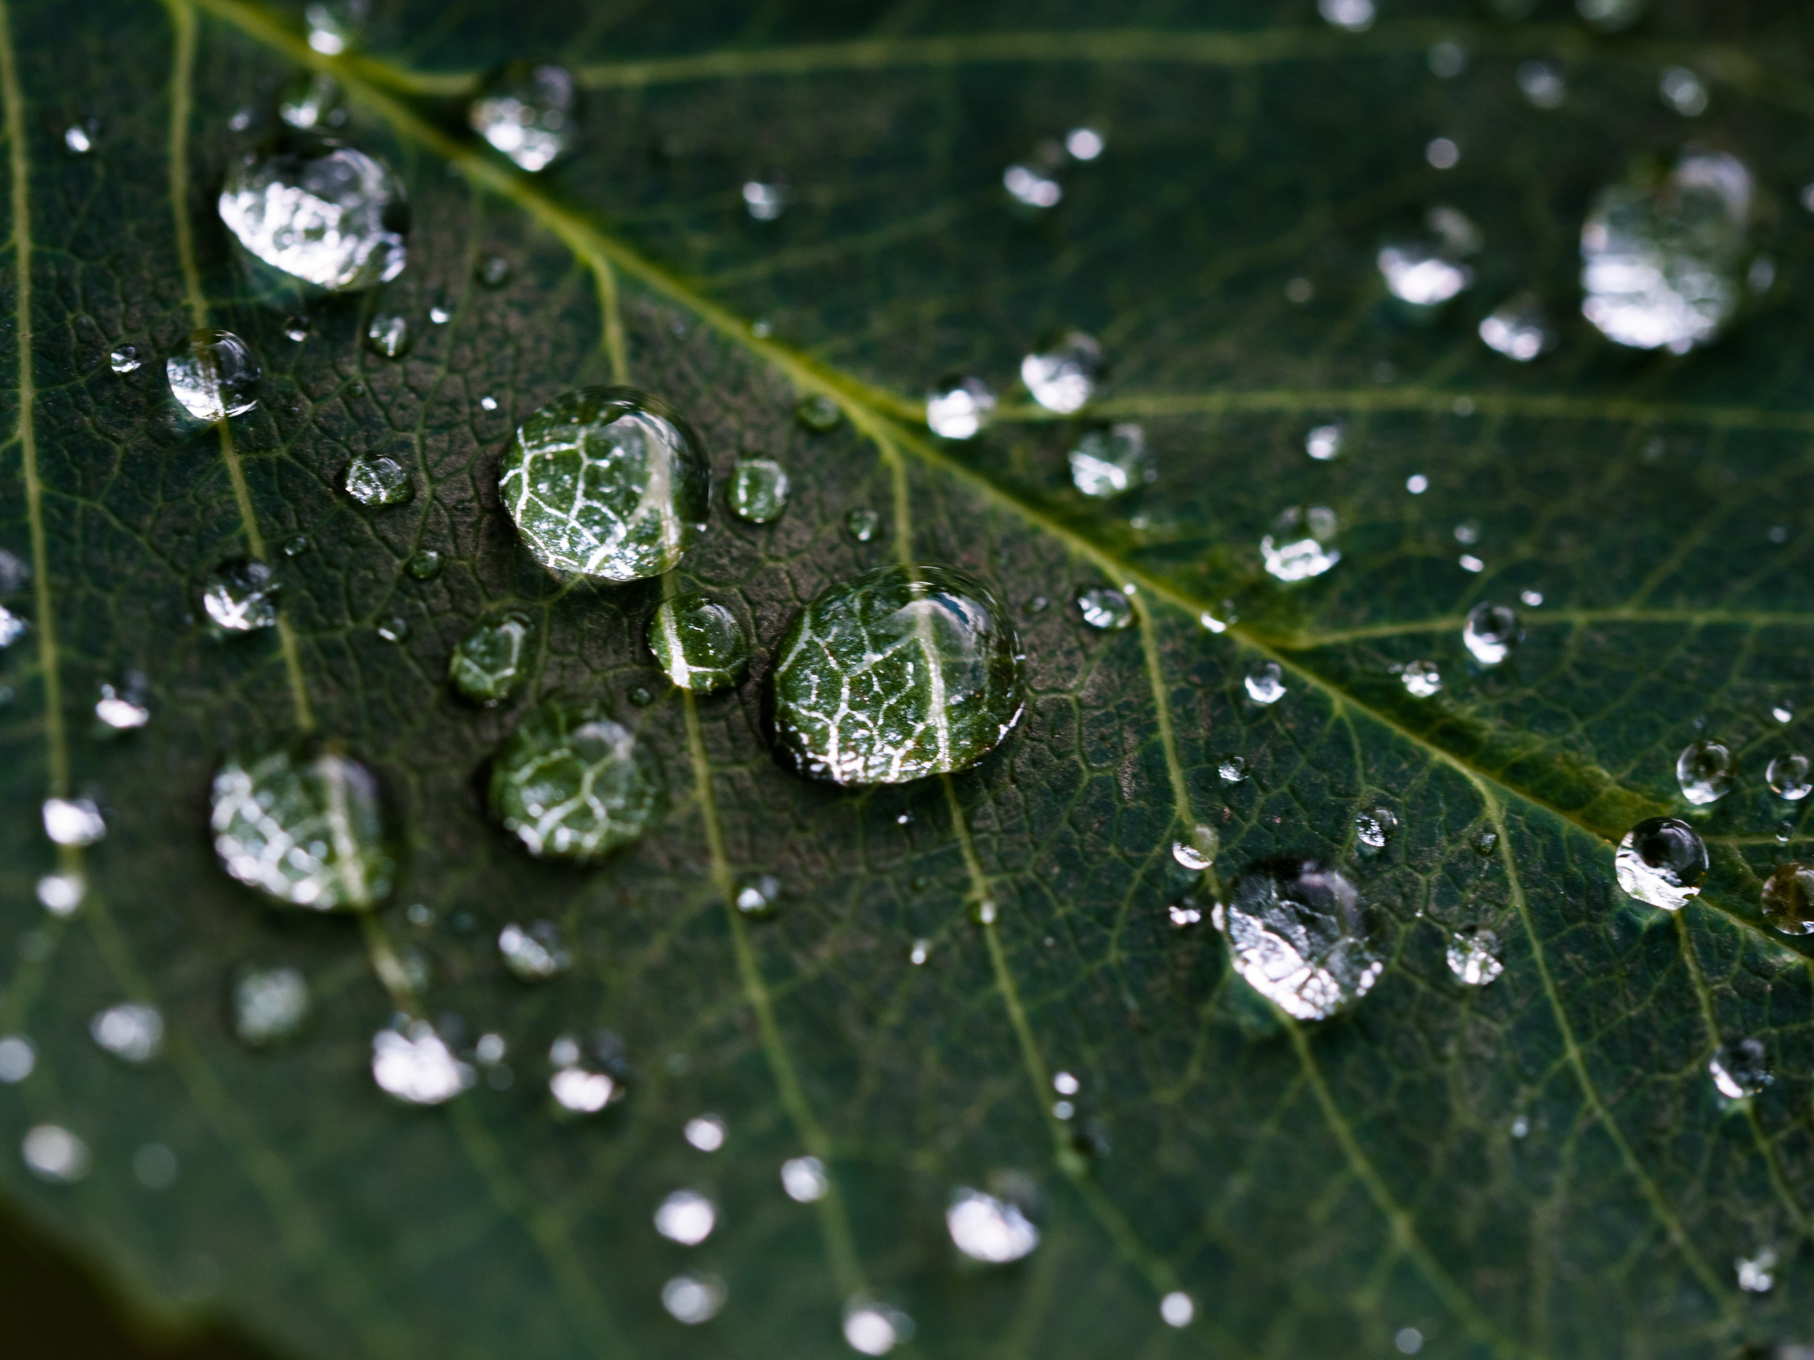
RESIDUE

Slide 2
Acts 15 v 17:
So that the residue of mankind may seek the Lord, Even all the Gentiles who are called by My name, Says the Lord who does all these things.’

Slide 3
Definition of Residue:
Something that remains after a part is taken, separated, or designated or after the completion of a process.

Slide 4
RESIDUE
OF
YOUR
SPEECH

Slide 5
WE ARE PROMISED
“the tongue of the wise promotes health,” that
“whoever guards his mouth keeps his soul from troubles,”
and that “those who deal truthfully are God’s delight” (Proverbs 12:18; 21:23; 12:22)

Slide 6

Proverb 18 v 20 - 21:
20 From the fruit of his mouth a man’s belly is filled; with the harvest from his lips he is satisfied. 21Life and death are in the power of the tongue, and those who love it will eat its fruit.

Slide 7
James 3:
³ When we put bits into the mouths of horses to make them obey us, we can turn the whole animal. ⁴ Or take ships as an example. Although they are so large and are driven by strong winds, they are steered by a very small rudder wherever the pilot wants to go.

Slide 8
James 3:
⁵ Likewise, the tongue is a small part of the body, but it makes great boasts. Consider what a great forest is set on fire by a small spark. ⁶ The tongue also is a fire, a world of evil among the parts of the body. It corrupts the whole body, sets the whole course of one’s life on fire, and is itself set on fire by hell.

Slide 9
James 3:
⁷ All kinds of animals, birds, reptiles and sea creatures are being tamed and have been tamed by mankind, ⁸ but no human being can tame the tongue. It is a restless evil, full of deadly poison. ⁹ With the tongue we praise our Lord and Father, and with it we curse human beings, who have been made in God’s likeness.

Slide 10
James 3:
¹⁰ Out of the same mouth come praise and cursing. My brothers and sisters, this should not be. ¹¹ Can both fresh water and salt water flow from the same spring? ¹² My brothers and sisters, can a fig tree bear olives, or a grapevine bear figs? Neither can a salt spring produce fresh water.

