Slide 1


Slide 2

Confidentiality Agreement
The undersigned reader acknowledges that the information provided by N2S in this project plan is confidential; therefore, reader agrees not to disclose it without the express written permission of N2S.
It is acknowledged by reader that information to be furnished in this project plan is in all respects confidential in nature, other than information which is in the public domain through other means and that any disclosure or use of same by reader, may cause serious harm or damage to N2S.
Upon request, this document is to be immediately returned to N2S.
___________________
Signature
___________________
Name (typed or printed)
___________________
Date
This is a project plan. It does not imply an offering of securities.

Slide 17
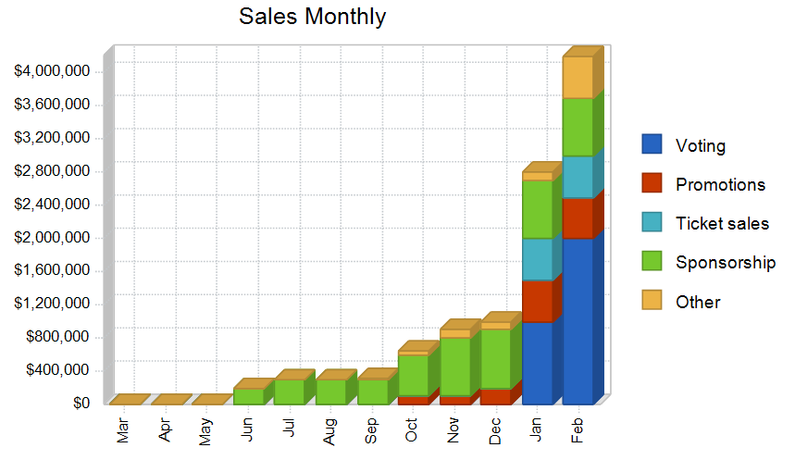

Slide 42
No: | Country Name | Population in 2019 | Active in network | Voting once | Total
1 | Algeria | 42 627 652 | 21 000 000 | 31 500 000 | 31 500 000
2 | Angola | 31 709 397 | 7 078 067 | 10 617 101 | 10 617 101
3 | Benin | 11 777 285 | 3 801 758 | 5 702 637 | 5 702 637
4 | Botswana | 2 371 462 | 923 528 | 1 385 292 | 1 385 292
5 | Burkina Faso | 20 277 683 | 3 704 265 | 5 556 398 | 5 556 398
6 | Burundi | 11 543 888 | 617 116 | 925 674 | 925 674
7 | Cabo Verde | 559 817 | 265,972 | 398 958 | 398 958
8 | Cameroon | 25 264 265 | 6 128 422 | 9 192 633 | 9 192 633
9 | Central African Republic (CAR) | 4 818 955 | 256 432 | 384 648 | 384 648
10 | Chad | 15 778 877 | 768 274 | 1 152 411 | 1 152 411
11 | Comoros | 849 487 | 130 578 | 195 867 | 195 867
12 | Congo, Democratic Republic of the | 86 517 962 | 650 000 | 975 000 | 975 000
13 | Congo, Republic of the | 5 531 271 | 5 137 271 | 7 705 907 | 7 705 907
14 | Cote d'Ivoire | 25 483 105 | 6 538 355 | 9 807 533 | 9 807 533
15 | Djibouti | 984 599 | 180 000 | 270 000 | 270 000
16 | Egypt | 101 031 602 | 49 231 493 | 73 847 240 | 73 847 240
17 | Equatorial Guinea | 1 356 542 | 312 704 | 469 056 | 469 056
18 | Eritrea | 3 300 327 | 71 000 | 106 500 | 106 500
19 | Eswatini (formerly Swaziland) | 1 413 632 | 446 051 | 669 077 | 669 077
20 | Ethiopia | 109 936 178 | 16 437 811 | 24 656 717 | 24 656 717
21 | Gabon | 2 105 919 | 985 492 | 1 478 238 | 1 478 238
22 | Gambia | 2 223 131 | 392 277 | 588 416 | 588 416
23 | Ghana | 30 048 461 | 10,110,000 | 15 165 000 | 15 165 000
24 | Guinea | 13 371 653 | 1 602 485 | 2 403 728 | 2 403 728
25 | Guinea-Bissau | 1 950 164 | 120,000 | 180 000 | 180 000
26 | Kenya | 52 117 944 | 43 329 434 | 64 994 151 | 64 994 151
27 | Lesotho | 2 290 420 | 627 860 | 941 790 | 941 790
28 | Liberia | 4 968 200 | 4,028,418 | 6 042 627 | 6 042 627
29 | Libya | 6 563 708 | 3 800 000 | 5 700 000 | 5 700 000
30 | Madagascar | 26 915 436 | 1 900 000 | 2 850 000 | 2 850 000
31 | Malawi | 19 676 219 | 1 828 503 | 2 742 755 | 2 742 755
32 | Mali | 19 644 483 | 12 480 176 | 18 720 264 | 18 720 264
33 | Mauritania | 4 651 865 | 810 000 | 1 215 000 | 1 215 000
34 | Mauritius | 1 271 136 | 803 896 | 1 205 844 | 1 205 844
35 | Mayotte | 265 867 | 107 940 | 161 910 | 161 910
36 | Morocco | 36 601 385 | 22 567 154 | 33 850 731 | 33 850 731
37 | Mozambique | 31 341 277 | 5 279 135 | 7 918 703 | 7 918 703
38 | Namibia | 2 637 852 | 797 027 | 1 195 541 | 1 195 541
39 | Niger | 23 109 993 | 951 548 | 1 427 322 | 1 427 322
40 | Nigeria | 200 572 537 | 111,632,516 | 167 448 774 | 167 448 774
41 | Reunion | 889 432 | 480 000 | 720 000 | 720 000
42 | Rwanda | 12 771 963 | 3 724 678 | 5 587 017 | 5 587 017
43 | Saint Helena | 4 094 | 2,200 | 3 300 | 3 300
44 | Sao Tome and Principe | 213 030 | 57 875 | 86 813 | 86 813
45 | Senegal | 16 709 382 | 9 749 527 | 14 624 291 | 14 624 291
46 | Seychelles | 95 667 | 67 119 | 100 679 | 100 679
47 | Sierra Leone | 7 870 630 | 902 462 | 1 353 693 | 1 353 693
48 | Somalia | 15 601 303 | 1 200 000 | 1 800 000 | 1 800 000
49 | South Africa | 58 014 345 | 31 185 634 | 46 778 451 | 46 778 451
50 | South Sudan | 13 236 809 | 2 229 963 | 3 344 945 | 3 344 945
51 | Sudan | 42 437 345 | 11 816 570 | 17 724 855 | 17 724 855
52 | Tanzania | 60 773 660 | 23 000 000 | 34 500 000 | 34 500 000
53 | Togo | 8 171 421 | 3 687 036 | 5 530 554 | 5 530 554
54 | Tunisia | 11 773 735 | 7 898 534 | 11 847 801 | 11 847 801
55 | Uganda | 45 601 140 | 19 000 000 | 28 500 000 | 28 500 000
56 | Western Sahara | 513 000 | 28 000 | 42 000 | 42 000
57 | Zambia | 18 096 902 | 7 248 773 | 10 873 160 | 10 873 160
58 | Zimbabwe | 17 268 153 | 6 796 314 | 10 194 471 | 10 194 471
 | Conservative Total in 1 Month |  |  | 694 293 834 | 694 293 834
 | Conservative Total in 2 Month |  |  | 1 388 587 668 | 1 388 587 668
 | Conservative Total in 3 Month |  |  | 2 082 881 502 | 2 082 881 502
 | Conservative Total in 4 Month |  |  | 2 777 175 336 | 2 777 175 336
 | Conservative Total in 5 Month |  |  | 3 471 469 170 | 3 471 469 170
 | Conservative Total in 6 Month |  |  | 4 165 763 004 | 4 165 763 004
 | Conservative Total in 7 Month |  |  | 4 860 056 838 | 4 860 056 838
 | Conservative Total in 8 Month |  |  | 5 554 350 672 | 5 554 350 672
 | Conservative Total in 9 Month |  |  | 6 248 644 506 | 6 248 644 506
 | Conservative Total in 10 Month |  |  | 6 942 938 340 | 6 942 938 340
 | Conservative Total in 11 Month |  |  | 7 637 232 174 | 7 637 232 174
 | Conservative Total in 12 Month |  |  | 8 331 526 008 | 8 331 526 008
 |  |  |  | 54 154 919 052 | 54 154 919 052

Slide 44
Total collection from voting in all African countries each month
 |  |  | Total in Rands
Conservative Total in 1 Month |  |  | 694 293 834 | 694 293 834
Conservative Total in 2 Month |  |  | 1 388 587 668 | 1 388 587 668
Conservative Total in 3 Month |  |  | 2 082 881 502 | 2 082 881 502
Conservative Total in 4 Month |  |  | 2 777 175 336 | 2 777 175 336
Conservative Total in 5 Month |  |  | 3 471 469 170 | 3 471 469 170
Conservative Total in 6 Month |  |  | 4 165 763 004 | 4 165 763 004
Conservative Total in 7 Month |  |  | 4 860 056 838 | 4 860 056 838
Conservative Total in 8 Month |  |  | 5 554 350 672 | 5 554 350 672
Conservative Total in 9 Month |  |  | 6 248 644 506 | 6 248 644 506
Conservative Total in 10 Month |  |  | 6 942 938 340 | 6 942 938 340
Conservative Total in 11 Month |  |  | 7 637 232 174 | 7 637 232 174
Conservative Total in 12 Month |  |  | 8 331 526 008 | 8 331 526 008
Grand Total |  |  | 54 154 919 052 | 54 154 919 052

Slide 45
Ticket sales at the stadium
Ticket sales at the stadium
Composition |  |  | Ordinary Ticket Price |  | VIP Price | Couples | Totals
No: Ordinary | 50 000 |  | 300 |  | 0 | 0 | 15 000 000
No: VIP | 10 000 |  | 0 |  | 500 | 0 | 5 000 000
No: Couples | 4 000 |  | 0 |  | 0 | 450 | 1 800 000
Grand Total |  |  |  |  |  |  | 21 800 000

Slide 46
First year total earnings
Total Earnings in the first year
Votings Earning |  | 54 154 919 052
Ticket Sales |  | 21 800 000
Final Voting |  | 526 122 805
Grand Total |  | 54 702 841 857

