Slide 1
E101A Topic1
Electrical Trades
Apply OSH regulations, codes and practices in the Workplace
The purpose of this presentation is to provide you with the opportunity to answer questions from Topic1 of the UEENEEE101A Portfolio
Click the left mouse button for each slide
(Or press the SPACEBAR or ENTER key)
E101A Portfolio of Evidence Topic 1.pps Version 1
10 February 2016

Slide 2
E101A Portfolio Questions
These are the titles of the Work Sheets for this Section.
Topic 1
Topic 2
Topic 3
Topic 4
Topic 5
This is the current Work Sheet
Topic 6
Topic 7
Continue

Slide 3
What is an ACT
ACT
An Act is a statute or law passed by both Houses of Parliament that has received Royal Assent. On Royal Assent, Acts are given a year and number. Once an Act is formally enacted it can generally only be amended or repealed by another Act. When an Act changes, a compilation of the Act is prepared to show the Act as amended. Acts are also known as primary legislation.

Slide 4
What is an REGULATION
Regulations
Most Regulations are made under an Act of Parliament and are classified as legislative instruments. Some prerogative instruments also have the word Regulations in their title. Regulations were part of the Statutory Rules series until 2005, and the Select Legislative Instrument series until 2015.
Legislative instruments (LIs)
Legislative instruments are laws on matters of detail made by a person or body authorised to do so by the relevant enabling legislation. Examples of LIs include regulations, rules and determinations

Slide 5
E101A Portfolio Questions
1. What is the stated purpose of the OS&H Act 1984?
Typical answer:
The Occupational Safety and Health Act 1984 is an act of WA parliament which is intended mainly to promote and improve standards for occupational safety and health. The act details the legal responsibilities of various groups and individuals in matters relating to occupational safety and health, and establishes WorkSafe to administer the Act.
Lead paragraph of OS&H Act extracts.
Continue

Slide 6
E101A Portfolio Questions
2. How does the Occupational Safety and Health Act benefit you as an employee?
Typical answer:
The Occupational Safety and Health Act 1984 is an act of WA parliament which is intended mainly to promote and improve standards for occupational safety and health. The act details the legal responsibilities of various groups and individuals in matters relating to occupational safety and health, and establishes WorkSafe to administer the Act. Provides a safe working environment for you and other workers.
Lead paragraph of OS&H Act extracts.
Continue

Slide 7
E101A Portfolio Questions
3. State the underlying principles of OS&H.
Typical answer:
The Occupational Safety and Health Act 1984 is an Act of the WA parliament which is intended mainly to promote and improve standards for occupational safety and health and provide a safe workplace. To make the workplace a safe place for all workers.
Continue

Slide 8
E101A Portfolio Questions
4. What are the objectives of the Occupational Safety and Health Act 1984?
Typical answer:
The objectives of the Occupational Safety and Health Act 1984 is to:
promote better standards of safety and health
improve standards for occupational safety and health.
detail the legal responsibilities of various groups and individuals
To establish WorkSafe to administer the Act.
Provides a safe working environment for WA workers.
Continue

Slide 9
E101A Portfolio Questions
5. What is the purpose of the Occupational Safety and Health Regulations1996?
Typical answer:
The purpose of the Occupational Safety and Health Regulations 1996 is to:
Implement and regulate through WorkSafe the laws resulting from the 1984 Act.
Continue

Slide 10
E101A Portfolio Questions
6. What is meant by the term 'duty of care' in relation to Occupational Safety and Health?
Typical answer:
It means that a person or employer has a legal responsibility to take reasonable care in matters relating to safety and health.
OS&H Act - paragraphs 19 & 20
Continue

Slide 11
E101A Portfolio Questions
7. List FOUR 'duties of care' which are the responsibility of the employer in relation to Occupational Safety and Health? State the clause number.
Typical answer:
Workplace without hazards;
provide information and training;
consult safety representatives;
provide protective materials;
use safe processes.
OS&H Act - paragraph 19
Continue

Slide 12
E101A Portfolio Questions
8. List FOUR 'duties of care' which are the responsibility of the employee in relation to Occupational Safety and Health? State the clause number.
Typical answer:
Take reasonable care;
Avoid adversely affecting others;
Comply with instructions;
Use protective equipment;
Do not damage safety equipment;
Report unsafe conditions;
Report injuries.
OS&H Act - paragraph 20
Continue

Slide 13
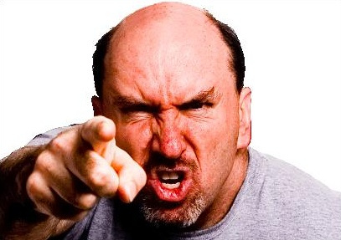
E101A Portfolio Questions
9. The primary responsibility for safety in the workplace rests with?
Typical answer:
You!
Continue

Slide 14
E101A Portfolio Questions
10. List the three responsibilities of an individual. State the clause number.
Typical answer:
An individual should:
Take reasonable care to ensure their own safety and the safety of others
Follow instructions, use protective equipment properly, look after protective equipment and report hazards in a timely way
Cooperate with employer with regard to OS&H
OS&H Act - paragraph 20.
Continue

Slide 15
E101A Portfolio Questions
11. What two actions must an employee take if he or she becomes aware of a situation which is hazardous?
Typical answer:
Attempt to remove/remedy the hazard - if possible; Report the hazard.
OS&H Act Clause 20.2.(d)
Continue

Slide 16
E101A Portfolio Questions
12. What are five of the functions of a Safety and Health Committee? State the clause number.
Typical answer:
To facilitate co-operation; to keep informed as to standards; to recommend safety programmes; to maintain safety information; to make recommendations for changes; to perform other safety related functions.
OS&H Act - paragraph 40.
Continue

Slide 17
E101A Portfolio Questions
13. What are four of the functions of a Safety and Health representative? State the clause number.
Typical answer:
To:
Inspect the workplace at an agreed time
Investigate accident or hazardous situation
Keep informed of regulations and updates
Forthwith any hazard or potential hazard to an employer
Refer to OS&H committee
Consult and cooperate with employer
Liaise with employees
OS&H Act - paragraph 33.
Continue

Slide 18
E101A Portfolio Questions
14. Worksafe WA inspectors are empowered to issue two types of notices if they are of the opinion that the Occupational Safety and Health Act is being contravened. What are the names given to each of the notices?
Typical answer:
An Improvement Notice
Prohibition Notice.
OS&H Act - paragraphs 48 and 49.
Continue

Slide 19
E101A Portfolio Questions
15. List four of the powers of a Worksafe WA inspector. State the clause number.
Typical answer:
Inspect;
examine;
enter;
take;
interview;
photograph;
record;
measure in a workplace.
OS&H Act - paragraph 43
Continue

Slide 20
E101A Portfolio Questions
16. What might happen if a job site is deemed non-compliant with OS&H by a Worksafe WA inspector.
Typical answer:
The inspector will place a prohibition notice up and work will cease until he is satisfied the situation has been remedied.
The inspector can issue a person or company with an improvement notice which complies them to remedy the situation.
OS&H Act - paragraphs 48 and 49
Continue

Slide 21
E101A Portfolio Questions
17. Why should housekeeping be done.
Typical answer:
Less risk of accidents and increased personal safety
Happier workplace with more pride in the workplace
Higher morale and work gets done more efficiently
Improved work methods and improved staff relations
Less damage to materials
Fire risk reduced
Continue

Slide 22
E101A Portfolio Questions
18. State five potential hazards in relation to improper housekeeping.
Typical answer:
See next page
Continue

Slide 23
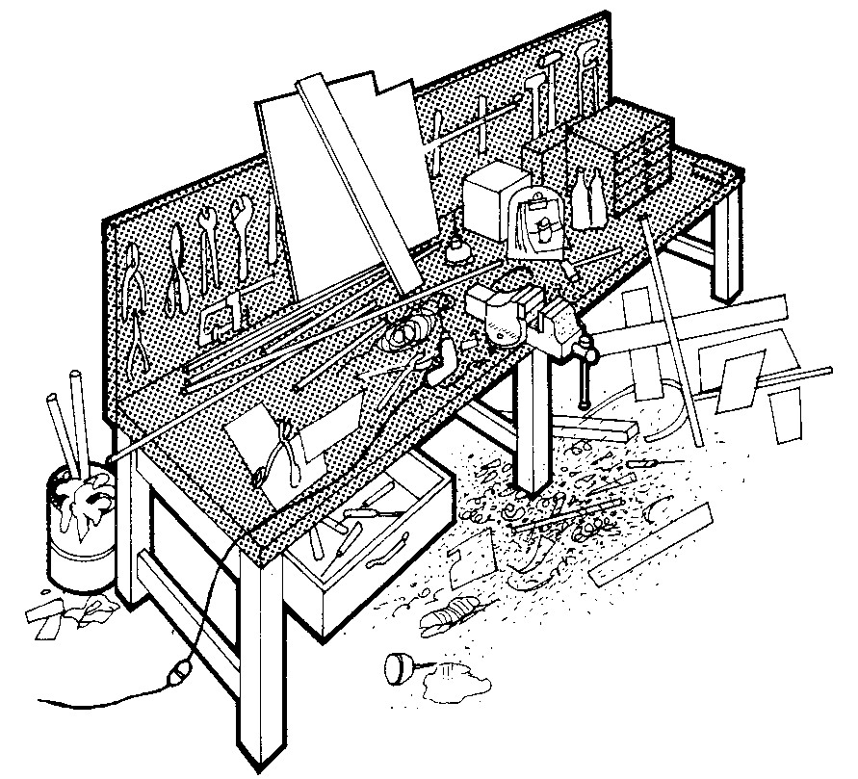
E101A Portfolio Questions
Bad storage
Cluttered bench
Tools on bench
Bin full
Rubbish on floor
Unsafe cord
Untidy open drawer
Typical answer:
Oil on floor
Continue

Slide 24
E101A Portfolio Questions
19. State why PPE must be appropriate to the task.
Typical answer:
The hazard that the PPE is protecting against will not be adequately prevented.
Continue

Slide 25
E101A Portfolio Questions
20. State a hazardous situation that will require PPE and how you can ensure it’s suitable for the PPE being used.
Typical answer:
Sharpening a drill bit at a grinder.
Safety glasses to protect the eyes from flying hot metal pieces
Ear plugs to reduce the noise from the machine
Safety boots to guard against dropped items while sharpening.
Continue

Slide 26
Finished E101A Portfolio Questions
That is the end
Topic One
Continue

Slide 27
The End
Thank you for participating in this presentation.
Click or press Escape to exit
Continue

