Slide 1
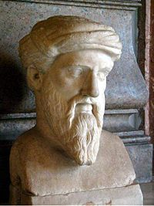
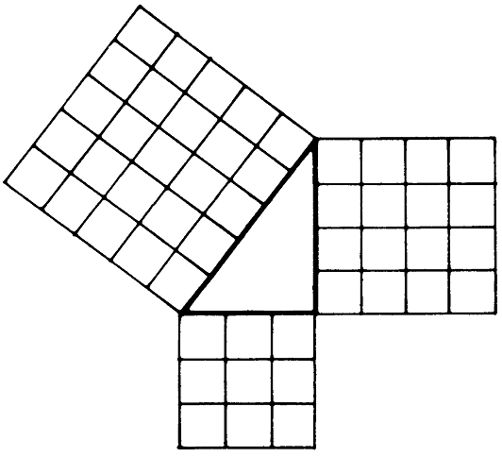
Trigonometry and the right triangle
Angles

Slide 2
Trigonometry

Slide 4
Triangles

Slide 6
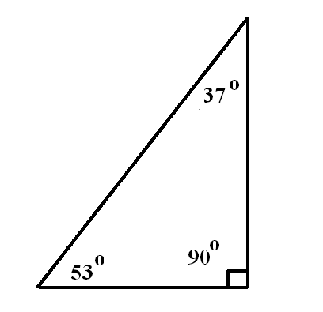
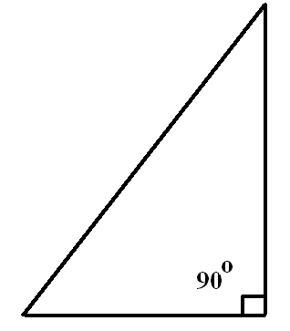
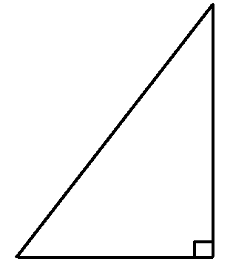
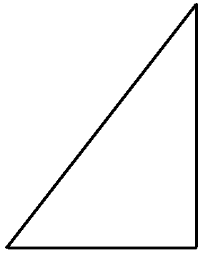
A right triangle is a triangle where one of the three angles is 90 degress
The size of the remaining two angles will add up to 90 degrees
53 + 37 = 90˚
The addition of all three angles will add up to 180 degrees
53 + 37 + 90 = 180˚

Slide 7
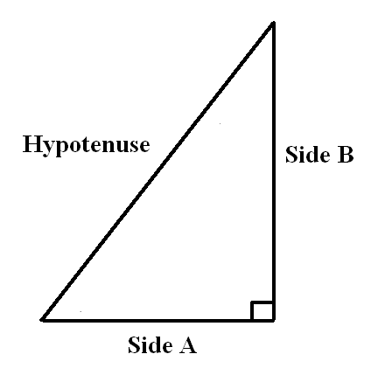
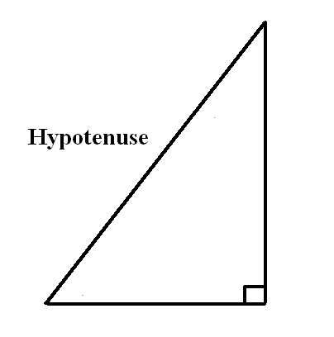
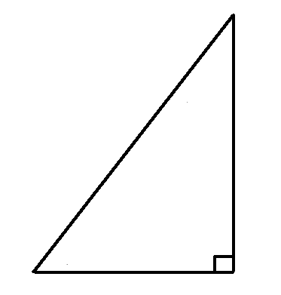
A right triangle has three sides
The longest side which is opposite to the right angle is called the hypotenuse
The other two sides are commonly labeled
Side A and Side B

Slide 8
Pythagoras was a Greek mathematician who is famous for his theorem regarding right triangles

Slide 9
He found that the square of side A added to the square of sibe B equaled the square of the hypotenuse

Slide 10
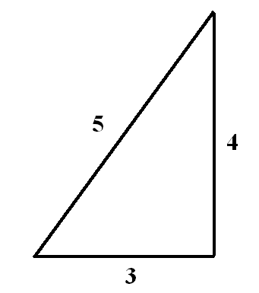
This right triangle has the following dimensions
Side A = 3 meters
Side B= 4 meters
The hypotenuse = 5 meters

Slide 11
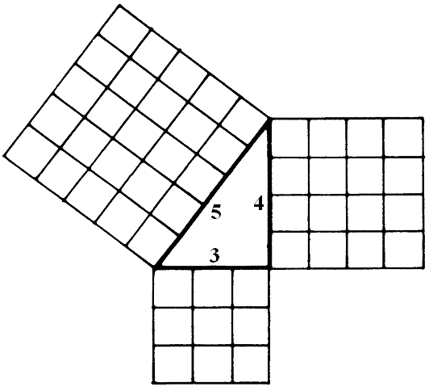

Slide 12
This formulae can be transposed

Slide 13
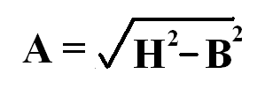

Slide 14
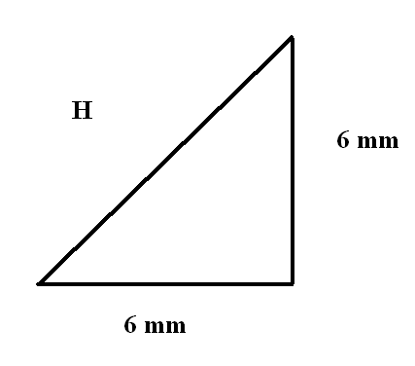
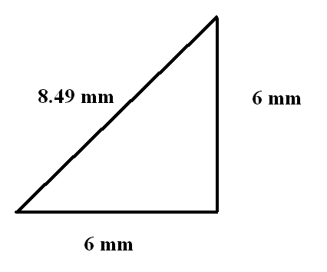

Slide 15
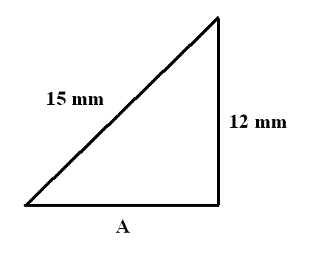
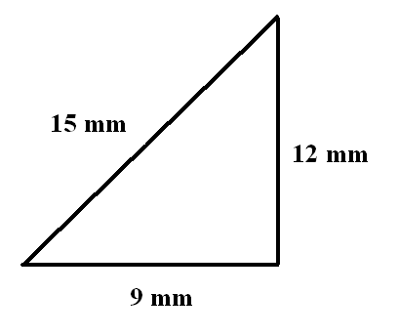

Slide 16
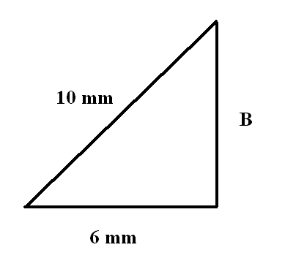
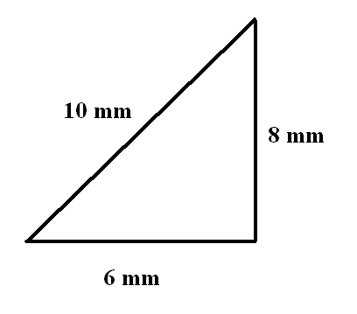

Slide 17
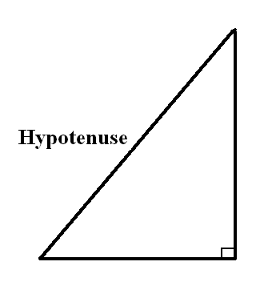
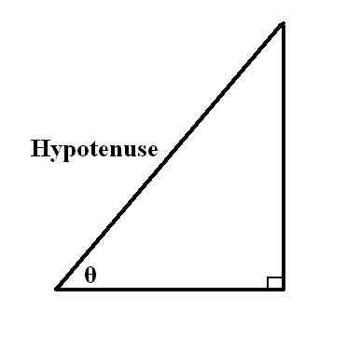
We know that the angle opposite the hypotenuse in a right triangle is 90 degrees
The other two angles are often unknown and are represented by the Greek symbol theta
θ

Slide 18
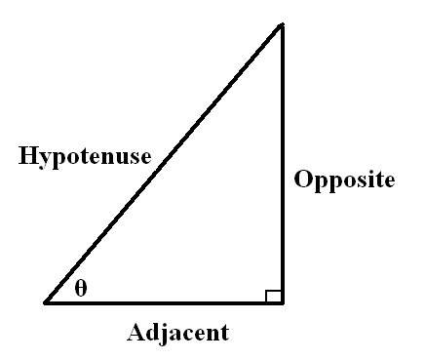
We now refer to Side A and Side B as the ‘Adjacent’ (next to) side to the angle θ and the ‘Opposite’ to the angle θ

Slide 19
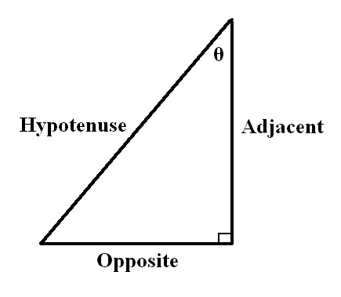
Notice here that we are now referring to the other angle
The ‘Adjacent’ side to this angle θ is now the vertical side and the ‘Opposite’ is the horizontal side

Slide 20
As you can here, the side that we designate as ‘Adjacent’ or ‘Opposite’ depends on which angle θ we are referring to

Slide 21
This is where our trigonometry functions of Sine Cosine and Tangent come in
These are usually represented as
SinƟ - SOH
CosƟ - CAH
TanƟ - TOA

Slide 22
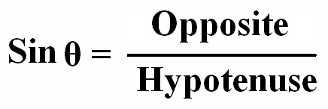

Slide 23
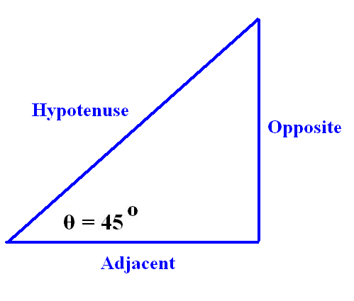
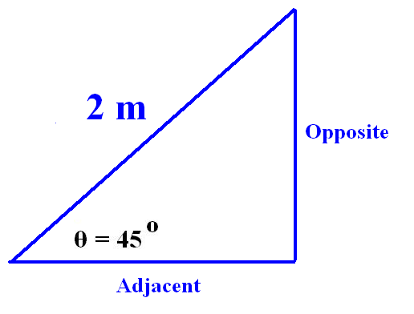
Lets see what this means for this triangle

Slide 24
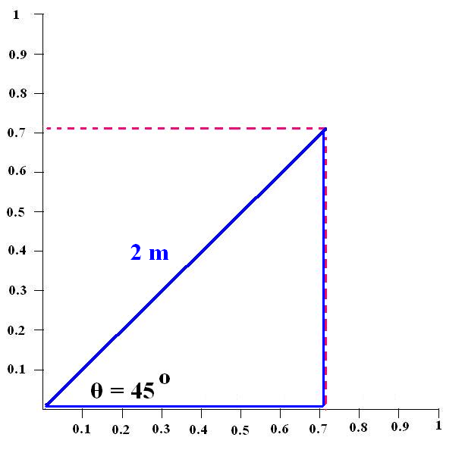
The hypotenuse is 2 meters in length
The Cos represents the ratio reduction for the Adjacent or horizontal line of the triangle
The Adjacent side is 2 x 0.707
Adjacent = 1.41

Slide 25
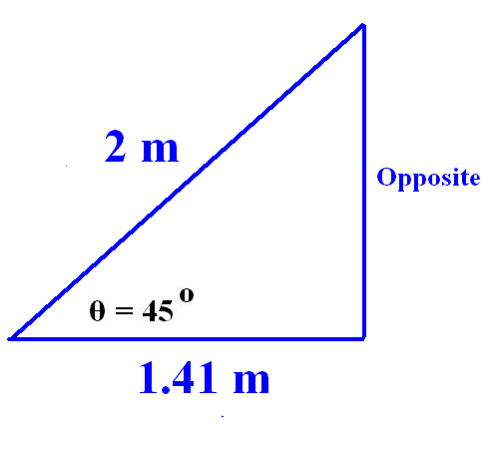

Slide 26
The hypotenuse is 2 meters in length
The Sin represents the ratio reduction for the Opposite or vertical line of the triangle
The Opposite side is 2 x 0.707
Opposite = 1.41 m

Slide 27
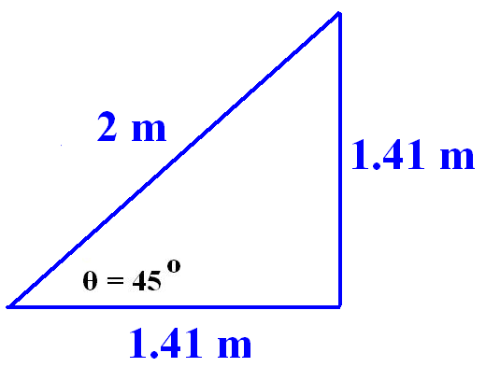

Slide 28
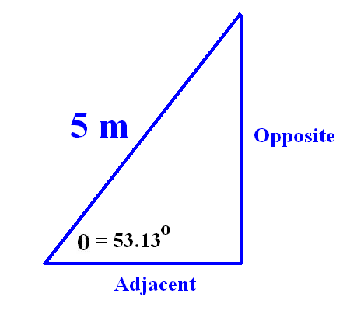
This time our triangle has a hypotenuse that is 5 meters long and the angle indicated is 53.13 degrees

Slide 29
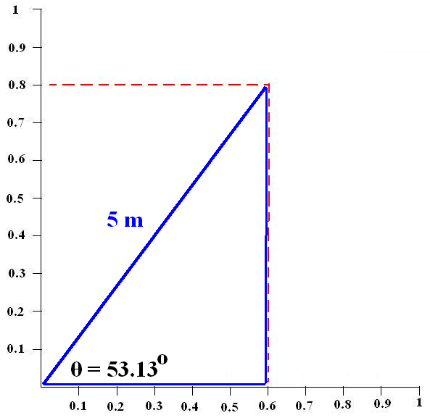
Adjacent
= 5 x 0.6
Adjacent = 3 m

Slide 30
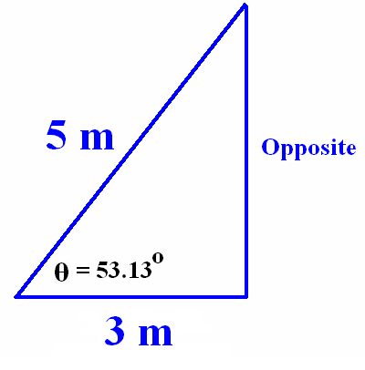

Slide 31
Opposite
= 5 x 0.8
Opposite = 4 m

Slide 32
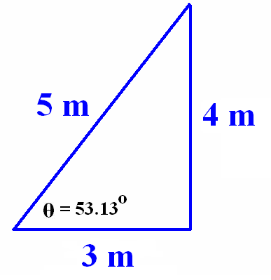

Slide 33
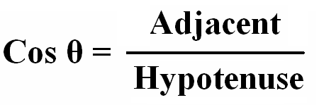
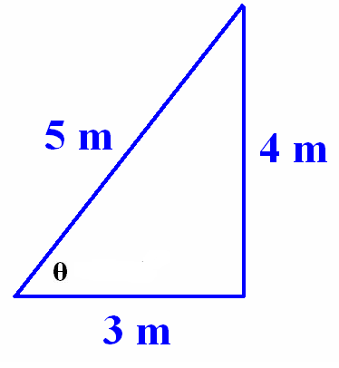
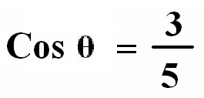

Slide 34
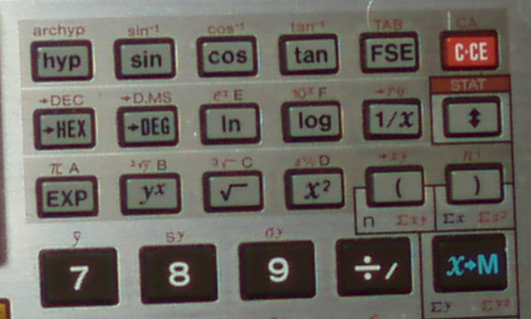

Slide 35
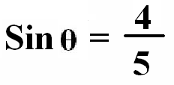

Slide 37
We have seen that Cos and Sin give us the ratio reduction in size when compared with the Hypotenuse
This mean that Cos or Sin will never be greater than 1
If Cos was 1 then your triangle will be reduced down to a horizontal line
If Sin was 1 then your triangle will simply be a vertical line

Slide 38
The tangent or Tan is the ratio relationship between the Opposite side and the Adjacent side
In the case of Tan the result can range from a fraction to a number much higher than 1

Slide 39
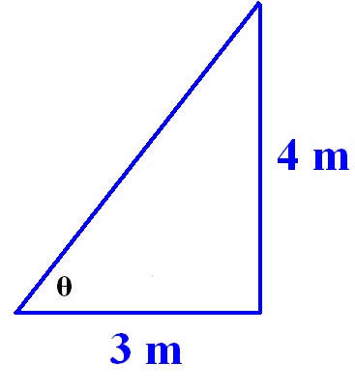
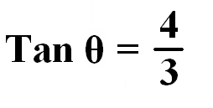

Slide 40
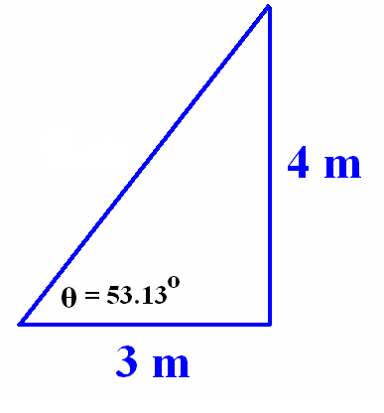

Slide 42
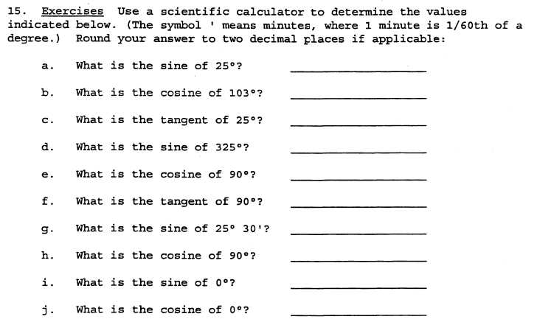
Exercises 1

Slide 43
Answers to Exercise 1
a) 0.42
b) -0.22
c) 0.47
d) -0.57
e) 0
f) tan90=1 You can only have a true tangent for angle measures up to 89.99 repeating because the tangent is a ratio of a leg to the hypotenuse, so the leg cannot equal the hypotenuse of a right triangle.
G) 0.43
h) 0
i) 0
j) 1

Slide 44
Exercise 2

Slide 45
Answers to Exercise 2
a) 3 m
b) 7.37cm
c) 6.39cm
d) 6.15m
e) 8.16cm
f) 59.84mm

Slide 46
Exercise 3

Slide 47
Answers to Exercise 3
a) 30˚
b) 35˚26’
c) 64˚15’
d) 21˚71’
e) 18˚19’
f) 67˚38’

Slide 48
Exercise 4

Slide 49
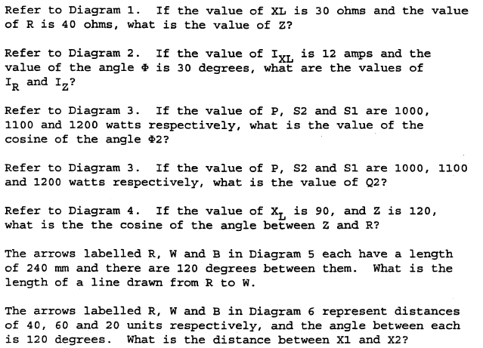
Exercise 4 (cont)
a.
b.
c.
d.
e.
f.
g.
h.

Slide 50
Answers to Exercise 4
a)
b)
c)
d)
e)
f)
g)
h)
i)

