Slide 1
Maths Tutorial
Trigonometry and AC Theory

Slide 2
Trigonometric Function Definitions - Sin
Defines the value of an angle on the “y” or vertical axis. We use the sin function to define the output voltage of an alternator at any given point in time by the equation Vins = Vpeak sinθ. We view the vector as starting at zero degrees and rotating counter clockwise as the alternator turns through it’s 360⁰ rotation. By multiplying the sin of the angle by the peak output we can calculate the voltage output at any point in time throughout the whole 360⁰ cycle.

Slide 3
Trigonometric Function Definitions - Cos
Defines the value of an angle on the “x” axis. We use the cos function to define the true power when calculating power factor and other power related functions. By multiplying the cos of the angle by the apparent power we can calculate the true or real power because this is the resistive part of the load which appears on the “x” axis. So by defining the value of the apparent power at a certain phase angle using the cos function we are able to define true power. Equation as follows. 〖Power〗_true=V x I cosθ

Slide 4
Trigonometric Function Definitions - Tan
Defines the value of an angle on a line that intersects with the circumference of the circle and runs parallel to the “y” axis. This is why tan can have a value greater than one as it is outside the unit circle. The tan of 90⁰ cannot be calculated because that angle is parallel to the tan line outside the circle and as such they can never intersect.

Slide 5
Polar- Rectangular Conversions.
Scenario – We want to travel from Perth to Scarborough and have two options.
Using rectangular co-ordinates we travel West for 10km then turn right 90⁰ and travel North for 8km. This will take us to Scarborough.
Using polar co-ordinates we determine the direction, represented by the angle theta, and distance, represented by the hypotenuse.
This is the information a pilot or navigator requires to plot a course.

Slide 6

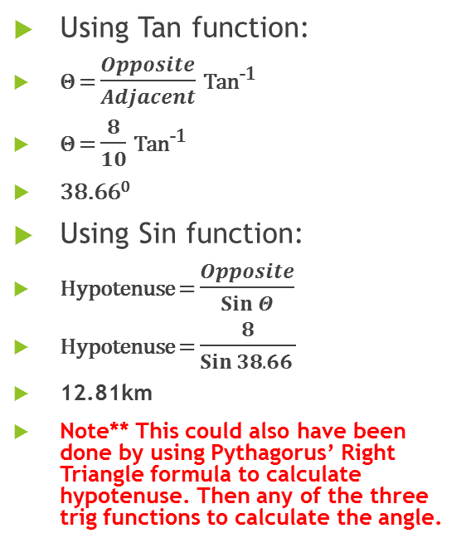
Calculation of Angle and Hypotenuse
Using Tan function:
Θ = $\frac{Opposite}{Adjacent}$ Tan⁻¹
Θ = $\frac{8}{10}$ Tan⁻¹
38.66⁰
Using Sin function:
Hypotenuse = $\frac{Opposite}{Sin Θ}$
Hypotenuse = $\frac{8}{Sin 38.66 }$
12.81km
Note** This could also have been done by using Pythagorus’ Right Triangle formula to calculate hypotenuse. Then any of the three trig functions to calculate the angle.
We now know our polar co-ordinates and can fly to Scarborough !!!

Slide 7
Calculating Angle and Hypotenuse Using Pol Function
Knowing the value of the two sides of the triangle adjacent to the 90⁰ angle allows the simple calculation of angle and hypotenuse utilizing the “Pol” function. This is an abbreviation for Polar.

Slide 8
Calculating Angle and Hypotenuse Using Pol Function
Press Pol(
Enter “X” axis (resistive) value
Press comma key
Enter “Y” (reactive) axis value
Press enter
Display shows hypotenuse value
Press RCL then Letter “F”
Display shows angle
Press RCL “E” to go back to hypotenuse
Switch between the two using “F” or “E”

Slide 9
Calculating Angle and Hypotenuse Using Pol Function
Select “Pol(“ function
Enter “X” value
Enter comma
Enter “Y” value
Display shows hypotenuse
Enter RCL then “F”
Display shows angle
Enter RCL then “E”
Display shows hypotenuse

Slide 10

Calculate Impedance of a Series Circuit
Consider the circuit shown
Consider the circuit shown
X_{L} = $2πfL$ = $2πx50x0.25$ = 78.5Ω
R = 50Ω
Calculate Z = Pol(50,78.5 =
Display show 93.0712093
Z = 93.07Ω
Press RCL “F”
Display shows 57.50520006 (Angle)
Angle = 57.5⁰
Press RCL “E”
Display shows 93.0712093 (Hyp)

Slide 11

Impedance of a Parallel Circuit
Consider the circuit shown
XL = 2𝜋𝑓𝐿 = 2𝜋𝑥50𝑥0.25 = 78.5Ω
I_{R} = V/R = 230/50 = 4.6A
I_{L} = V/X_{L} = 230/78.5 = 2.93A
Enter Pol(4.6,2.93 = 5.453888521
Line current = 5.45A
Press RCL “F”
Display shows 32.49536432 (Angle)
Angle = 32.5⁰
Press RCL “E”
Display shows 5.453888521 (Hyp)
Z = V/I_{L} = 42.2Ω

Slide 12
Phasor Addition
The phasor diagram shows the voltage reference phasors as being all at the correct angle and the current phasors for each phase as being lagging and of varying magnitudes. Thus representing an unbalanced load as may occur in a three phase system where each of the individual phases is functioning as a single phase circuit. We need to be able to calculate the neutral current and this requires the addition of the three phasors to give the resultant magnitude and angle representing the neutral current. Remembering that in a balanced three phase system there is no neutral current.

Slide 13
Graphical Method
Choose any two phasors to start the process. In this instance we have chosen Red and White with the result being shown as a red dashed line.
Simply draw a line starting at the end of the white phasor that runs parallel with the red phasor.
Repeat with red phasor starting at the end and drawing a line parallel to the white phasor.
At the point where they intersect draw a line from there to the point of origin. This is the result of adding Red and White phasors.
Repeat using Blue phasor and this resultant to complete plotting of the overall resultant.
Draw a line from this point to the point of origin and measure. This represents the neutral out of balance current.
Draw a line from point of origin as a continuation of the resultant for the same distance. Ie 180⁰ out of phase

Slide 14

Phasor Addition By Calculation
The first task is to reference all phasors back to zero degrees.
Red phasor 22A and -33.4⁰. Already referenced to zero
White phasor 37A and -37.6⁰ Reference is 240⁰ so this phasor is at 202.4⁰
Blue phasor 27A and -28.2⁰ Reference is 120⁰ so this phasor is at 91.8⁰
By using the “Rec” function we can convert these polar co-ordinates to rectangular for addition and then convert back to polar.

Slide 15
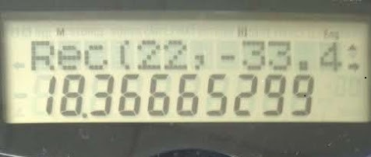
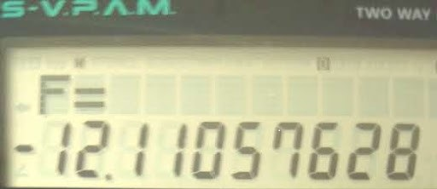
Using Rec Function to Convert Polar to Rectangular For Addition
Press “Rec” key.
Enter value of current then press comma.
Enter zero referenced angle and press enter.
This is the “X” axis value. 18.37
Press RCL “F”
This the “Y” axis value. -12.11
Repeat for other two phases.
Add all “X” values together
Add all “Y” values together

Slide 16
Using Pol Function to Calculate Current and Phase Angle
The values are as follows:
Add all “x” values together and all “y” values then convert to polar form
Pol( x+x+x,y+y+y =
Enter into calculator as follows –
Press Pol(18.36+(-34.2)+(-.85),-12.11+(-14.1)+26.9 =
Display shows 16.70821654 round off to 16.7A this is the neutral current.
Press RCL “F” display shows 177.28999969 round off to 177.29
Add 177.63 to 180 to obtain correct angle of 357.29⁰ or -2.71⁰
The phase angle of the neutral current is of little consequence.
Phasor | “X” (Cos) | “Y” (Sin)
Red | 18.36 | -12.11
White | -34.2 | -14.09
Blue | -0.85 | 26.99

Slide 17
Alternative Method Using Sin and Cos
Functions
By calculating the sin and cos of each angle, define magnitude by multiplying by the current for each phase, then adding them together we can also achieve the correct outcome as follows.
Enter cos -33.4 x 22 = 18.37 (rounded) this is “X” value.
Enter sin -33.4 x 22 = -12.11 (rounded) this “Y” value.
Repeat for other two phases.
Repeat calculation of final values by repeating method in previous slide.
Phasor | Cos = x | Sin = y
Red = -33.40⁰ | 0.835 x 22 = 18.37 | -0.550 x 22 = -12.11
White = 202.40⁰ | -0.92 x 37 = -34.2 | -0.38 x 37 = -14.09
Blue = 91.80⁰ | -0.0314 x 27 = -0.85 | 0.99 x 27 = 26.99

Slide 18
3 Phase Sin Wave in Correct Phase

Slide 19
3 Phase Sin Wave – White Phase Lagging 30⁰.

Slide 20
Phasor Addition Chart – In Correct Phase

Slide 21
Phasor Addition Chart White Phase -30⁰
0
90
1
1
0
0
0
120
60
.
866
0
.
866
Blue
0
0
0
150
30
.
5
0
.
5
Red
0
0
0
180
0
0
-
0
White
-
30
0
.
5
-
0
.
0
5
0
330
210
-
0
.
866
-
0
.
0
866
0
300
-
240
1
-
0
1
270

Slide 22
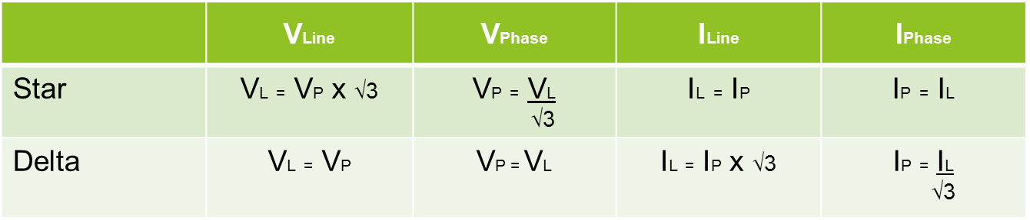
The Square Root of 3
We use √3 as a factor to convert between line and phase values for voltage and current.

Slide 23
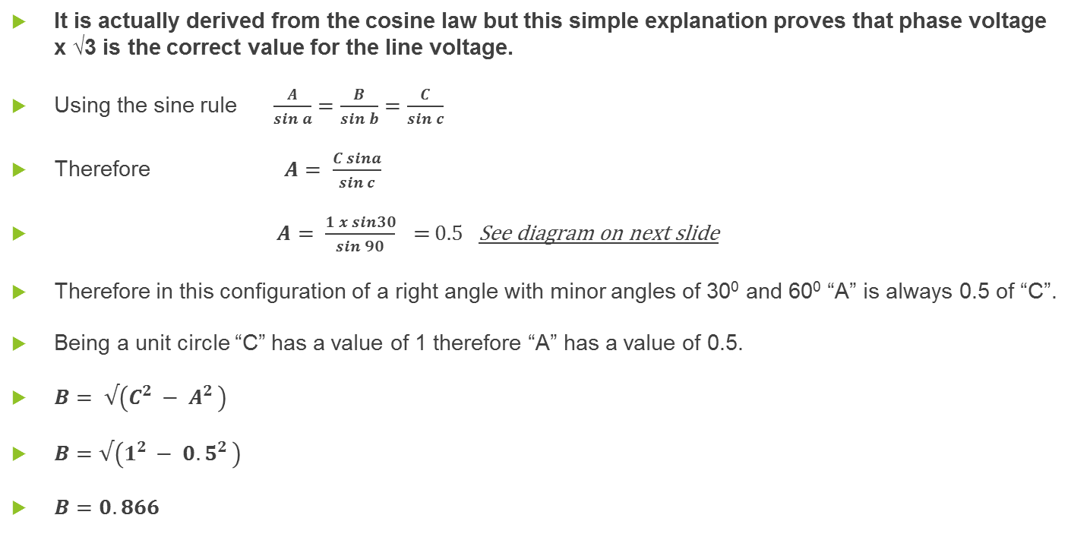
Where does this value come from?
It is actually derived from the cosine law but this simple explanation proves that phase voltage x √3 is the correct value for the line voltage.
Using the sine rule $\frac{A}{sin a}=\frac{B}{sin b}=\frac{C}{sin c}$
Therefore $A= \frac{C sina}{sin c}$
$A= \frac{1 x sin30}{sin 90}$ = 0.5 See diagram on next slide
Therefore in this configuration of a right angle with minor angles of 30⁰ and 60⁰ “A” is always 0.5 of “C”.
Being a unit circle “C” has a value of 1 therefore “A” has a value of 0.5.
$B= √\left(C^{2 }− A^{2 }\right)$
$B=√\left(1^{2 }− {0.5}^{2 }\right)$
$B=0.866$

Slide 24
On the phasor diagram below the dark blue line represents a phase voltage. The resultant right triangle shows values of side A=0.5 and side B=0.866

Slide 25
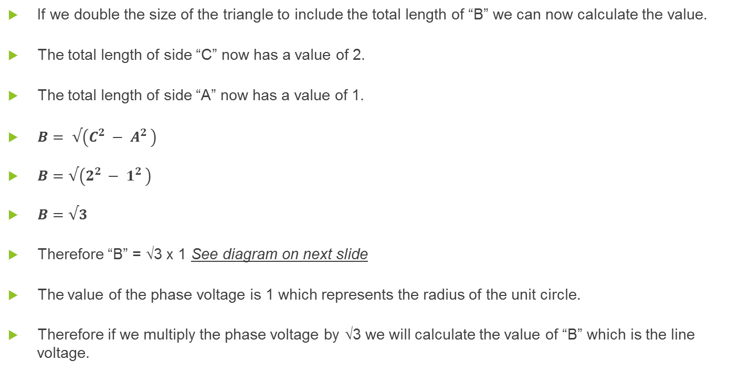
To calculate the value between the points where two phasors intersect the circumference of the circle we need a triangle that includes this distance.
If we double the size of the triangle to include the total length of “B” we can now calculate the value.
The total length of side “C” now has a value of 2.
The total length of side “A” now has a value of 1.
$B= √\left(C^{2 }− A^{2 }\right)$
$B=√\left(2^{2 }− 1^{2 }\right)$
$B=√3$
Therefore “B” = √3 x 1 See diagram on next slide
The value of the phase voltage is 1 which represents the radius of the unit circle.
Therefore if we multiply the phase voltage by √3 we will calculate the value of “B” which is the line voltage.

Slide 26
Hence the distance between the points where Line 1 and Line 3 phasors intersect with the circumference is the phase voltage (1) x √3…….

