Slide 1
UEENEE107A
Use drawings, diagrams, schedules, standards, codes and specifications

Slide 2


Slide 3
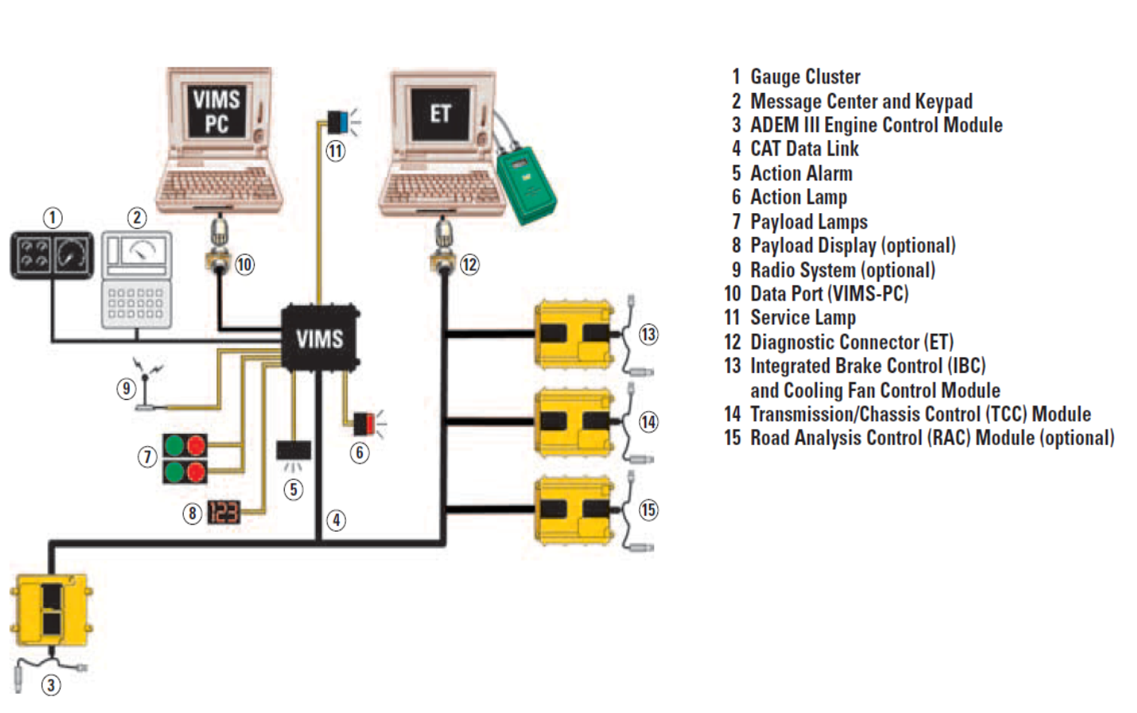

Slide 4
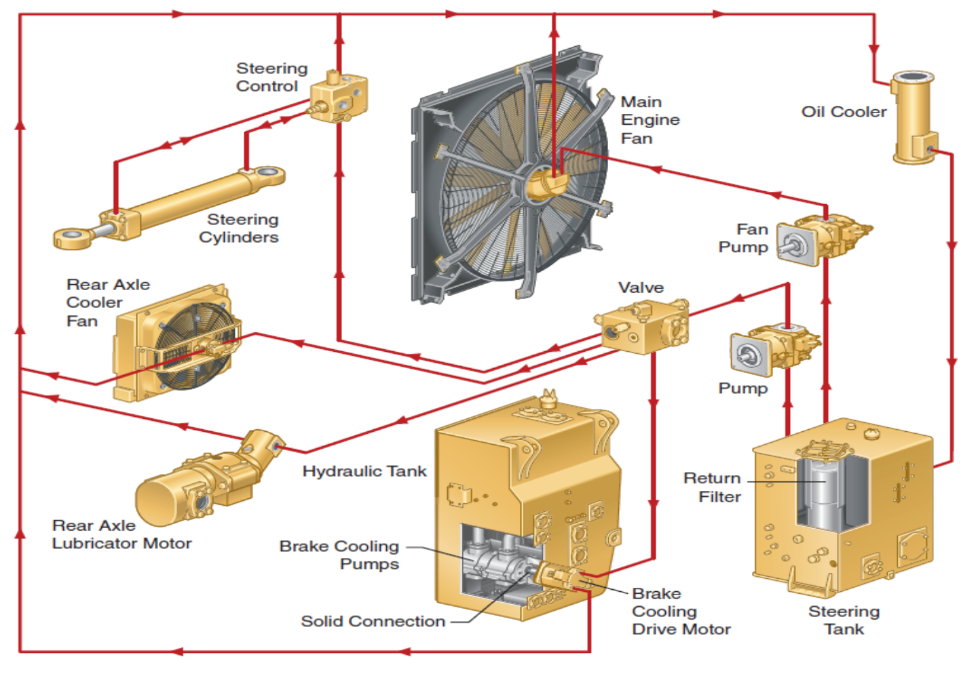

Slide 5
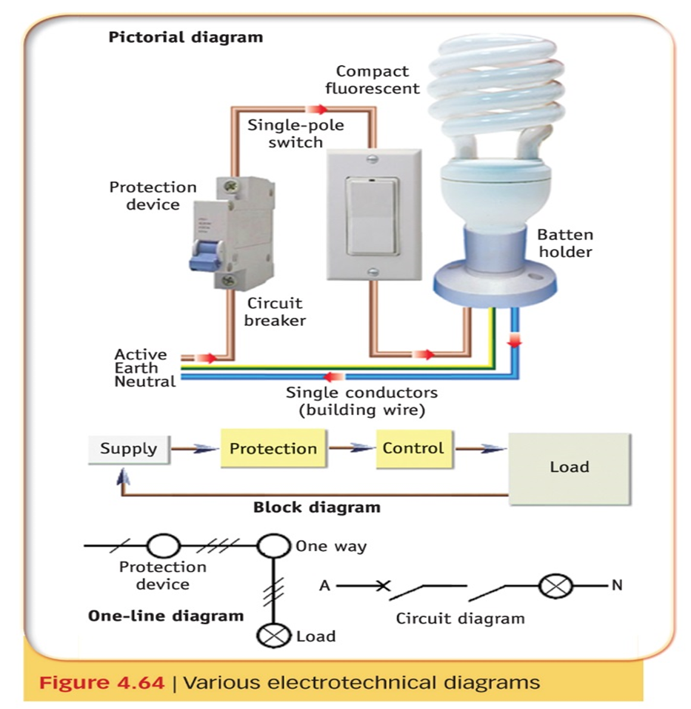

Slide 6
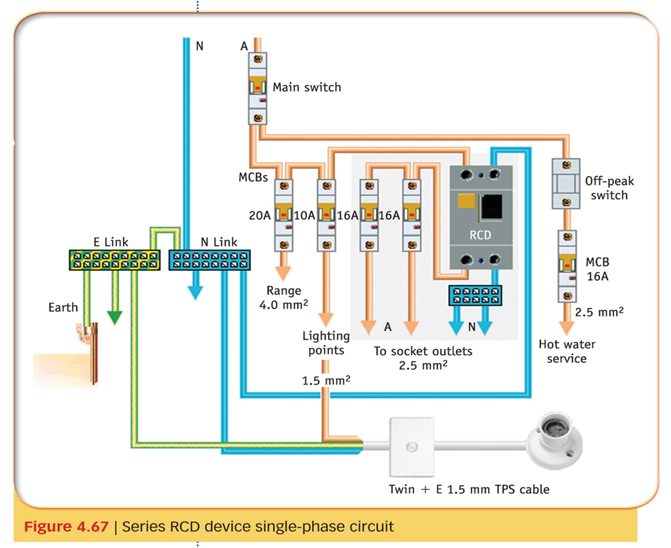

Slide 7
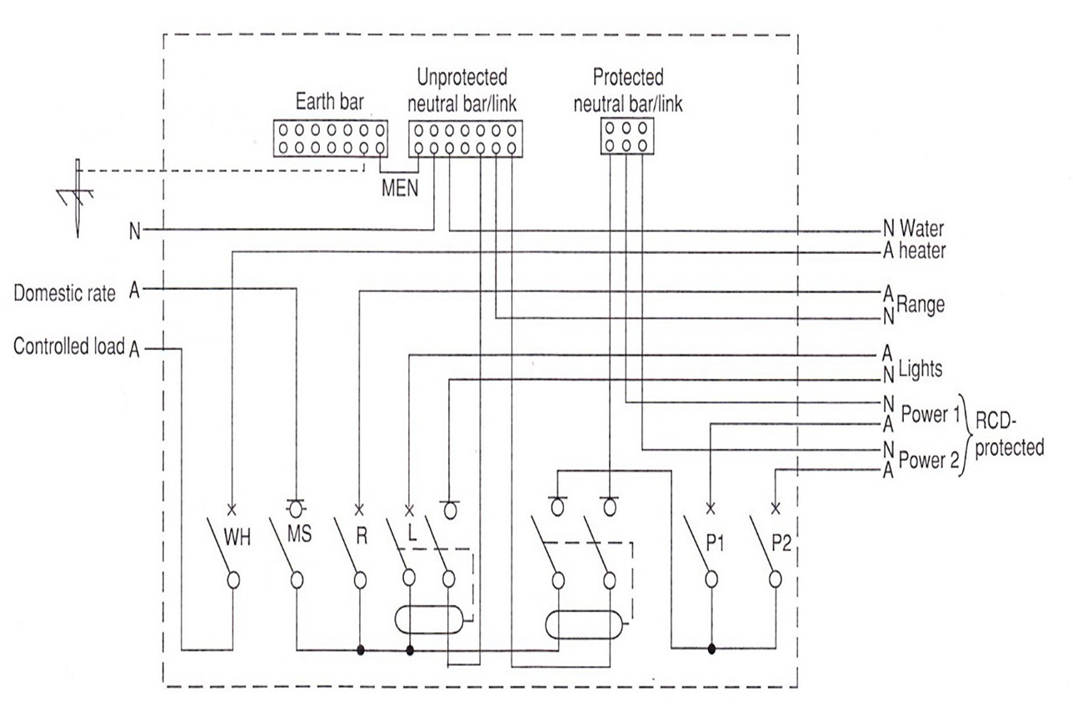

Slide 8
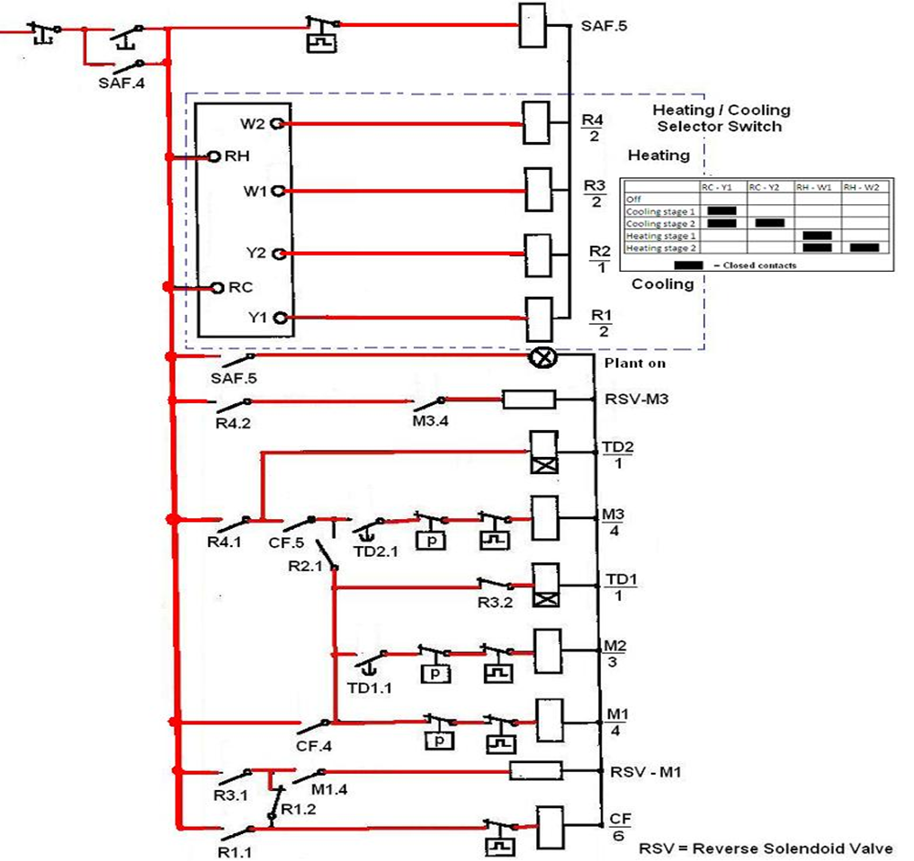

Slide 9
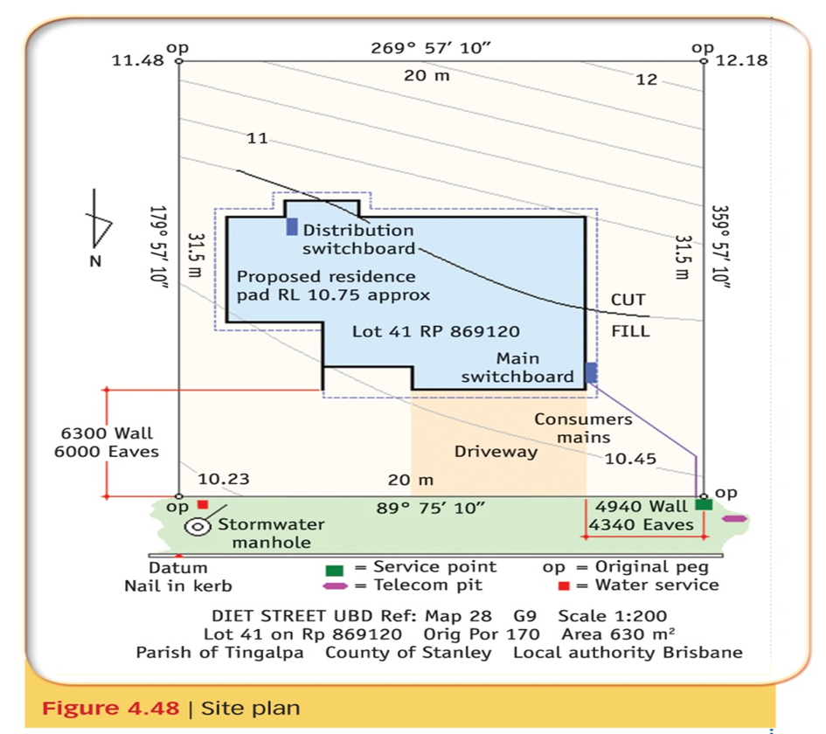
Architectural drawings

Slide 10
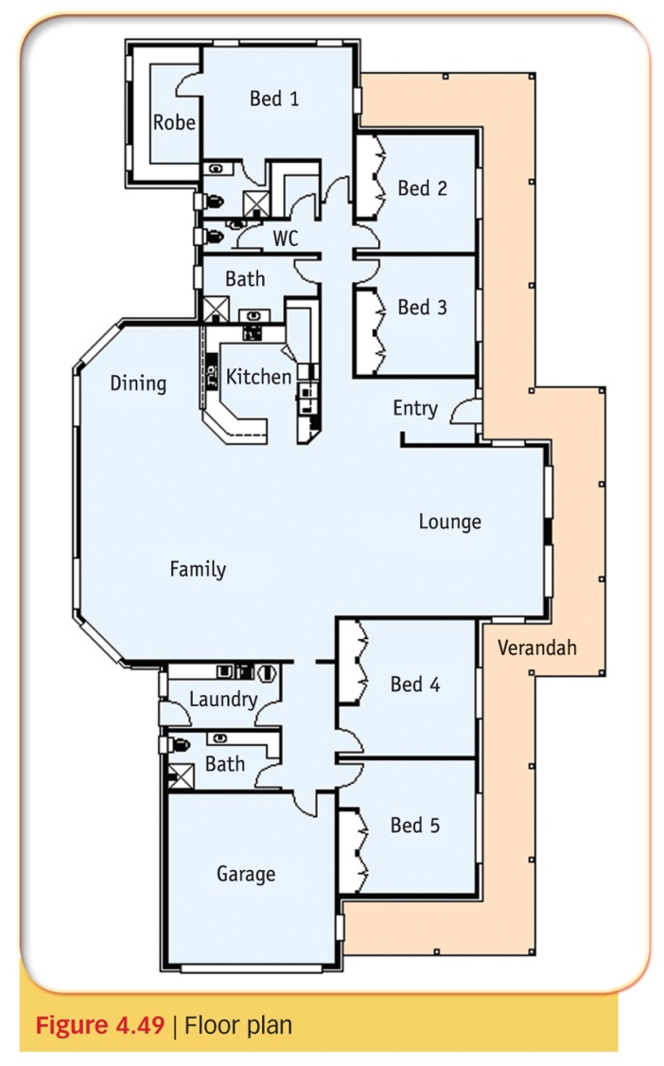
Architectural drawings

Slide 11
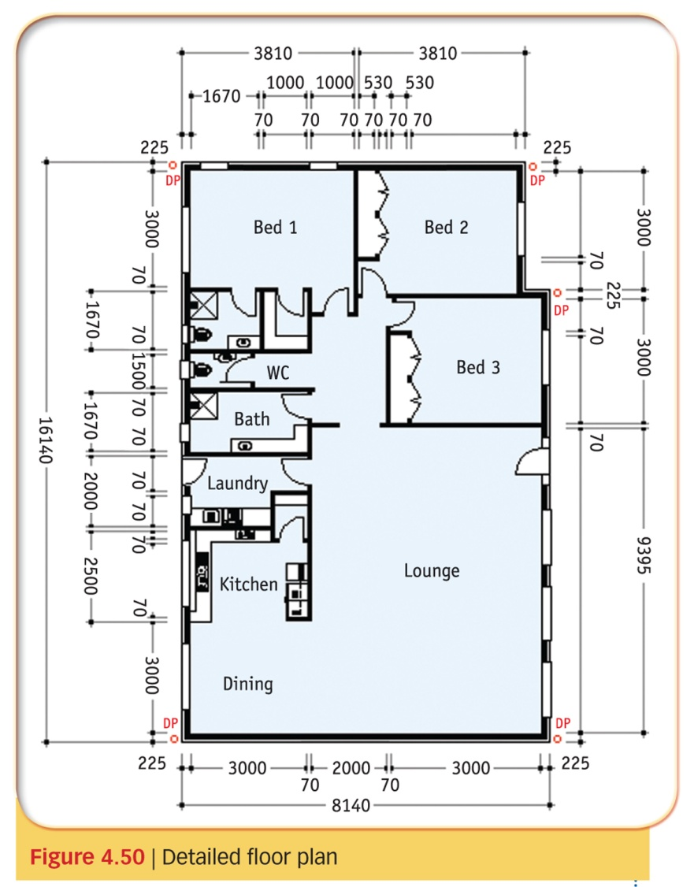
Architectural drawings

Slide 12
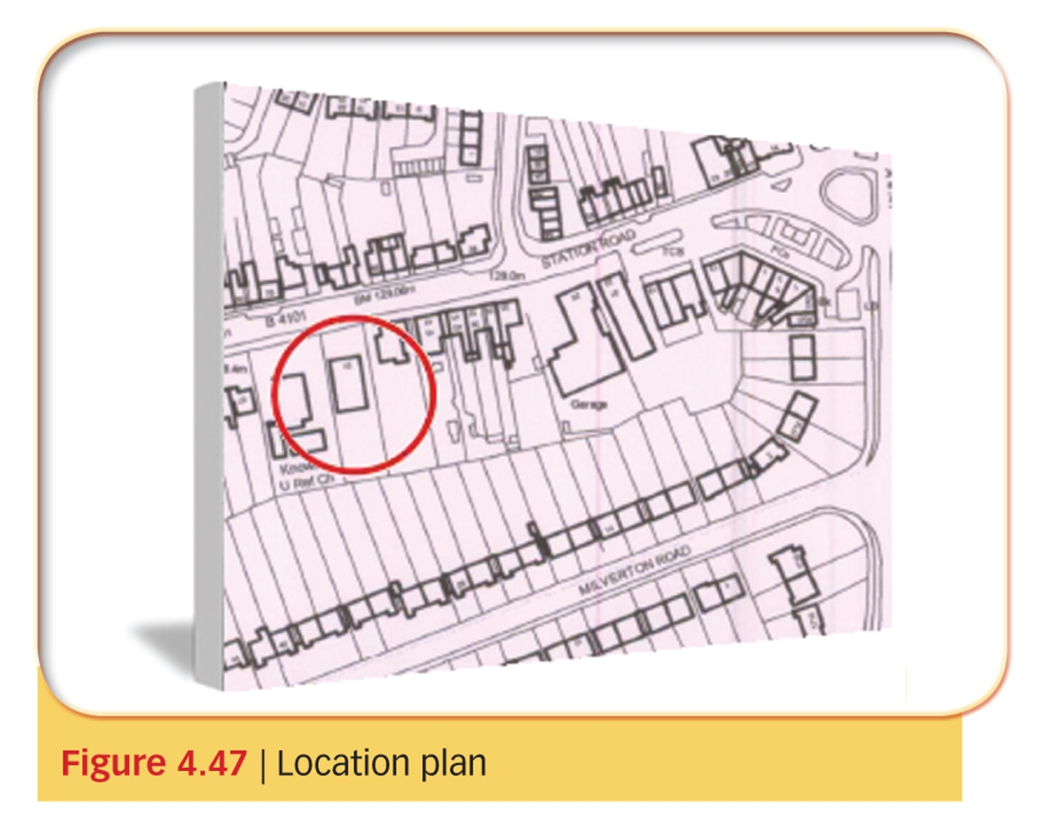
Architectural drawings

Slide 13
Drawing Scales
A scale drawing is a reproduction diagram of a building or object, but at a standardised fraction of its original size.
When designing a building, you use a specific scale to draw diagrams.
For example, when you need to draw a plan of a building you reduce the size of the diagrams to 1/50 or 1/100 of its actual size, that is, you use a 1:50 or 1:100 scale.

Slide 14
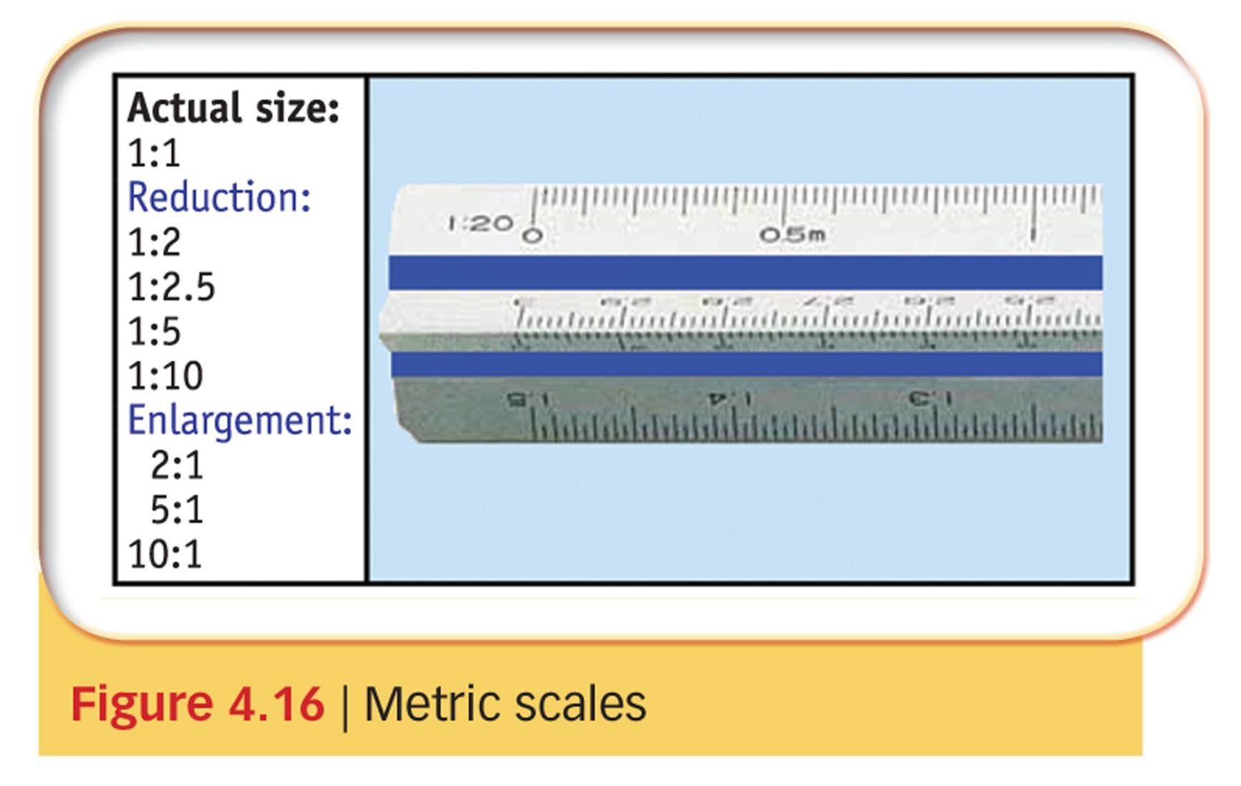
Drawing standards

Slide 15
Scales
Indication of scale
The scale should normally be noted in the title block of a drawing.
When more than one scale is used they should be shown close to the views to which they refer, and the title block should read ‘scales as shown’.

Slide 16
Scales
Indication of scale
The scale should normally be noted in the title block of a drawing.
When more than one scale is used they should be shown close to the views to which they refer, and the title block should read ‘scales as shown’.

Slide 17
Scales
For a scale of 1:10: 100 mm will represent 1000 mm, or 1 m.
For a scale of 1:100: 100 mm will represent 10 000 mm, or 10 m.
For a scale of 1:50: 100 mm will represent 5000 mm, or 5 m.
For a scale of 1:200: 150 mm will represent 30 000 mm, or 30 m.

Slide 18
Scales
It is simply a matter of multiplying the scale measurement by the scale ratio.
1:(10) x 100 mm = 1000 mm or 1 m
1:(50) x 100 mm = 5000 mm or 5 m
1:(200) x 150 mm = 30 000 mm or 30 m

Slide 19
Electrical drawings
Symbols
Derived electrical symbols and their meanings can be sourced from AS/NZS 1102.102:1997 Graphical symbols for electrotechnical documentation.

Slide 20
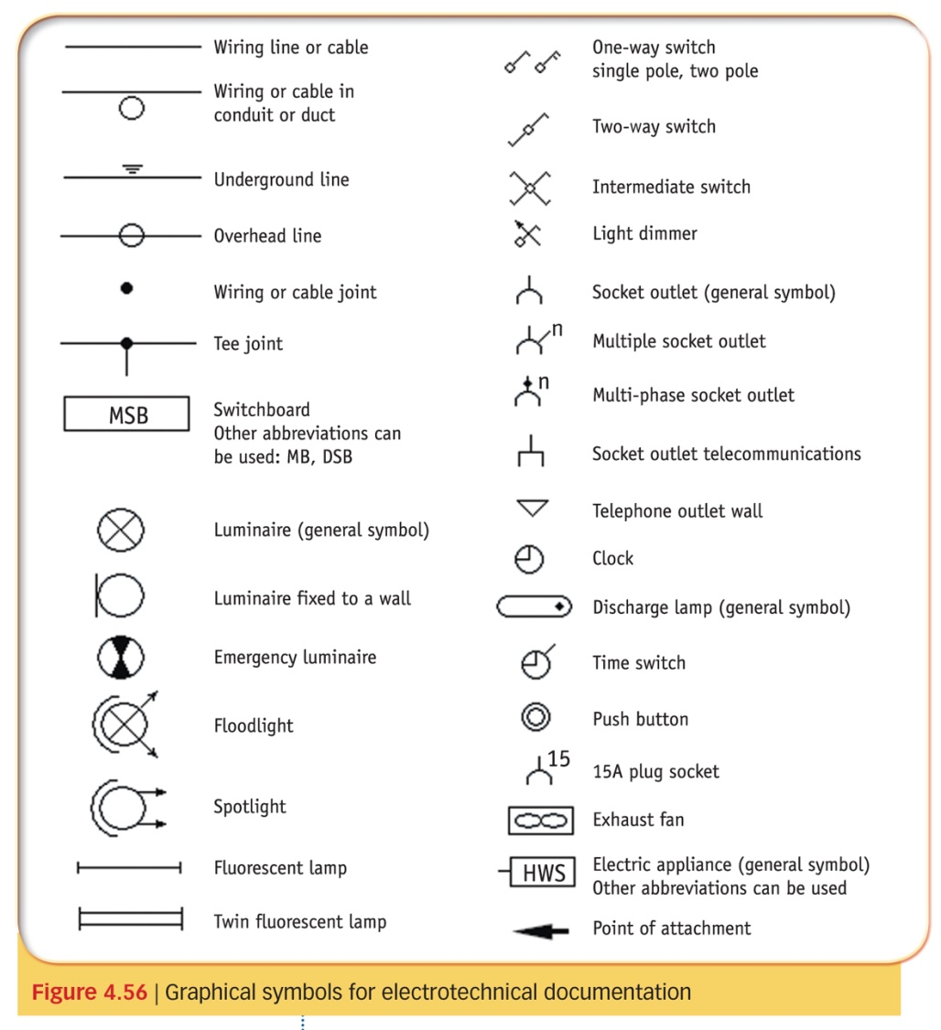
Electrical
Drawings
Symbols

Slide 21
Electrical plan
The electrical plan is a floor plan which provides the location and type of switches, socket outlets, clocks, lighting points, switchboard, consumer’s mains, water heater, etc.

Slide 22
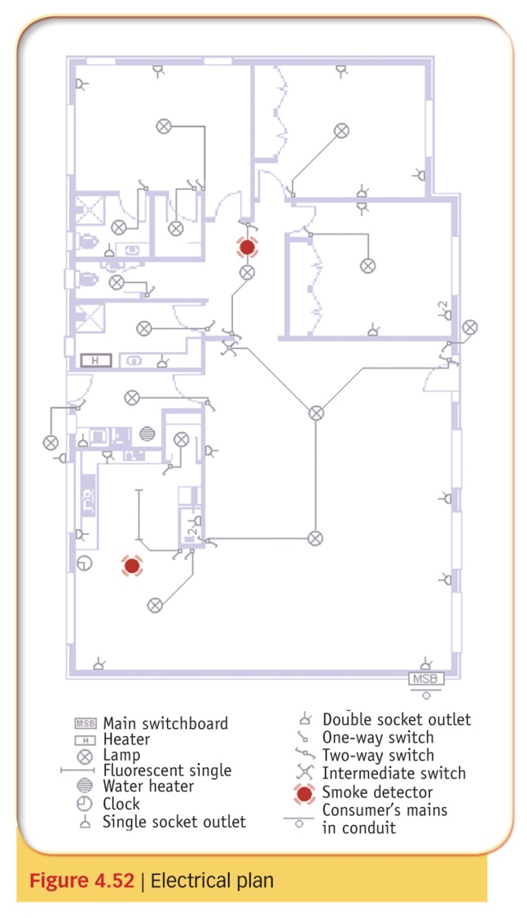
Electrical
plan

Slide 23
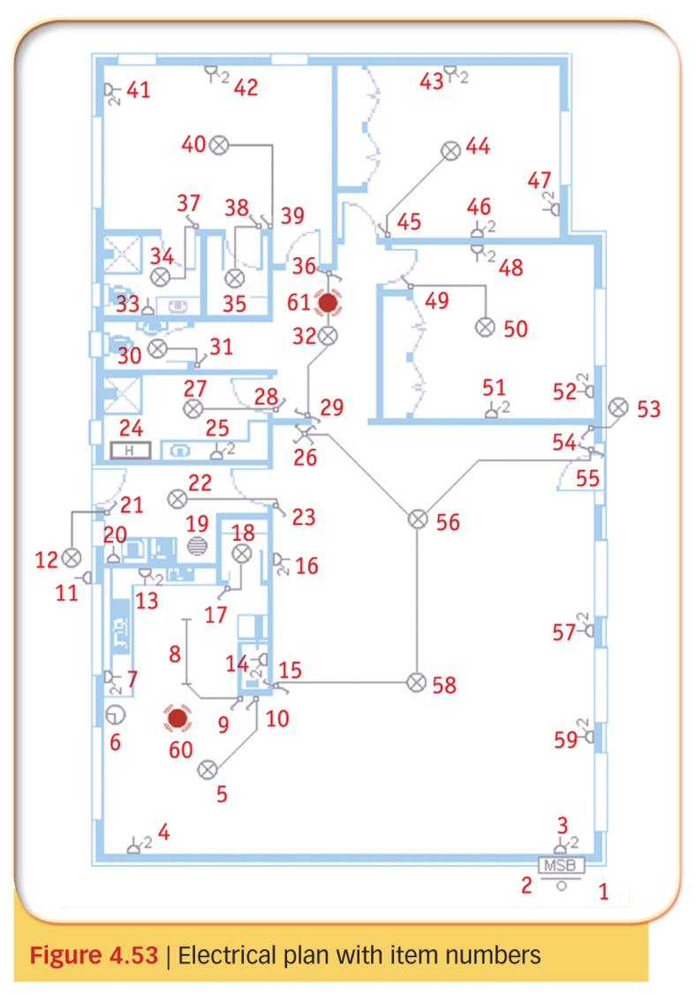
Electrical
plan

Slide 24
Electrical drawings
Symbols are communications that have specific meaning.
Usually visual, symbols act as communication shortcuts that convey one or more messages that have been previously learned by both the sender and the recipient.
When symbols are standardised a common language is provided which orders and standardises electrotechnical documentation throughout Australia and New Zealand.

Slide 25
Electrical drawings
Line diagrams
Line diagrams are a simplified notation for representing a power system.
Instead of representing each conductor with a separate line or terminal, only one conductor is represented.

Slide 26
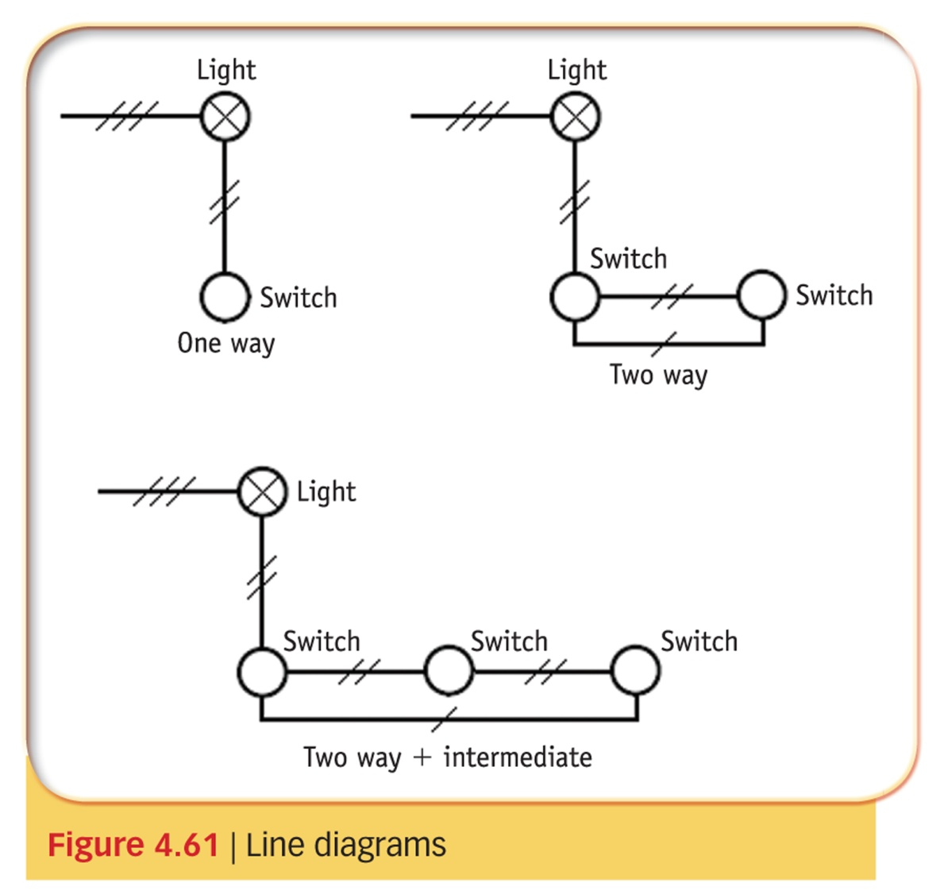
Electrical
drawings

Slide 27
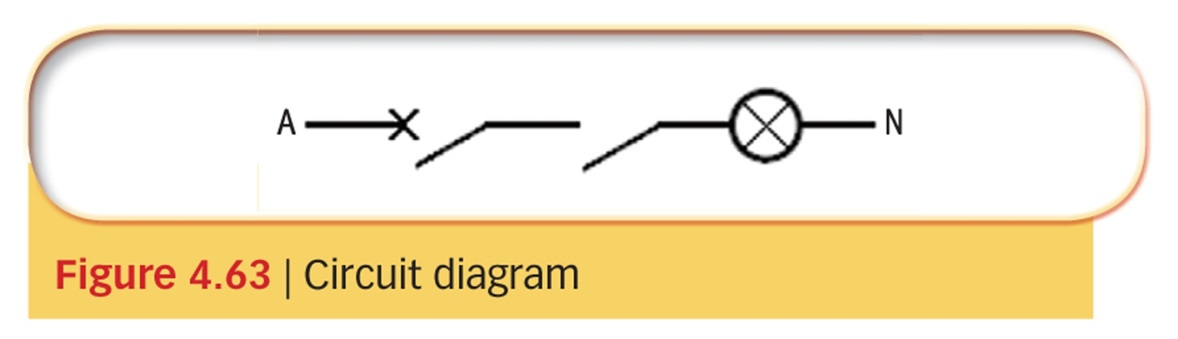
Electrical
drawings

Slide 28
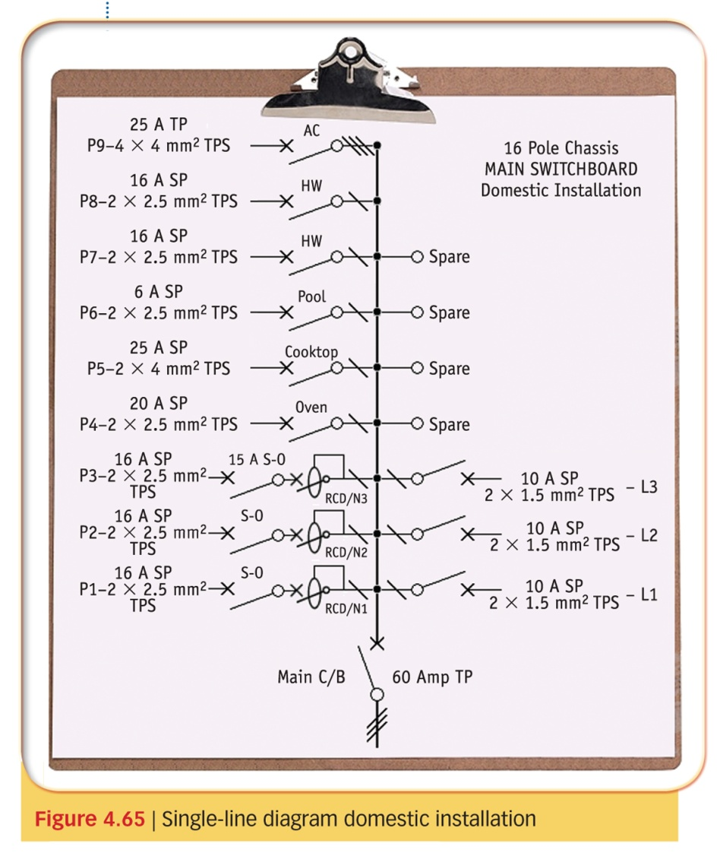
Electrical
drawings

Slide 29
Electrical drawings
Wiring diagrams (or Connection diagrams)
A wiring diagram shows the physical relationship between the components (not necessarily to scale), and the actual location of the terminals and wiring between them.
All connections are shown at the terminal at which they are made.
An example of a wiring diagram is shown in Figure 2.The wiring diagram also identifies the conductors by numbers, letters or colour coding.
Typical uses for a wiring diagram include:
a. Checking the actual wiring between components in a piece of electrical equipment.
b. Wiring up a particular piece of equipment.
c. Locating the individual components in a piece of equipment.

Slide 30
Electrical drawings

Slide 31
Electrical drawings
Circuit Diagrams (or Schematic diagrams)
Circuit diagrams show the detailed operation of a circuit in its simplest form.
They are drawn to aid the rapid understanding of how a circuit operates, but they give no indication of the physical position of the components, nor do they give any indication where the conductors actually terminate - all connections are shown in conductors, not at actual terminals.
Electrical components in circuit diagrams are represented by symbols.
Typical uses for a circuit diagram include:
a. Checking the detailed operation of a circuit.
b. Locating operational faults in a particular circuit or installation using logical reasoning.

Slide 32
Electrical drawings
Australian Standard symbols are published in the AS/NZS 1102 series, but there are several different standards throughout the world and some manufacturers use their own standards (or a combination of standard and non-standard symbols) so it is sometimes necessary to work out the meaning of a symbol from its position in the circuit.

Slide 33
Electrical drawings

Slide 34
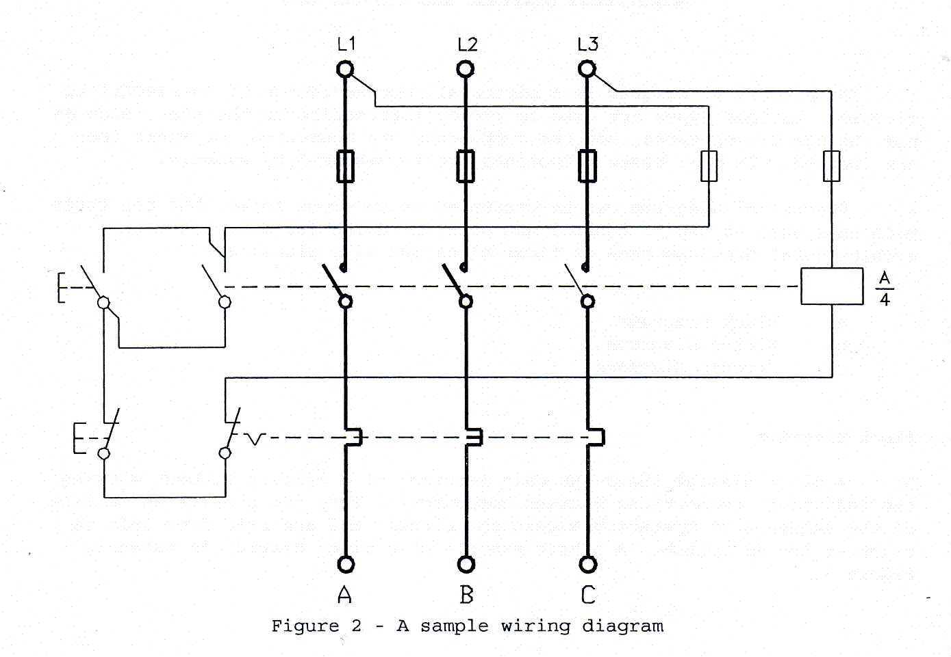
Electrical drawings

Slide 35
THE END

