Slide 1
R.C.D.
Residual Current Device
Known by these Capital Letters

Slide 2
TEST SWITCH
Test at least once a month
Trigger current

Slide 3
Functions
A safety device
Automatically trips when sufficient current (e.g. 30mA) flows in the Earth path.
A circuit breaker (e.g. I>40A)

Slide 4
How RD works
http://www.explainthatstuff.com/howrcdswork.html

Slide 5
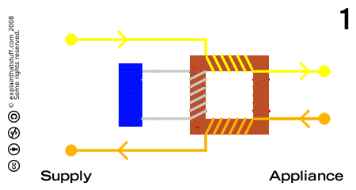
How RD works
http://www.explainthatstuff.com/howrcdswork.html

Slide 7
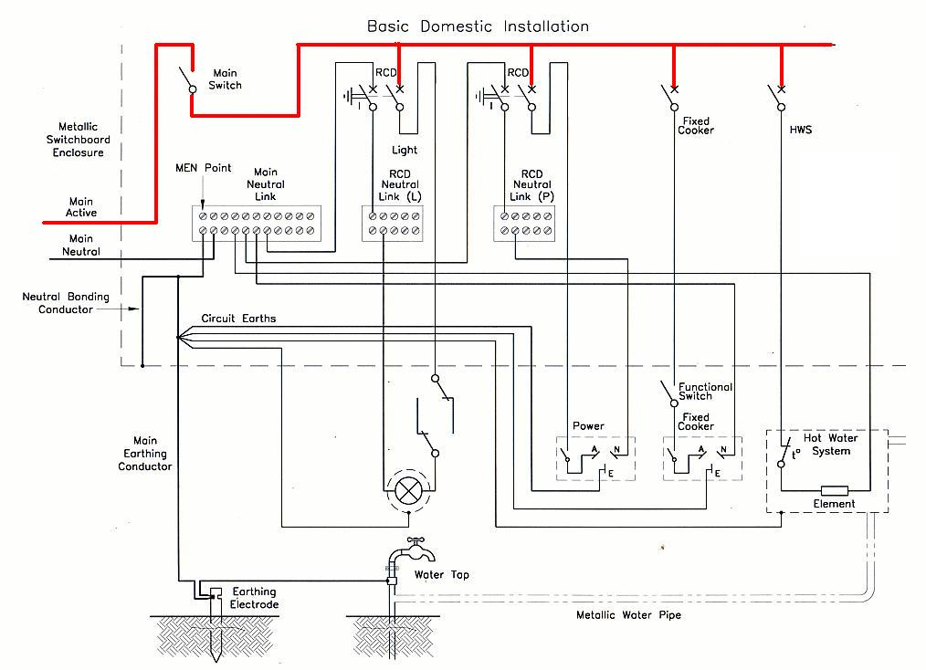

Slide 8
Neutral wires
Live wires
Earth wires
Which ones are RCD ? Which ones are Circuit Breaker ?

Slide 9
END

