Slide 1
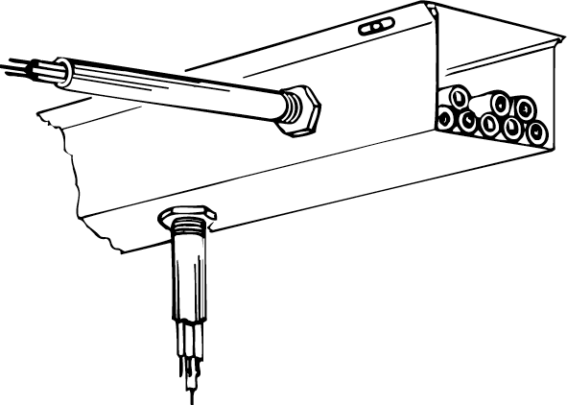
Bending Steel Conduit

Slide 2
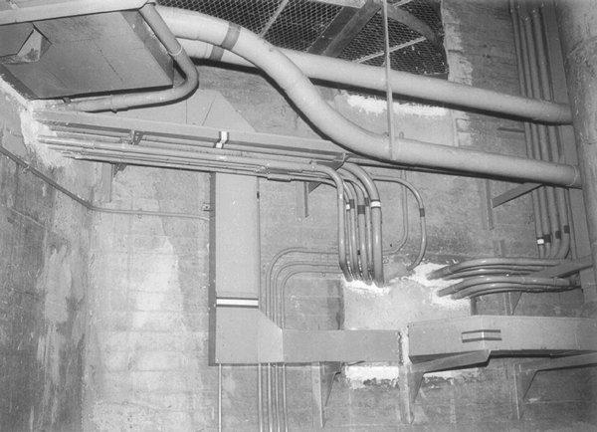
Galvanised steel conduit

Slide 3
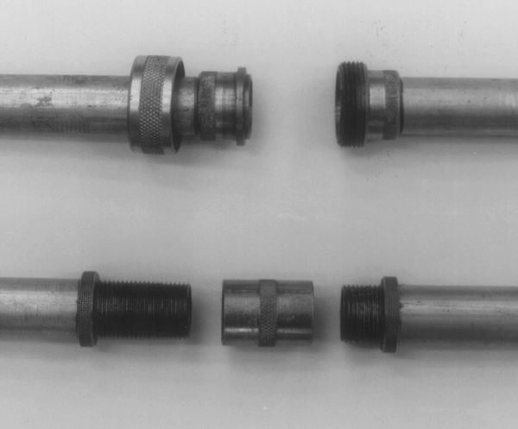
Barrel union and running thread

Slide 4
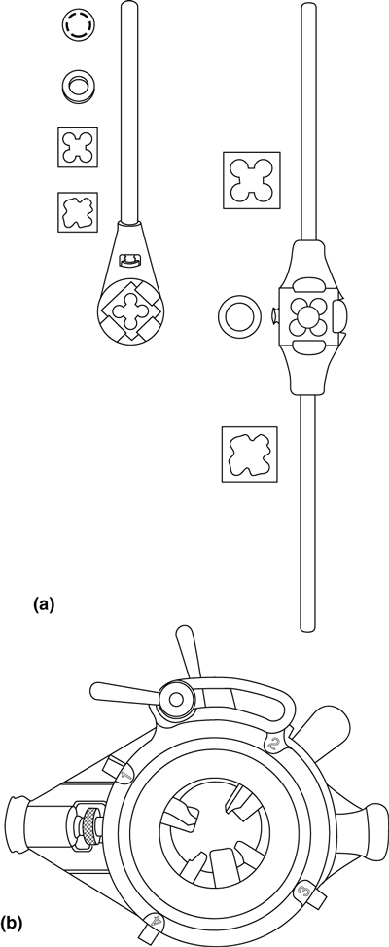
Stock & die sets: Warragul single-block type

Slide 5
Austec 4R adjustable type

Slide 6
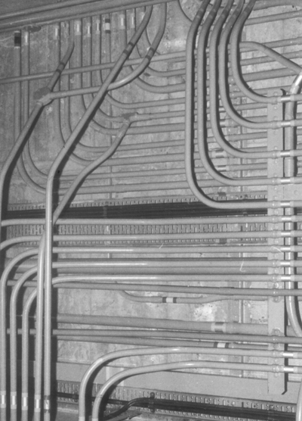
Large-radius bends and sets used in galvanised conduit work

Slide 7
Conduit sets and bends (a) Marking bender & (b) Single-set (c) Double-set (off-set) & (d) 90º bend (e) 90º return

Slide 8
Bending points for 20 mm conduit (a) Single-set & (b) 90º bend (c) offset 9 to 45, bending angle 15º & (d) Offset > 45, bending angle 35º (e) 90º return

Slide 9
Marking a 100mm offset (double-set) in 20 mm steel conduit

Slide 10
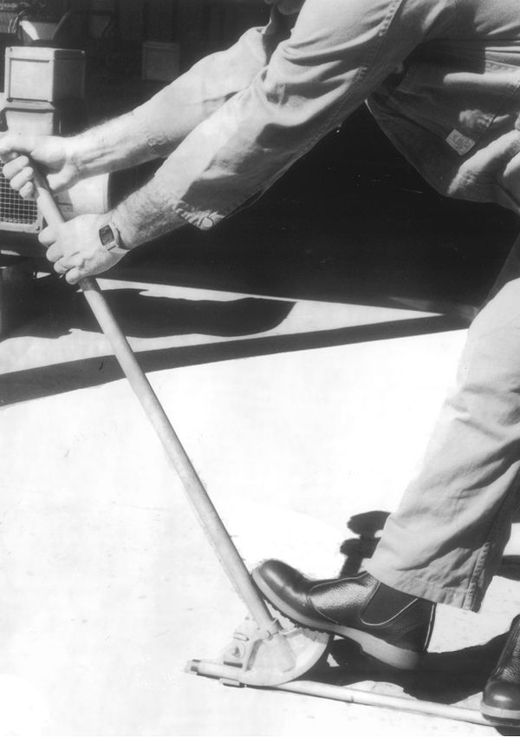
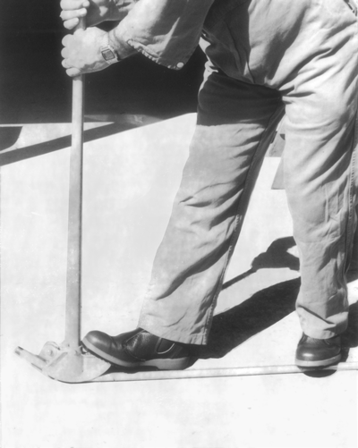
fit the bender to the conduit & forcing the conduit around the die

Slide 11
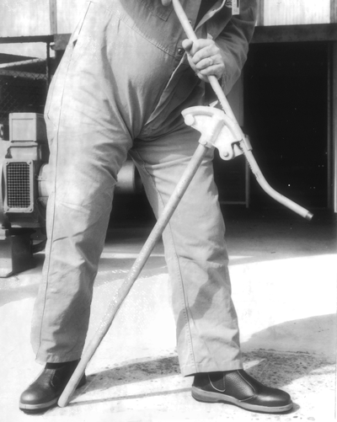
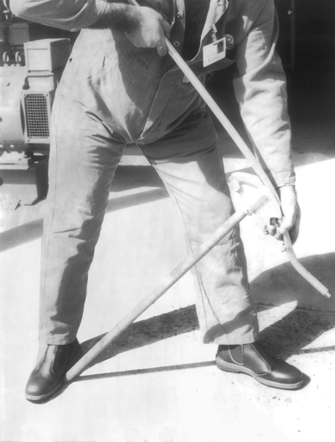
Rotate the conduit in the bender and align & force the conduit down and around the bender die

Slide 12
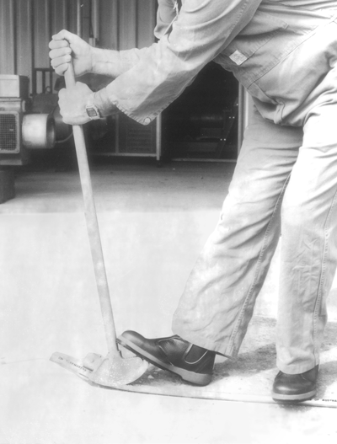
finish the second bend on the floor

Slide 13
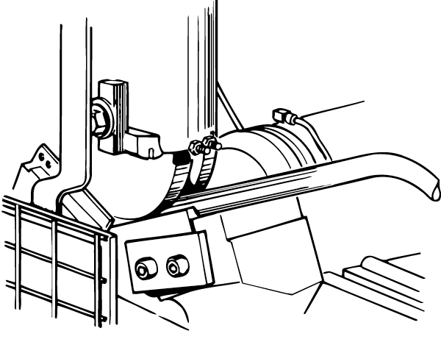
Automatic conduit-bending machine

Slide 14
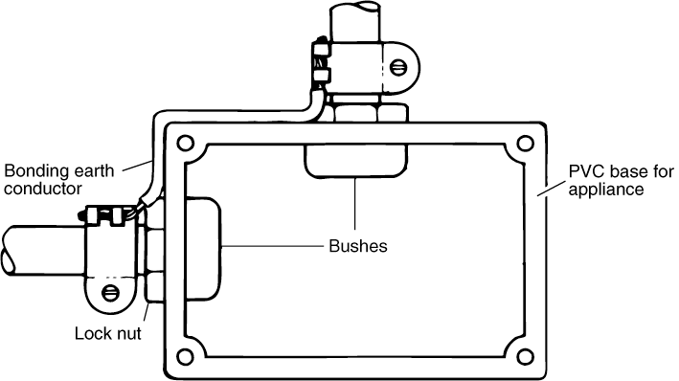
Maintaining electrical continuity of a metallic conduit run

Slide 15
AS/NZS 3000:2000
5.6.7.7.2 Metallic wiring enclosures
Metallic wiring enclosures and associated fittings that require to be earthed, including those used as an earthing medium, shall be mechanically and
electrically continuous.
The resistance of such a wiring enclosure earthing arrangement shall be in accordance with Clause 5.4.3.

Slide 16
AS/NZS 3000:2000
5.4.3 Resistance of the earthing system
The resistance from any point on the electrical installation required to be earthed to the point where the main earthing conductor is connected to the neutral conductor of the supply system shall be low enough to permit the passage of current necessary to operate the circuit protective devices.

Slide 17
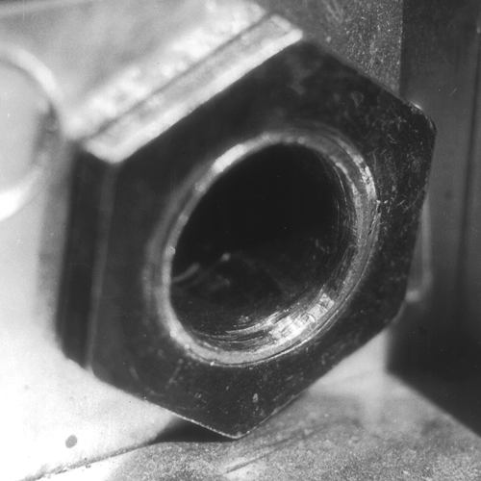
Termination of a steel conduit at an accessory

Slide 18
AS/NZS 3000:2000
3.10.2.1 Types
The following types of wiring enclosures may be used for the protection of
cables requiring further enclosure as specified in Clause 3.10 (this does not
preclude the use of wiring enclosures for sheathed cables):
(a) Steel conduits or other metallic tubing or conduit.
(b) Flexible metallic conduit.
(c) Rigid and flexible non-metallic conduit.
(d) Corrugated non-metallic conduit.
(e) Cable trunking with or without compound filling.
(f) Other wiring enclosures providing protection at least equivalent to
those listed in Items (a) to (e).

Slide 19
AS/NZS 3000:2000
3.10.2.2 Change of wiring enclosures
If more than one type of wiring enclosure is used for the protection of cables requiring further enclosure any change from one enclosure to another shall be made —
(a) at a switchboard; or
(b) by means of a suitable device which provides for the complete protection of the conductor insulation and for continuity of the wiring enclosure.

Slide 20
AS/NZS 3000:2000
3.10.2.3 Entry of water
Wiring enclosures shall be —
(a) installed in a manner that will prevent water from entering electrical equipment and enclosures;
and
(b) where exposed to the weather, provided with adequate means to prevent the entry of rain.

Slide 21
AS/NZS 3000:2000
3.10.2.4 Support of cables
Where wiring enclosures are run vertically, adequate provision shall be made for the support of the enclosed cables.
Cable supports shall be provided at intervals not exceeding 8 m or as recommended by the cable manufacturer.

Slide 22
AS/NZS 3000:2000
3.10.3.2 Support
Where a wiring enclosure is not continuously supported it shall be supported by suitable means to prevent damage to the enclosure or any associated cables.
The authors Pethebridge and Neeson recommend that
Steel conduit be supported at intervals not exceeding
2 metres.

Slide 23
AS/NZS 3000:2000
3.10.3.3 Continuity
Mechanical and electrical continuity of metallic enclosures shall be maintained.

Slide 24
AS/NZS 3000:2000
3.10.3.4 Bending
The radius of every bend in a wiring system shall be such that conductors and cables will not suffer damage.
Bends in rigid conduit shall be such that the internal diameter is not significantly reduced.
Direction changes in trunking or ducts or similar applications shall permit the bending of cables laid therein so as to comply with the requirements of this Clause.

Slide 25
AS/NZS 3000:2000
3.10.3.5 Passage for conductors
Where conductors or cables, including flexible cables and flexible cords, are to be threaded through conduits, tubes or channels or passed through openings formed in metalwork, such tubes, channels, conduit ends or openings shall be of adequate size and shall —
(a) be provided with bushes which are securely fixed in position;
or
(b) if not bushed, have no sharp angles or projecting edges which would be likely to damage a conductor or the insulation, braiding or sheathing of a cable.

Slide 26
AS/NZS 3000:2000
3.10.3.6 Terminations
Terminations shall be arranged so that wiring enclosures terminate in, and are supported on, electrical equipment in such a manner as to fully protect the enclosed cables as they pass into the electrical equipment.
The ends of flexible conduit shall be securely anchored to the fixed conduit, structure or electrical equipment to which it is attached.

Slide 27
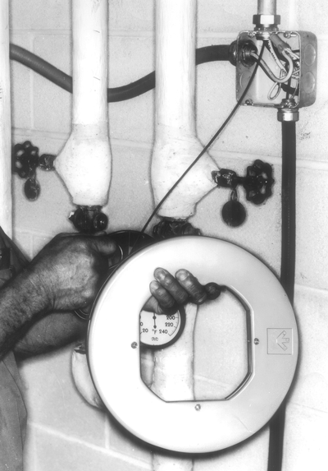
Drawing in cables

Slide 28
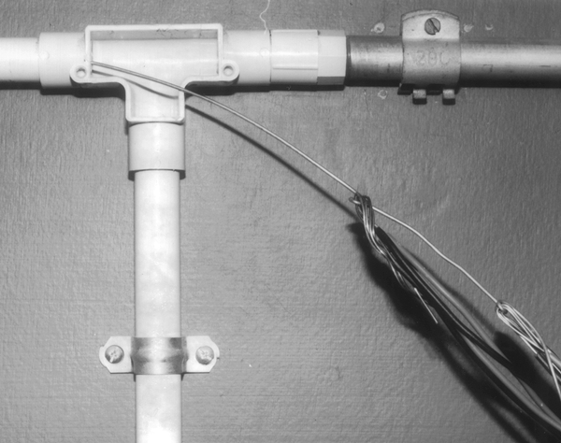
Staggered joints to permit easier drawing in of cables

Slide 29
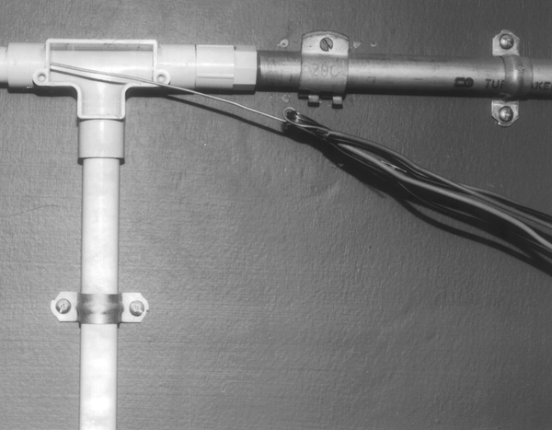
Single tie for a small number of cables and/or a short run

Slide 30
Galvinsed steel stocking used for pulling cables 6mm to 8mm diameter

Slide 31
There is no specific requirement that stipulates the
maximum number of cables that may be enclosed
in one conduit.
The only basic guide is that cables should be installed
without damage.
Remember too that table 22 of AS/NZS 3008.1 provides
a derating factor for cables bunched in conduit.

Slide 32
Bore Area
The cross sectional area of a conduit will be a determining
factor when installing cables.
20mm light duty PVC has a nominal bore area of 189mm²
20mm heavy duty PVC has a nominal bore area of 165mm²
20mm Flexible PVC has a nominal bore area of 300mm²

Slide 33
Based on the space factor that was used in previous editions
of the wiring rules the following can be used:
The useable space factor is the ratio of the sum of the cross
sectional area of the cables to the minimum internal cross
sectional area of the conduit.
One cable in conduit 0.5
Two cables in conduit 0.33
Three or more cable in conduit 0.4

Slide 34
Example of useable space factor:
Install four by 10mm2 cable in 25mm light duty PVC conduit
Bore area of 25mm light duty conduit is 330mm²
Conduit CSA of 330mm² divided by 0.4 = 132mm²
Cross sectional area of 10mm² cable is 31mm²
therefore 31 x 4 = 124mm²
The CSA of the combined cables is less than the useable
space of the conduit and is therefore satisfactory.

