Slide 1
Sustainable energy technologies
NOTIONS OF SUSTAINABLE ENERGY

Slide 2
What is the definition of sustainable energy?
Sustainable energy is defined as energy which, in its creation or use, has minimal harmful impacts on the health and safety of the vast variety of life-forms that exist and the effective functioning of vital ecological systems, including the worldwide environment, and that can be supplied continually to existing and future generations.

Slide 3
Six principles of sustainable energy.
Equitable access by all persons to sustainable energy resources and development – to reduce drastically and ultimately eliminate dependence on unsustainable forms of energy.
Poverty eradication – to provide sustainable energy resources to promote the development of poorer countries and their population.
Global security – to reduce the environmental protections that fossil and nuclear fuel use require.

Slide 4
Six principles of sustainable energy.
Climate protection – to reduce harmful emissions of greenhouse gases.
Environmental and social protection – to reduce non-greenhouse energy-related pollutants affecting air, water and land and, concurrently, the health of affected peoples.
Technological innovation and dissemination – to promote the accelerated development and dissemination of sustainable energy industries and businesses

Slide 5
The earth’s atmosphere
The atmosphere is a mixture of various gases that surrounds the earth and protects all life forms by blocking out dangerous rays from the sun. A mixture of:
Nitrogen 78.08%
Oxygen 21.00%
Argon 0.9%
Water vapour 0-4%
Carbon dioxide 0.038%
Methane 0.00017%
Nitrous oxide 0.00003%
Ozone 0.000004%
Aerosols (dust, soot, etc.) 0.000001%

Slide 6
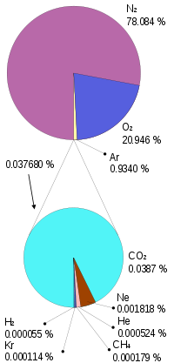
Using a pie pie graph illustrates the concept much better

Slide 7
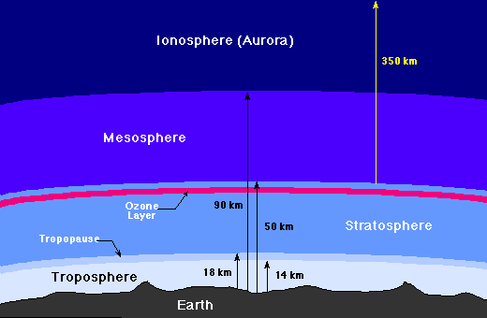
LAYERS OF THE ATMOSPHERE

Slide 8
The greenhouse effect
The greenhouse effect is a natural process that assists in maintaining the Earth’s temperature and the stability of the Earth’s climate.

Slide 9
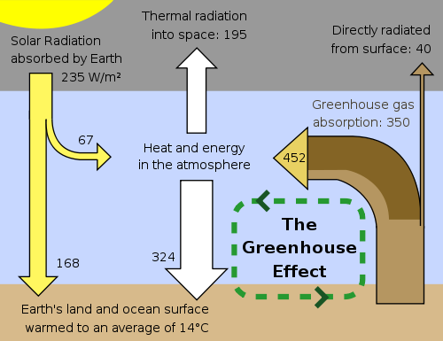

Slide 10
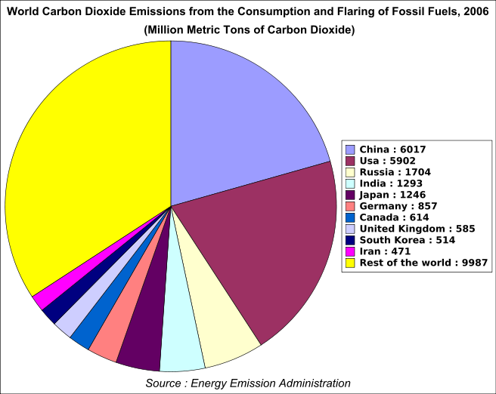

Slide 11
Australia’s contribution
It is estimated that Australia contributes approximately 2% of global greenhouse gas emissions.

Slide 12
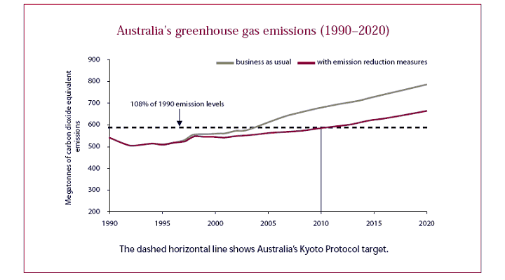

Slide 13
Facts about the atmosphere
Nitrogen is extremely important in living organisms because it forms the building blocks of proteins.
Without oxygen, living organisms that need oxygen cannot breathe. Oxygen is also necessary for the production of ozone.
Argon is the third most abundant gas in the atmosphere.

Slide 14
Facts about the atmosphere
Water vapor is a greenhouse gas that absorbs heat energy in the atmosphere and helps to warm the earth.
Carbon dioxide absorbs heat energy in the atmosphere thereby allowing the planet to maintain a temperature range suitable for living organisms.
Methane is created naturally from wetlands, forests and grassland fires and the oceans.

Slide 15
Facts about the atmosphere
Nitrous oxide is a very powerful greenhouse gas. Nitrous oxide emissions to the atmosphere come from agricultural use of nitrogen fertilisers, soil disturbance, burning of grasslands and animal waste.
Its global warming potential is far higher than that of carbon dioxide

Slide 16
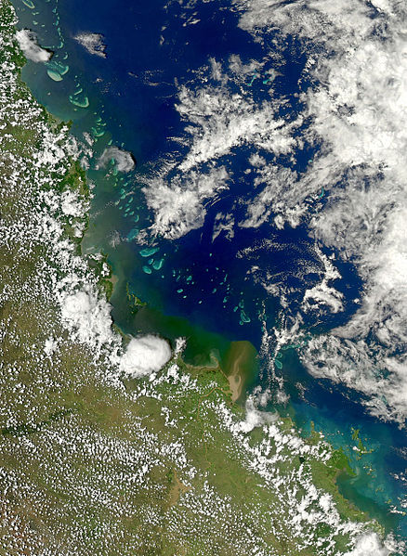
Satellite View of the Queensland Coast showing the green sediment build up from nitrogen fertilizers washed down in the 2010/2011 floods.

Slide 17
ozone
Ozone is made of three molecules of oxygen (0₃) and effectively provides the earth with sunblock.
The ozone absorbs up to 99% of the sun’s high-frequency ultraviolet light with wavelengths between 150nm and 300nm (UV-B).
It is the UV-B light which is potentially damaging to life on earth.
Most skin carcinomas are attributed to UV-B exposure

Slide 18
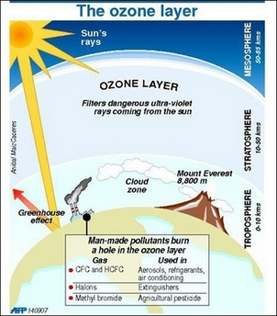

Slide 19
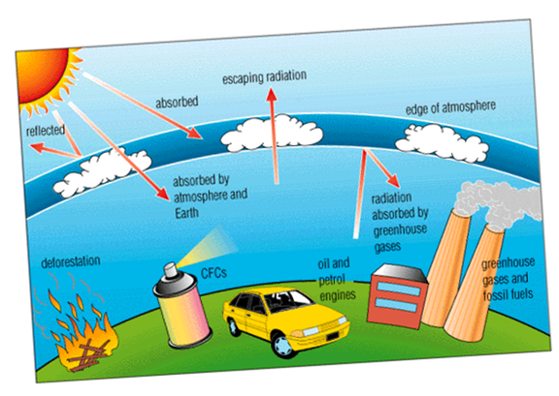
Human activity that contributes to ozone depletion

Slide 20
http://www.theozonehole.com/ozonelayer.htm

Slide 21
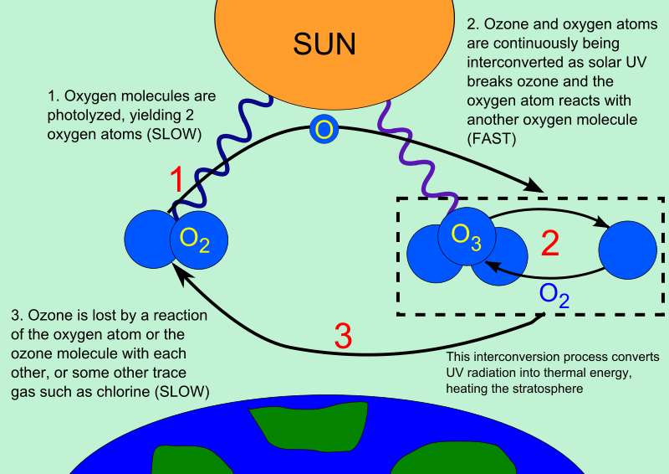

Slide 22
aerosols
Aerosols (fine particles) are produced by a range of sources, including deserts, forest and grassland fires, volcanoes and urban and industrial pollution.
The direct effects of aerosols are the scattering (which causes cooling) and absorption (which causes warming) of the sun’s emissions as they pass through the atmosphere.

Slide 23
Measures to reduce the greenhouse effect
Everyday measures to reduce greenhouse gas emissions are intended to reduce energy consumption. They include:
installing energy-efficient bulbs
having a shower rather than a bath
cutting back on waste
saving energy (air-conditioning settings etc)

Slide 24
Major measures to reduce greenhouse gas emissions include:
Emissions trading – reductions in greenhouse emissions (or removals by sinks, such as carbon uptake in biomass). A sink, such as growing forest or soil, actively removes a greenhouse gas from the atmosphere.
A sink is distinct from a place where greenhouse gases can be stored (sequestered), such as an underground reservoir or a mature forest.

Slide 25
Greenhouse gas charge
A greenhouse gas charge is an environmental charge applied on the greenhouse gas emissions from activities such as the production and/or consumption of fossil fuels

Slide 26
Role of the Regulators
Regulations impose requirements, emission limits or performance standards for major emitters in key sections.

Slide 27
Government support
Increased financial support from the government will encourage homeowners to install renewable energy systems by providing rebates for grid-connect renewable energy power systems.
Following are rates paid by various State and Territory governments throughout Australia in early 2009.

Slide 28
Photovoltaic support (Source RISE 2009)
State | Current Status | Max size | Rate paid | Program duration | Model
VIC | Commenced in 2009 | 3.2 kW | 60c | 15 years | Net
SA | Commenced in July 2008 | 10 kW | 44c | 20 years | Net
ACT | Commenced March 2008 | Under 10 kW |  | 20 years | Gross
TAS | Commenced | Tba | 20c | Tba | Net
NT | Incentive is available for 225 rooftop PV systems in Alice Sprins | Tba | 45.75c capped at $5 per day, then reverts to 23.11 c per kWh | Tba | Net
WA | Little activty since election committment | tba | Expected to be up to 60c kWh | Likely 2-9 years | Gross
QLD | Commenced in July2008 | 10 kW | 44c | 20 years | Net
NSW | Under review to commence 2009 | Tba | Not yet specified – may be approx 60 c kWh | Tba | tba

Slide 29
Contributing factors to greenhouse gases include
Fossil fuel burning
Industrial emissions
Buildings
Transportation
Fossil fuel
Deforestation/land use change
Livestock
Rice cultivation
Waste disposal
Use of fertilisers
Use of man-made GHG’s

Slide 30
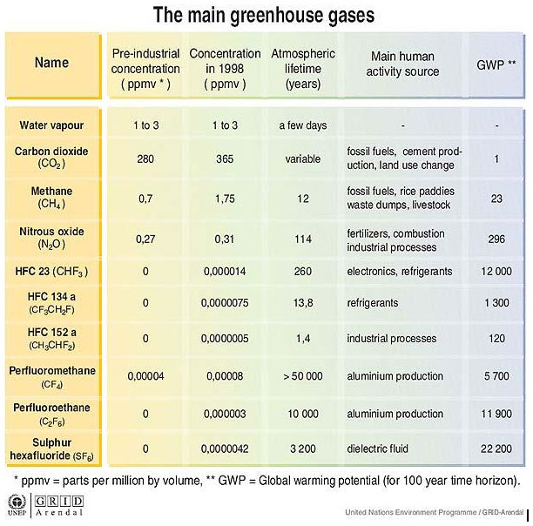

Slide 31
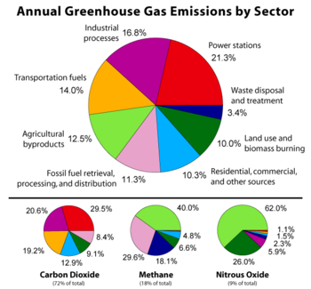
Note power stations and how much they contribute.

Slide 32
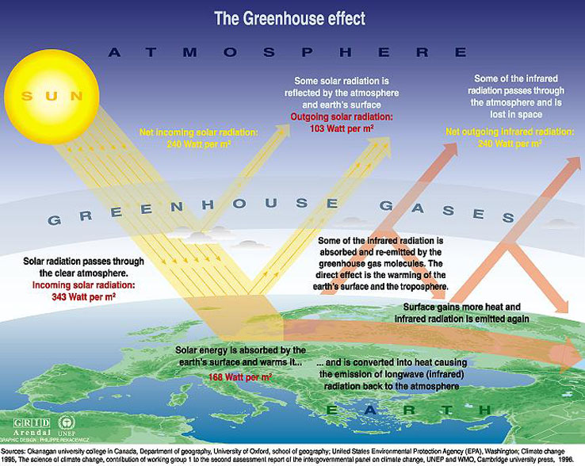

Slide 33
How to reduce emissions?
Factors such as increasing world population, economic growth and technological development all affect energy usage and therefore the production of greenhouse gases.
Clearly substantial reduction in greenhouse gas emissions can be achieved by working towards reducing the greenhouse intensity of the existing electricity supply. Australia can do this by generating renewable, low-greenhouse-intensive energy.

Slide 34
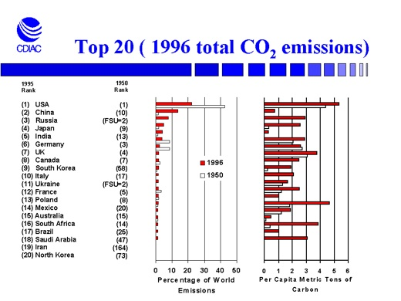

Slide 35
Notions of Sustainable energy
Complete review questions .

Slide 36
Review questions
State the six principles supporting the drive for sustainable energy
Name four gases that comprise the atmosphere.
What is the greenhouse effect?
Which greenhouse gas is able to undergo phase changes?
To which gas are other greenhouse gases compared compared with respect to their warming effect?

Slide 37
Review questions - Continued
Name two activities that result in nitrous oxide emissions into the atmosphere.
Which gas is extremely important in living organisms?
State the purpose of ozone with respect to the sun’s high-frequency ultraviolet light.
Why are aerosols an issue that concern all countries?

Slide 38
Review questions - Continued
List the four distinct layers of the atmosphere.
State two everyday measures that can be implemented to reduce greenhouse gas emissions and energy usage.
Describe one major measure that can be used to reduce greenhouse gas emissions and energy usage.
List five contributing factors to the greenhouse gas problem.

Slide 39
Notions of Sustainable energy
End

