Slide 1
Energy Efficient Building Design

Slide 2
Energy-efficient building design
Energy-efficient building design is all about the creation of buildings that are in harmony with the environment and maximise the use of natural energy sources.
Such buildings provide thermal comfort, natural light, a reduction in non-renewable energy resources and minimal greenhouse pollution.

Slide 3
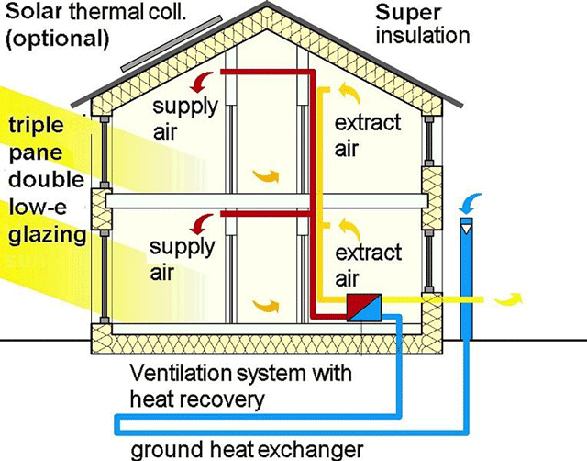

Slide 4
Siting of Buildings

Slide 5
Site planning
Site planning involves the thoughtful placement of a building (long side should face north) on a site to take advantage of natural site features such as topography and vegetation(trees) in order to maximise use of the sun’s energy in the form of heat and light.

Slide 6
Ventilation

Slide 7
ventilation
Ventilation is a most important aspect of a building design, along with thermal comfort.
To realise good natural ventilation the interior and exterior design of a building is critical.
The interior must provide for the unrestricted flow of the ventilation air while the exterior needs to make maximum use of the prevailing winds.

Slide 8
Passive Solar Energy

Slide 9
Passive solar energy
Passive solar energy is a system designed to rely on the integration of a buildings design and construction materials to reduce heating and cooling loads.
A passive energy system is based upon local climatic conditions, such as temperature, solar radiation and wind, in order to create a climate-responsive, thermal-comfort building.

Slide 10
Passive solar systems
The passive system uses the building materials as a thermal mass to collect, store and distribute solar heat.
Passive systems do not rely mechanical means to drive the heat and cooling process but instead use natural means such as convection, conductance and radiation materials themselves.

Slide 11
Passive solar systems
There are four general connections with respect to passive solar design:
Collector
Load
Storage
Eaves

Slide 12
Passive solar systems
The collector is where the solar energy gains access to the building, while
The load is where the energy is needed to maintain thermal comfort
Storage is generally provided to allow comfort at night and during overcast periods and
Eaves are used so the building is cool in summer

Slide 13
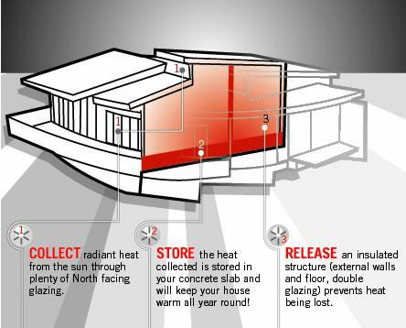

Slide 14
Glazing
The type of glass windows (glass, plastic, treated glass) used in building is very important consideration in terms of their light and heat transmission characteristics.
The glass itself has different R-values (thermal resistance). If a window’s R value is high, it will lose less heat than one with a lower R-value.

Slide 15
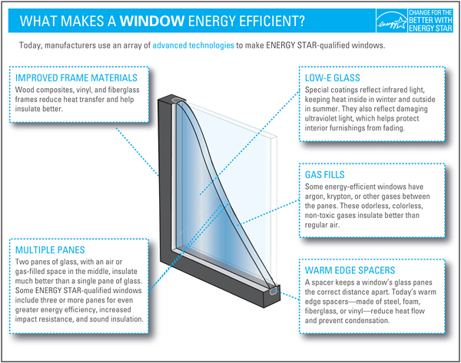

Slide 16
Window ratings
Usually, window R-values range from 0.9 to 3.0 but some exceptions exist.
Windows also have a U-factor, also known as the solar heat gain coefficient, expressed as W/m² K(K=temperature difference across glass). If a window’s U-value is low, it will lose less heat than one with a high U-value.

Slide 17
U-value
The U-value indicates how quickly heat is transferred through a window, and R-value indicates the opposite.
So a window with low U-factor, or a high R-value, is better at keeping buildings warmer in winter and cooler in summer.

Slide 18
Window Energy Rating Scheme (WERS)
In Australia the Window Energy Rating Scheme (WERS) is an excellent example of government and industry working in partnership to address the greenhouse problem.
Up to 40% of energy is lost through windows in typical Australian homes.

Slide 19
insulation
Building materials used to insulate a house such as building blankets and batts, foils and polystyrene panels are specified by their R-value (thermal resistance).

Slide 20
Insulation R-value
The R-value is defined for a given thickness of material as:
The R-value combines the thickness (l) and the thermal conductivity (k) in one number.
The higher the R-value number the better is the thermal resistance properties of the insulating material

Slide 21
Natural light
The sun is the definitive source of natural light, also called daylight.

Slide 22
Section 3 - review questions
  1. State the purpose of an energy-efficient building design.
2. State the purpose of site planning.
3. Why is it important to consider window size and openings as a function of light transmission and their resultant thermal impacts upon a building’s interior?
4. How can good natural ventilation be achieved in the design of a building?
5. List the three control factors that affect a decision with respect to ventilation choice.
6. What type of ventilation system presents a diversity of indoor climatic conditions?
7. Describe how a displacement ventilation system works.
8. Name two factors that a passive energy system is based upon.
9. What is indirect-gain passive solar heating?
10. What is the purpose of a trombe wall?
11. With respect to glazing what is the difference between a U-value and an R- value?
12. How can unwanted heat in buildings from north- east- and west-facing glass be controlled?
13. Daylight is dependent upon two factors: name them.
14. How is glare established?

Slide 23
Selecting of Energy-reducing Control Systems

Slide 24
Basic lighting systems
It is estimated that lighting systems produce around 12% of greenhouse gas emissions from domestic sector, and around 25% of emissions from the commercial sector.
Therefore, lighting is an area where emission reduction and energy savings can be easily made simply by phasing out in-efficient lighting systems and replacing them with energy-efficient alternatives.

Slide 25
Effective lighting systems
An efficient and effective lighting system should follow these rules:
make use of natural light
provide a high level of visual comfort and prevent glare
Provide the correct luminous efficacy for the task
Provide controls for reduced energy usage

Slide 26
Effective lighting systems
Use high-efficiency fluorescent systems as the primary light source for most commercial spaces and for many high-bay lighting applications
Use compact fluorescent or LED sources to enhance the lighting system and provide visual interest

Slide 27
Effective lighting systems
Use high-intensity discharge (HID) lighting systems wherever an intense point source of light is required, particularly pulse-start metal halide. Ceramic metal halide lighting systems are a good choice in applications where colour quality is very important.

Slide 28
Type of Energy-Efficient Bulbs

Slide 29
CFL’s & LED’s
Types of efficient bulbs include the linear fluorescent lamps, compact fluorescent lamps (CFLs) and light emitting diodes (LEDs).
All these bulbs use less energy to produce their lumens.
Using less energy means a reduction in a lighting system’s peak demand, tariff charges and greenhouse gas emissions.

Slide 30
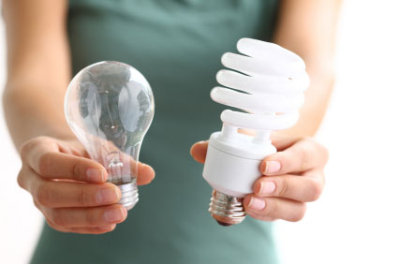
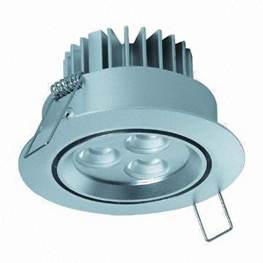
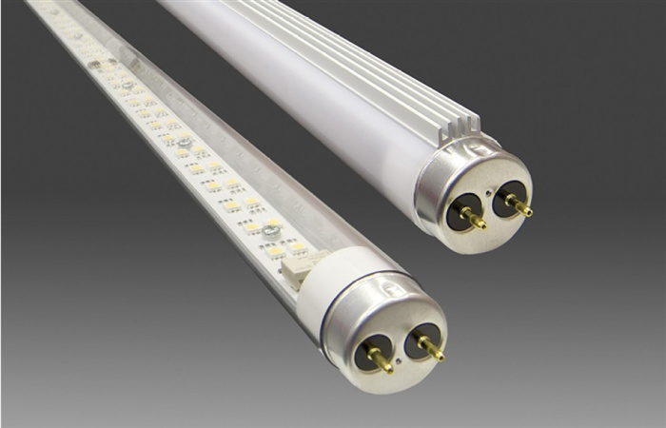

Slide 31
Compact fluorescent lamps (CFL’s)
CFL’s are manufactured to replace incandescent lamps.
CFL’s combine a lamp, ballast and base which fits the incandescent lamp socket in a single sealed assembly.
CFL’s are often physically larger than the incandescent bulbs they replace and simply may not fit the luminaire conveniently or at all.

Slide 32
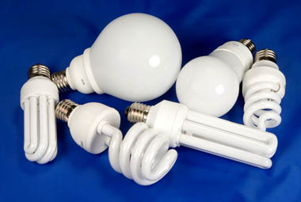
CFL compact fluorescent lamps

Slide 33
disadvantages of CFL’s
Elongated or circular shaped CFL’s may result in a reduced optimal pattern
They are sensitive to frequent on/off cycling
They contain small amounts of mercury
(≤ 5mg per lamp). This metal may be released if the bulb is broken, or during disposal.

Slide 34
advantages of CFL’s
They are rated from 10 000 to 12 000 hours of service life
They provide excellent colour rendering by the use of rare earth phosphors which provide bright vibrant colours
Most CFL’s have reliable starting that is flicker free and instant. Depending upon the wattage, CFL’s have a lumen range varying between 450 lm and 2780 lm.

Slide 35
Light emitting diodes
LED’s are solid state electronic devices that create light.
LED’s are naturally narrow-band sources, and the colour of the light they generate depends on the materials used to construct the LED.
LED’s have the ability to vary colour, create sparkle and aim the light precisely.

Slide 36
Led applications
LED lighting finds application in the signage industry, retail accent lighting (via their small size and directional nature of the light output), in traffic signals and exit signs and in some domestic lighting applications.
As yet LED’s are not as cost effective as a replacement for compact fluorescent lamps.

Slide 37
Led service life and output
LED service is five times longer than CFL’s.
Some very efficient LED’s have an efficacy of around 70 lumens per watt at 350 mA with a luminous flux of 80 lm.

Slide 38
Advantages of led’s
230V ac LED bulbs available (1 watt Cree XR-E LED’s provides 270 lumens light output for the cool white condition – 6000 Kelvin)
Long life, running over 100 000 hours
Virtually no maintenance or routine replacement of light globes needed
Environmentally friendly – no disposal of glass or toxic substances

Slide 39
Advantages of led’s
Brightness and directional control, meaning that light pollution is a significantly reduced risk in occupational health and safety due to reduction in maintenance and not having to access lamps to replace broken globes
Very wide operating ambient temperature range

Slide 40
Light control
The simplest way to reduce the amount of energy consumed by lighting systems is to turn lights off whenever no one is present to benefit from the illumination.
Because the simplest way is also the most unreliable, other methods to modulate the output of lighting systems have been designed.

Slide 41
Automatic light control
The most effective variety of automatic lighting control bases its operation on whether an occupant is present to make use of the illumination.
Known as occupancy sensors, these sensors are very different in reducing lighting energy consumption.

Slide 42
Two types of occupancy sensors
Passive infrared sensors (PIR)
  Which require direct line of sight to the moving warm occupant (change in infrared heat levels is protected)
Ultrasonic sensors
  These listen for change in the frequency of reflected sound. Which detect any movement, occupant or otherwise (curtains, blinds, air-conditioning cycling)

Slide 43
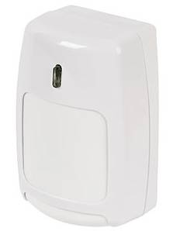
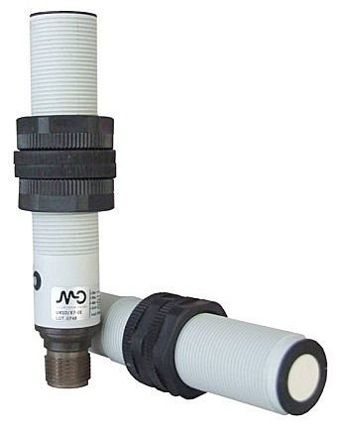
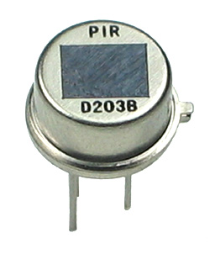

Slide 44
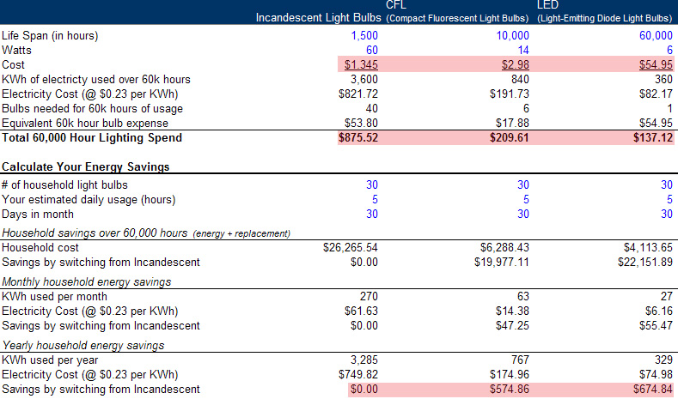

Slide 45
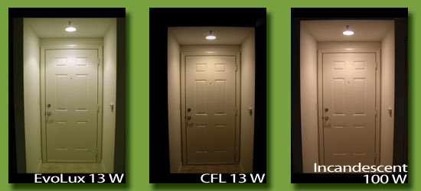

Slide 46
Complete the following review questions.

Slide 47
Section 3 - review questions
In which electrical area can emission reduction and energy saving be easily made?
Name the three elements that every lighting system consists of.
Describe two elements that an efficient and effective lighting system should contain.
Which bulbs use less energy to produce their lumens?

Slide 48
review questions - continued
What lamp were compact fluorescent lamps manufactured to replace?
State one disadvantage of a CFL.
Name two advantages of a CFL.
What is the name of the solid-state electronic device that creates light?
In what area of activity is LED lighting used?
Name three advantages of LED lighting.

Slide 49
review questions - continued
State the simplest method used to reduce the amount of energy consumed by lighting systems.
Name a manual-type energy saving control.
What type of sensor is very effective in reducing lighting energy consumption?
Name another type of control also used to minimise energy usage.
What factors can reduce total illumination by 50% or more?

Slide 50
THE END

Slide 51
References
Electrical Trade Principles; A Practical Approach
by Jeffrey Hampson and Steven Hanssen 2nd Edition 2009
www.pearsoned.com.au/hampson
www.google.com.au/images
Research Institute of Sustainable Energy (RISE) – Western Australia

