Slide 1
Protective Earthing Systems AS/NZS3000:2007
The purpose of this presentation is to outline the general principles associated with the multiple earthed neutral (MEN) protective earthing system.
Click the left mouse button for each slide
(Or press the SPACEBAR or ENTER key)
Earting.pps Version 2 S. G. Brooks. 2006

Slide 2
The MEN System
In the multiple earthed neutral (MEN) system the parts of the installation which are required to be earthed are connected to the general mass of earth within the installation (via a main protective earthing conductor), and, in addition, are connected within the installation to the neutral conductor of the supply system at one point - the main neutral link (see Wiring Rules, Clause 1.4.66).
The neutral is also earthed at the supply authority's distribution transformers and sub-stations.
A general outline of this arrangement is shown in the next slide.
Continue

Slide 3
MEN Outline Diagram
The installation main neutral link is connected to the general mass of earth:
Continue

Slide 4
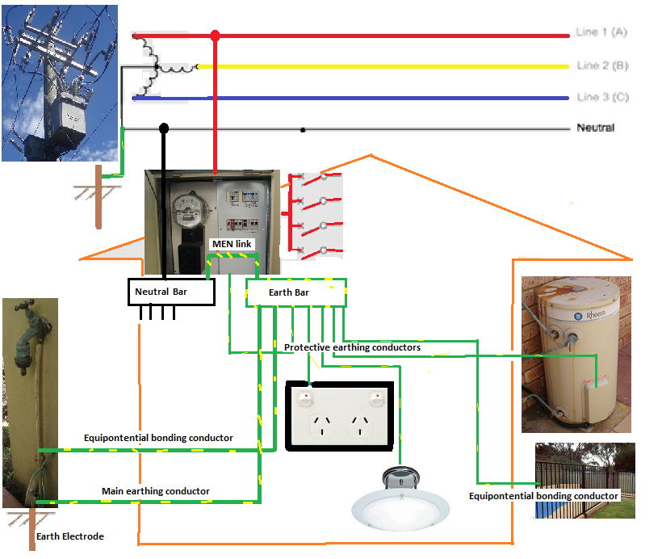

Slide 5
Advantage of the MEN System
The main advantage of the MEN system is that the neutral is connected to the earth at every distribution centre and installation in the supply system, thus providing many parallel paths for any fault currents.
The main disadvantage is that the resistance of the earthing conductors and earthing circuits must always be low enough to ensure that sufficient current can flow under fault conditions to allow the protection device to operate within a specified time (see AS/NZS 3000 Clause 8.3.5.2(a)). The Wiring Rules require that the resistance of a main earthing conductor must not exceed 0.5 ohms (see Clause 5.5.1.4).
The MEN system is the system used in most installations in W.A.
Continue

Slide 6
Operation of the MEN System
The operation of an MEN earthing system depends mainly on there being an adequate conducting path between the neutral conductor and the general mass of earth.
The supply is automatically disconnected when sufficient current flows in the circuit to operate the circuit protection device such as a fuse or circuit breaker, thus providing protection against electric shock in case of a fault.
Continue

Slide 7
Automatic Isolation
Earth Fault
If the earthing conductor was correctly connected a high current would flow from the outer casing to earth via the earth in the socket outlet and the circuit protection device (fuse or circuit breaker) protecting the circuit would operate and automatically isolate the circuit from the supply.
Continue

Slide 8
Fault Condition
Earth Fault
If the earthing conductor was not connected, or if it was not able to carry the current required to operate the circuit protection device, or the resistance of the earthing circuit was too high, the outer metal casing would remain alive; any person touching the frame while in contact with any earth would suffer an electric shock.
Continue

Slide 9
Limitations
Earthing an appliance does not provide protection against electric shock if a person touches the active and neutral or active and earth simultaneously.
Earthing an appliance does not prevent faults from occurring, nor does it correct any faults; it limits the touch voltage and removes the supply from the faulty section of the circuit
Continue

Slide 10
Disconnection Times
Clause 1.5.5.3 of AS/NZS 3000 specifies the disconnection times for a 230/240 volt supply voltage as:
0.4 seconds for socket outlets.
5 seconds for other circuits including submains and final subcircuits supplying fixed or stationary equipment.
Continue

Slide 11
Requirements for Earthing
The main requirements for earthing are contained in Section 5 of the Wiring Rules.
Typical samples of the requirements are given in the slides which follow.
Continue

Slide 12
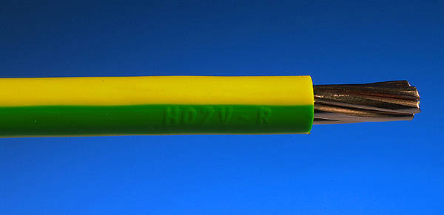
Cable Colour
The only permissible colour for an insulated earthing conductor is green/yellow
Continue

Slide 13
Insulation Resistance
The condition in which the resistance between any part of circuit and the exposed metal frame of an appliance (i.e. the insulation resistance) is below specified limits is known as an 'earth fault' or low insulation resistance to earth. The same term is applied to complete installations.
The insulation resistance between all live conductors connected together and earth must not be less than 1 megohm, measured with a high voltage insulation tester (Megger), and with all protective devices in circuit and all switches on (individual consuming devices may be disconnected).
Continue

Slide 14
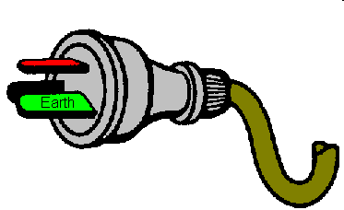
Make First - Break Last
Where a portable single insulated appliance is supplied by a flexible cord, and is connected to the supply via a plug and socket-outlet, provision must be made for the earthing pin to automatically make contact first and break contact last.
This is achieved by making the earth pin in the plug-top longer that the other pins.
Continue

Slide 15
Incorporation of Earthing Conductor
If a portable single insulated appliance is supplied by a flexible cord the earthing conductor must be incorporated in the same outer sheath as the associated live conductors
It is not permissible to supply a single insulated appliance using two core flexible cord, and tape an additional conductor to the outside of the sheath of the flexible cord and use it as an earthing conductor.
Continue

Slide 16
Exposed Conductive Parts
The conditions under which a protective earthing conductor may be connected to exposed conductive parts such as a constructional bolt are contained in AS/NZS 3000
It is not permissible to connect an earthing conductor to structural or ornamental metallic framework which does not form an integral part of an appliance.
Continue

Slide 17
Earthed Situation
An 'earthed situation' is a situation wherein there is a reasonable chance of a person touching the exposed metal of an appliance and, at the same time, coming in contact with an earth
Continue

Slide 18
Soldered Joints
Joints in copper main earthing conductors up to 16 square mm are usually soldered.
Soldered joints must be made so that the earthing conductors are retained in position independent of the solder
Continue

Slide 19
Equipotential Bonding
Equipotential bonding is the process of connecting metallic water piping, waste pipes and other extraneous metal in contact with the ground and accessible to personal contact, with the earthing system of the
They are intended to minimise unwanted voltages between accessible metallic parts of electrical equipment and accessible metallic parts which are not part of the electrical installation.
Equipotential bonding conductors are treated in the same way as earthing conductors.
Continue

Slide 20
Insulation Classifications
Most low voltage electrical appliances are manufactured to one of three general insulation specifications, namely:
a. Single Insulated (Class I equipment)
b. Double Insulated (Class II equipment)
c. All Insulated
Continue

Slide 21
Single Insulated (Class I)
Single Insulated In a single insulated appliance there is one layer of insulation between the internal live components and the outer metal enclosure.
Continue

Slide 22
Double Insulated (Class II)
Double Insulated In a double insulated appliance there are two layers of insulation between the internal live components and the outer metal enclosure; the layers of insulation are called the functional layer and the protective layer.
The international symbol to indicate double insulation is one square inside another.
Double insulated appliances must NOT have exposed metal connected to earth, and they have a warning label such as 'DO NOT EARTH - DOUBLE INSULATED'. See AS/NZS 3000 Clause 1.4.26 (Class II equipment)
Continue

Slide 23
All Insulated
All Insulated All insulated appliances have no exposed metal parts so they do not have an earth.
Continue

Slide 24
Single Insulated Devices
Many electrical appliances which operate at voltages exceeding 50 volts a.c. are of the single insulated type.
Single insulated devices must never be connected to the supply unless the exposed metal is connected to the general mass of earth via the earthing conductor in the flexible cord and the earthed pin in the socket-outlet.
Live terminals or parts must not be accessible to users of electrical equipment.
Continue

Slide 25
Size of Earthing Conductors
Protective earthing conductors must be large enough to carry the current which will enable the associated circuit protection device to operate before the cables in the circuit are damaged under fault current.
The requirements for determining the mimimum permissible size of earthing conductors are contained in AS/NZS 3000
Table 5.1 gives the minimum permissible earthing conductor size for a range of copper and aluminium cables.
Continue

Slide 26
Functional Earthing
Functional earthing is an earthing arrangement provided to ensure correct operation of electrical equipment or to permit reliable and proper functioning of electrical installations.
Functional earthing is required in the internal circuitry of some types of electronic equipment such as that used in entertainment, communications and instrumentation applications, to prevent unwanted potential differences in the equipment.
Continue

Slide 27
Introduction to Questions
The slides which follow are in the form of questions relating to the topic of protective earthing systems. There are 49 questions.
It is recommended that you consider the question and decide on a response, then left-click to see a correct answer.
You will need to have a current copy of AS/NZS 3000:2007 (Wiring Rules) to be able to answer some questions.
Continue

Slide 28
Question 1
What is the meaning of the term ‘earthed’?
Give the AS/NZS 3000 clause number
Answer: Connected to the general mass of earth. AS/NZS 3000 Clause 1.4.43
Continue

Slide 29
Question 2
What is the meaning of the term ‘earthed situation’? Give the AS/NZS 3000 clause number
Answer: Wherein a person can touch exposed conductive parts while in contact with earth. AS/NZS 3000 Clause 1.4.44
Continue

Slide 30
Question 3
What is the meaning of the term ‘equipotential bonding’? Give the AS/NZS 3000 clause number
Answer: Connections intended to bring exposed conductive parts to the same potential, but not intended to carry current in normal service.
AS/NZS 3000 Clause 1.4.52
Continue

Slide 31
Question 4
What is the meaning of the term 'Multiple earthed neutral (MEN) system'?
Give the AS/NZS 3000 clause number.
Answer: Earthing in which the parts of an installation, required to be earthed are connected to earth and the neutral conductor of the supply system. AS/NZS 3000 Clause 1.4.66
Continue

Slide 32
Question 5
What is the meaning of the term 'Main earthing conductor'?
Give the AS/NZS 3000 clause number.
Answer: A conductor connecting the main earthing terminal to the earth electrode.
AS/NZS 3000 Clause 1.4.65
Continue

Slide 33
Question 6
What is the meaning of the term ‘Protective earth’?
Give the AS/NZS 3000 clause number.
Answer: A conductor connecting the earthing system to equipment required to be earthed.
AS/NZS 3000 Clause 1.4.79
Continue

Slide 34
Question 7
What is the meaning of the term 'Functional earthing'?
Give the AS/NZS 3000 clause number.
Answer: An earth required to ensure correct operation of equipment.
AS/NZS 3000 Clause 1.4.56
Continue

Slide 35
Question 8
What is the main reason why single insulated 240 volt equipment must be earthed?
Answer: To provide a mechanism for automatically disconnecting the supply in the case of an earth fault.
To limit the touch voltage.
Continue

Slide 36
Question 9
What is the only permissible colour for an insulated earthing conductor?
Give the Wiring Rules Clause or Table Number.
Answer: Green/yellow.
Continue

Slide 37
Question 11
What is the MAXIMUM permissible resistance of a main earthing conductor or any equipotential bonding conductor?
Answer: 0.5 ohms.
Continue

Slide 38
Question 12
What is the MINIMUM permissible size of a copper main earthing conductor?
Give the Wiring Rules Clause or Table Number
Answer: 4 square mm.
Clause: 5.3.3.2
Continue

Slide 39
Question 13
An EARTHED SITUATION is where there is a reasonable chance of a person touching .....?..... and at the same time coming in contact with an earth.
Give the Wiring Rules clause number.
Answer: exposed metal
AS/NZS 3000 Clause 1.4.44
Continue

Slide 40
Question 14
Any situation within .....?..... metres of a concrete floor or metal pipe is deemed to be an earthed situation.
Give the Wiring Rules Clause or Table Number .
Answer: 2.5
AS/NZS 3000 Clause 1.4.44
Continue

Slide 41
Question 15
All parts of a .....?..... are deemed to be an earthed situation.
Give the Wiring Rules Clause or Table Number.
Answer: bathroom, laundry, lavatory, toilet or kitchen
AS/NZS 3000 Clause 1.4.44
Continue

Slide 42
Question 16
Any situation which is external to a building and within .....?..... of exposed earthed metal is deemed to be an earthed situation.
Give the Wiring Rules Clause or Table Number .
Answer: 2.5 metres
AS/NZS 3000 Clause 1.4.44
Continue

Slide 43
Question 17
Is it necessary to provide an earthing conductor to a lighting point consisting of a ceiling mounted batten holder installed inside a domestic building?
Answer: Yes
Clause 5.4.3
Continue

Slide 44
Question 18
Is it permissible to install a general purpose 10 amp socket-outlet without earthing the earthing contact?
Answer: No
AS/NZS 3000 Clause 5.4.2
Continue

Slide 45
Question 20
What type of earthing system is used in most installations in W.A.?
Answer: The Multiple Earthed Neutral (MEN) System.
Continue

Slide 46
Question 21
Where is the protective earth connected to the neutral in a typical domestic MEN installation?
Answer: At the main neutral link (usually at one end).
AS/NZS 3000 Clause 2.9.5.4.
Continue

Slide 47
Question 23
Is it permissible to install bare MIMS cable without earthing the copper sheathing?
Answer: No.
AS/NZS 3000 Clause 5.5.3.2
Continue

Slide 48
Question 24
An aluminium luminaire is to be installed outdoors on a wooden pole, 3 metres from the nearest earthed metal. Does the Wiring Rules require the exposed metal casing of the luminaire to be earthed?
Answer: No.
AS/NZS 3000 Clause 5.4.3 (2) (c)
Continue

Slide 49
Question 25
Is it necessary to earth accessible metal parts of low voltage equipment if the accessible metal is separated from live parts by double insulation?
Answer: No.
AS/NZS 3000 Clause 5.4.1.1 (b) (i)
Continue

Slide 50
Question 26
What is the internationally recognised symbol which means 'Double insulated - Do not earth'?
Answer: One square inside another
Continue

Slide 51
Question 27
What precaution must be taken to prevent an internal conductor from coming into contact with accessible metal if it becomes detached from its terminal in a double insulated appliance?
Answer: It must be protected, secured or insulated so that it (or its single insulation) can not come in contact with accessible metal.
AS/NZS 3000 5.4.1.1 (b)(i) (C)
Continue

Slide 52
Question 28
Is it necessary to earth exposed metal in a 32 volt portable hand-lamp?
Answer: No.
AS/NZS 3000 5.4.1.1 (b) (iii)
Continue

Slide 53
Question 29
Is it permissible to loop a MAIN earthing conductor into a luminaire to avoid having to run another earthing conductor to the luminaire?
Answer: No.
AS/NZS 3000 Clause 5.5.1.1
Continue

Slide 54
Question 30
Is it permissible to connect a subsidiary earthing conductor to a main earthing conductor using a soldered tee joint?
Answer: Yes.
AS/NZS 3000 Clause 5.5.2.1
Continue

Slide 55
Question 31
Is it permissible to earth equipment by connecting exposed metal to an earthing conductor which is being used to earth equipment supplied from another distribution board?
Answer: No.
AS/NZS 3000 clause 5.5.2.2.3
Continue

Slide 56
Question 32
A steel wire armoured (SWA) cable is installed in such a way that the armouring is required to be earthed. At which point in the installation must the armouring be earthed?
Answer: It must be earthed at the end adjacent to the switchboard or at which the cable originates.
AS/NZS 3000 Clause 5.5.3.2 (b)
Continue

Slide 57
Question 33
What limitation is placed on the use of metal conduit as the protective earthing conductor for cables which are contained in the conduit?
Answer: The metallic enclosure and associated fittings must be electrically and mechanically continuous.
AS/NZS 3000 Clause 5.5.4.2
Continue

Slide 58
Question 34
A metal conduit is installed in such a way that it is required to be earthed. At which point in the installation must it be earthed?
Answer: It must be earthed at the end adjacent to the switchboard or accessory at which the conduit originates.
AS/NZS 3000 Clause 5.5.3.2 (a)
Continue

Slide 59
Question 35
How must a hinged door of a metallic electrical cubicle be earthed?
Answer: By connecting a flexible conductor between the fixed component of the cubicle and the door.
AS/NZS 3000 Clause 5.3.2.3(c)(ii)
Continue

Slide 60
Question 36
The exposed metal of electrical equipment on a wheeled overhead gantry crane is required to be earthed. Can metal-to-metal contact between the wheels and the rail be regarded as an effective connection for the purposes of earthing?
Answer: Yes.
AS/NZS 3000 Clause 5.2.3.2 (C) (iii)
Continue

Slide 61
Question 37
A particular electric motor is to be fixed in position using four bolts with nuts. Is it permissible to use one of the fixing bolts as the earthing terminal?
Answer: No.
AS/NZS 3000 Clause 5.5.6.2
Continue

Slide 62
Question 38
What is the minimum permissible size of copper MAIN earthing conductor if the active conductor in the associated consumer's mains is 16 square mm?
Answer: 6 mm^{2.}
AS/NZS 3000:2000 Table 5.1
Continue

Slide 63
Question 39
What is the minimum permissible size of single core TPI cable (building wire) which can be used an earthing conductor?
Answer: 2.5 square mm.
Table 5.1
Continue

Slide 64
Question 40
In general, how must a clamped joints be made in copper earthing conductors up to 4 square mm?
Answer: Secured to prevent spreading.
AS/NZS 3000 Clause 3.7.2.5
Continue

Slide 65
Question 41
What is the minimum permissible diameter of a copper-coated mild steel driven earthing electrode?
Answer: 12 mm
AS/NZS 3000 Table 5.2
Continue

Slide 66
Question 43
In general, where must a driven earth electrode be located?
Answer: Exposed to the weather; outside the building; separated from metallic enclosures of other buried surfaces.
AS/NZS 3000 Clause 5.3.6.4
Continue

Slide 67
Question 44
To what minimum depth must a driven earth electrode be driven?
Answer: 1.2 metres.
As/NZS 3000 Clause 5.3.6.3
Continue

Slide 68
Question 45
What action must be taken if exposed metal of wiring enclosures is in unavoidable contact with metallic piping of other systems such as fire sprinklers, gas or hot water?
Answer: The metallic parts must be connected using an equipotential bonding conductor.
AS/NZS 3000 Clause 5.6.2.3
Continue

Slide 69
Question 46
What is the purpose of an equipotential bond in an installation?
Answer: To minimise the risk associated with voltage differences between accessible metal parts.
AS/NZS 3000 Clause 5.6.1.
Continue

Slide 70
Question 47
What are two requirements for an effective earth joint?
Answer: Joints must be mechanically and electrically sound.
AS/NZS 3000 Clause 3.7.1
Continue

Slide 71
Question 48
Is it necessary to earth the metal frame of a domestic installation?
Answer: Yes.
AS/NZS 3000 Clause 5.5.6.2
Continue

Slide 72
The End
Thank you for participating in this presentation
Click the left mouse button to exit
(Or press the SPACEBAR or ENTER key)
S. G. Brooks. 2003

