Slide 1
Metering Requirements

Slide 2
Clause 1.2 D of the AS/NZS3000:2007 refers to the requirements of service rules and conditions provided by local electricity distributors.
For WA these service rules are the WA Electrical Requirements 2015.
The WAER in turn refers to the requirements of network operators including Western Power and Horizon Power which document their rules in the Western Australian Distribution Connections Manual 2015.
The following slides are excerpts from the WADCM to provide an overview of the sort of information on metering that this document contains.
You will need to refer to the actual documents to gain a more comprehensive insight into any particular job that you are involved in.

Slide 3
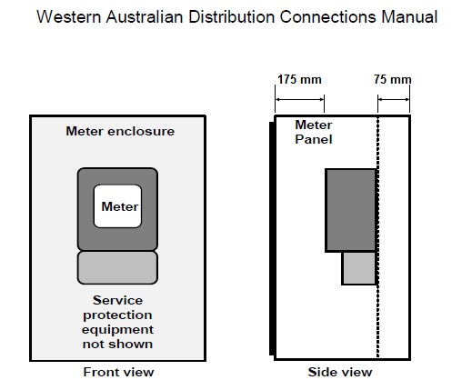

Slide 4
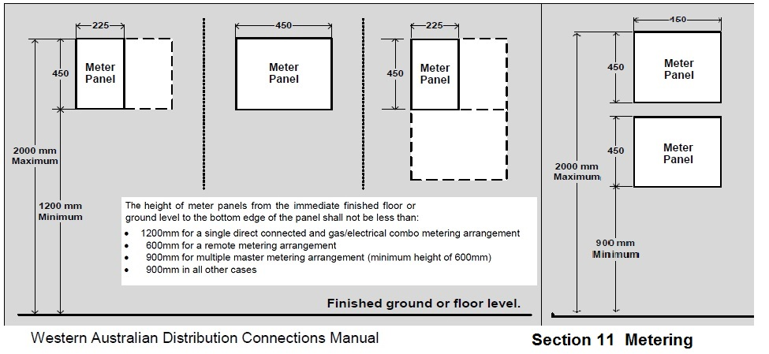

Slide 5
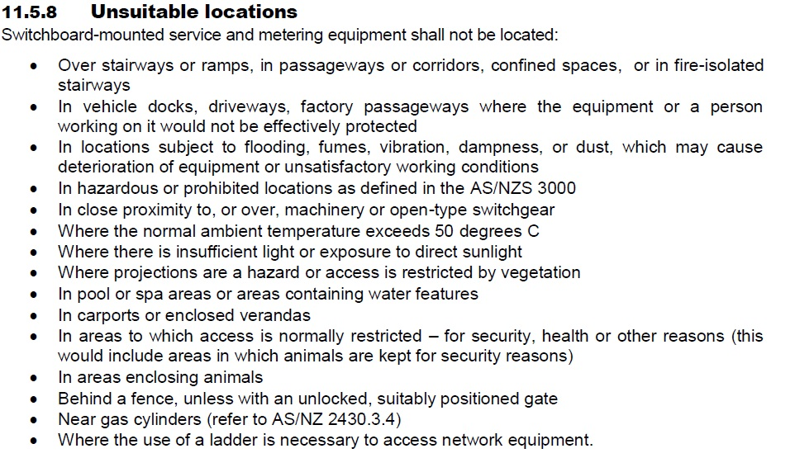

Slide 6
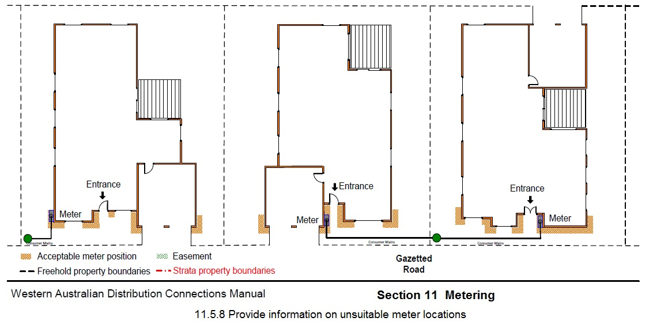

Slide 7
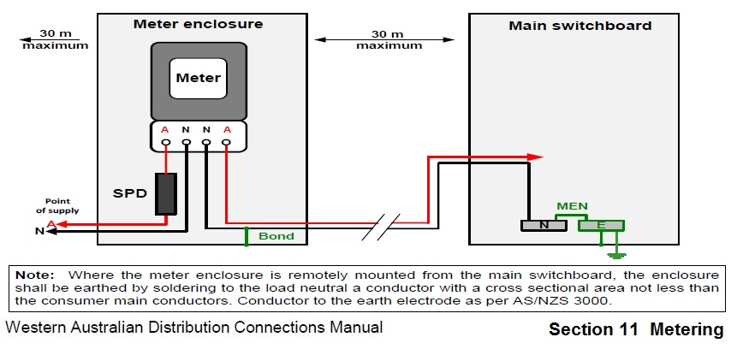

Slide 8
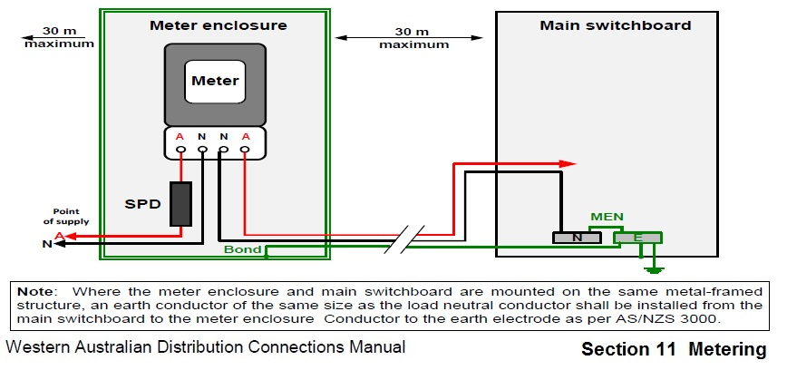

Slide 9
