Slide 1
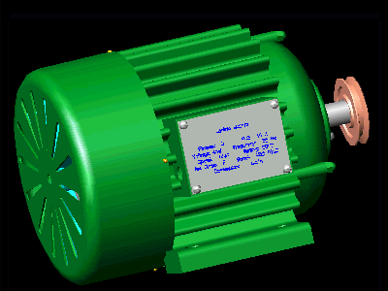
3 Phase Motor Starters
Electrical Trades
The purpose of this presentation is to describe the principles of 3-phase non-electronic current limiting starters.
Click the left mouse button for each slide
Continue
3 Phase Motor Starters.pps S. G. Brooks Version 3 12/2007

Slide 2
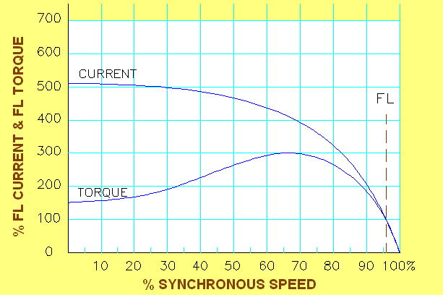
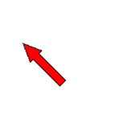
3-Phase Motor Characteristics
A 3-phase squirrel cage induction (SCI) motor draws a high current and produces maximum torque when it is started direct-on-line (DOL).
The starting current is much higher than the full load current
Full load current.
Continue

Slide 3
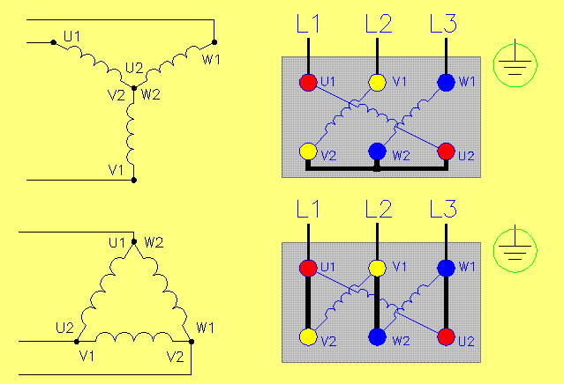
Typical 3-Phase SCI Motor Connections
415 V 50 Hz
STAR
6-terminal terminal block.
415 V 50 Hz
DELTA
In each case the motor must be designed for that connection on full load.
Continue

Slide 4
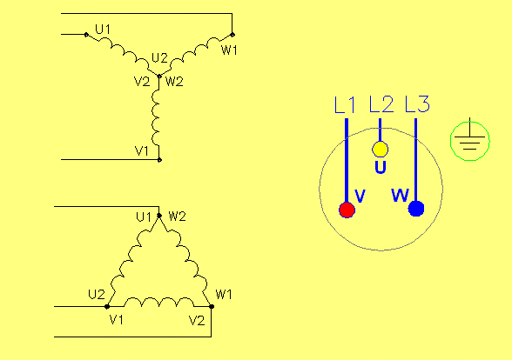
Internal Motor Connections
415 V 50 Hz
STAR
or
DELTA
3-terminal terminal block.
In many cases the motor is internally connected in either star or delta, with a 3-terminal terminal block.
Continue

Slide 5
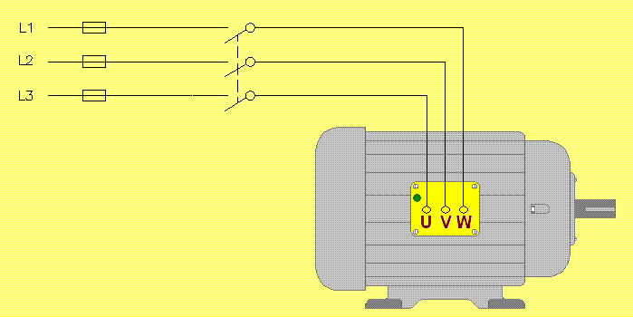
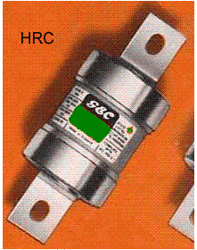
3-Phase DOL Starting
Direct-on-line (DOL) starting is equivalent to starting the motor with a triple-pole switch.
Motor overtemperature protection not shown
Motor-rated HRC fuses are required to withstand the high inrush current during starting.
DOL starting gives maximum starting current and maximum starting torque.
Continue

Slide 6
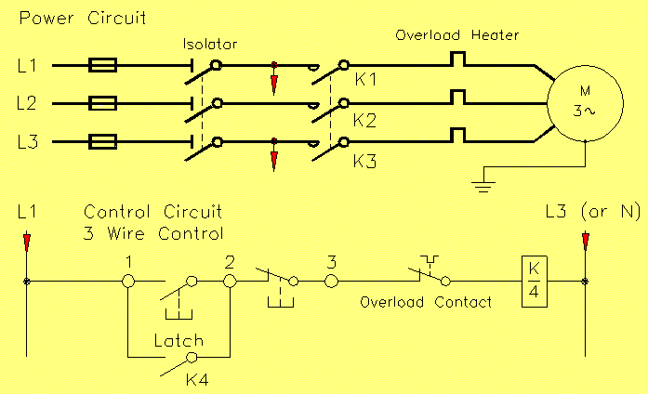
3-Phase DOL Starting With a Contactor
Direct-on-line (DOL) starting is usually achieved with an electromagnetic contactor circuit.
DOL starting gives maximum starting current and maximum starting torque.
Continue

Slide 7
Reducing Starting Current
Reducing the starting current of an SCI motor can be achieved by:
a. Changing the stator connections during starting (using a star-delta starter).
b. Reducing the line voltage with an autotransformer during starting (using an autotransformer starter).
c. Reducing the line current with series resistors during starting (using a primary resistance starter.
Each method results in a reduction in starting torque.
Continue

Slide 8
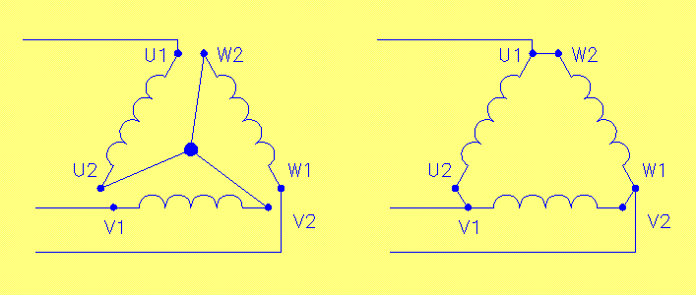
Star-Delta Connection
A 3-phase SCI motor that has been designed to run in delta on full load can be temporarily connected in star to reduce the current during starting.
The voltage across each phase winding is reduced to 240 V during starting.
START
RUN
415 V 50 Hz
415 V 50 Hz
STAR
DELTA
The voltage across each phase winding is 415 V for running.
Continue

Slide 9
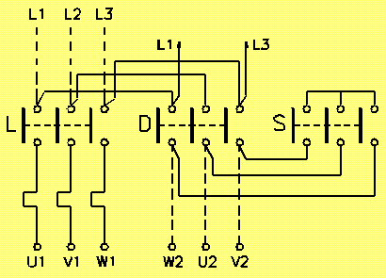
Typical Star-Delta Starter Power Circuit
415 V 50 Hz
The Star and Line contactors come in for starting.
Star drops out and Delta comes in for running.
Star must drop out before Delta comes in.
Continue

Slide 10
Typical Star-Delta Starter Control Circuit
Start button
415 V coils
Star
Timer
Delta
Line
Continue

Slide 11
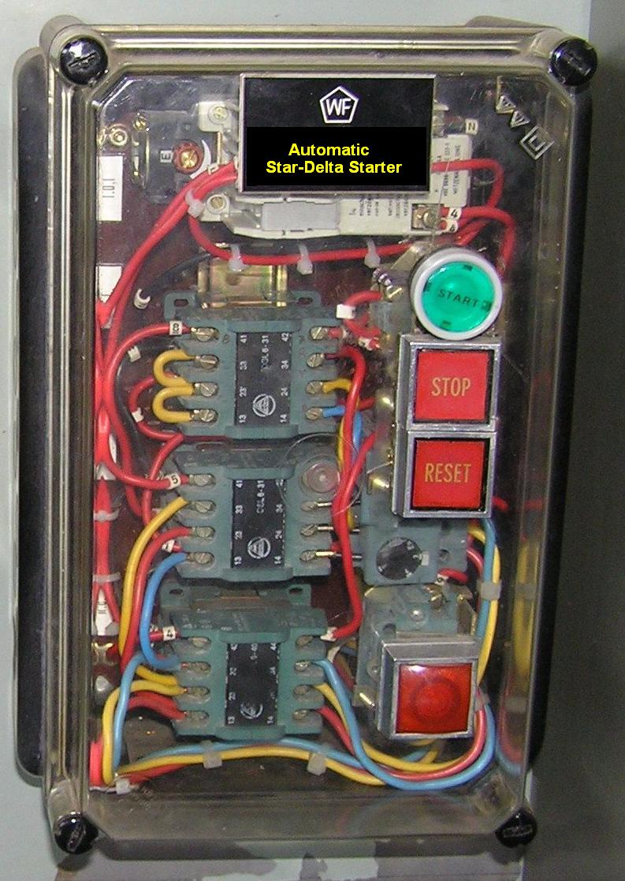
Typical Automatic Star-Delta Starter
Timer
Start button
Stop button
Star point
Overload reset
Contactor
Overload relay
Continue

Slide 12
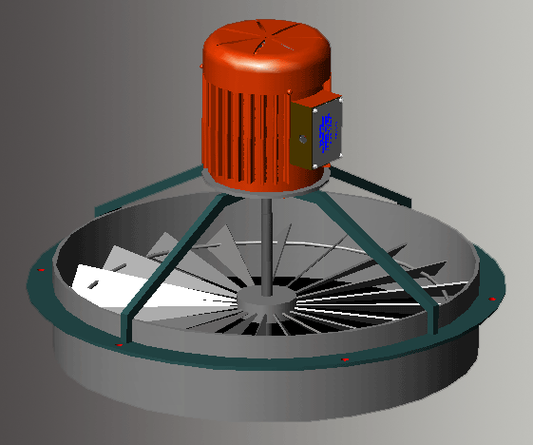
Star-Delta Starter Characteristics
A star-delta starter reduces the line current to 33% of the DOL current, and reduces the starting torque to 33% of the DOL torque.
A star-delta starter can only be used to start motors on light starting loads (such as centrifugal pumps or air circulating fans).
A standard star-delta starter momentarily disconnects the motor during the transition from start to run.
A star-delta starter requires a 6-terminal SCI motor that is designed to run in delta on full load.
Continue

Slide 13
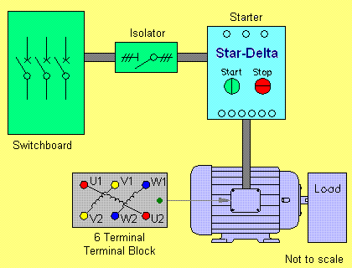
Star-Delta Starter Connections
3 line terminals
Coils may be 415 V to avoid running a neutral
6 motor terminals
AS/NZS 3000:2000 Clause 2.8.3.5
6 motor cables (plus earth)
Cable size can be 58% of line cables
Continue

Slide 14
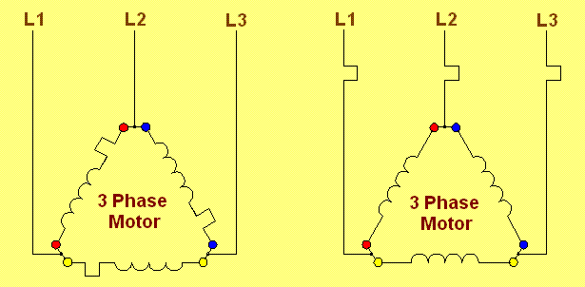
Overloads and Single Phasing
Thermal overload heaters should be connected in the motor coil circuit, and set to the maximum coil current (not the line current) to provide ‘single phasing’ protection.
Overload heater
This arrangement may not provide protection against the loss of one phase.
Overload heater
Continue

Slide 15
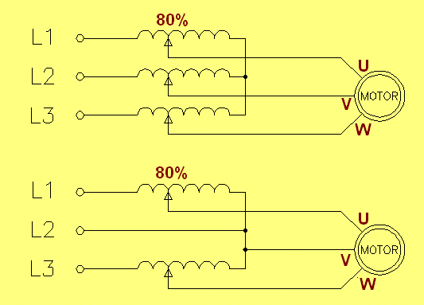
3-Phase Autotransformer
A 3-phase autotransformer starter reduces the line current by reducing the voltage applied to the motor during starting.
3-coil autotransformer
415 V 50 Hz
80% line voltage gives 64% of DOL starting torque.
Star connection
2-coil autotransformer
415 V 50 Hz
Open-delta connection
3-terminal SCI motor (star or delta)
Motor starting torque is proportional to the square of the applied voltage.
Continue

Slide 16
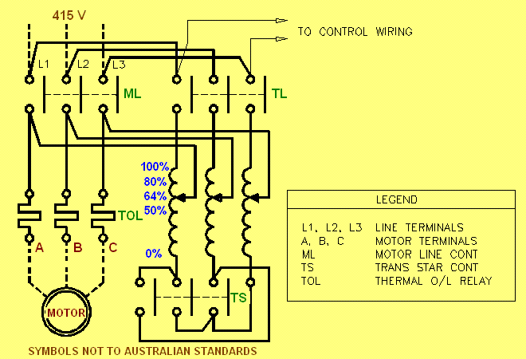
Autotransformer Starter Power Circuit
Start with autotransformer on 64%, then switch to DOL.
3-coil autotransformer
Continue

Slide 17
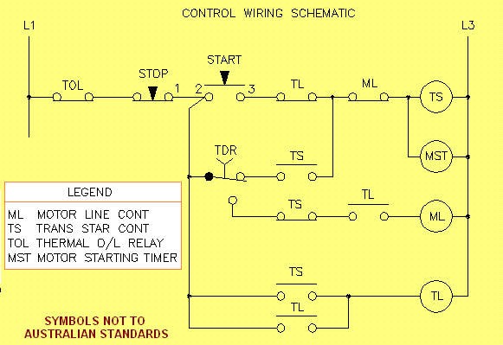
Autotransformer Starter Control Circuit
Start button
Continue

Slide 18
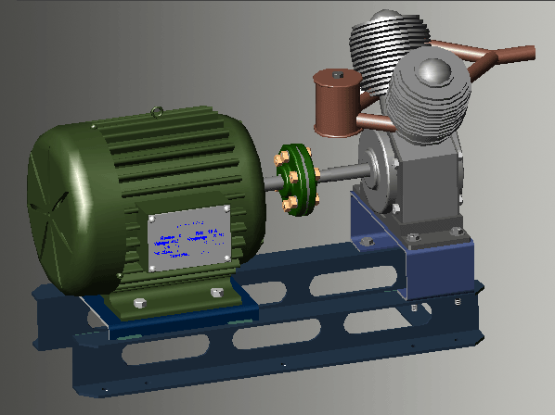
Autotransformer Starter Characteristics
An autotransformer starter on an 80% starting setting reduces the line current to 64% of the DOL current, and reduces the starting torque to 64% ( 0.8 ² ) of the DOL torque.
An autotransformer starter can be used to start motors on heavy loads (such as compressors, conveyors and refrigeration units).
An autotransformer starter requires a 3-terminal SCI motor.
Continue

Slide 19
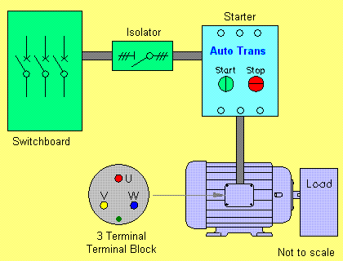
Autotransformer Starter Connections
3 line terminals
Coils may be 415 V to avoid running a neutral
3 motor terminals
Cables same size as line cables
3 motor cables (plus earth)
Continue

Slide 20
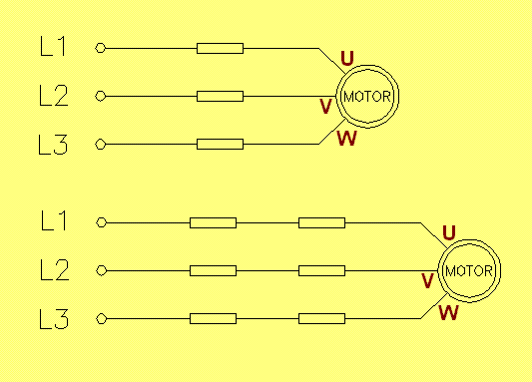
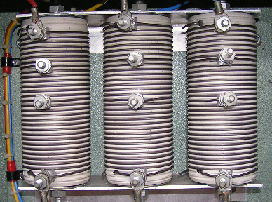
Primary Resistance Starter
A 3-phase primary resistance starter reduces the line current by connecting resistors in series with the motor during starting.
High power resistors
415 V 50 Hz
415 V 50 Hz
3-terminal SCI motor (star or delta)
50% line voltage gives 25% of DOL starting torque.
Continue

Slide 21
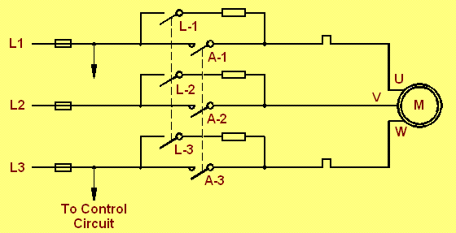
Primary Resistance Starter Power Circuit
415 V 50 Hz
Start with L in, then switch in A.
3-terminal SCI motor (star or delta)
Motor starting torque is proportional to the square of the applied voltage.
Continue

Slide 22
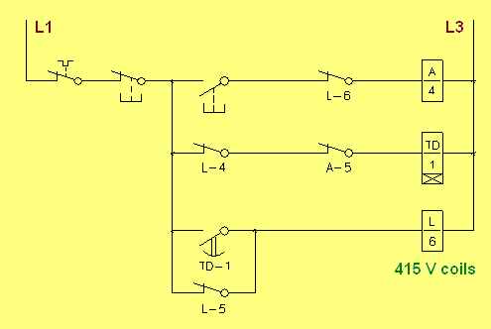
(FIND THE FAULTS IN THE CIRCUIT) Primary Resistance Starter Control Circuit
415 V 50 Hz
Start button
Continue

Slide 23
CORRECT CIRCUIT Primary Resistance Starter Control Circuit
Start button
Continue

Slide 24
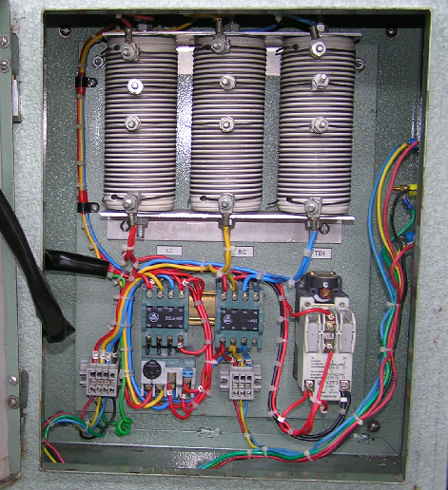
Typical Primary Resistance Starter
A primary resistance starter has one or more sets of 3 high power resistors.
Contactors
Timer
Overload relay
Stop-start station not shown
Continue

Slide 25
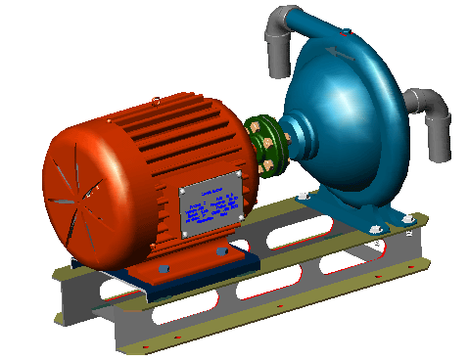
Primary Resistance Starter Characteristics
A primary resistance starter on a 50% starting setting reduces the line current to 25% of the DOL current, and reduces the starting torque to 25% ( 0.5 ² ) of the DOL torque.
A primary resistance starter can can only be used to start motors on light starting loads (such as centrifugal pumps or air circulating fans).
A primary resistance starter requires a 3-terminal SCI motor.
A primary resistance starter can have several steps to increase the speed gradually.
Continue

Slide 26
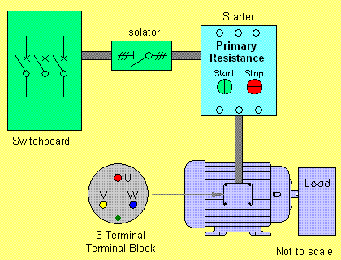
Primary Resistance Starter Connections
3 line terminals
Coils may be 415 V to avoid running a neutral
3 motor terminals
Cables same size as line cables
3 motor cables (plus earth)
Continue

Slide 27
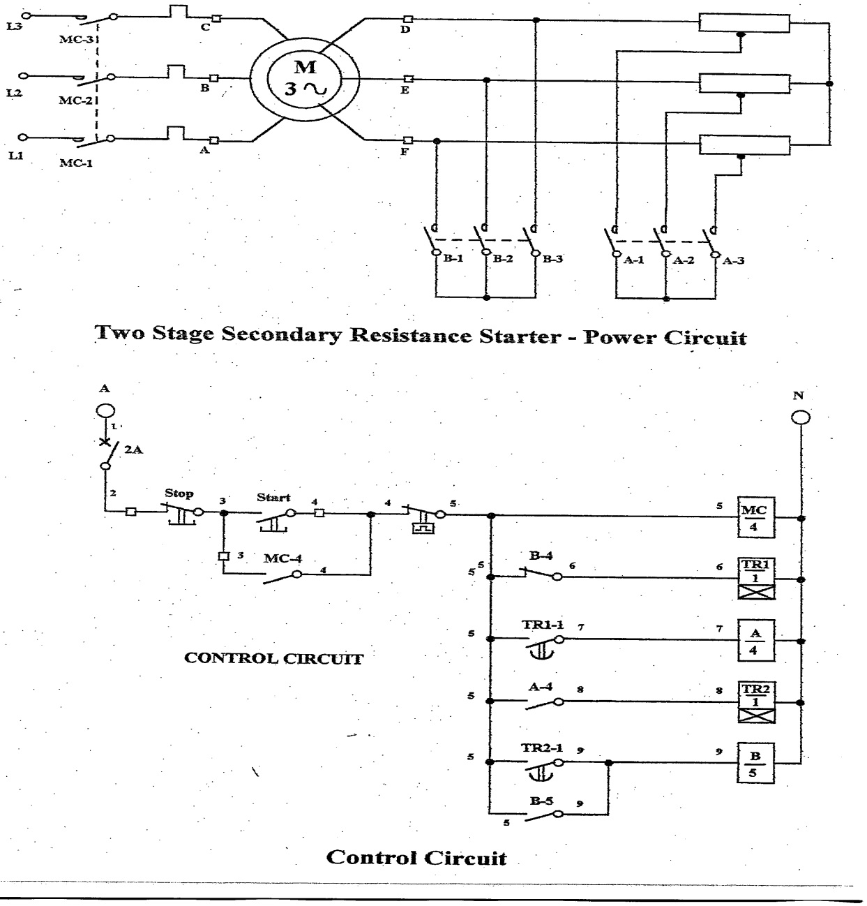
Secondary Resistance Starter Characteristics
For starting HEAVY loads you require a Secondary Resistance starter.
When the rotor resistance is equal to the rotor inductive reactance maximum torque is produced. With the introduction of external resistances into the wound rotor circuit, the rotor resistance and impedance values can be adjusted to produce maximum torque at the same time will minimise starting currents.
Requires a wire Wound rotor though.
Continue

Slide 28
Useful References
1. Electrical Principles for the Electrical Trades, J. R. Jenneson, 5th Ed:
Section 13.5 - ALTERNATING CURRENT MOTOR-STARTER CIRCUITS
2. Electrical Trade Principles, J. Hampson:
Page 255 - Starter operations and applications
3. AS/NZS 3000:2000: Clauses 2.8.3.5 and 4.3.4
Continue

Slide 29
The End
That is the end of this presentation.
3 Phase Motor Starters
Thank you for your participation.
Continue

