Slide 1

Variable Speed Drives

Slide 2
Understanding VSD’s (Variable Speed Drives)
or VFD’s (Variable Frequency Drives)
While all variable frequency drives (VFDs) control the speed of an AC induction motor by varying the motor's supplied voltage and frequency of power, they all do not use the same designs in doing so.
There are 3 basic types of variable frequency drives that offer certain advantages as well as disadvantages depending on your motor application.
PWM – Pulse width Modulation
CSI – Current Source Inverter
VSI – Voltage Source inverter
Flux Vector PWM Drives

Slide 3
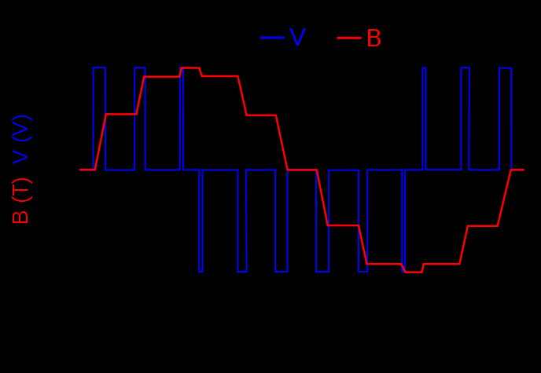
PWM – Pulse width Modulation
The term "pulse width modulation" explains how each transition of the alternating voltage output is actually a series of short pulses of varying widths. By varying the width of the pulses in each half cycle, the average power produced has a sine-like output. The number of transitions from positive to negative per second determines the actual frequency to the motor.

Slide 4
PWM – Pulse width Modulation
PWMs have the following advantages.
Excellent input power factor due to fixed DC bus voltage.
No motor cogging normally found with six-step inverters.
Highest efficiencies: 92% to 96%.
Compatibility with multi motor applications.
Ability to ride through a 3 to 5 Hz power loss.
Lower initial cost.

Slide 5
PWM – Pulse width Modulation
The following are disadvantages, however, that you should also consider.
Motor heating and insulation breakdown in some applications due to high frequency switching of transistors.
Non-regenerative operation.
Line-side power harmonics (depending on the application and size of the drive).

Slide 6
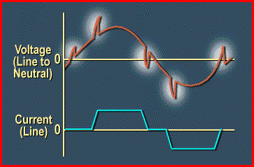
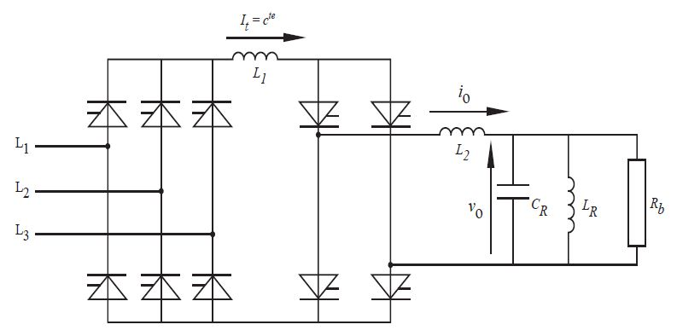
CSI – Current Source Inverter
The incoming power source to the CSI design is converted to DC voltage in an SCR converter section, which regulates the incoming power and produces a variable DC bus voltage. This voltage is regulated by the firing of the SCRs as needed to maintain the proper volt/hertz ratio. SCRs are also used in the inverter section to produce the variable frequency output to the motor. CSI drives are inherently current regulating and require a large internal inductor to operate, as well as a motor load.

Slide 7
CSI – Current Source Inverter
CSIs have the following advantages.
Reliability due to inherent current limiting operation.
Regenerative power capability.
Simple circuitry.

Slide 8
CSI – Current Source Inverter
The following are disadvantages, however, in the use of CSI technology.
Large power harmonic generation back into power source.
Cogging below 6 Hz due to square wave output.
Use of large and costly inductor.
HV spikes to motor windings.
Load dependent; poor for multi motor applications.
Poor input power factor due to SCR converter section.

Slide 9
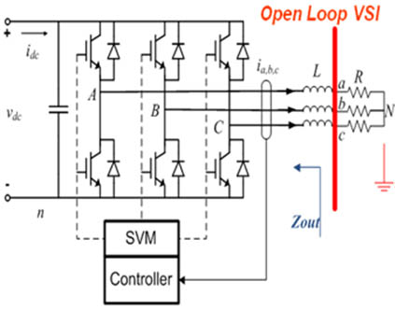
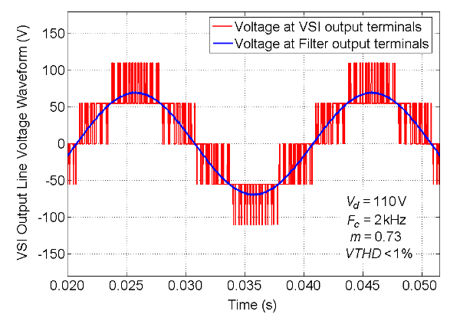
VSI – Voltage Source Inverter
VSI drive is very similar to a CSI drive in that it also uses an SCR converter section to regulate DC bus voltage. Its inverter section produces a six-step output, but is not a current regulator like the CSI drive. This drive is considered a voltage regulator and uses transistors, SCRs or gate turn off thyristors (GTOs) to generate an adjustable frequency output to the motor.

Slide 10
VSI – Voltage Source Inverter
VSIs have the following advantages.
Basic simplicity in design.
Applicable to multi motor operations.
Operation not load dependent

Slide 11
VSI – Voltage Source Inverter
The following are disadvantages, however, in the use of VSI technology.
Large power harmonic generation back into the power source.
Poor input power factor due to SCR converter section.
Cogging below 6 Hz due to square wave output.
Non-regenerative operation.

Slide 12
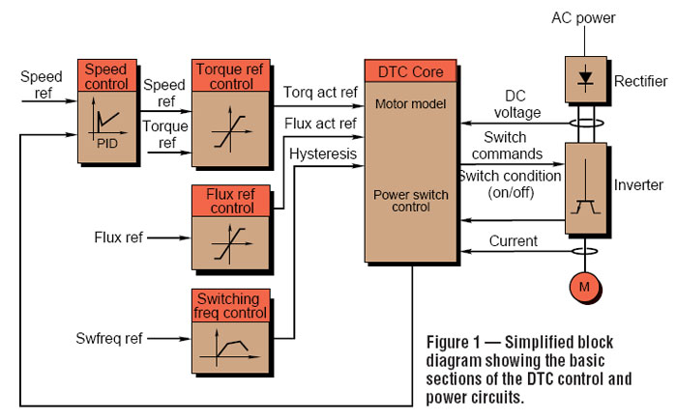
Flux Vector PWM Drives
Flux vector drives use a method of controlling torque similar to that of DC drive systems, including wide speed control range with quick response. Flux vector drives have the same power section as all PWM drives, but use a sophisticated closed loop control from the motor to the drive's microprocessor. The motor's rotor position and speed is monitored in real time via a resolver or digital encoder to determine and control the motor's actual speed, torque, and power produced.

Slide 13
Flux Vector PWM Drives
The following are advantages of this new drive technology.
Excellent control of motor speed, torque, and power.
Quick response to changes in load, speed, and torque commands.
Ability to provide 100% rated torque at 0 speed.
Lower maintenance cost as compared to DC motors and drives.

Slide 14
Flux Vector PWM Drives
As usual, there are disadvantages.
Higher initial cost as compared to standard PWM drives.
Requires special motor in most cases.
Drive setup parameters are complex.

Slide 15
THE END

