Slide 1
Electrical Trades
Three Phase Star and Delta concepts
Click the left mouse button for each slide
(Or press the SPACEBAR or ENTER key)
Continue
Updated 11Oct 2017. G Fielding

Slide 2
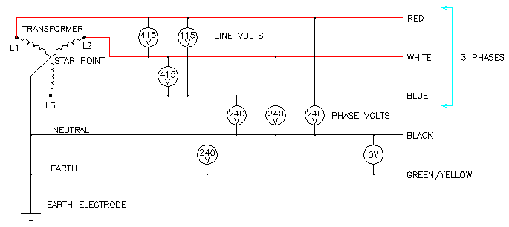
G006A
Continue

Slide 3
G006A
List two advantages of a three phase distribution system over a single phase distribution system.
Continue

Slide 4
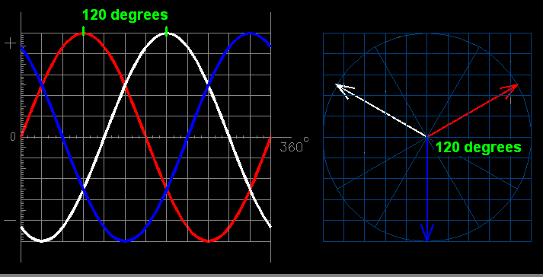
G006A
Continue

Slide 5
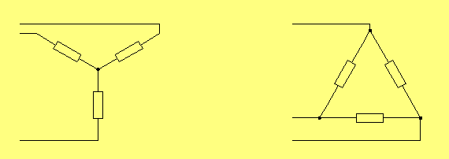
G006A
Star
Delta.
Continue

Slide 6
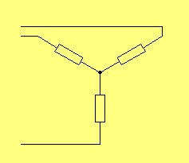
G006A
What is an alternative name for a star connection?
A Wye connection.
Continue

Slide 7
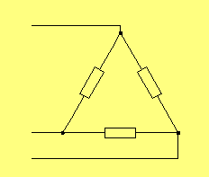
G006A
10. What is an alternative name for a delta connection?
A Mesh connection.
Continue

Slide 8
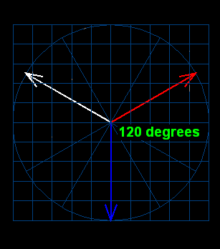
G006A
What is the name given to a three phase circuit in which the load on each of the three phases is identical?
A balanced three phase circuit.
Continue

Slide 9
G006A
How much current would be flowing in the neutral conductor if the load on each of the three phases in a three phase distribution system was identical?
Zero amps. If a three phase star connected circuit is balanced there is no difference of potential between the star point and earth.
Continue

Slide 10
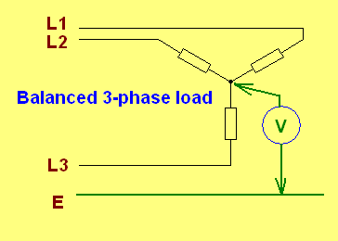
G006A
What is the voltage between the star point and earth if three identical electrical devices are connected in star?
Zero volts
Zero volts.
Continue

Slide 11
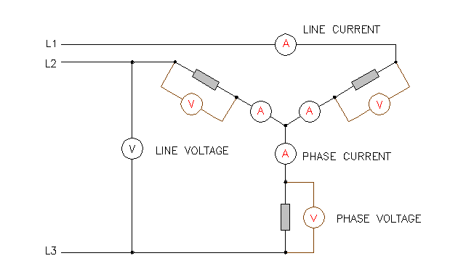
G006A
Three identical resistors or windings are connected in STAR. What is the name given to the values of voltage and current with respect to each of the three identical components?
Phase current or voltage; or coil current or voltage if the components are coils - as in motors or transformers.
Continue

Slide 12
G006A
Draw a neat circuit diagram showing three identical resistors connected in STAR. Show the three phase supply and include instruments to indicate one of each of the following values:
Line E Line I Phase E Phase I
Correct diagram - Star connection
Continue

Slide 13
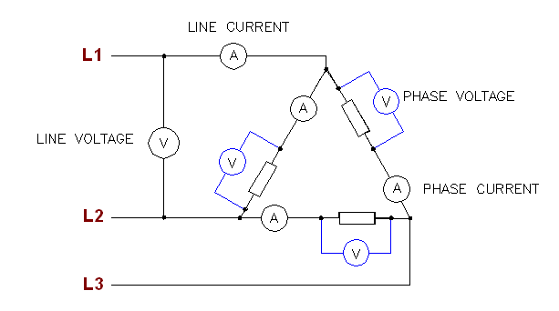
G006A
Draw a neat circuit diagram showing three identical resistors connected in DELTA. Show the three phase supply and include instruments to indicate one of each of the following values:
Line E Line I Phase E Phase I
Correct diagram - Delta connection.
Continue

Slide 14
G006A
Three identical resistors are connected in star to a 415 volt three phase supply. What is the PHASE voltage in the circuit?
240 volts.
240 volts
Continue

Slide 15
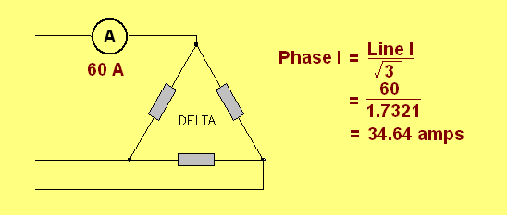
G006A
If a balanced three phase delta connected circuit has a line current of 60 amps, what is the value of the phase current?
34.64 amps approximately.
In DELTA; Phase I = Line I/1.7321.
Continue

Slide 16
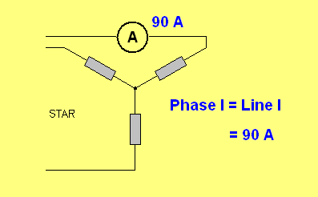
G006A
If a balanced star connected three phase circuit has a line current of 90 amps, what is the phase current?
90 amps. In STAR; Line I = Phase I.
Continue

Slide 17
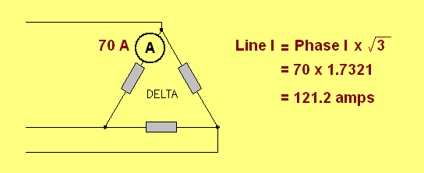
G006A
If a balanced three phase delta connected circuit had a phase current of 70 amps, what is the value of LINE current?
121.24 amps approximately. In DELTA; Line I = Phase I x 1.7321.
Continue

Slide 18
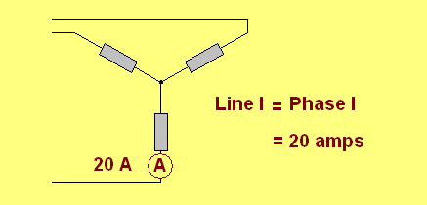
G006A
If a three phase balanced star connected circuit had a phase current of 20 amps, what is the value of LINE CURRENT?
20 amps. In STAR; Phase I = Line I.
Continue

Slide 19
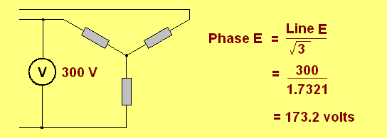
G006A
If a balanced star connected three phase circuit has a line voltage of 300 volts, what is the phase voltage?
173.21 volts. In STAR; Phase E = Line E/1.7321
Continue

Slide 20
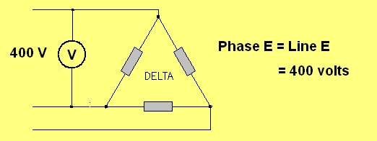
G006A
If a balanced delta connected three phase circuit has a line voltage of 400 volts, what is the phase voltage?
400 volts. In DELTA; Phase E = Line E.
Continue

Slide 21
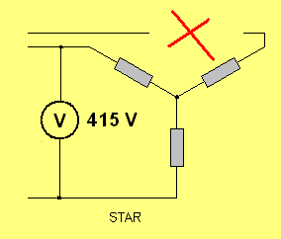
G006A
What is the phase voltage across two resistors in a balanced 415 volt three phase star connected circuit if the supply to the third resistor is safely disconnected?
207.5 volts - half the line voltage.
Continue

Slide 22
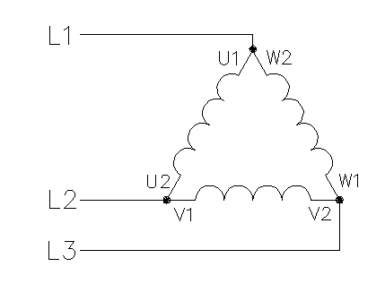
G006A
Which common balanced three phase connection has the dissimilar ends of each coil winding connected together?
The delta connection.
Continue

Slide 23
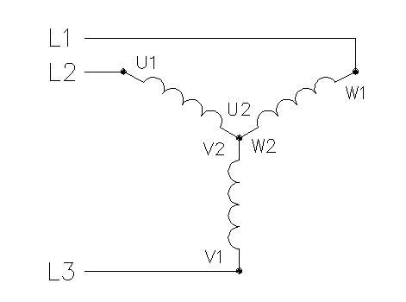
G006A
Which common balanced three phase connection has the similar ends of each coil winding connected together?
The star connection.
Continue

Slide 24
The End
Thank you for participating in this presentation.
Click or press ESC to exit.
Continue

