Slide 1
Testing Switchboards
Electrotechnology Practices
By Jeff Hampson
Animations by Grahame Byrnes

Slide 2
Preface
It is a requirement of the Electricity (Licensing) Regulations 1991 that
all electrical installing work carried out in Western Australia complies
with the relevant standards, including AS/NZS 3000:2007 and WA
Electrical Requirements.
All completed electrical work must be checked and tested by a licensed
electrician before the work is certified as complying to the relevant
network operator.
This PowerPoint presentation has been produced as a guide to
meeting the checking and testing requirements. While this guide is
mainly focused on domestic installations, the principles apply to all
electrical installing work. The methods in this presentation are not
intended to be exclusive. Other methods may be used, as long as they
meet the minimum requirements of AS/NZS 3000:2007

Slide 3
Installation Test Certificate
After the installation work is complete, a licensed electrician must carry
out checks and tests to make sure that the work meets the
requirements of the Wiring Rules.
Once the work is confirmed as correct, a Notice of Completion is
supplied to the network operator, a Safety Certificate to the client and a
Installation Test Certificate is fixed inside the meter enclosure.
The electrician is requested to record some key installation test results
and the route of the consumer’s mains cable on a self adhesive label
which is also placed inside the meter enclosure.
1) Main Earth Resistance
2) Earth Continuity or Fault Loop Impedance values of each sub-circuit
3) Insulation resistance value for each sub circuit

Slide 4
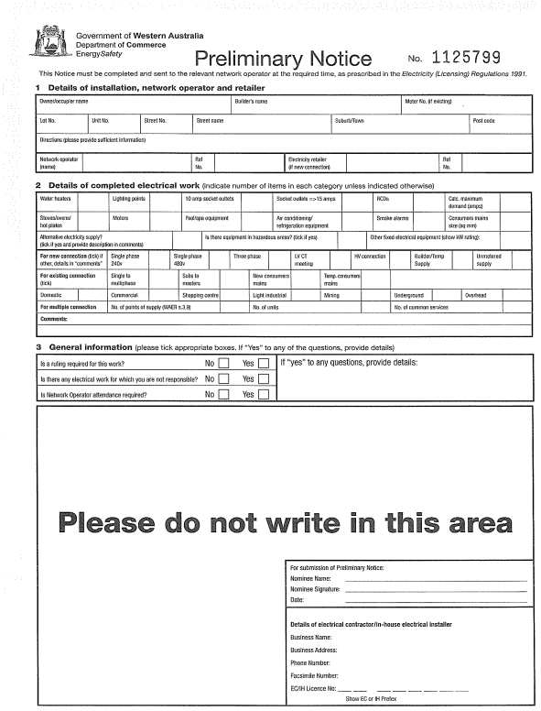
Installation Test Certificates
Preliminary/Completion Safety Certificate

Slide 5
Checking and Testing
1) Visual Inspection - should be carried out whilst referring to a plan to ensure a systematic check to pick up any omissions and to verify that the work complies with the requirements of the applicable standards.
2) Earth Resistance and Continuity Tests - this test includes the
main earthing conductor, protective earth conductors and bonding
conductors.
3) Insulation Resistance Test - this test is necessary to ensure that the
insulation resistance between live parts/conductors and earth is
adequate.
4) Polarity Test - used to ensure correct connection of active, neutral
and earthing conductors.

Slide 6
Checking and Testing
5) Correct Circuit Connections - this test checks earthing conductors do not carry current during normal operation and no short circuit exists.
6) Fault Loop Impedance - measures the fault loop impedance of each circuit to verify the protective device will operate.
7) Verification of RCD (residual current device) Operation - testing of RCDs is carried out to ensure that the RCD operates.

Slide 7
9.2 Functional blocks of an electrical installation
Point of
Supply
Main
Board
Distribution
Board
Load
Consumer’s
Mains
Final
Subcircuit
Submains

Slide 8
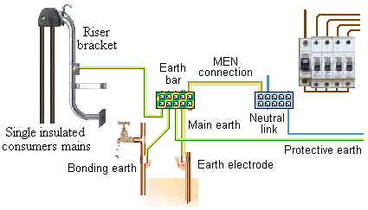
Figure 9.5 Visual inspection of earthing system

Slide 9
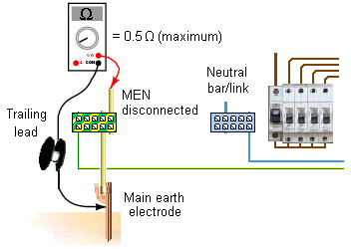
Figure 9.12 Measuring resistance of main earthing conductor
Disconnect Equipotential Bonding conductor

Slide 10
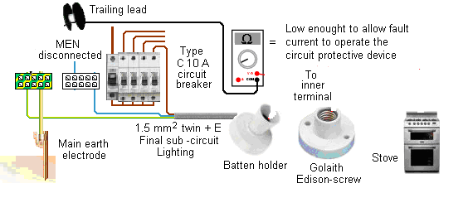
Figure 9.13 Resistance test of protective earth at lighting point & fixed equipment
(In 3000:2007 – Pg 329, Table 8.2)
Disconnect Equipotential Bonding conductor

Slide 11
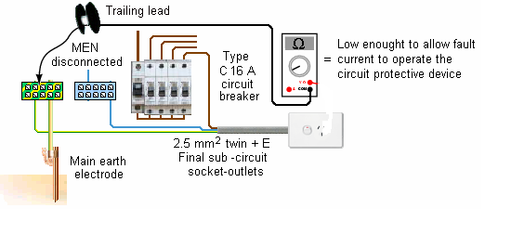
Figure 9.14 Resistance test of protective earth at socket-outlet
Disconnect Equipotential Bonding conductor

Slide 12
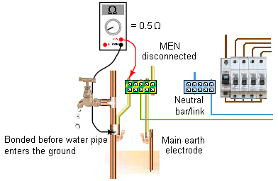
Figure 9.15 Resistance tests of equipotential bonding conductors
Reconnect Equipotential Bonding conductor

Slide 13
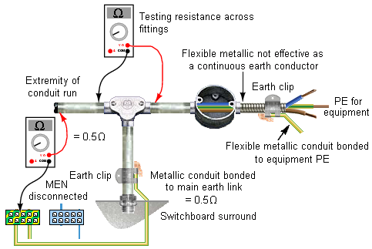
Figure 9.16 Resistance test of conduit bonding conductor and conduit continuity

Slide 14
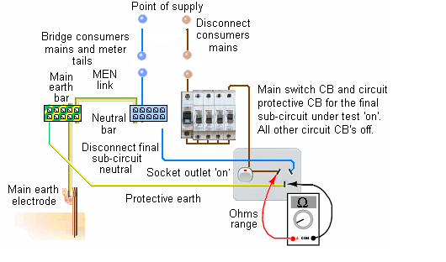
Figure 9.19 Testing the impedance of the earth-fault loop of a final sub-circuit

Slide 15
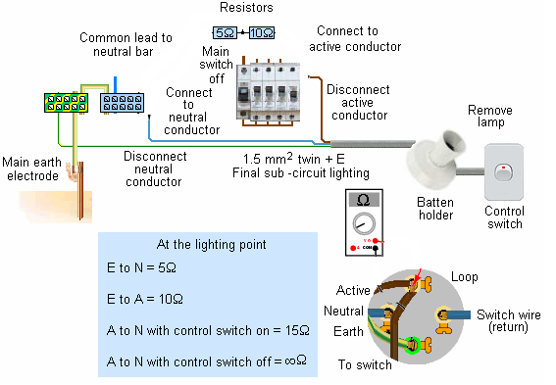
Figure 9.20 Connection test – lighting points

Slide 16
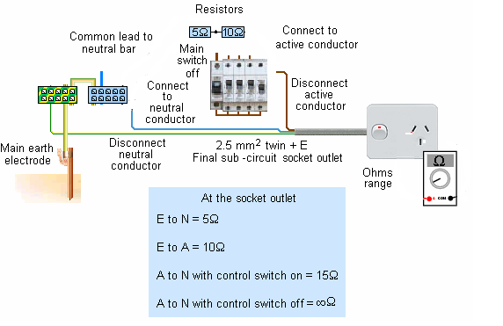
Figure 9.21 Connection test – socket outlets

Slide 17
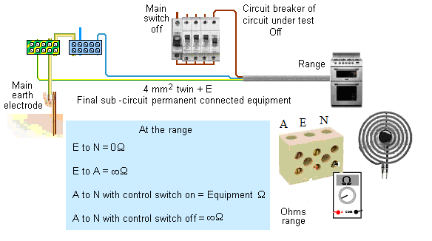
Figure 9.22 Connection test – permanently connected equipment

Slide 18
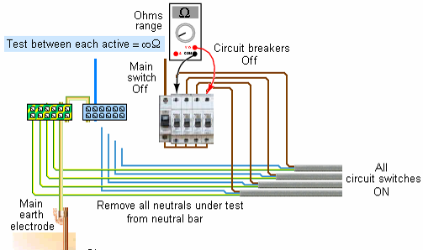
Figure 9.23a Interconnection tests between conductors of different circuits

Slide 19
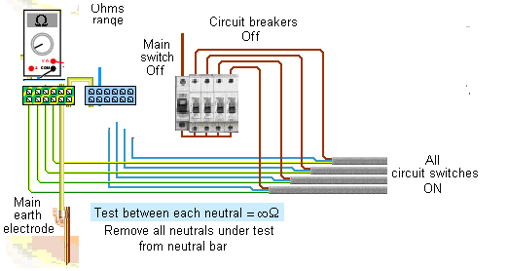
Figure 9.23b Interconnection tests between conductors of different circuits

Slide 20
Figure 9.28 Theoretical fall of resistance around an earth electrode
x
P
C
100
80
60
Resistance (ohms)
40
20
0
10m
20m
Distance (m)

