Slide 1
PROTECTIVE EARTHING SYSTEMS AS/NZS 3000:2018
The purpose of this presentation is to outline the general principles associated with the multiple earthed neutral (MEN) protective earthing system.
Click the left mouse button for each slide
(Or press the SPACEBAR or ENTER key)

Slide 2
Protective EARTHING SYSTEMs
There are three general systems of earthing used in different countries only the MEN is covered by the AS/NZS 3000.
1. The MEN (Multiple Earthed Neutral)
2. The Direct Earthing system or TT or TN-S earthing System.
3. The Voltage operated ELCB

Slide 3
REASONS FOR AN EARTHING SYSTEM
An earthing system is a safety feature of an electrical installation.
An earthing system provides:
protection against electric shock hazards
protection against electrically initiated fires
voltage stability
correct functioning of equipment.

Slide 4
REASONS FOR AN EARTHING SYSTEM (Cont)
Fault currents or standing leakage currents in an unearthed electrical system may cause the electrical potential of the system to ‘float’.
Connection of the neutral conductor to the earthing system provides a stable electrical potential with respect to earth.
This ensures that electrical equipment has the correct applied voltage.

Slide 5
The MEN EARTHING System
In the multiple earthed neutral (MEN) system the parts of the installation which are required to be earthed are connected to the general mass of earth within the installation (via a main protective earthing conductor), and, in addition, are connected within the installation to the neutral conductor of the supply system at one point - the main neutral link (see Wiring Rules, Clause 1.4.66).
The neutral is also earthed at the supply authority's distribution transformers and sub-stations.
Continue

Slide 6
The MEN EARTHING System ( cont)
The MEN earthing system includes:
the main earth terminal
the main earthing conductor
the earth electrode
the MEN connection
protective earthing conductors
equipotential bonding conductors
functional earthing conductors.
Continue

Slide 7
The MEN EARTHING System (cont)
The MEN system is a current-operated system. Circuit protection devices disconnect the supply in the event of an over-current.
The impedance of the current path must be low enough to ensure that the protection device will operate.
Continue

Slide 8
MEN earthing Outline Diagram
The installation main neutral link is connected to the general mass of earth:
Continue

Slide 9
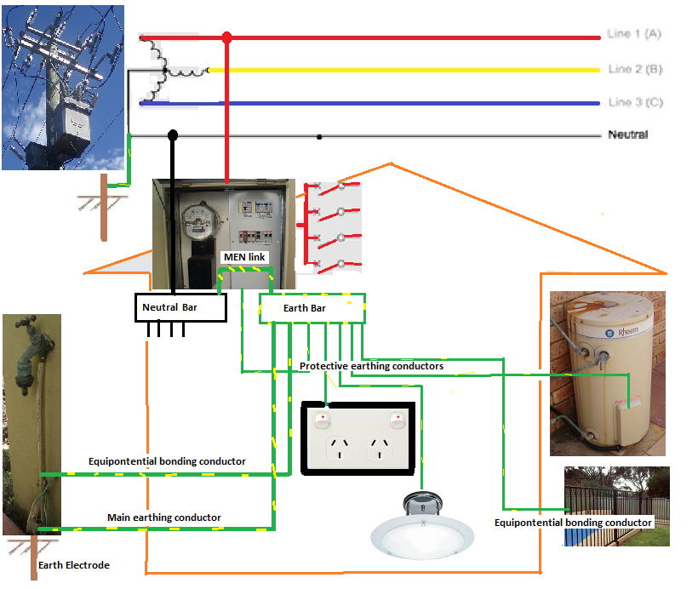

Slide 10
Advantage of the MEN earthing System
The main advantage of the MEN system is that the neutral is connected to the earth at every distribution centre and installation in the supply system, thus providing many parallel paths for any fault currents.
The main disadvantage is that the resistance of the earthing conductors and earthing circuits must always be low enough to ensure that sufficient current can flow under fault conditions to allow the protection device to operate within a specified time (see AS/NZS 3000 Clause 1.7.4.3.3). The Wiring Rules require that the resistance of a main earthing conductor must not exceed 0.5 ohms (see Clause 6.3.3).
The MEN system is the system used in most installations in W.A.
Continue

Slide 11
Operation of the MEN earthing System
The operation of an MEN earthing system depends mainly on there being an adequate conducting path between the neutral conductor and the general mass of earth.
The supply is automatically disconnected when sufficient current flows in the circuit to operate the circuit protection device such as a fuse or circuit breaker, thus providing protection against electric shock in case of a fault.
Continue

Slide 12
Automatic Isolation
Earth Fault
If the earthing conductor was correctly connected a high current would flow from the outer casing to earth via the earth in the socket outlet and the circuit protection device (fuse or circuit breaker) protecting the circuit would operate and automatically isolate the circuit from the supply.
Continue

Slide 13
Fault Condition
Earth Fault
If the earthing conductor was not connected, or if it was not able to carry the current required to operate the circuit protection device, or the resistance of the earthing circuit was too high, the outer metal casing would remain alive; any person touching the frame while in contact with any earth would suffer an electric shock.
Continue

Slide 14
Men Earth faults
Faults that affect the operation of an electrical installation include:
open circuit supply neutral
reversed polarity of the supply
mistakes in wiring
neutral to earth breakdown.
Continue

Slide 15
Men Earth faults
The supply neutral conductor normally carries out-of-balance currents and under fault conditions it carries the fault current.
A high-resistance connection or an open circuit in the neutral conductor could place the electrical installation in a potentially dangerous condition.
Continue

Slide 16
Men Earth faults
Even though an open circuit neutral may present a dangerous situation, the advantages of the MEN system are deemed to outweigh the disadvantages.
Reversed polarity of the supply should not happen if correct procedures are followed.
Continue

Slide 17
Limitations
Earthing an appliance does not provide protection against electric shock if a person touches the active and neutral or active and earth simultaneously.
Earthing an appliance does not prevent faults from occurring, nor does it correct any faults; it limits the touch voltage and removes the supply from the faulty section of the circuit
Continue

Slide 18
Disconnection Times
Clause 1.5.5.3 of AS/NZS 3000 specifies the disconnection times for a 230/240 volt supply voltage as:
0.4 seconds for final subcircuits that supply
socket outlets having rated currents less than 63A or
Hand held Class 1 equipment or
Portable equipment intended for manual movement during normal use
5 seconds for other circuits including submains and final subcircuits supplying fixed or stationary equipment.
Continue

Slide 19
Requirements for Earthing
The main requirements for earthing are contained in Section 5 of the Wiring Rules.
Typical samples of the requirements are given in the slides which follow.
Continue

Slide 20
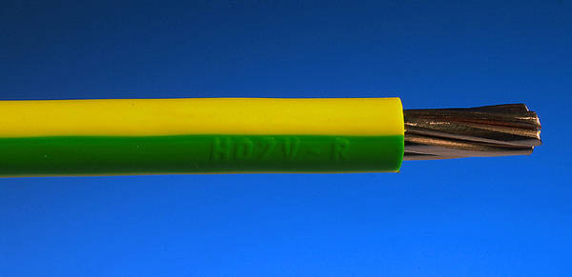
Cable Colour
The only permissible colour for an insulated earthing conductor is green/yellow
Continue

Slide 21
Insulation Resistance
The condition in which the resistance between any part of circuit and the exposed metal frame of an appliance (i.e. the insulation resistance) is below specified limits is known as an 'earth fault' or low insulation resistance to earth. The same term is applied to complete installations.
The insulation resistance between all live conductors connected together and earth must not be less than 1 megohm, measured with a high voltage insulation tester (Megger), and with all protective devices in circuit and all switches on (individual consuming devices may be disconnected).
Continue

Slide 22
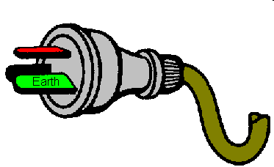
Make First - Break Last
Where a portable single insulated appliance is supplied by a flexible cord, and is connected to the supply via a plug and socket-outlet, provision must be made for the earthing pin to automatically make contact first and break contact last.
This is achieved by making the earth pin in the plug-top longer that the other pins.
Continue

Slide 23
Incorporation of Earthing Conductor
If a portable single insulated appliance is supplied by a flexible cord the earthing conductor must be incorporated in the same outer sheath as the associated live conductors
It is not permissible to supply a single insulated appliance using two core flexible cord, and tape an additional conductor to the outside of the sheath of the flexible cord and use it as an earthing conductor.
Continue

Slide 24
Exposed Conductive Parts
The conditions under which a protective earthing conductor may be connected to exposed conductive parts such as a constructional bolt are contained in AS/NZS 3000
It is not permissible to connect an earthing conductor to structural or ornamental metallic framework which does not form an integral part of an appliance.
Continue

Slide 25
Earthed Situation
An 'earthed situation' is a situation wherein there is a reasonable chance of a person touching the exposed metal of an appliance and, at the same time, coming in contact with an earth
Continue

Slide 26
Soldered Joints
Joints in copper main earthing conductors up to 16 square mm are usually soldered.
Soldered joints must be made so that the earthing conductors are retained in position independent of the solder
Continue

Slide 27
Equipotential Bonding
Equipotential bonding is the process of connecting metallic water piping, waste pipes and other extraneous metal in contact with the ground and accessible to personal contact, with the earthing system of the electrical installation
They are intended to minimise unwanted voltages between accessible metallic parts of electrical equipment and accessible metallic parts which are not part of the electrical installation.
Equipotential bonding conductors are treated in the same way as earthing conductors.
Continue

Slide 28
Insulation Classifications
Most low voltage electrical appliances are manufactured to one of three general insulation specifications, namely:
Single Insulated (Class I equipment)
Double Insulated (Class II equipment)
All Insulated
Continue

Slide 29
Single Insulated (Class I)
Single Insulated
In a single insulated appliance there is one layer of insulation between the internal live components and the outer metal enclosure.
Continue

Slide 30
Double Insulated (Class II)
Double Insulated In a double insulated appliance there are two layers of insulation between the internal live components and the outer metal enclosure; the layers of insulation are called the functional layer and the protective layer.
The international symbol to indicate double insulation is one square inside another.
Double insulated appliances must NOT have exposed metal connected to earth, and they have a warning label such as 'DO NOT EARTH - DOUBLE INSULATED'. See AS/NZS 3000 Clause 1.4.26 (Class II equipment)
Continue

Slide 31
All Insulated
All Insulated
All insulated appliances have no exposed metal parts so they do not have an earth.
Continue

Slide 32
Single Insulated Devices
Many electrical appliances which operate at voltages exceeding 50 volts a.c. are of the single insulated type.
Single insulated devices must never be connected to the supply unless the exposed metal is connected to the general mass of earth via the earthing conductor in the flexible cord and the earthed pin in the socket-outlet.
Live terminals or parts must not be accessible to users of electrical equipment.
Continue

Slide 33
Size of Earthing Conductors
Protective earthing conductors must be large enough to carry the current which will enable the associated circuit protection device to operate before the cables in the circuit are damaged under fault current.
The requirements for determining the mimimum permissible size of earthing conductors are contained in AS/NZS 3000
Table 5.1 gives the minimum permissible earthing conductor size for a range of copper and aluminium cables.
Continue

Slide 34
Functional Earthing
Functional earthing is an earthing arrangement provided to ensure correct operation of electrical equipment or to permit reliable and proper functioning of electrical installations.
Functional earthing is required in the internal circuitry of some types of electronic equipment such as that used in entertainment, communications and instrumentation applications, to prevent unwanted potential differences in the equipment.
Continue

Slide 35
The End
Thank you for participating in this presentation
Click the left mouse button to exit
(Or press the SPACEBAR or ENTER key)

