Slide 1
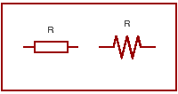
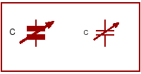
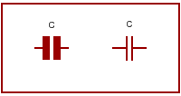
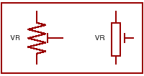
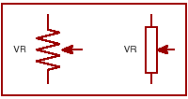
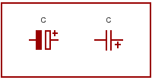
Component Identification – Resistors and Capacitors
.

Slide 2
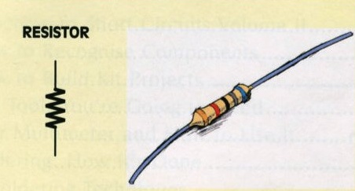
How to identify common components – The Resistor -
RESISTORS are used to regulate the amount of current flowing in a circuit - the higher the resistor's resistance, the less current that flows and vice versa.
Resistor values are measured in ohms Ω, and are identified by colour bands.
They may be connected into a circuit either way around (they are not polarised).
Resistors are made in different sizes, capable of dissipating or 'getting rid of' different amounts of energy (heat).
They are also made using different materials as the actual resistive element. Small low power resistors usually have an element made from either carbon or a thin film of metal oxide.
Larger resistors made to dissipate more power generally have an element wound from a wire such as nichrome (nickel-chromium alloy).
These are called wirewound resistors

Slide 3
Resistor Colour Codes
Resistors are one of the most common components in
electronic circuits, but many are too small to carry their value
and tolerance (margin of error) printed in text.
To get around this problem, a system of using bands of
coloured paint has been used for many years.
Each colour band is used to represent either a numeral, or a
particular decimal multiplier, so it's generally not too hard to
work out the value of a resistor by checking its 'colour code'
(see diagram on next slide).

Slide 4
.
4 band resistor

Slide 6
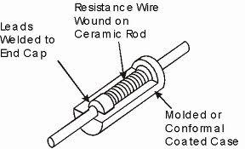
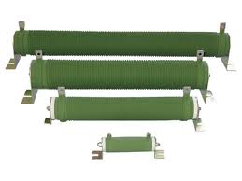
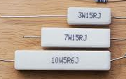
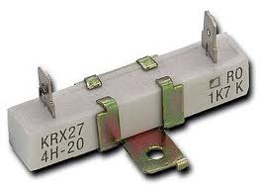
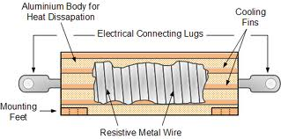
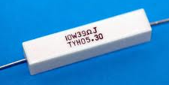
Wirewound Resistors

Slide 7
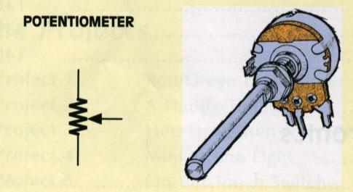
Variable Resistors
A POTENTIOMETER (or 'pot') is basically a variable
resistor. It has three terminals and is fitted with a
rotary control shall or spindle. Rotating this shaft
varies the position of a wiping metal contact on a
circular carbon resistance track inside the pot
body, and this in turn determines the resistance
between the wiper and the two outer terminals.
Potentiometers are commonly used as volume controls.

Slide 8
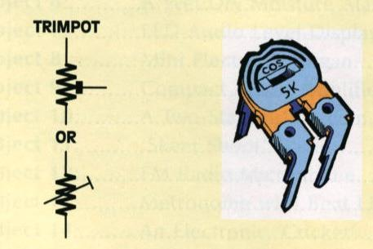
.
A TRIMPOT is a special type of potentiometer which,
while variable, is intended to be adjusted once or only
occasionally. A control shaft is not included.
A slot is provided so it can be adjusted with a small
screwdriver.
Some trimpots are made with their total resistive
element and wiper rotor exposed, others are enclosed
in a small plastic case.

Slide 9
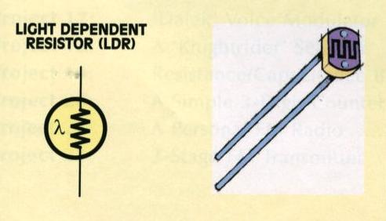
LDRs
A LIGHT DEPENDENT RESISTOR (or LDR) is a special type of resistor that varies its resistance value according to the amount of light falling on it.
When it is in the dark, an LDR will typically a very high resistance (eg, millions of ohms), but this will fall to just a few hundred Ω when the LDR is exposed to strong light.
They are not polarised.

Slide 10
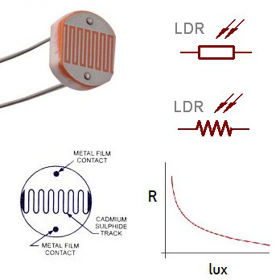
Light dependant Resistors

Slide 11
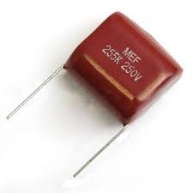
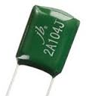
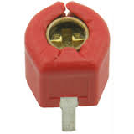
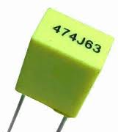
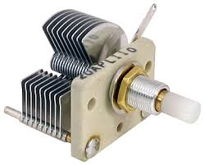
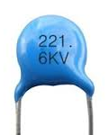
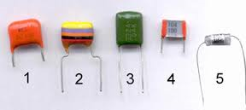
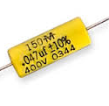
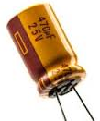
Capacitors

Slide 12
POLYESTER capacitors use polyester plastic film as their insulating dielectric. Some polyester capacitors are called green caps since they are coated on the outside with green (or brown!) plastic. Their values are specified in microfarads (µF), nanofarads (nF) or picofarads (pF), and range from 1 nF up to about 1µF. They are not polarised.

Slide 13
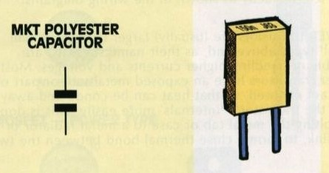
.
MKT capacitors are another type of polyester
capacitor, but they are in a retangular 'block'
shape and are usually yellow in colour. One of the
major advantages of MKT capacitors is a more
standardised lead spacing, making them more
useful for PC boards. In most circuits, MKT
capacitors can always be substituted for greencaps
if required..

Slide 14
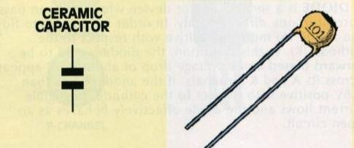
.
CERAMIC capacitors use a tiny disc of ceramic material for their insulating dielectric, and range in value from 1 pF (picofarad) up to about 1µF.
Ceramic capacitors are often used in RF (radio frequency) and filter circuits. Like greencaps and MKTs, they are not polarised.

Slide 15
ELECTROLYTIC capacitors (or 'electros') use a very thin film of metal oxide as their dielectric, which allows them to provide a large amount of capacitance in a very small volume. They range in value from about 1µF up to thousands of microfarads . They are commonly used to filter power supply rails, for coupling audio signals and in timing circuits. All electrolytic capacitors allow a very small DC 'leakage' current through them, but special 'low leakage' types are made so that this leakage current is much smaller than normal.
Note that electrolytic capacitors are polarised. The Positive and negative leads are clearly marked on their
bodies. Be sure to connect them the right way around !!

Slide 16
This is what happens if you “get the polarity wrong”

Slide 17
Sometimes the amount of capacitance in a circuit needs to be adjusted or 'trimmed' – such as setting the frequency of a tuned circuit, for example. A VARIABLE capacitor has one set of fixed plates, and one set which can be moved either by turning a knob (like a pot) or a screwdriver (like a trimpot). The dielectric between the two sets of plates is usually either air or a plastic film. Because of their construction, most variable capacitors have quite low maximum values - up to a few tens of picofarads (pF) for trimmer capacitors and a few hundred picofarads for larger variable capacitors used for tuning radios.

Slide 18
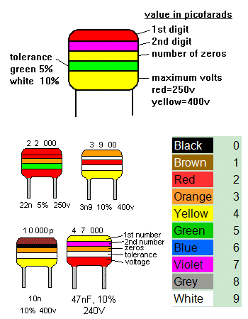
Capacitor colour codes

Slide 19
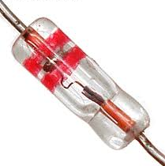
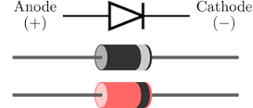
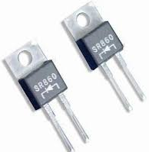
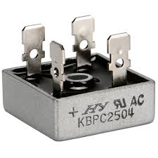
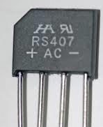
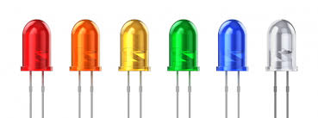
Semiconductors: DIODES

Slide 20
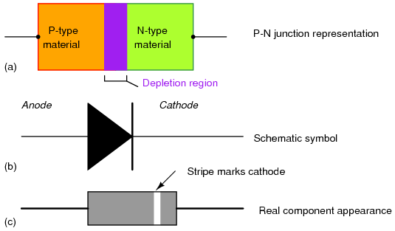

Slide 21
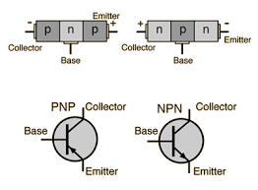
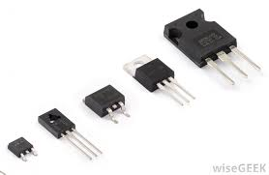
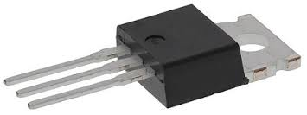
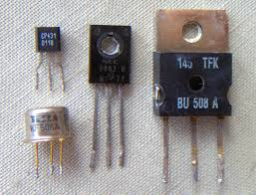
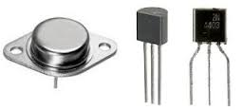
TRANSISTORS

Slide 22
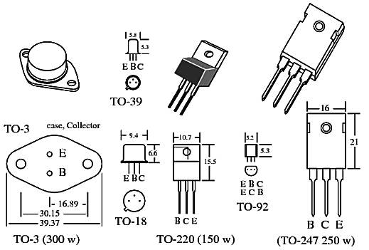
Transistor packages

Slide 23
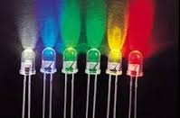
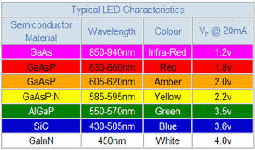
Light Emitting Diodes
Google Images

Slide 24
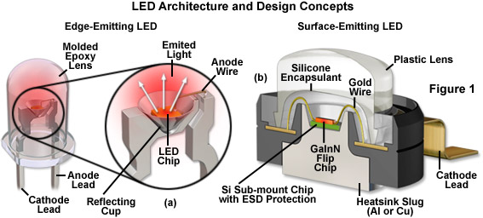
Google Images

Slide 25
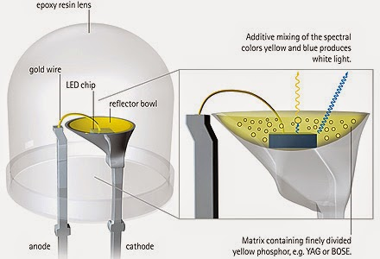
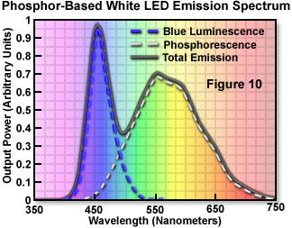
White LEDs are actually an ultra blue LED with a phosphor reflector that emits yellow light after excitation by the blue light. The yellow and blue light combine to form white light
Google Images

Slide 26
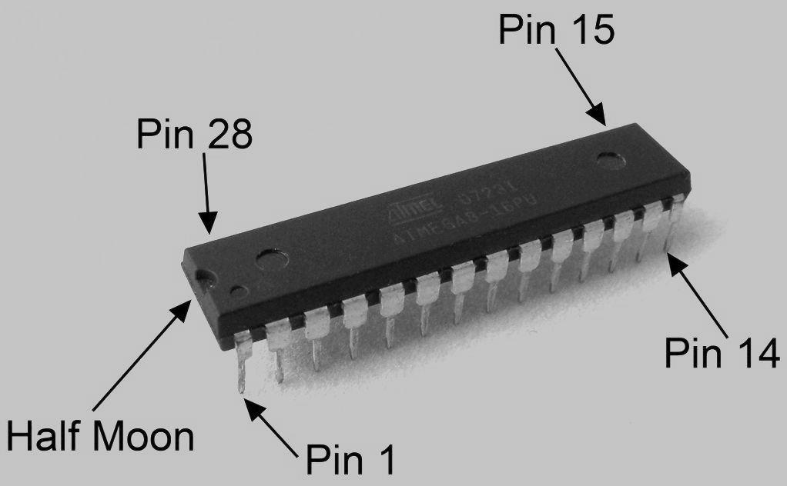
Integrated circuits: 28 pin DIL package (dual In line)
Google Images

Slide 27
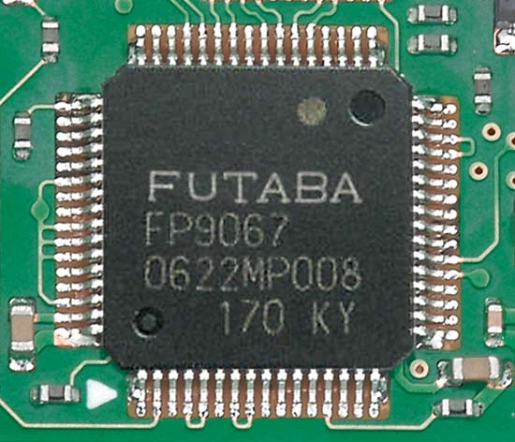
Other types of ICs, 64 pin surface mount IC
Google Images

Slide 28
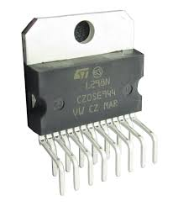
Audio power amplifier ICs
Google Images

Slide 29
Internal structure of IC
Google images

Slide 30
Images courtesy of Google Images

