Slide 1
Inductance in an AC circuit

Slide 2
Suggested Resources:
- “Electrical Principles For Electrical Trades” Jenneson J.R., 5th edition, Chapter 8, Pages (160 – 194)
- “Electrical Trade Principles – A Practical Approach”, Hampson & Hanseen, 2nd Edition, Pages 183 – 186.

Slide 3
At the conclusion to this section, you will be able to:
Define inductive reactance.
Calculate the inductive reactance of a given inductor and show the relationship between inductive reactance and frequency.
Apply series and parallel circuit rules to determine the equivalent inductive reactance in any part of an AC circuit.
Apply Ohm’s law to determine voltage, current or inductive reactance in a purely inductive AC circuit given any two of these quantities.
Compare the current limiting characteristics of inductors and resistors.

Slide 4
At the conclusion to this section, you will be able to:
Apply Ohm’s law to determine voltage, current or inductive reactance in a purely inductive AC circuit given any two of these quantities.
Give examples of inductive components in power circuits and systems and describe their effect on the phase relationship between voltage and current.
Compare the current limiting characteristics of inductors and resistors.
Give examples of inductive components in power circuits and systems and describe their effect on the phase relationship between voltage and current.

Slide 5
Resistance in a AC Circuit
When a direct current flows through a resistive circuit, the current flow is directly proportional to the voltage and inversely proportional to the resistance and its magnitude can be calculated using Ohm’s law. The same is true if an AC voltage is applied to that circuit. The current flow can again be determined by Ohms Law and is calculated in the same way.

Slide 6
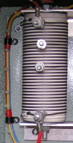
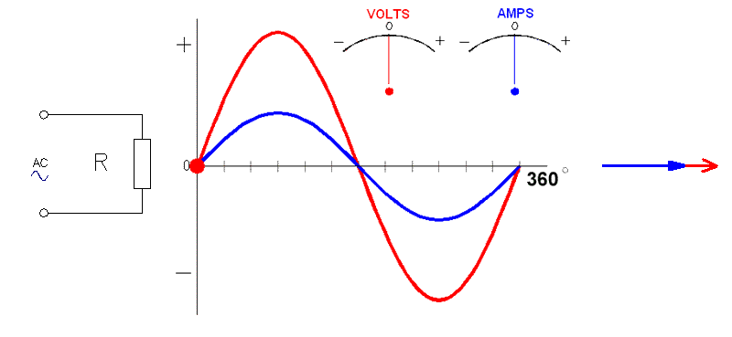
Resistors on AC
When a resistor is connected to an a.c. supply the current is in phase with the voltage.
All of the electrical energy is converted to heat energy
Phasor diagram
Continue

Slide 7
Inductance in a AC Circuit
The property of an inductor is to resist any change in the current flowing through it. This property is called self inductance and is the factor responsible for producing a back e.m.f.
Back e.m.f has the effect of delaying current rise through an inductor and is the reason why current reaches it’s maximum value sometime after voltage is applied.

Slide 8
Inductance in a AC Circuit
A similar effect occurs when current stops flowing. The collapse of the magnetic field around the inductor induces a voltage back into the windings in an attempt to keep the current flowing. This has a delaying effect on the current and prevents it from returning to zero immediately the voltage source is removed.

Slide 9
Inductance in a AC Circuit
In both cases the effect of the inductance is to delay the rise or fall of the current through the inductor. This effect only occurred when there was a change in current. In a DC circuit, current eventually reaches a final value determined by the DC resistance of the inductor.

Slide 10
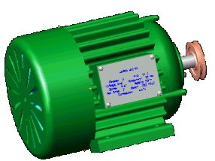
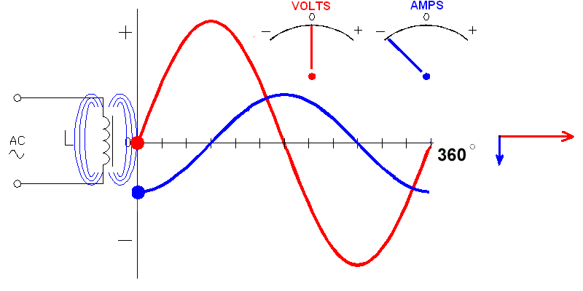
Inductors on AC
When a pure inductor is connected to an a.c. supply the current lags the voltage by 90 degrees.
Phasor diagram
Phasors are assumed to be rotating anticlockwise.
The electrical energy is stored in a magnetic field and returned to the mains during the negative half-cycle.
Continue

Slide 11
Factors which Govern the Inductance of a coil on AC
The number of turns – as the turns increases, the inductance increases.
The area of the magnetic core – the larger the core, the higher the inductance.
The relative permeability of the core – the higher the permeability, the higher the inductance.
The length of the inductor – the inductance increases as the mean length of the magnetic core increases.

Slide 12
What is Inductive Reactance (XL)?
When an inductor is connected into an AC circuit, a similar effect occurs. Because current reverses periodically, back e.m.f is induced each time the direction of current flow reverses. This acts as an opposition to current flow and limits current flow in the inductor.

Slide 13
Inductive Reactance (XL)
This current limiting property of an inductor is called the inductive reactance or AC resistance and is given the quantity symbol XL. Like resistance, inductive reactance is measured in ohms.

Slide 14
Inductive Reactance (XL)
Unlike resistance however, inductive reactance for a given inductive component is not fixed because it depends on the rate at which the magnetic field is changing, and this of course is determined by the frequency of the AC supply. The value of reactance for a given inductor can be found from the expression.
XL = 2π f L
Where π = 3.142
f = Frequency in Hz.
L = Inductance in Henrys
XL = Inductive reactance in Ohms
Inductive reactance is directly proportional to frequency.

Slide 15
Example 1
Calculate the inductive reactance of a coil that has an inductance of 0.25 H if it is connected to a 50 Hz supply.
XL = 2π f L
= 2 x π x 50 Hz x 0.25 H
= 78.539 Ω

Slide 16
Inductive Reactance Vs Frequency
Inductive reactance is directly proportional the frequency of the supply to which the inductor is connected.
As frequency increases, so does inductive reactance.
F proportional to XL

Slide 17
Example 2
Calculate the change in inductive reactance that will take place if a 0.45 H coil is initially connected to a 50 Hz supply and then to a 100 Hz supply.
At 50 Hz
XL = 2π f L
= 2 x π x 50 Hz x 0.45 H
= 141.372 Ω
At 100 Hz
XL = 2π f L
= 2 x π x 100 Hz x 0.45 H
= 282.743 Ω
In this example, since the frequency doubled from 50 to 100 Hz, the inductive reactance also doubled from 141.372 Ω to 282.743 Ω

Slide 18
Current limiting
The use of inductive reactance to limit current in AC circuits is common applications and more efficient than using resistors for the same purpose.
When a resistor is used to limit current, a large amount of power is dissipated in the form of waste heat. This heat is an energy loss and affects the overall efficiency of a system.

Slide 19
Current limiting
When an inductor is used to limit current in an AC circuit, much less power is wasted because a purely inductive component does not dissipate any power. The only power dissipated is in the resistive component of an inductor. (This concept will be dealt with in another section). Inductive current limiting is used in
Gas discharge lighting circuits
Speed control of small induction motors such as ceiling fans
Dimming of incandescent stage lighting
Current control on AC arc welders

Slide 20
Discharge Lighting Application
When a gas is ionised, it has a negative resistance characteristic. Current must be limited to a safe level for the lamp to operate safely.
A
Ballast
N
The lamp current for a typical 40 W tube is limited to about 0.42 A and a ballast or choke is used for this purpose.

Slide 21
Speed Control
Ceiling, pedestal and desktop fans are generally provided with a switch that enables their speed to be varied in a series of steps.
The speed control device used is often a multi-tapped choke. This is allows the user to vary speed by varying the number of turns placed in series with the motor.
When the low speed setting is selected, the switch connects the maximum number of turns in series with the motor. The medium setting has less turns and the high speed setting connects the motor directly across the supply.

Slide 22
Speed Control
When the low speed setting is selected, the switch connects the maximum number of turns in series with the motor. The medium setting has less turns and the high speed setting connects the motor directly across the supply.
A
M
FAN
High
Med
Low
Switchable reactance
N

Slide 23
Lamp dimming & Welder current Control
Both of these applications use an identical means of current control.
An iron core is moved in and out of an air-cored inductor. The further the core is inserted into the coil, the higher its inductance and the greater the inductive reactance.
Core fully retracted
Core fully inserted
Minimum inductance
Maximum inductance

Slide 24
Lamp dimming & Welder current Control
When the core is fully retracted, reactance is at its lowest and maximum current will flow through the primary winding of the welder (or through the lamps). As the core is inserted, inductive reactance increases and current through the primary (or the lamps) is reduced.
Welding Transformer
A
Primary
Secondary
N

Slide 25
Resistance of an Inductor
Inductors are made by winding a conductor into a coil. This means that the resistance of a given inductor will be dependent on
The material used for the conductor.
Its total length .
Its cross sectional area and
Ambient temperature.

Slide 26
Resistance of an Inductor
Whatever the material used to wind an inductor, it will always have some resistance. This DC resistance, although smaller than the reactance, will have some effect on the current flowing through it, and is one of the factors responsible for power loss in any inductor.
For the purposes of this discussion, DC resistance will be ignored.

Slide 27
Current Flow in an Inductor
When using Ohm’s law to calculate current flow through an inductor, simply replace R by XL in the formula.
The current flowing in a circuit containing only inductive reactance, is given by the expression.

Slide 28
Example 3
Calculate the change in current flow of an inductor with an inductance of 0.45 H when connected to 230V AC if the frequency is initially at 50 Hz and is then increased to 100 Hz.
At 50 Hz
XL = 2 π f L
= 2 x π x 50 x 0.45
= 141.371 Ω

Slide 29
At 100 Hz
XL = 2 π f L
= 2 x π x 100 x 0.45
= 282.743Ω
In this example, since the frequency doubled from 50 to 100 Hz, the current decreased by half from 1.626 to 0.813 A.
= 0.813 A

Slide 30
Series Connected Inductors
Inductors and resistors both oppose current flow in an AC circuit.
For this reason, inductors connected in series have the same effect on circuit current as resistors connected in series.
That is, the total inductance of inductors connected in series is the sum of the individual inductance values.

Slide 31
Series Connected Inductors
Ltotal = L1 + L2 + L3
L₁
L₂
L₃

Slide 32
Example 4
Calculate the total inductance and the resulting inductive reactance of three inductors 0.25 H, 0.5 H and 0.75 H connected in series across a 230 volt, 50 Hz supply.
Ltotal = L1 + L2 + L3
= 0.25 H + 0.5 H + 0.75 H
= 1.5 H
XL = 2 π f L
= 2 x π x 50 Hz x 1.5 H
= 471.239 Ω

Slide 33
Example 4 (Cont)
XL1 = 2π f L1
= 2 x π x 50 Hz x 0.25 H
= 78.540 Ω
XL2 = 2π f L2
= 2 x π x 50 Hz x 0.5 H
= 157.079 Ω
XL3 = 2π f L3
= 2 x π x 50 Hz x 0.75 H
= 235.619 Ω
X L total
= XL1 + XL2 + XL3
= 78.540 Ω + 157.079 Ω + 235.619 Ω
= 471.238 Ω
This result can be verified by calculating the inductive reactance of the individual inductors and then adding these together.

Slide 34
Parallel Connected Inductors
The same rules apply to inductor connected in parallel as apply to resistors connected in parallel.
The total inductance is less than the lowest valued inductor in the parallel network.
L₁
L₂
L₃

Slide 35
Example 5
Calculate the total inductance and the resulting inductive reactance of three inductors 0.25 H, 0.5 H and 0.75 H connected in parallel across a 240-volt 50 Hz supply.
= 0.136 H
XLTot = 2π fL
= 2 x π x 50 Hz x 0.136 H (Tot H)
= 42.70 Ω

Slide 36
Calculating Inductance
Inductance can be determined if the inductive reactance of the inductor and frequency of the power source it is connected to is known. This is done by transposing the formula.

Slide 37
Example 6
What is the inductance of a coil that has a reactance of 1.2kΩ at a frequency of 400 Hz?

Slide 38
Calculating Frequency
The frequency of the power source to which an inductor is connected can be determined if its inductive reactance and inductance is known.

Slide 39
Example 7
If an inductance of 750 mH has an inductive reactance of 235.619 Ω, calculate the frequency of the power source to which it is connected.

Slide 40
Phase Relationship
An inductor will oppose any change of current flow through it i.a.w Lenz’s Law.
When connected to an AC source, the back e.m.f induced by the changing magnetic field, delays the rise of current through an inductor when the source is turned on, and keeps the current flowing for a short time after the source is turned off.
Current through the inductor only reaches its final maximum value some time after the supply has reached its maximum value. That is, current is said to lag the voltage. Jen Pg 170.

Slide 41
Phase Relationship
The effect of the back e.m.f is not only to reduce the amount of current flow, but to delay or shift the current in time with respect to the voltage. In a purely inductive circuit, current lags the applied voltage by 90°.
Voltage
Current
Back e.m.f
0⁰
90⁰
180⁰
270⁰
360⁰

Slide 42
CIVIL
In Capacitive circuits
C - I Leads V
In Inductive circuits
L - V Leads I

Slide 43
Phasor Diagrams
Using sinewaves to show the phase relationships between two or more waveforms is cumbersome. A better method is to have currents and voltages represented by straight lines called phasors that have direction and magnitude.
Phasors can be rotated from their reference in both directions.
A current phasor is represented by a closed arrowhead
A voltage phasor by an open arrowhead.

Slide 44
Phasor Diagrams
The phasor diagram of a purely inductive circuit can be used to show the phase relationship between the applied voltage, current and back e.m.f.
Back e.m.f
V
The applied voltage and back e.m.f are shifted in phase by 180⁰
Current lags the applied voltage by 90⁰
I

Slide 45
Power in a Purely Inductive AC Circuit
In an AC circuit containing inductance only, power is found by multiplying the voltage across the inductive load by the current flowing through it. In this case the correct term to use for the result of this raw calculation is Volt-Amps.
Where P = V x I
V = Load voltage
I = Load current
P = Power in (V.A)

Slide 46
Voltage and Current in a purely Inductive Circuit
Voltage and Current in a purely Inductive Circuit
8
6
4
2
0.4
- 2
- 4
- 6
8
Voltage
Current
45°
Intervals

Slide 47
Power Curve for an Inductive Circuit
8
6
4
2
0.4
- 2
- 4
- 6
8
Power
+
+
Voltage
Current
-
-
Power Curve for an Inductive Circuit

Slide 48
Total Power in inductive circuit
The average power in a purely inductive circuit is zero.
Since only positive power performs useful work, the power in an inductive circuit performs no useful work and is referred to as Reactive Power.
Inductive components are used in a very wide range of application in AC power circuits. Some of these include:
Relays
Contactors
Solenoids
Motors
Generators
Chokes or ballasts
Transformers

Slide 49
Conclusion
In all of these devices, current will lag the applied voltage. In many instances this does not affect the performance of the device but should be kept in mind when performing calculations or taking reading of current and voltage.
Transformers are devices where the effects of phase shift between voltage and current are very evident.

Slide 50
The End

