Slide 1
Electrical Trades
Three Phase Systems
(Or press the SPACEBAR or ENTER key)
Continue
NUE57ws21.pps S. G. Brooks Version 3 05/2007

Slide 2
Three Phase Generation
A simple three phase alternator operates on the same basic principle as a single phase alternator, but there are three coils on the rotor instead of one, and the three coils are physically arranged so that they are at 120 mechanical degrees to each other.
In some alternators the a.c. coils are wound in the stationary stator and the permanent magnet or d.c. coils which produce the initial magnetic field are on the rotor; in either case the output is the same.
Alternators must be run at a constant speed to produce a constant output frequency. The customary frequency in Australia is 50 Hz, but in some American installations 60Hz is used. The peak output voltage from one revolution of a three phase alternator which has three coils rotating in a

Slide 3
Three Phase Generation
The output from a three phase alternator is governed by:
a. The speed of rotation –in general, the higher the speed the higher the output voltage, and the higher the frequency of the sinusoidal output.
b. The strength of the magnetic flux – in general, the stronger the magnetic flux the higher the output voltage.
c. The number of turns on the coil – in general, the higher the number of turns the higher the output voltage
d. The angle at which the coil cuts the magnetic flux. The induced voltage is zero when the coil is moving parallel to the flux and maximum when it is cutting the flux at 90 degrees, so the output voltage varies sinusoidally between zero and maximum to produce one complete sine wave (or cycle) for every revolution (for a two pole machine).

Slide 4
THREE PHASE ELECTRICITY EXPLAINED
https://youtu.be/4oRT7PoXSS0

Slide 5
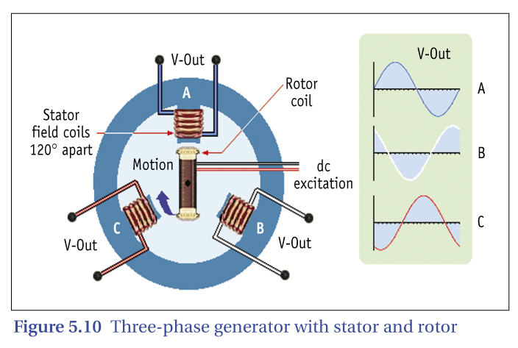

Slide 6
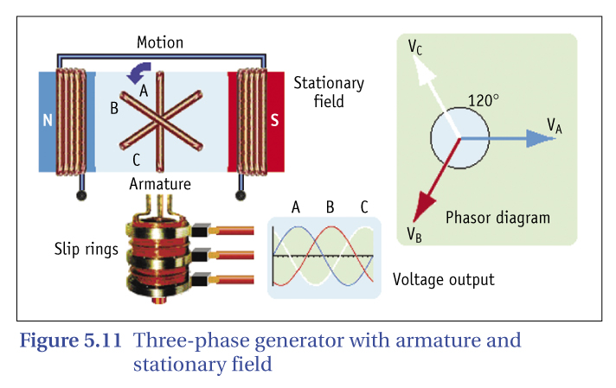

Slide 7
Continue

Slide 8
Adv of Three Phase System
Most supply authorities generate and distribute electrical energy using the three phase system. The main advantages of a three phase distribution system compared to a single phase system include:
a. Two operating voltages are available to consumers; 240 volts rms for lighting and small power applications and 415 volts rms for large motors and other high power applications.
b. Three phase machines can be smaller and more efficient than single phase machines for the same power output.
c. The three phase squirrel cage induction motor is one of the simplest and most reliable motors available.
d. The torque produced by a three phase motor is more constant than the torque produced by a single phase motor, so there is less vibration.
e. A three phase distribution system requires less copper in the transmission lines than a single phase system with the same power transmission capability.

Slide 9
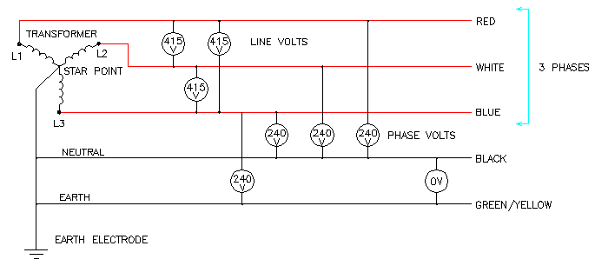
Continue

Slide 10
The sum of the instantaneous currents or voltages in a balanced three phase circuit is zero.
Continue

Slide 11
Star & Delta Connections
The voltage across each ‘leg’ of a star or delta connection is known as the ‘phase voltage (Vp)’ (or ‘coil voltage;) and the incoming three phase voltage is known as the ‘line voltage (VL)’
Star
Delta.
Continue

Slide 12
What is an alternative name for a star connection?
A Wye connection.
Continue

Slide 13
What is an alternative name for a delta connection?
A Mesh connection.
Continue

Slide 14
The name given to a three phase circuit in which the load on each of the three phases is identical is a BALANCED THREE PHASE CIRCUIT?
Continue

Slide 15
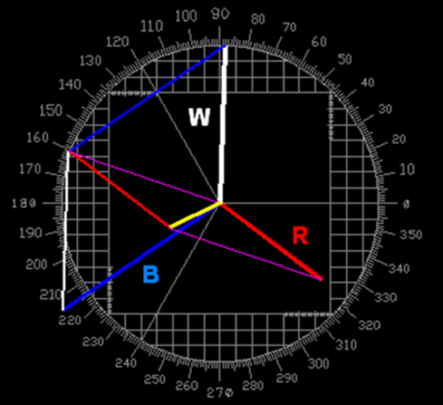
The name given to a three phase circuit in which the load on each of the three phases are not identical is called an OUT OF BALANCE THREE PHASE CIRCUIT.?
Continue

Slide 16
The voltage between the star point and earth if three identical electrical devices are connected in star?
Zero volts
Continue

Slide 17
The names of the coils and line in a STAR circuit is Phase current or voltage; or coil current or voltage if the components are coils - as in motors or transformers.
Continue

Slide 18
The names of the coils and line in a DELTA circuit is Phase current or voltage; or coil current or voltage if the components are coils - as in motors or transformers.
Continue

Slide 19
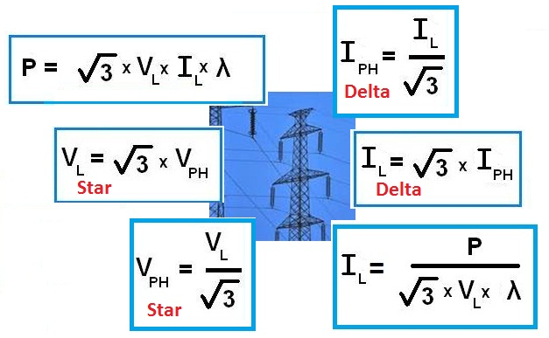

Slide 20
If a balanced three phase delta connected circuit has a line current of 60 amps, what is the value of the phase current?
Continue

Slide 21
If a balanced star connected three phase circuit has a line current of 90 amps, what is the phase current?
Continue

Slide 22
If a balanced three phase delta connected circuit had a phase current of 70 amps, what is the value of LINE current?
Continue

Slide 23
If a three phase balanced star connected circuit had a phase current of 20 amps, what is the value of LINE CURRENT?
Continue

Slide 24
If a balanced star connected three phase circuit has a line voltage of 300 volts, what is the phase voltage?
Continue

Slide 25
If a balanced delta connected three phase circuit has a line voltage of 400 volts, what is the phase voltage?
Continue

Slide 26
What is the phase voltage across two resistors in a balanced 415 volt three phase star connected circuit if the supply to the third resistor is safely disconnected?
207.5 volts - half the line voltage.
Continue

Slide 27
Harmonics
Harmonics are a series of subsidiary waveforms that accompany a primary, or fundamental, waveform. A sinusoidal waveform is made up of a large number of waveforms, each having a frequency which is an integer multiple of the fundamental frequency. A subsidiary waveform which has a frequency of, for example, three times the fundamental frequency is commonly known as a ‘3rd harmonic’.
Figure 19 shows a fundamental sinusoidal waveform, with the 3rd and 5th harmonic.

Slide 28
Figure 19 – A fundamental sinusoidal waveform with 3rd and 5th harmonic.
Harmonics are caused by any reactive or inductive load, or by any device that
uses a rectifier to convert a.c. to d.c. Typical sources of harmonics are
electronic lighting equipment, fluorescent ballasts, personal computers,
uninterruptable power supply systems, some variable speed motor
drives, welders and television sets. See AS/NZS3000:2007 Clause 3.5.2.(b) (ii).
Harmonics cause problems such as:
a. Distortion of the electricity supply voltage
Failure or overheating of transformers and motors
Erratic operation of control and protection relays
interference in telecommunications systems and equipment
Destruction of reactive components in extreme cases
f. Difficulties in calculating power losses
g. Abnormal currents in neutral conductors
h. Nuisance operation of fuses
i High circulating currents associated with power factor correction capacitors
One method of reducing harmonic currents is to install specially designed
harmonic ‘filters’ which consist of an appropriate combination of reactors
(inductors and /or capacitors) selected to decrease the problems
at harmonic frequencies.

Slide 29
How much current would be flowing in the neutral conductor if the load on each of the three phases in a three phase distribution system was identical?
Zero amps. If a three phase star connected circuit is balanced there is no difference of potential between the star point and earth.
Continue

Slide 30
A phasor diagram of the output voltage from a three phase alternator. Indicate the reference phasor and the direction of rotation.
Phasor diagram - horizontal reference phasor - rotation anti-clockwise. Phase rotation red-white-blue.
Continue

Slide 31
Which common balanced three phase connection has the dissimilar ends of each coil winding connected together?
Typical answer:
The delta connection.
Continue

Slide 32
Which common balanced three phase connection has the similar ends of each coil winding connected together?
Typical answer:
The star connection.
Continue

Slide 33
What is the phase relationship between line voltage and phase voltage in a balanced three phase star connected load?
Typical answer:
Line voltage leads phase voltage by 30 degrees.
Continue

Slide 34
Determine the out-of-balance current in the neutral for the following 415 volt 50 Hz three phase circuit: Red Phase: 40 amps at a power factor of 0.8 lagging White Phase: 50 amps at a power factor of 0.85 lagging Blue Phase: 60 amps at a power factor of 0.9 lagging
18 amps
Red phase angle = 36.86 degrees White phase angle = 31.78 degrees Blue phase angle = 25.84 degrees
Typical answer:
Approximately 18 amps.
Continue

Slide 35
How can the out-of-balance current in the neutral be reduced in a large industrial installation?
Typical answer:
By balancing the load on each of the phases more evenly.
Continue

Slide 36
A three phase four wire industrial installation has active conductors which have a current carrying capacity of 150 amps. What is the minimum permissible current carrying capacity of the associated neutral conductor? State the Wiring Rules Clause number.
Typical answer:
100 amps. Clause 3.5.2.
Continue

Slide 37
When determining the current carrying capacity of the neutral conductor in a three phase four wire installation, is it necessary to take abnormal circuit conditions (such a blown fuse in one phase) into account? State the Wiring Rules clause number.
Typical answer:
No. 3.5.2(b).
Continue

Slide 38
Name two electrical devices which can be designed for operation from two phases of a three phase supply.
Typical answer:
Cooking ranges and arc welders
Continue

Slide 39
What effect would it have on the operation of an unbalanced three phase four wire MEN installation if the neutral is open circuited when the circuit is energised?
Typical answer:
Voltages could vary and damage equipment. A voltage occurs across the break in the neutral.
Continue

Slide 40
What is the phase relationship between the input voltage and the output voltage of a three phase transformer which is connected delta to star?
Typical answer:
The output voltage lags the input voltage by 30 degrees.
Continue

Slide 41
What is meant by the term 'Harmonic' when applied to sinusoidal electrical power systems?
Typical answer:
Harmonics are subsidiary waveforms which are integer multiples of the fundamental frequency.
Continue

Slide 42
Give two possible sources of undesirable harmonics in sinusoidal electrical power systems? How can the effects be overcome?
Typical answer:
Fluorescent ballasts. Electronic switching circuits. Reduce inductive components. Install harmonic filters.
Continue

Slide 43
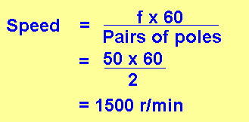
At what speed must a 4-pole three phase alternator be rotated to produce a frequency of 50 Hz?
Typical answer:
1500 r/min. Speed = fx60/Pairs of poles or fx120/Poles.
Continue

Slide 44
The End
Thank you for participating in this presentation.
Click or press ESC to exit.
Continue

