Slide 1
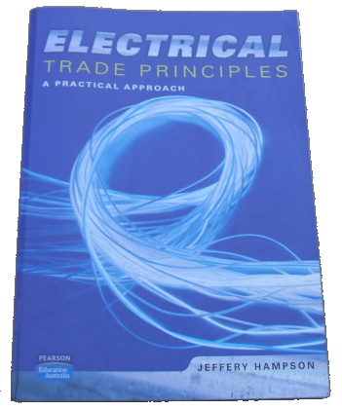
Three Phase Star Connections
Tutorial
The purpose of this presentation is to provide you with the opportunity to check your knowledge of three phase star connections.
Reference: Electrical Trade Principles - A Practical Approach, Jeffery Hampson, Pearson Education Australia. Page 196
The recommended method of using this presentation is to read the question carefully, then work out your answer on a separate sheet of paper.
When you have the answer, left-click and the correct answer will be displayed.
Left-click to advance. Right-click for a user menu.
Three Phase Star Connections.pps
Exit
Version 4
S.G. Brooks 2007

Slide 2
Three Phase Star Connections 1
1. Why is the generation and distribution of energy carried out using a three-phase star connection?
Answer:
There are many advantages of using a star connected system one of which is that the phase voltages are lower in this system when compared with a delta system requiring less insulation with respect to the stator.
Reference: Hampson - Page 192
Continue

Slide 3
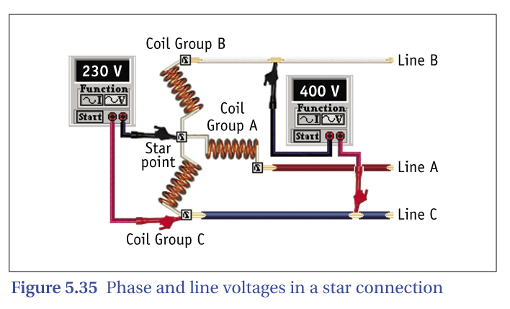
Three Phase Star Connections 2
2. Between what two points on a coil group is a phase voltage measurement taken?
Answer:
The voltage measured across a single coil group in a star connection is known as the phase voltage.
Reference: Hampson - Page 192
Continue

Slide 4
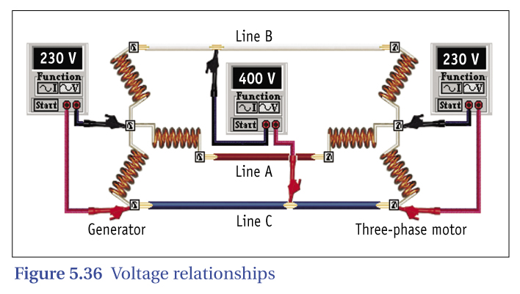
Three Phase Star Connections 3
3. The voltage measurement between the lines of a star system is known as . . .?
Answer:
The voltage measured between the lines is known as the line-to-line voltage or line voltage.
Reference: Hampson - Page 192
Continue

Slide 5
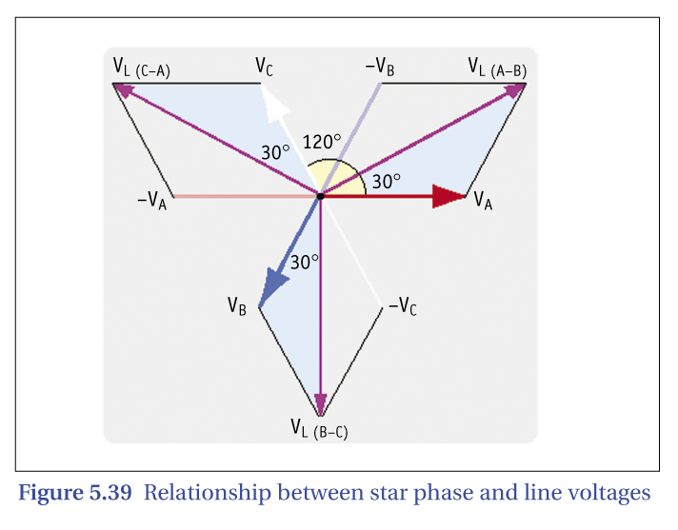
Three Phase Star Connections 4
4. By what factor does the line voltage differ from the phase voltage in a star-connected system?
Answer:
In a star connected system the line voltage is of greater potential than the phase voltage by a factor of the √3 (1·732).
Reference: Hampson - Page 193
Continue

Slide 6
Three Phase Star Connections 5
5. In a star-connected system state the angle of relationship between the line voltage and the phase voltage.
Answer:
The line voltage leads the phase voltage by 30º.
Reference: Hampson - Page 193
Continue

Slide 7
Three Phase Star Connections 6
6. If the phase voltage in a star generator is 288 675 V, determine the line voltage.
Line voltage = Phase voltage x √3
Answer:
500 kV
Reference: Hampson - Page 192
Continue

Slide 8
Three Phase Star Connections 7
7. The line voltage in a star generator is 66 kV. Determine the phase voltage.
Phase voltage = Line voltage √3
Answer:
38 105 V
Reference: Hampson - Page 192
Continue

Slide 9
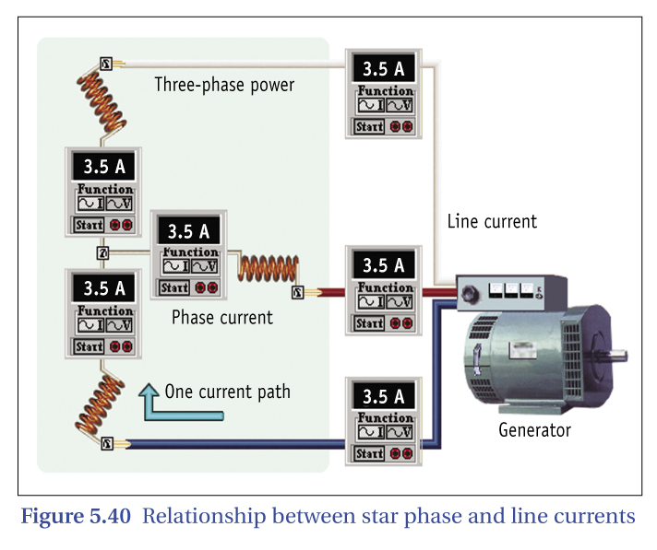
Three Phase Star Connections 8
8. State the current relationship between the line current and phase current in a star-connected system.
Answer:
The line current equals the phase current.
Reference: Hampson - Page 193
Continue

Slide 10
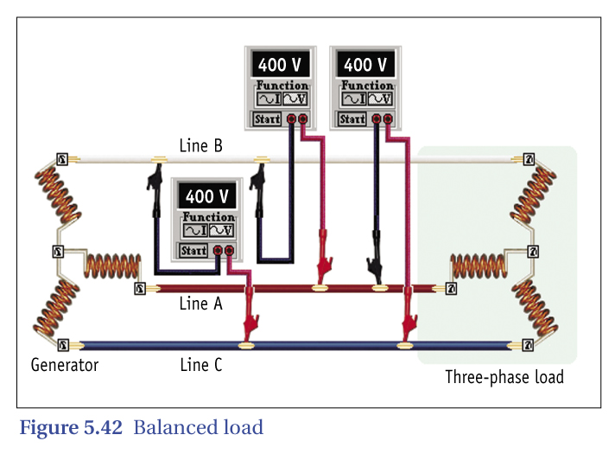
Three Phase Star Connections 9
9. What are the two electrical conditions that must exist for a three-phase system supplying a load to be balanced?
Answer:
For a system to be balanced the load must be drawing the same current at the same angle θº (power factor) on each phase.
Reference: Hampson - Page 194
Continue

Slide 11
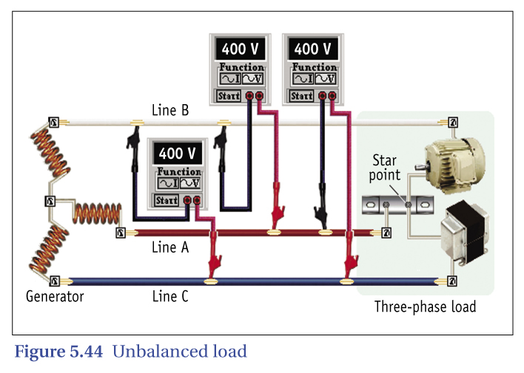
Three Phase Star Connections 10
10. What creates an unbalanced star-connected single­phase load?
Answer:
Many three-phase systems represent an unbalanced condition due to uneven loading on the different phases.
Reference: Hampson - Page 194
Continue

Slide 12
Three Phase Star Connections 11
11. When the three-phase currents deviate from the ideal balanced conditions what effect does this have on the phase voltage across the loads?
Three-phase three-wire systems are rarely used in practice.
Answer:
If the three-phase load currents deviate from the ideal balanced condition the voltage between each phase and the star point will experience wide variations. Depending upon the degree of unbalance between the three single-phase loads the three voltages across the loads could vary from zero to any voltage up to phase-to-phase voltage.
Reference: Hampson - Page 194
Continue

Slide 13
Three Phase Star Connections 12
12. State the consequence on equipment and appliances connected across phases when the phase voltage varies under unbalanced conditions.
Three-phase three-wire systems are rarely used in practice.
Answer:
Such a consequence causes damage to connected loads due to over voltage on the circuit
Reference: Hampson - Page 194
Continue

Slide 14
Three Phase Star Connections 13
13. Under what conditions could an unbalanced system exist?
Answer:
With four wire three-phase systems it is possible for a neutral to be displaced from the system due to poor workmanship, environmental conditions such as storms, and vandalism creating the out-of-balance problems.
Reference: Hampson - Page 195
Continue

Slide 15
Three Phase Star Connections
That is the end of this presentation.
Reference: Electrical Trade Principles - A Practical Approach, Jeffery Hampson, Pearson Education Australia. ISBN 1 74103 389 6. Dewey: 621.3
Thank you for your participation.
Finished

