Slide 1
Batteries

Slide 2
25.3 Batteries
This section provides an overview of the types of batteries used in the electrical industry as back-up power supplies.
It describes the main types of primary cells (those that cannot be recharged) and typical types of secondary cells.

Slide 3
Background
The electric cell has three components: a positive electrode, a negative electrode and an electrolyte.
An electrolyte – usually an acid or an alkali, is a liquid with ions.
The electrodes are made from different materials and are immersed in the electrolyte

Slide 4
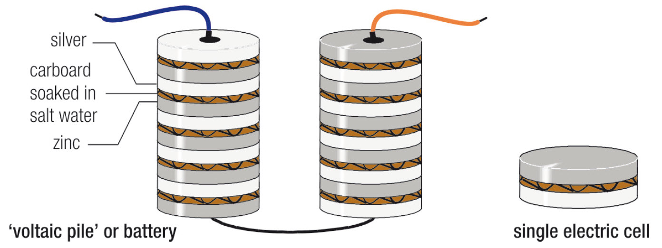
The first battery
Volta’s ‘voltaic pile’ is a stack of single cells, devised in 1800, the first practical source of electrical power
Notes:
Figure 25.43

Slide 5
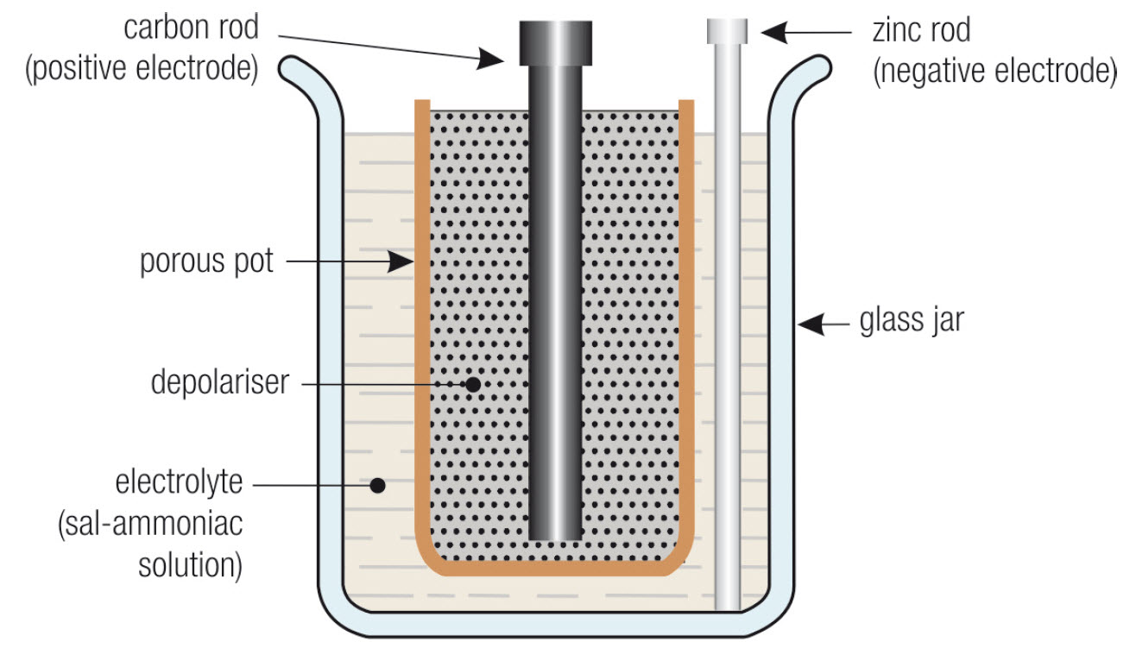
The leclanché cell
The Leclanché cell has a depolariser that converts hydrogen to water by combining it with oxygen.
Notes:
Figure 25.44

Slide 6
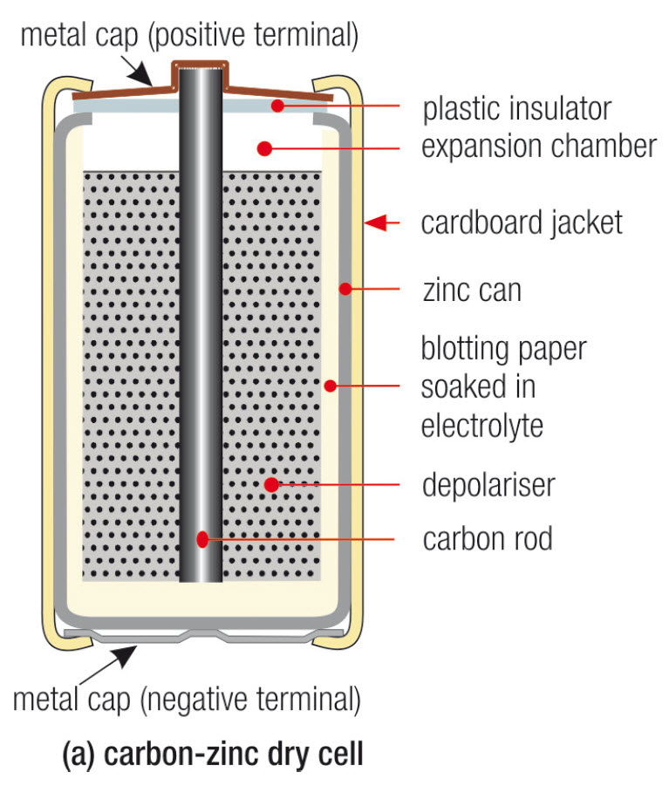
Carbon-zinc dry cell
The carbon-zinc dry cell is based on Leclanché’s wet cell, except the liquid chemicals are formed into a paste.
Notes:
Figure 25.45 (a) only

Slide 7
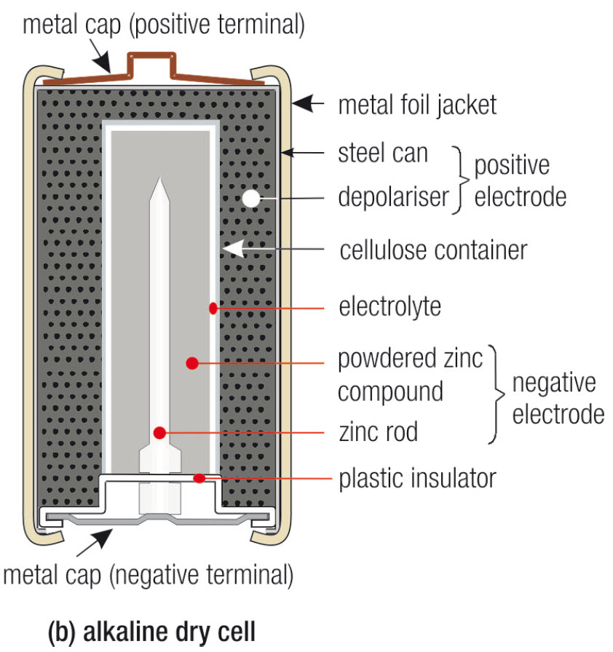
Alkaline cell
The alkaline cell is a development of the carbon-zinc cell.
Its advantages include longer life, higher output current and a more stable output voltage.
Notes:
Figure 25.45 (b) only

Slide 8
Lithium cell
There are several types of lithium cells, with different electrolytes, and therefore different output voltages. The output voltage per cell ranges from 2.9 V (most common type) to 3.7 V.
Notes:
Figure 25.46

Slide 9
Secondary cells
A primary cell is no longer useable once it’s discharged, as its chemical action can’t be reversed. (Carbon Zinc, Alkaline batteries)
The chemical action of a secondary cell can be reversed. That is, it can be recharged by passing a current through it, in the reverse direction. (Lead acid, NiCad, NiMh etc)
This is done by connecting a DC power source (charger) to the battery.

Slide 10
The lead-acid cell
When charged, the lead acid cell has:
an electrolyte of sulphuric acid mixed with water
a positive electrode of lead peroxide
a negative electrode of spongy lead

Slide 11
The lead-acid cell (2)
When discharged, the:
concentration of sulphuric acid in the electrolyte is much weaker
positive electrode is mainly lead sulphate
negative electrode is mainly lead sulphate.

Slide 12
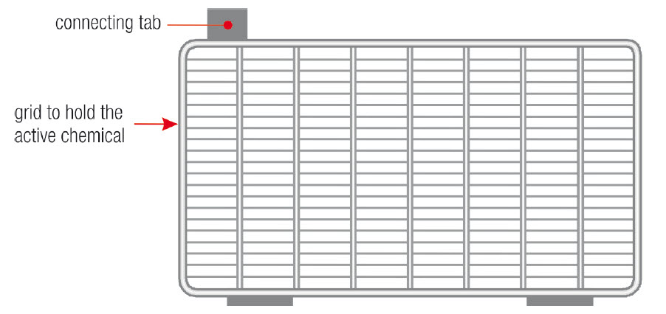
Plates in a lead-acid cell
The active materials (lead peroxide and spongy lead) are a paste, and are held by grids (or plates) made of lead-antimony
Notes:
Figure 25.47

Slide 13
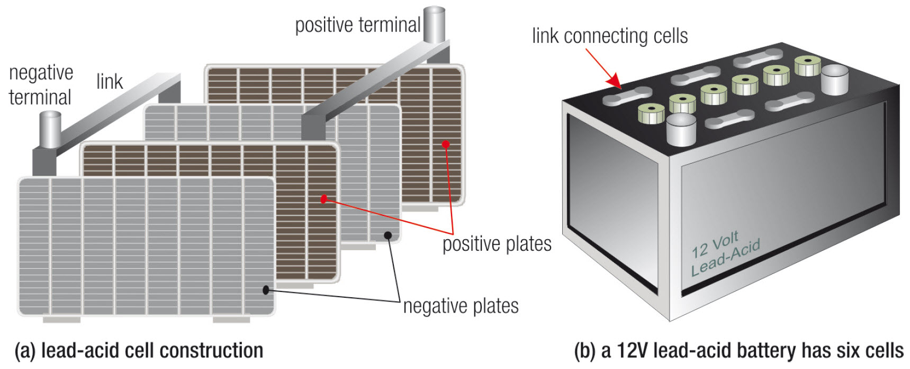
Cell and battery construction
A lead-acid cell is made with interleaved plates, a 12 V battery has six cells (each of 2 V) connected in series
Notes:
Figure 25.48

Slide 14
Valve regulated lead-acid battery
A standard lead-acid cell is called a vented, wet or flooded cell, as it has a liquid electrolyte that is open to atmosphere.
The valve regulated lead-acid (VRLA) battery, or maintenance-free battery, is sealed and has absorbent materials to hold the electrolyte.
A high internal gas pressure due to an excessive charging current is released with a pressure relief valve.

Slide 15
Gel battery
The gel battery (or gel cell) is another type of sealed, valve regulated lead-acid battery.
The electrolyte is combined with a silicon dioxide gel into a jelly-like solid.
Gases released during charging are combined in the same way as the maintenance-free battery
A pressure release valve operates if the internal case pressure is too high.

Slide 16
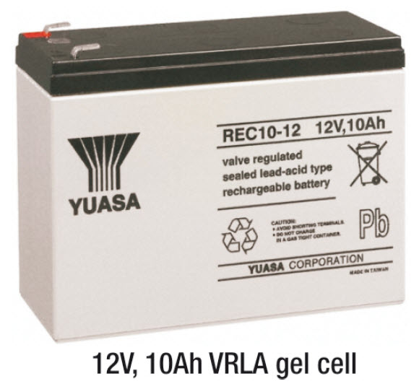
Typical gel battery
A gel battery has a pressure release valve, but is otherwise sealed
Notes:
Figure 25.49

Slide 17
Nickel-cadmium cell
The nickel-cadmium cell (nicad) was developed in Sweden in 1898.
The positive and negative plates are both made as a grid fitted with finely perforated pockets to hold the active materials.
The active material for the positive plate is nickel hydroxide; cadmium oxide for the negative plate.
Electrolyte is potassium hydroxide (an alkali).
The terminal voltage of a nicad cell is 1.2 V.

Slide 18
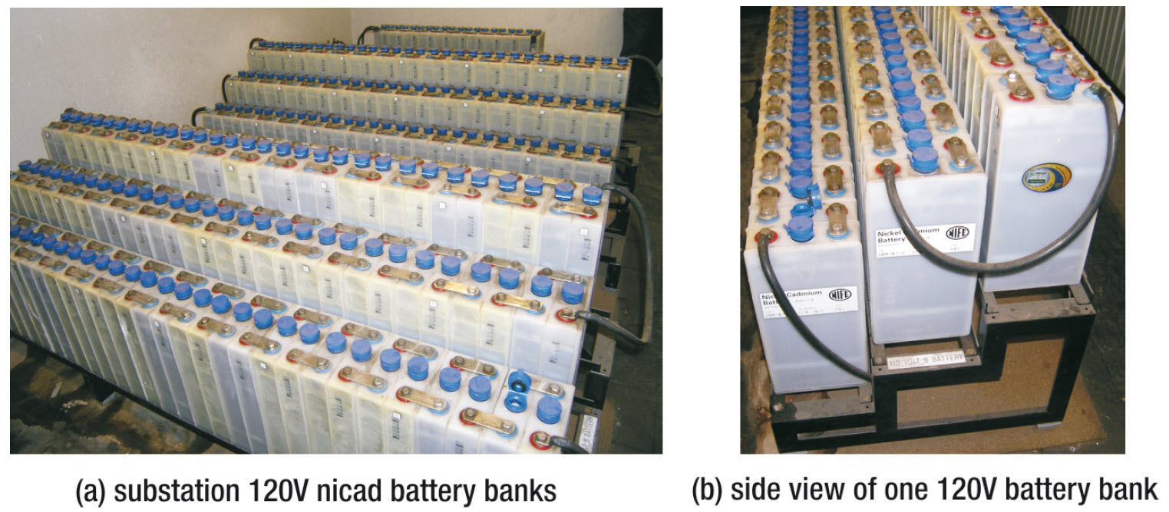
Nicad battery bank
All substations have a bank of batteries to provide a back-up DC power supply to the control and switch gear
Notes:
Figure 25.50

Slide 19
Nickel-iron (nife) cell
The NiFe cell was developed by Thomas Edison in 1901 for use in electric cars.
It is made in a similar way to the nicad cell, and like the nicad is lighter and more robust than the lead-acid cell.
The active material for the negative plates is powdered iron.
Like the nicad, the active material for the positive plate is nickel hydroxide, and the electrolyte is potassium hydroxide.

Slide 20
Nickel metal-hydride (ni-mh)
The main features of an Ni-MH cell compared to a nicad are reduced memory effect and 40% more capacity.
The Ni-MH cell can often be used as a replacement for nicads, and has the same terminal voltage.
The Ni-MH cell does not grow internal crystalline ‘shorts’ (dendrites) that short-circuit the battery.
They are more environmentally friendly than nicads, as they don’t contain cadmium (an environmental hazard).

Slide 21
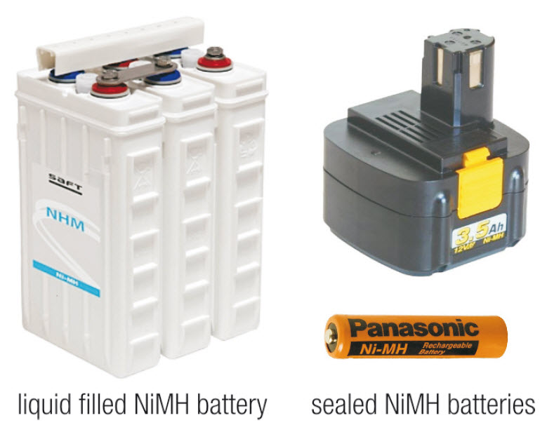
Ni-mh examples
Example nickel metal-hydride batteries. They are available as sealed or open (vented) types.
Notes:
Figure 25.51

Slide 22
Lithium-ion cell
The Li-Ion cell has about twice the capacity of a similar size nicad. Its terminal voltage is 3.6 V.
It has a higher internal resistance, but a much reduced self-discharge (about 5 per cent per month), and no memory effect.
It is environmentally safe as there is no free lithium metal.
If overheated or overcharged, Li-Ion batteries can suffer thermal runaway and cell rupture.

Slide 23
Ampere-hour rating of a battery
The capacity of a battery is a measure of how long it can supply a certain value of current.
The usual way of expressing this is with an ampere-hour rating (Ah).
An Ah rating is based on a discharge current one tenth of the rating, in which that current can be sustained by the battery for 10 hours.
A discharge over 10 hours is called a C/10 discharge. A discharge over one hour is a C discharge current.

Slide 24
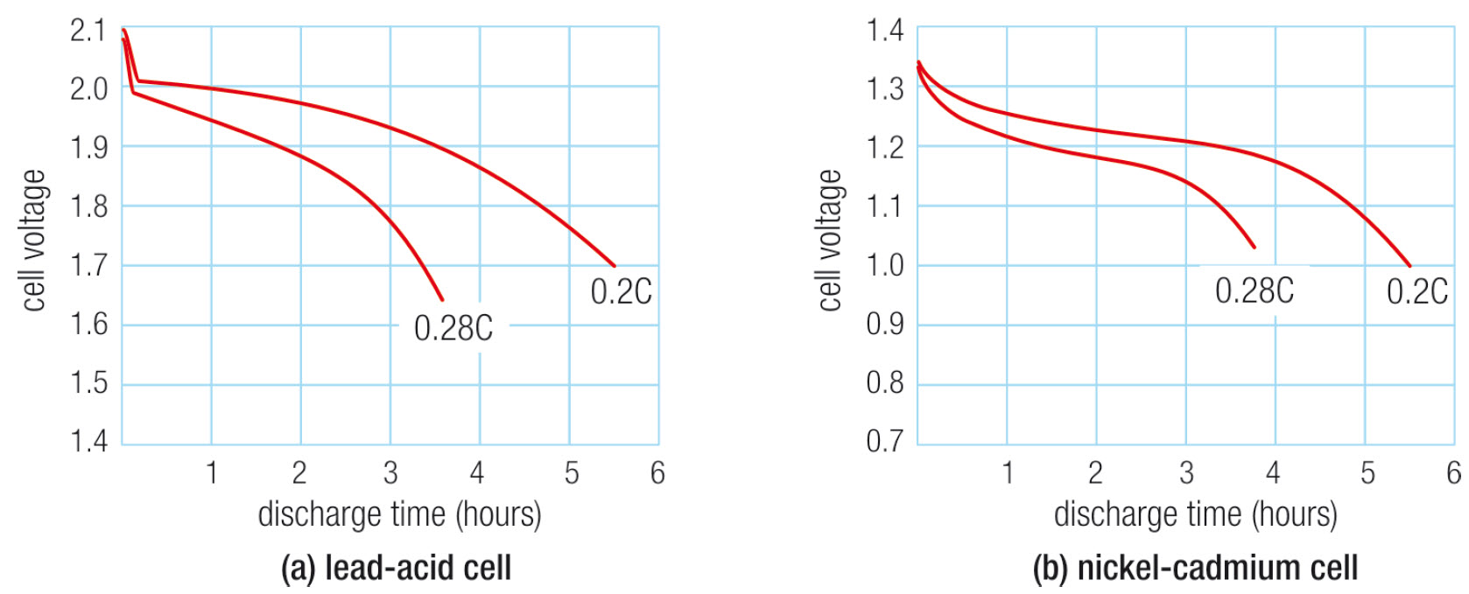
Output voltage
Voltage discharge curves for a five hour (0.2C) and a three hour (0.28C) discharge rate
Notes:
Figure 25.52

Slide 25
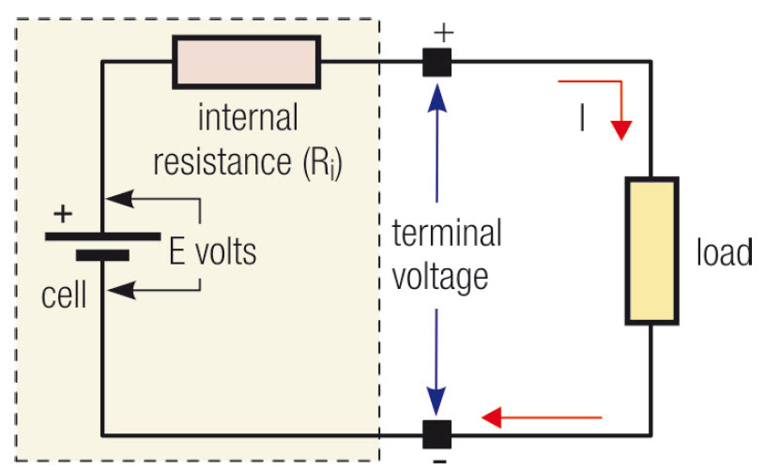
Internal resistance
The internal resistance of a cell causes the terminal voltage to drop when the cell is connected to a load
Notes:
Figure 25.53

Slide 26
Calculating internal resistance
To find the internal resistance of a battery, measure the open-circuit voltage of the battery (V_{NL}), then connect a load, measure the load current (I_{L}) and the voltage of the battery when the load is connected (V_{L}).
The internal resistance (R_{i}) of the battery is then found with the equation:

Slide 27
Connecting cells – in series
Cells are connected in series to get a higher voltage. Six 2V, 10Ah cells in series gives a 12V 10Ah battery
Notes:
Figure 25.54

Slide 28
Connecting cells – in parallel
Cells are connected in parallel to achieve a higher current. Three 2V, 10Ah cells in parallel gives a 2V 30Ah battery
Notes:
Figure 25.55

Slide 29
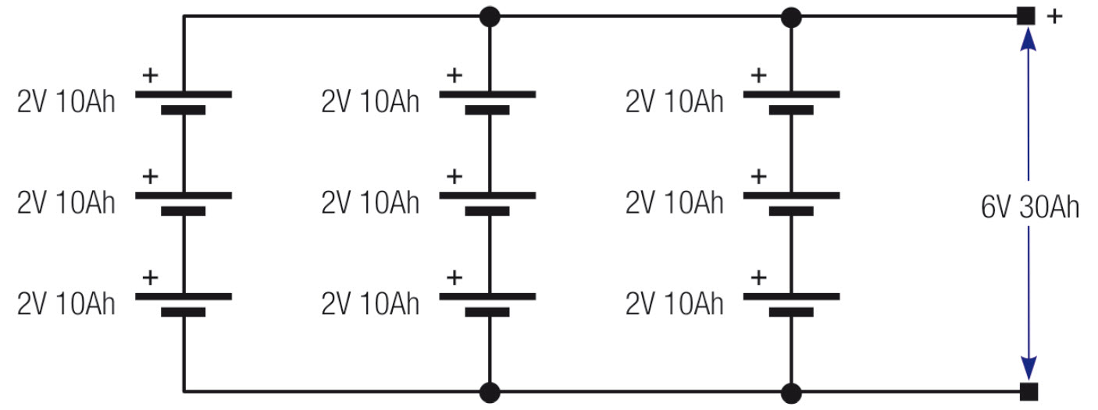
Connecting cells – in series-parallel
Connecting cells in series-parallel gives a battery with a higher voltage and a higher current capability
Notes:
Figure 25.56

Slide 30
Testing cells
Batteries or cells are tested in various ways, depending on the type of battery.
The state of charge of a lead-acid cell can be determined by measuring the specific gravity of its electrolyte. This test does not apply to Nicad and NiMH cells
A discharge test at a specified current is done to test a battery’s charge capacity and quality.
A capacity test of a battery bank measures its ampere-hour capacity.

Slide 31
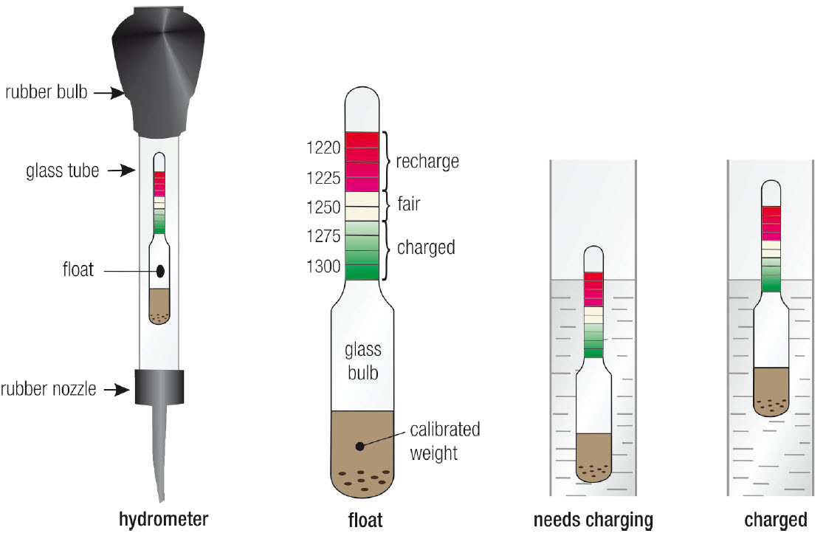
Measuring charge: lead-acid battery
The state of charge of a lead-acid cell can be measured with a hydrometer
Notes:
Figure 25.57

Slide 32
Charging batteries
Batteries are charged by passing a DC current through the battery in the reverse direction to the battery discharge current.
Care must be taken to ensure the charge current is not excessive, particularly in sealed batteries. Otherwise excessive heat and gasses can build up.
There are different types of charging systems to suit different types of batteries.

Slide 33
Charging nicads
A nicad battery is usually charged with a constant current over a fixed time.
The simplest is a float charger that provides a charge current equal to the battery’s C/10 discharge current.
The charge current is maintained for 12 to 14 hours, and is terminated or reduced when the battery voltage starts to rise fairly rapidly.
A typical float voltage is 1.42 V per cell.

Slide 34
Charging lead-acid batteries
A lead-acid cell is usually charged with a constant voltage source.
For a 12 V battery, the charge voltage is 14.8 V.
It typically takes five times as long to recharge a lead acid battery to the same level as it does to discharge it.

Slide 35
Safety with batteries
Batteries of all types contain corrosive, poisonous and even explosive chemicals.
Don’t put any type of battery into a fire: it can explode.
Heavy batteries and cells should be lifted and transported correctly.
Batteries should only be charged in a place where there’s good ventilation.
When mixing acid and water, always add the acid to the water.

