Slide 1
Specialised Transformers

Slide 2
Introduction
Identify auto-transformers, voltage transformers and current transformers from their winding diagrams.
Calculate the voltage and current in the windings of an auto-transformer.
List the advantages and disadvantages of an autotransformer.
State the AS/NZS3000 requirements with respect to transformers.
Describe the construction of voltage transformers.
State the ratings of voltage transformers.
Describe the construction of current transformers.
State the ratings of current transformers.
List the precautionary measures taken to connect and disconnect instrument transformers.
Complete connection diagrams for instrument transformers.
List the applications for auto-transformers and instrument transformers

Slide 3
Auto & Instrument
Transformers

Slide 4

Auto Transformers
What are They?
Transformer that acts like a transformer by changing
Voltage Levels
Current Levels
Impedance values
But does not isolate between the Primary and the Secondary

Slide 5
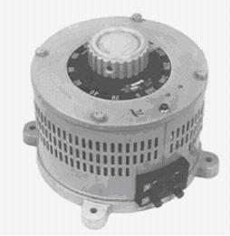
AUTO-TRANSFORMERS
Step down Transformer
Primary
Secondary
Variable Auto Transformer - VARIAC
Step up Transformer
There is no isolation between the supply and secondary
Secondary
Primary

Slide 6
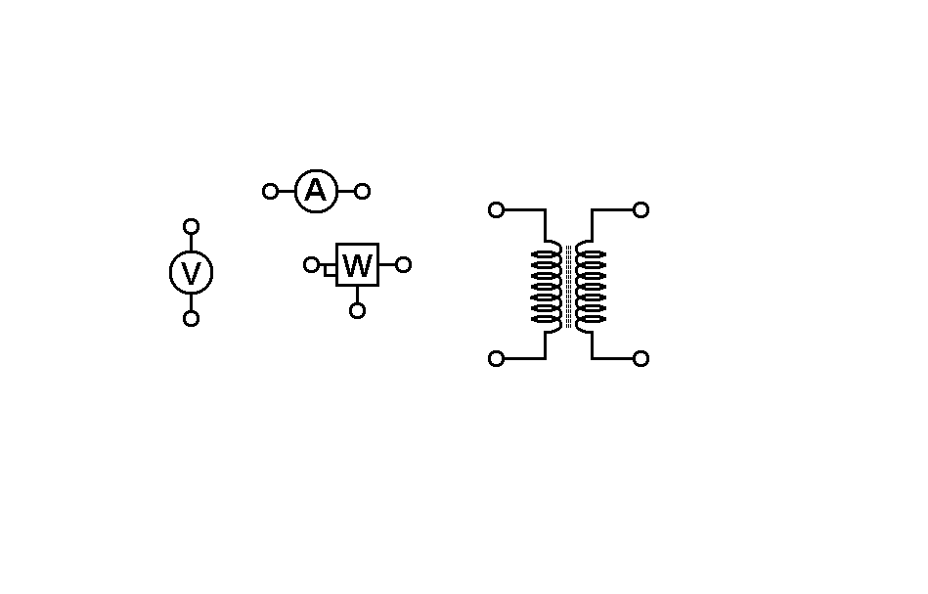
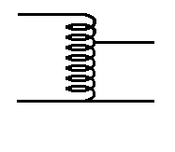
Auto Transformer does not have this coil
Isolation Transformer
Auto Transformer
As a result:
Requires less copper
Lighter
I²R losses are less
More efficient
But No isolation

Slide 7
AUTO-TRANSFORMERS
DISADVANTAGES:
In the event of an open circuit fault in the common part of the winding, the input voltage of a stepdown autotransformer would appear on the output terminals.
The autotransformer cannot be used where isolation of the primary and secondary circuits is required.
ADVANTAGES:
The regulation, leakage inductance and physical size of an autotransformer for a given VA rating are all less than those of a double wound transformer delivering the same power.
The copper I² R of an autotransformer is lower than for a compatible double wound transformer.
The efficiency of an autotransformer is higher than a compatible double wound transformer.
APPLICATIONS:
Speed control of induction motors.
Lighting control in theatres, hotels and photographic studios.
Starting polyphase induction motors.
Power Supplies

Slide 8
LEAKAGE TRANSFORMERS
Leakage Transformers are transformers where the magnetic flux of the secondary is loosely coupled to the flux of the primary. This loose coupling ensures that the transformer can withstand short circuit conditions.
This is particularly required in the case of welding transformers, where high currents may occur if the welding electrode gets fused with the job. Thus these transformers have high leakage inductance.
Typical Applications
- Furnace Ignition
- Gaseous Discharge Lighting
- Welding Machines

Slide 9
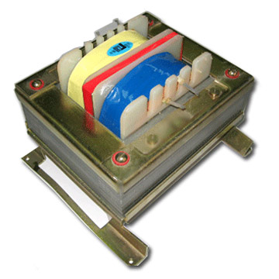
LEAKAGE TRANSFORMERS

Slide 10
INSTRUMENT
TRANSFORMERS
PT
CT
Used to reduce voltage or current to provide metering or protection
Regardless of the input level the output always stays the same
PTs =
CTs =
110V
5A

Slide 11
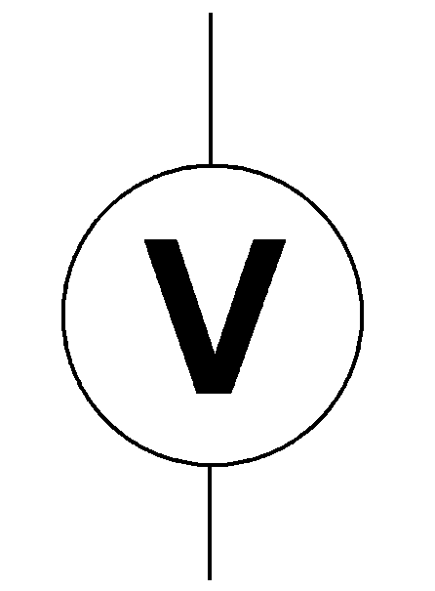
Voltage Transformers
(PT)
Potential Transformer
Primary Voltage
Secondary Voltage
System Phase Voltage
Could be 330kv
110V
Burden
Ratings generally less than 500VA

Slide 12
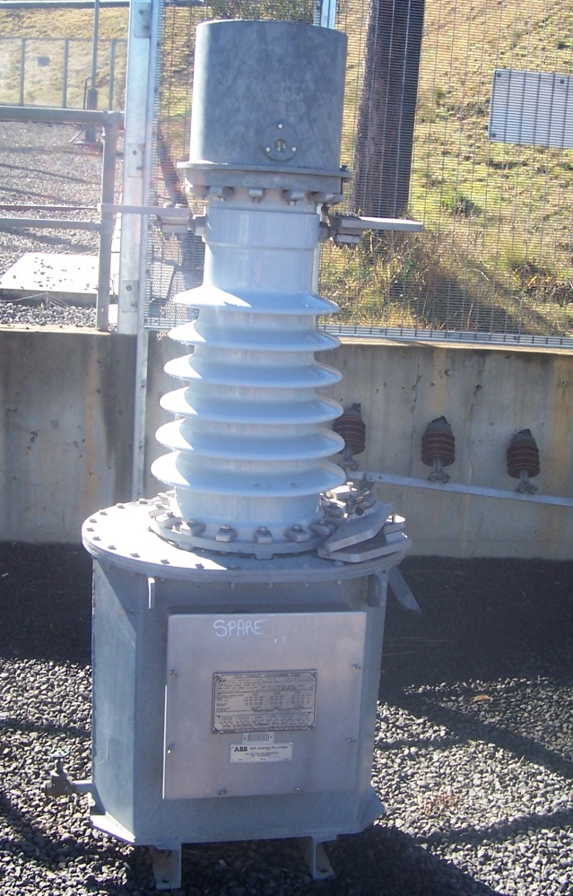
Current Transformers
CT
There are two Types
Conventional winding
Toroidal
Used for two reasons
Metering
Protection

Slide 13
Current transformers
Current transformers differ from the voltage transformer, because the primary circuit consists of a supply feeder cable rather than a winding connected across a supply, as shown below.

Slide 14
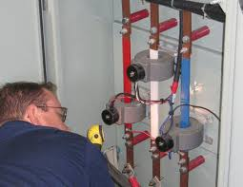
Current transformers

Slide 15
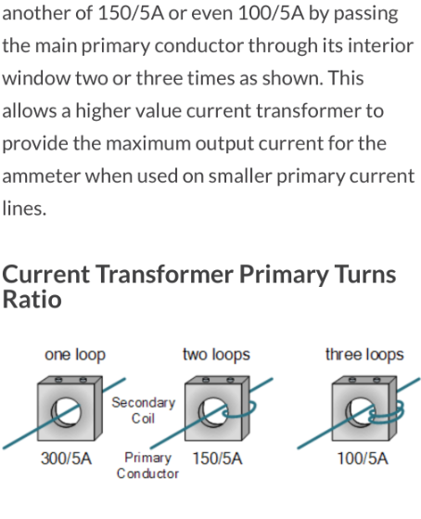
Current transformers
Can be placed in parallel to read large currents.
Looping of conductors

Slide 16
In this arrangement, the alternating magnetic field associated with the load current is linked to the current transformer secondary winding via a laminated soft iron core, through which the feeder (primary) passes. The secondary current is used to feed a meter and typically registers the current flowing from an AC generator to the busbar or load. The secondary current can additionally be used to supply power meters and to monitor the load-sharing in an electrical circuit.

Slide 17
In AC power generation systems, this type of transformer can also be used as a sensor in a differential protection circuit, as shown below.

Slide 18
All CTs
Must be very accurate with regard to
Turns ratio
Characteristics change little with load changes
Phase angle between primary & secondary very small

Slide 19
Difference Between
Protection & Metering CTs
A 100:5 CT is used to measure current
A 2kA fault appears
A Metering CT will saturate producing no more than 5A
∴ Metering equipment is protected
More Accurate
A Protection CT will NOT saturate & try to produce 100A
∴ Protection equipment will react quicker

Slide 20
Dangers of CTs
Secondary coil must never be open circuited with supply available
Short circuit secondary coil then remove meter.
CT has to remain short circuited until another meter is obtained
This will not damage the CT

