Slide 1

ELECTRICAL TRADES
Voltage Drop

Slide 2
Voltage Drop
Volt Drop occurs as load current flows through the cable resistance.
Ohm’s Law in the form V = I.R shows that there are two factors that determine the Volt Drop in any Circuit:
- Current required by the load.
- Resistance of the conductors.

Slide 3
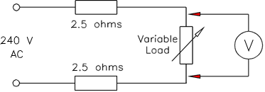
VOLTAGE DROP

Slide 4
Voltage Drop Limits
AS/NZS 3000 sets the allowable limits for Voltage Drop.
For Low Voltage circuits the Voltage at the load terminals is not to drop more than 5% of the Voltage at the Point of Supply.
What is the minimum Voltage required at the load in a 230V circuit?
230V - 5% = 230V – 11.5V = 218.5V
What is the minimum Voltage required at the load in a 400V circuit?
400V – 5% = 400V - 20V = 380V

Slide 5
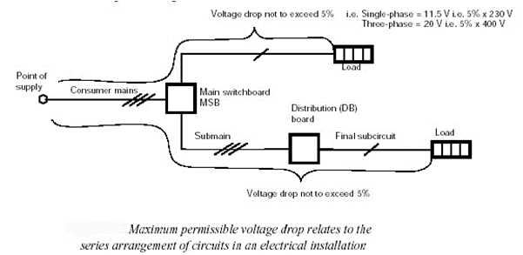
VOLTAGE DROP LIMITS

Slide 6
Limiting Volt Drop ensures:
Equipment fed by the circuit operates correctly.
Cable impedances are low enough to allow circuit protective devices to operate during circuit fault conditions.
Other customers are not affected by your operations.

Slide 7
Controlling Volt Drop
As the load current and cable length are usually fixed we are only able to choose between Copper and Aluminium cable and then select a cable size that is large enough to comply with the limits.
It is acceptable to parallel two or more cables - however AS 3000 cl 3.4.3 places some restrictions on this practice.
What are these restrictions?

Slide 8
Volt Drop Calculations are based on the following conventions:
The current is the steady current that flows during the normal operation of the circuit. High transient currents such as motor starting or inrush currents are not used.
Final sub circuits with distributed loads such as lighting or power can be calculated using 50% of the protective device current rating.
The current rating for Mains and Submains is the calculated Maximum Demand of that part of the installation.

Slide 9
Volt Drop Formulae
There are two formulas used for simple Volt Drop calculations. Refer to p86 of AS 3008.1.1.2011
The first calculates what is known as the “per Unit Value” of Volt drop and is used to select cable sizes.
The second calculates the actual Volt drop of a cable under given conditions.
Note the meanings of :
V_{c}, V_{d}, V_{p}, L and I as used in the formulas
Note also the tables are for THREE PHASE use and conversion factors are given for single phase use.

Slide 10
Per Unit Values of Volt Drop
V_{c} values for 3Ø (phase)circuits are found in Tables 40 to 51 for a range of cable types.
Vc values are in mV/A.m (milliVolts per Ampere Metre) and they are for three Phase .
Conductor temp is usually max value for the cable type unless otherwise stated in the problem. (Table 1 in AS/NZS 3008)
Power factor is taken as Max unless otherwise stated in the problem.

Slide 11
DIFFERENT FORMULAE TO USE
Vd = L x I x V_{c}
1000
Vc = 1000 x V_{d}
L x I
L= 1000 x V_{d}
V_{c} x I

Slide 12
Try looking these up
What is the Vc for a 3Ø set of single core TPS V90 cables which are 120mm² copper laid in trefoil?

Slide 13
Answer: 0.359mV/A.m (Table 42)
The AS 3008 (Table 1, pg 14) states that V90 cable is used under NORMAL operating conditions which is 75 C

Slide 14
What is the Vc for a 3Ø multicore TPS V75 cables which is 25mm² circular copper?

Slide 15
Answer: 1.54mV/A.m (Table 42)

Slide 16
What is the Vc for a 3Ø multicore 70mm² copper MIMS cable laid in Trefoil which is rated at 1/1kV and running at 100deg C?

Slide 17
Answer: 0.581mV/A.m (Table 49)

Slide 18
Volt Drop Example 1
A 3 Ø Consumers Mains cable is 16mm², 4 C & E, V75 Copper and runs for 45M to the switchboard from the P.O.S.
What is the Volt Drop if this circuit has a Maximum Demand of 63 Amps?
Vd = L x I x V_{c}
1000
= 45 x 63 x 2.43 (T42)
1000
= 6.89V

Slide 19
Volt Drop Example 2
A 2.5mm², V75 TPS cable runs 30 m to supply a 15 Amp single phase load. What will the voltage be at the load terminals when operational?
Vd = V_{C} x L x I
1000
(T42)
= 30 x 15 x 15.6 x 1.155
1000
= 8.108 Volts dropped
Volts at load:
230 – 8.108 = 221.89V
(single phase conversion factor)

Slide 20
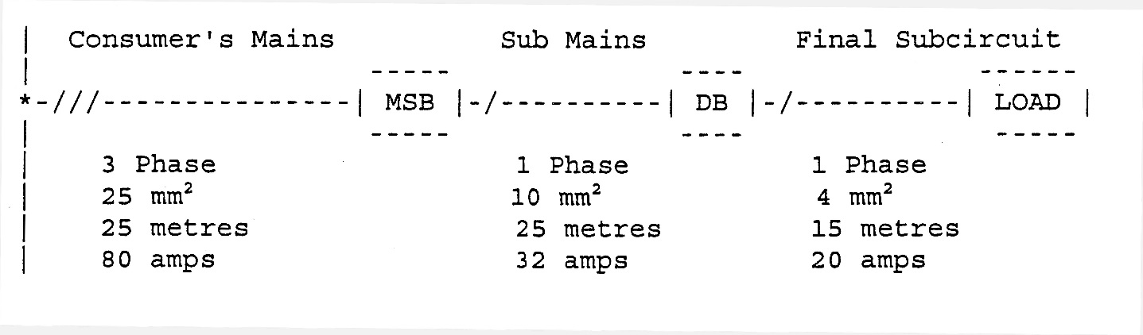
VOLT DROP EXAMPLE 3
Calculate the voltage at the load in the following 230/400V installation. Using Multicore, V75, circular conductors
[1] Consumers mains
V_{D} = L x I x V_{C}
1000
V_{D} = 25 x 80 x 1.54
1000
V_{D} = 400-3.08 = 396.92V
396.92V/ 1.73 = 229.16V
V_{C} = 1.54 FROM TABLE
42 OF AS 3008
[2] Sub mains
V_{D} = L x I x V_{C}
1000
V_{D} = 25 x 32 x 3.86 x 1.155
1000
V_{D} = 229.16V - 3.566 V =
= 225.595V
V_{C} = 3.86 FROM TABLE
42 OF AS 3008
[3] Final Subcircuit
V_{D} = L x I x V_{C}
1000
V_{D} = 15 x 20 x 9.71 x 1.155
1000
V_{D} = 225.595 - 3.364 V =
= 222.231V
V_{C} = 9.71 FROM TABLE
42 OF AS 3008

Slide 21
I_{B} ≤ I_{N} ≤ I_{Z}
Maximum Demand ≤ Current rating of protective device ≤ Current carrying capacity
(Clause 2.2.2 & Appendix ‘C) (Clause 2.5.3 & Appendix B3) (Clause 3.4 AS 3000.2007)
Volt drop consideration Installation condition
(Clause 3.6 AS3000.2007 & (AS/NZS 3008.1.1)
Section 4, AS/NZS 3008.1.1)
Short circuit performance (Clause 2.5.4.5 AS3000.2007)

