Slide 1
Section 2 – Special Situations

Slide 2
In general, the requirements of AS/NZS 3000 are applicable to all consumer’s electrical installations in Australia and New Zealand. Where there are specific or special requirements for additional safety from the risk of electric shock or fire, additional standards apply.

Slide 3
Public Buildings
The WA Health (Public Buildings) Regulations 1992 specify special requirements for lighting and lighting control in public buildings. It covers such aspects as:
a. Exit signs Clause 16
b. Lighting levels Clause 28
c. Position of luminaires Clause 28
d. Switches controlling lighting Clause 30
e. External lighting requirements Clause 31
f. Emergency lighting Clause 32
g. General lighting for auditoriums Clause 38
h. Safety lighting Clause 39
i. Construction of luminaires Clause 40
j. Stage equipment Clause 42
k. Lighting in classrooms Clause 50

Slide 4
Electrical Installations in Medical Treatment Areas
Doctor’s surgeries, hospitals and other buildings where medical procedures are performed, require the electrical installation to conform to AS/NZS 3003 Electrical installations-Patient areas as well as AS/NZS 3000

Slide 5
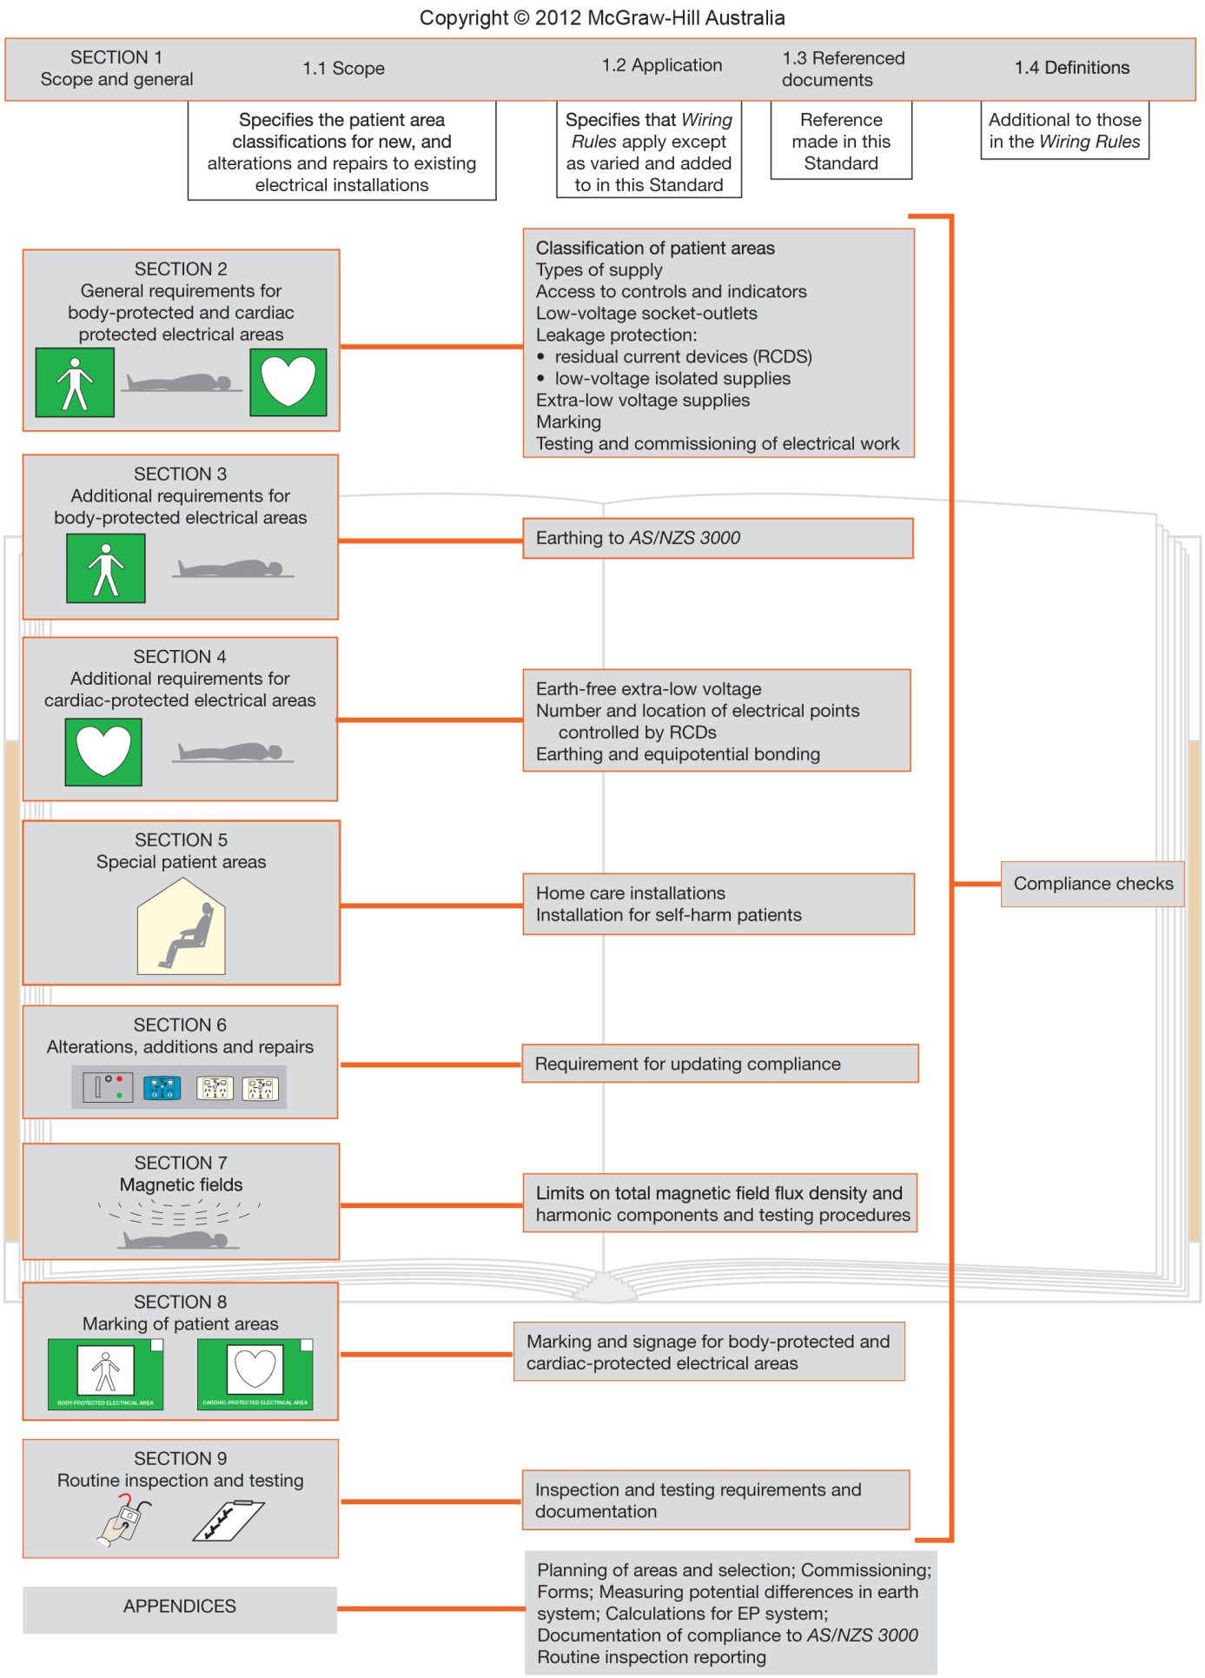

Slide 6
All Australian Heritage listed buildings are covered by the Burra Charter. The Burra Charter defines the basic principles and procedures to be followed to conserve places of cultural heritage significance in Western Australia.
The guiding principles are:
• do as much as necessary to care for the place and make it useable; but otherwise
• change as little as possible so that its cultural significance is retained.

Slide 7
Exercise extreme caution if old rubber-insulated (VIR) wiring is still in use in older buildings. Age turns the rubber very brittle and any movement of the cables can cause it to disintegrate and the wiring to short circuit.
Early installations may not be earthed, adding to their danger. Other potential problems that should be checked are the mechanical wear of switches, wear, arcing or corrosion of electrical contacts and any sign of abnormal deterioration.

Slide 8
Before starting work on a Heritage Listed Building, you should seek advice from the
WA Heritage Council
Unless

Slide 9
The work involves the following:
Building maintenance that does not involve the removal of, or damage to, the existing fabric of the building or the use of new materials.
Replacement of utility services (e.g. electrical circuits) using existing routes or voids that does not involve the removal of, or damage to, the fabric of the building.
Installation of a temporary security fence, scaffold, hoarding or surveillance system that does not affect the fabric of a building, the landscape or archaeological features of the land.

Slide 10
Caravan Parks
A typical caravan park consists of permanent structures such as an office, delicatessen, amenities block, toilets, ablutions and security lighting. It also has facilities for providing a temporary supply to movable premises such as caravans.
In general, the electrical installation in a caravan park must comply with the requirements of the Wiring Rules, but some variations and/or additional requirements are specified in AS/NZS 3001. The installation of wiring and equipment in the movable premises themselves are also subject to requirements of AS/NZS 3000 and AS/NZS 3001 if they are to be connected to a 240 volt supply.

Slide 11
Caravan Park Maximum Demand
The maximum demand of caravan park submains to service pillars and other switchboards providing site supply shall be determined by one of the methods outlined in AS/NZS 3000
The information contained in Appendix A is provided as a guide to calculating the expected maximum demand of electrical installations with various numbers of caravan park socket-outlets provided for transportable structures.

Slide 12
Amenities
For a submain supplying communal amenities, 50% of the sum of the current ratings of the circuit-breakers supplied by each active conductor of the submains should be assumed to be the maximum demand on that conductor.

Slide 13
Service pillars
For submains supplying service pillars and other switchboards that provide site supply, the maximum demand of the socket-outlets installed in the pillar or switchboard can be estimated as follows:
Socket-outlets for light-duty loads (little use of air-conditioning or heating)
(i) for 1 to 6 points......................6 A per point
(ii) for 7 to 50 points ..................36 A plus 4 A for the 7th and each successive point
(iii) for 51 to 100 points .............212 A plus 3 A for the 51st and each successive point
(iv) for more than 100 points ... 362 A plus 1 A for the 101st and each successive point

Slide 14
Socket-outlets for heavy-duty loads (substantial air-conditioning or heating load)
(i) for 1 to 6 points...................... 10 A per point
(ii) for 7 to 50 points .................. 60 A plus 6 A for the 7th and each successive point
(iii) for 51 to 100 points ..............324 A plus 3 A for the 51st and each successive point
(iv) for more than 100 points ..... 474 A plus 1 A for the 101st and each successive point

Slide 15
Boating Marinas
This section relates to electrical installations in boating marinas as defined in AS/NZS 3004.1:2008. A marina is any wharf, jetty, pier or floating pontoon arrangement intended for berthing or mooring one or more pleasure craft.
Marinas require special consideration with regard to electrical installations because of the presence of:
A corrosive, salt-laden atmosphere.
Water spray.
Water level variation.
High temperatures.
Dissimilar metals immersed in an electrolyte, resulting in electrolytic corrosion.

Slide 16
The Wiring Rules requires that electrical installations in boating marinas comply with of AS/NZS 3004.
AS/NZS 3004 requires that electrical installations in marinas and recreational boats be carried out in accordance with the Wiring Rules except as varied in AS/NZS 3004.

Slide 17
Hazardous Areas
Hazardous areas are areas in which an explosive atmosphere is present or may be expected to be present in quantities such as to require special precautions for the construction, installation and use of electrical equipment (See AS/NZS 3000 Clause 7.7).
The purpose of the special precautions is to prevent electrical devices and their associated wiring systems from becoming a source of ignition as a result of arcing, heating or other operational features

Slide 18
The Wiring Rules recognises two general hazardous areas:
Flammable gas or vapours.
Combustible dust, fibres or flyings.

Slide 19
Explosion Protection Techniques
In situations where it is not possible to avoid installing electrical equipment and wiring systems in hazardous areas, various methods of preventing an explosion can be employed. The basic types are:
Exclusion - prevent hazardous material from entering electrical equipment.
Containment - confine an explosion within the electrical equipment.
Dilution - ensure good ventilation to decrease gas concentration.
Ignition source not present - equipment designed to avoid being an ignition source.
Energy limitation - equipment cannot produce enough energy for ignition.

Slide 20
Now use the additional documents and standards to complete the worksheet questions on page 46 and the caravan park maximum demand exercise on page 41.

Slide 21
THE END

