Slide 1
Section 3
Special Situations – Safety Services

Slide 2
At the main switchboard of large electrical installations, safety services such as; fire detection and fire-fighting systems, evacuation systems and lifts must be controlled separately from the main switch(es) that control general electrical services in the building.
Controlling safety services independently, ensures that the electrical supply is not inadvertently disconnected from electrical equipment that is required to operate during emergency conditions

Slide 3
Note:
Main switches f & g control general electrical services – switched off in an emergency
Main switches h, i & j separately control various safety services

Slide 4
Main switches controlling safety circuits shall identify the equipment it supplies, They shall also be marked
‘IN THE EVENT OF FIRE, DO NOT SWITCH OFF’
and identified by contrasting colour from other equipment on that switchboard (see AS/NZS 3000 clause 7.2.6.2)
Where the main switchboard supplies a safety equipment sub board, no switch shall be placed between the two switchboards that can isolate the safety equipment (see AS/NZS 3000 clause 7.2.4.2 Interposing switches)

Slide 5
Fire Pump Circuits
Fire pump motor circuits must comply with AS/NZS 3000 clause 7.2.9. The isolating switch for the fire pump must be adjacent to the pump and must be locked in the on position.
Fire pump control circuits are wired differently than conventional motor control systems, for example: the fire pump control circuit Active conductor is wired directly to the contactor coil and any control switch is in the neutral conductor.
No overload protection device shall be inserted between the pump controller and the motor.

Slide 6
Fire Detection Equipment
In commercial and industrial installations, the electrical tradesperson will come across a number of different devices to detect fire. These devices can be either:
Smoke detectors
Carbon monoxide detectors
Heat detectors
Flame detector alarms

Slide 7
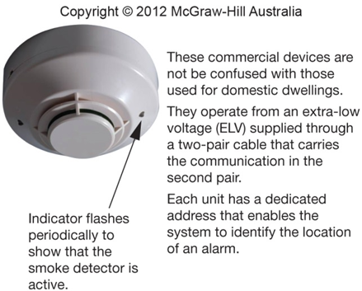
A commercial smoke detector used in offices

Slide 8
In domestic installations it has been mandatory for many years to install smoke detectors.
AS/NZS 3000 suggest that smoke and fire detectors are connected to a lighting final sub-circuit rather than connected to a dedicated alarm circuit.
The use of the lighting final sub-circuit provides monitoring that the main supply is available, as failure of the lighting circuit would be indicated by the lack of illumination, see AS/NZS 3000 clause 4.6

Slide 9
Now answer the questions on page 52.

Slide 10
THE END

