Slide 1
Section 6
Installation Test Documentation

Slide 2
The WA Electricity (Licensing) Regulations 1991 require an electrical contractor to submit a Preliminary Notice at least 3 working days before Notifiable electrical installing work is commenced, and a Notice of Completion within 3 days of completion of the electrical work.
It is important to document design and installation details so that they can be traced back to their source in the event of a query at some time in the future.

Slide 3
“Notifiable work” means electrical installing work other than:
a) maintenance work, unless that work requires the disconnection and reconnection of the supply of
electricity to the electrical installation concerned or the replacement of service apparatus;
b) the alteration of a final sub-circuit; or
c) the addition of a single final sub-circuit

Slide 4
Preliminary Notice (Green Border)

Slide 5
Notice of Completion (Yellow Border)

Slide 6
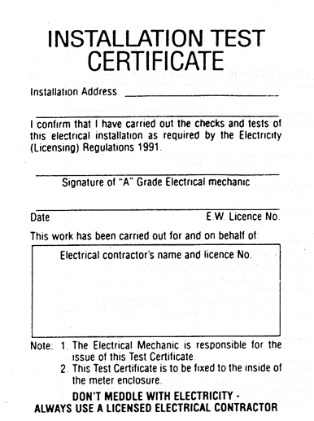
Installation Test Certificate
The Installation test certificate is to be completed by the electrician responsible for the testing and checking of the electrical Installation and fixed inside the meter enclosure.

Slide 7
Electrical Safety Certificate
An electrical safety certificate must also be completed by the electrical contractor for ALL electrical Installing work (both notifiable and non-notifiable work).
The certificate is to be provided to the person for whom the work was carried out within 28 days of completion of the work

Slide 8
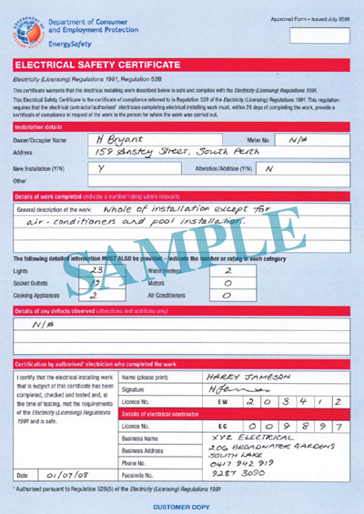
Electrical Safety Certificate

Slide 9
THE END

