Slide 1
Section 5
Selection of Equipment for ELV Installations

Slide 2
The selection of equipment for ELV installations is based on several considerations, including:
Compliance with AS/NZS 3000.
Sources of extra low voltage supply:
Separated extra low voltage SELV
Protected extra low voltage PELV
Segregation and arrangement of circuits.
Voltage drop in conductors.
Control and protection from overcurrent and overvoltage.
Special considerations of types of plugs and sockets.
Types of wiring systems.

Slide 3
Voltage Range
Clause 1.4.98 of the Wiring Rules defines extra low voltage as ‘Differences in potential normally existing between conductors and between conductors and earth as not exceeding 50 volts a.c. or 120 volts ripple-free d.c.
Persons carrying out electrical work at ELV do not require to be licensed under the Electricity (Licensing Regulations 1991) as these voltages are considered to be less likely to create hazards such as severe electric shock or damage to property.

Slide 4
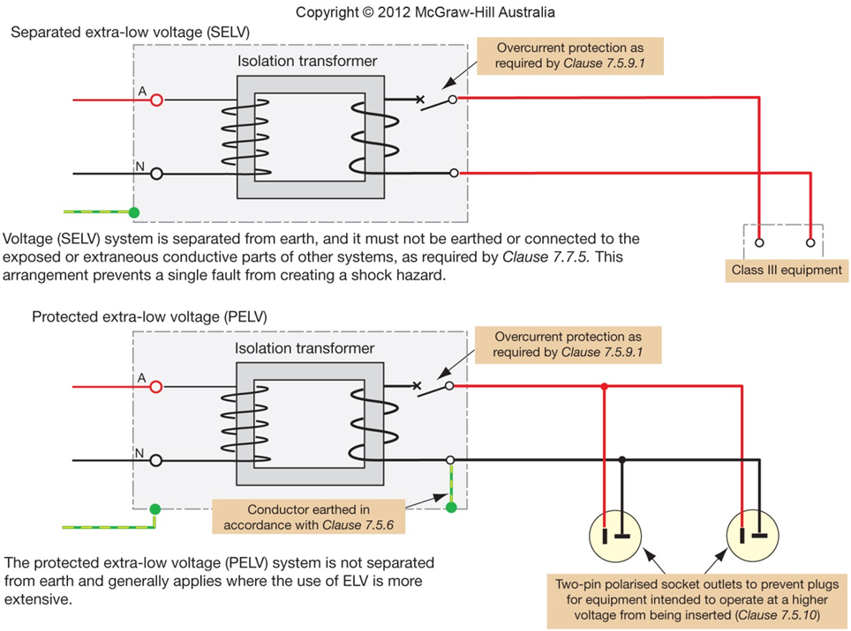
Comparison of SELV and PELV Power Systems
The following applies for PELV circuits, where one conductor of the output circuit is earthed.
Basic protection shall be provided by—
(a) barriers or enclosures affording the degree of protection at least IPXXB or IP2X; or
(b) insulation capable of withstanding a test voltage of 500 V a.c. for 1 min.

Slide 5
Voltage Drop
Clause 7.5.7 of the Wiring Rules requires the volt drop not to exceed 10% of the nominal value of the voltage when the circuit is operating at its normal operating current.

Slide 6
Plugs and Sockets
The selection of ELV equipment such as plugs and sockets must be made consistent with the assigned voltage and type of equipment being installed. Clause 7.5.10 of the wiring rules requires that:
Plugs shall not be able to enter socket outlets of other voltages.
A socket outlet shall not accept plugs of other voltages.
Socket outlets must not have a contact for a protective earth wire.

Slide 7
Now answer the questions on page 63.

Slide 8
THE END

