Slide 1
G063A Work Sheet 1
Unit Title: G063A – Select and Arrange Equipment for General Electrical Installations
Risks Associated with Electric Current Flow
The purpose of this presentation is to provide you with the opportunity to answer the 26 questions from Work Sheet 1 of G063A .
Click the left mouse button for each slide
(Or press the SPACEBAR or ENTER key)
Risks.pps Version 6
S. G. Brooks. 2008

Slide 2
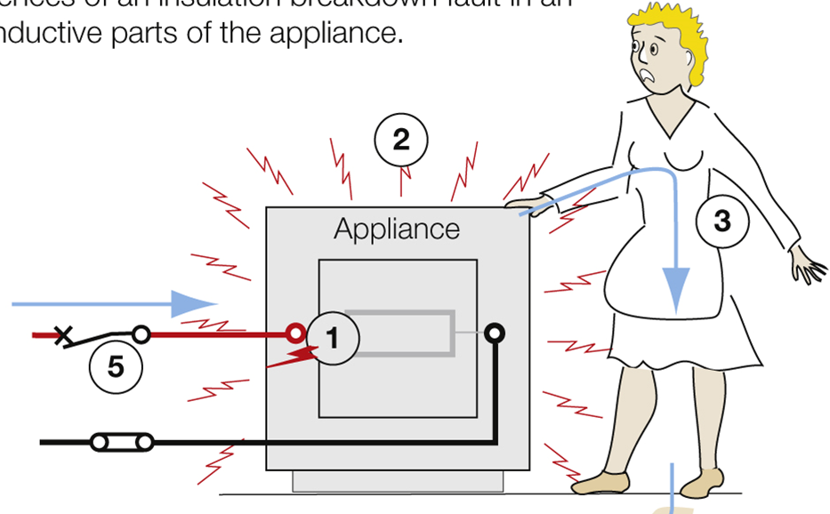
Question 1
What are the two main undesirable effects of high current passing through the human body?
Answer:
Electrocution and burns.
Continue

Slide 3
Question 2
How can the risk of injury from unexpected mechanical movement, of electrically actuated equipment, be reduced?
Give the AS/NZS 3000:2018 clause number.
Answer:
Provide devices to disconnect or isolate equipment (e.g. interlocks).
AS/NZS 3000:2018 Clause 1.5.13.
Continue

Slide 4
Question 3
What are the general requirements where insulation is the method for protecting against direct contact with live parts?
Give the AS/NZS 3000:2018 clause number.
Answer:
Live parts must be completely covered.
AS/NZS 3000:2018 Clause 1.5.4.3.
Continue

Slide 5
Question 4
What degree of protection (IP rating) is needed where barriers provide the method for protecting against direct contact with live parts?
Give the AS/NZS 3000:2018 clause number.
Answer:
IPXXB. IP2X. IP4X
AS/NZS 3000:2018 Clause 1.5.4.4
Continue

Slide 6
Question 5
What are the constructional requirements where barriers provide the method for protecting against direct contact with live parts?
Give the AS/NZS 3000:2018 clause number.
Answer:
Secured in place. Adequate strength. Restrictions on removal.
AS/NZS 3000:2018 Clause 1.5.4.4 (b)
Continue

Slide 7
Question 6
What are the requirements where the method for protecting against direct contact with live parts is the provision of obstacles?
Give the AS/NZS 3000:2018 clause number.
Answer:
Access must be restricted to competent persons. Must prevent unintentional bodily contact.
AS/NZS 3000:2018 Clause 1.5.4.5.
Continue

Slide 8
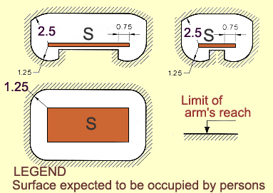
Question 7
What are the requirements where placing out of reach provides the method for protecting against direct contact with live parts?
Give the AS/NZS 3000:2018 clause number.
Answer: Access must be restricted to competent persons. Simultaneously accessible parts must not be within arms reach. AS/NZS 3000 Clause 1.5.4.6.
Continue

Slide 9
Question 8
What is the intention of measures for protecting against indirect contact with live parts?
Give the AS/NZS 3000:2018 clause number.
Answer:
To protect against contact under fault conditions.
AS/NZS 3000:2018 Clauses 1.5.5 and 1.4.78
Continue

Slide 10
Question 9
What is the purpose of automatic disconnection of supply when protecting against indirect contact with live parts?
Give the AS/NZS 3000:2018 clause number.
Answer:
To limit the touch voltage.
AS/NZS 3000:2018 Clause 1.5.5.3 (a)
Continue

Slide 11
Question 10
If a fault exists between a live part and an exposed conductive part, the protective device must automatically disconnect the supply where the touch voltage exceeds what limits?
Give the AS/NZS 3000:2018 clause number.
Answer:
50 V a.c. and 120 V d.c.
AS/NZS 3000:2018 Clause 1.5.5.3 (b).
Continue

Slide 12
Question 11
For fault loop impedance, the product of what two values must not exceed the nominal AC rms voltage to earth?
Give the AS/NZS 3000:2018 clause number.
Answer:
The impedance of the fault loop (Zs) at the fault, and the fault current (Ia).
AS/NZS 3000:2018 Clause 5.7.4
Continue

Slide 13
Question 12
For a 240 volt final subcircuit comprising socket outlets, hand-held Class I equipment or other portable equipment, what is the maximum disconnection time for automatic disconnection devices?
Give the AS/NZS 3000:2018 clause number.
Answer:
0.4 seconds (400 ms)
AS/NZS 3000:2018 Clauses 1.5.5.3(d)(i) and 5.7.2 (a)
Continue

Slide 14
Question 13
For a 240 volt final subcircuit supplying fixed equipment or submain, what is the maximum disconnection time for automatic disconnection devices?
Give the AS/NZS 3000:2018 clause number.
Answer:
5 seconds.
AS/NZS 3000:2018 Clauses 1.5.5.3(d)(i) and 5.7.2 (b)
Continue

Slide 15
Question 14
It is possible to reduce the fault-loop impedance by bonding extraneous conductive parts to the protective earthing system.
What is the name given to this?
Give the AS/NZS 3000:2018 clause number.
Answer:
Yes. Equipotential bonding.
AS/NZS 3000:2018 Clauses 1.5.5.3 (e) and 5.6
Continue

Slide 16
Question 15
What means are suitable for providing protection against dangerous voltages occurring on accessible conductive parts of electrical equipment in the event of a fault in the basic insulation?
Give the AS/NZS 3000:2018 clause number.
Answer:
Double insulation.
AS/NZS 3000:2018 Clause 1.5.5.4 (a)
Continue

Slide 17
Question 16
What measures are not considered to provide a suitable insulation covering?
Give the AS/NZS 3000:2018 clause number.
Answer:
Paint. Varnish. Enamel.
AS/NZS 3000:2018 Clauses 1.5.4.3 (Note) and 1.5.5.4 (a) (Note1)
Continue

Slide 18
Question 17
Briefly outline the measures for providing electrical separation.
Give the AS/NZS 3000:2018 clause number.
Answer:
Live parts not connected to any other circuit or earth. Isolating transformer. Double insulation between input and output.
AS/NZS 3000:2018 Clauses 1.5.5.5 and 7.4 to 7.4.3
Continue

Slide 19
Question 18
What means are suitable for providing protection from the risk of ignition of flammable materials in normal service?
Give the AS/NZS 3000:2018 clause number.
Answer:
Proper design and installation so as to prevent adverse effect on electrical equipment. Screening and enclosures.
AS/NZS 3000:2018 Clauses 1.5.8 and 4.2.2.3
Continue

Slide 20
Question 19
What means are suitable for providing protection from the risk of burns in normal service?
Give the AS/NZS 3000:2018 clause number.
Answer:
Proper design and installation so as to prevent adverse effect on electrical equipment.
Inaccessible and guards.
AS/NZS 3000:2018 Clauses 1.5.8 and 4.2.3
Continue

Slide 21
Question 20
What means are suitable for protecting an installation from the effect of unwanted voltages?
Give the AS/NZS 3000:2018 clause number.
Answer:
Segregation. Terminate and protect conductors at both ends. Overvoltage protection.
AS/NZS 3000:2018 Clauses 1.5.11 See also Appendix F
Continue

Slide 22
Question 21
What means are suitable for protecting an installation from the effect of over-current?
Give the AS/NZS 3000:2018 clause number.
Answer:
Automatic disconnection. Limiting overcurrent
AS/NZS 3000:2018 Clauses 1.5.9 and 2.5.1
Continue

Slide 23
Question 22
What means are suitable for protecting an installation from the effect of Earth fault currents?
Give the AS/NZS 3000:2018 clause number.
Answer:
Conductors capable of carrying fault current without reaching excessive temperatures.
AS/NZS 3000:2018 Clauses 1.5.10 and 2.5.1
Continue

Slide 24
Question 23
What means are suitable for protecting an installation from the effect of over voltage?
Give the AS/NZS 3000:2018 clause number.
Answer:
Segregation. Protection devices.
AS/NZS 3000:2018 Clauses 1.5.11.2 (a) & (b) and Appendix F
Continue

Slide 25
Question 24
Under what conditions may a person come in ‘indirect contact’ with a live part.
Give the AS/NZS 3000:2018 clause number.
Answer:
When exposed conductive parts, of an electrical installation, become live under fault conditions due to damaged or faulty insulation.
AS/NZS 3000:2018 Clauses 1.5.5.1 and Appendix F
Continue

Slide 26
Question 25
What is an electrical ‘interlock’?
Give the AS/NZS 3000:2018 clause number.
Answer:
A device intended to prevent mechanical movement of a part unless specified conditions are present (e.g. guards are in place) AS/NZS 3000:2018 Clauses 1.5.4.4 (b) (ii) and 1.5.13
Continue

Slide 27
Question 26
What are three methods of providing protection against indirect contact with live parts in a 240 volt installation?
Give the AS/NZS 3000:2018 clause number.
Answer:
Automatic disconnection, double insulation, separation and limiting fault current.
AS/NZS 3000:2018 Clause 1.5.5.2
Continue

Slide 28
The End
Thank you for participating in this presentation
Click the left mouse button to exit
(Or press the SPACEBAR or ENTER key)

