Slide 1
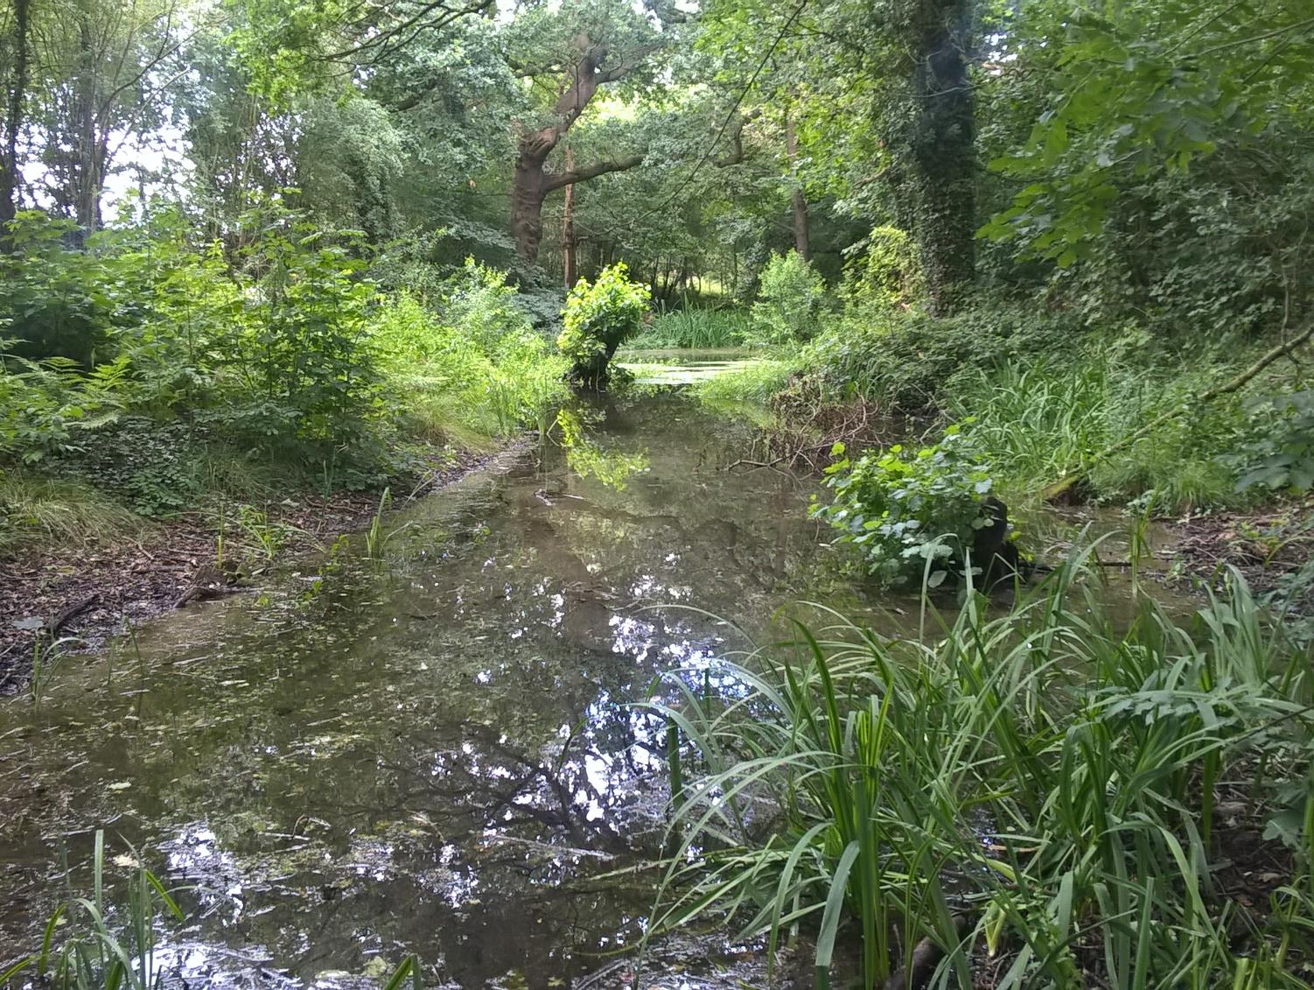
Survivors from a lost world -
Nature reserves around Carrington Moss
David Reeves

Slide 2
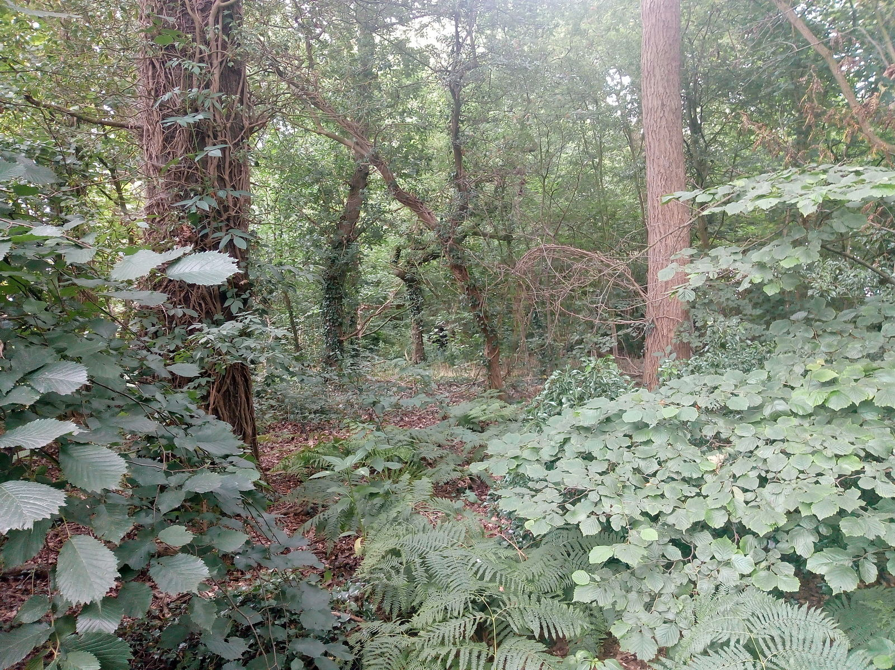
Caveats -
I am not an ecologist,
biologist, botanist, etc
Phots taken for recording
rather than artistic purposes

Slide 3
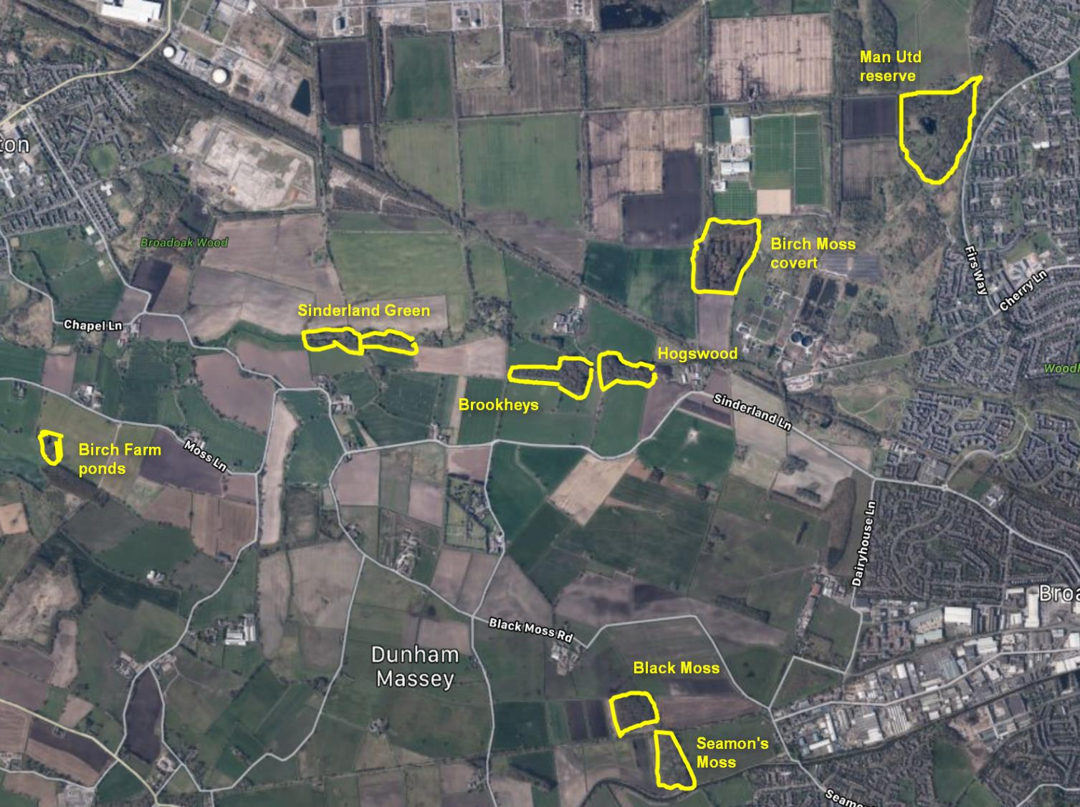
Shell pond

Slide 4
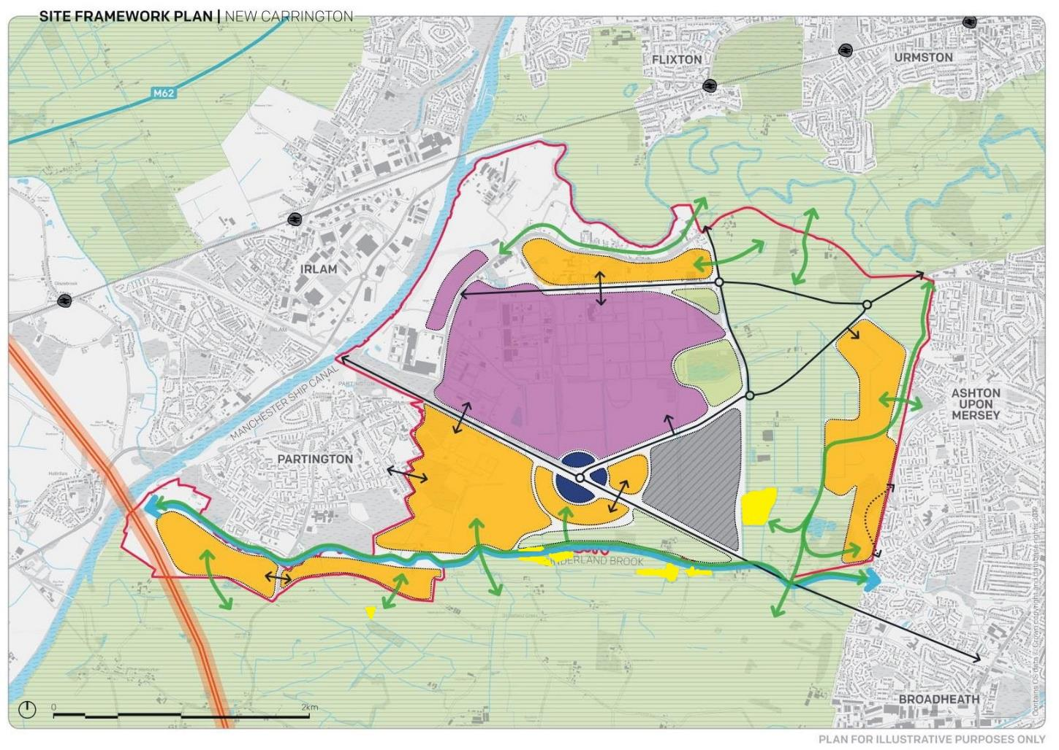

Slide 5
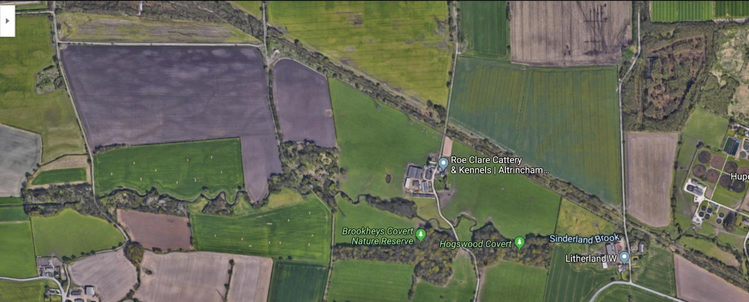
The Sinderland Brook corridor
Safeguarded
land?
Sinderland green woods
SBI, NT
Hogswood covert
SBI, NT
Brookheys covert
SSSI, NT
Birch Moss covert
SBI, HIMOR
SSSI are the finest sites for wildlife and natural features in England, supporting many characteristic, rare and endangered species, habitats and natural features
Natural England

Slide 6
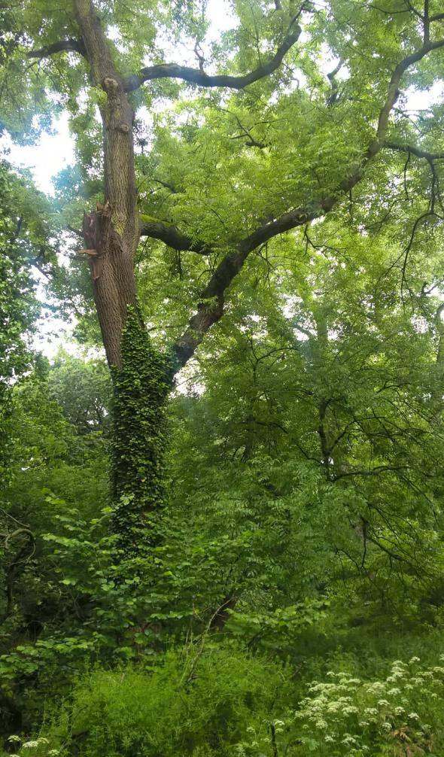
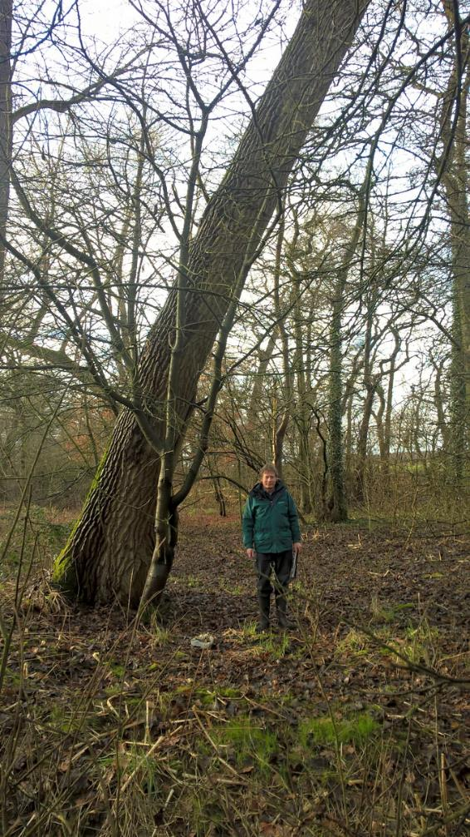
Ancient mixed woodland
Habitat of principal importance in UK Biodiversity Action Plan

Slide 7
180 plant species recorded in Brookheys since 1970
High biodiversity
Adela reamurella | Cantharis decipiens | Dog Rose | Hogweed | Perennial Rye-Grass | Skullcap
Aglaostigma fulvipes | Cape Thread-moss | Dog's Mercury | Holly | Phyllodrepa puberula | Slender Mouse-tail Moss
Agonum assimile | Cephalozia bicuspidata | Downy Birch | Honeysuckle | Pignut | Soft Rush
Alder | Chickweed | Elaphrus cupreus | Horse-Chestnut | Plagiomnium undulatum | Spear Thistle
Amblystegium riparium | Cleavers | Elder | Hybrid Oak | Plagiothecium succulentum | Stenus bimaculatus
Amblystegium serpens | Cock's-Foot | Enchanter's-Nightshade | Indian Balsam | Pohlia carnea | Stenus impressus
Anaspis humeralis | Coleophora serratella | Eriocrania subpurpurella | Isopterygium elegans | Polydesmus angustus | Stigmella aurella
Anaspis maculata | Common Cord-moss | Eriophyes avellanae | Ivy | Ramsons | Swan's-neck Thyme-moss
Ash | Common Couch | Eurhynchium swartzii | Kuehneola uredinis | Raspberry | Sycamore
Aspen | Common Duckweed | Eutrichapion vorax | Lemna | Red Campion | Tachyporus obtusus
Athous haemorrhoidalis | Common Feather-moss | False Oat-Grass | Lesser Burdock | Red Clover | Tetragnatha extensa
Barbula cylindrica | Common Figwort | Fern-leaved Hook-moss | Lesser Celandine | Reed Canary-Grass | Tufted Hair-Grass
Bedstraw | Common Knapweed | Field Horsetail | Lesser Periwinkle | Remote Sedge | Tufted Thread-moss
Beech | Common Nettle | Floating Sweet-Grass | Lesteva longoelytrata | Rhadinoceraea micans | Vicia
Birch Polypore | Common Pincushion | Foxglove | Lithobius forficatus | Rhingia campestris | Wall Screw-moss
Bird Cherry | Common Ragwort | Garlic Mustard | Lunularia cruciata | Rhinosimus planirostris | Water Horsetail
Bittersweet | Common Water-Starwort | Giant Fescue | Marsh Horsetail | Rhizomnium punctatum | Water-Plantain
Blackthorn | Cow Parsley | Gipsywort | Marsh Marigold | Rhizophagus dispar | Water-Starwort
Bluebell | Crab Apple | Great Willowherb | Melanotus villosus | Rhododendron | Water-Violet
Brachythecium rivulare | Creeping Buttercup | Greater Periwinkle | Mesembrina meridiana | Rhynchostegium riparioides | Wavy Bitter-Cress
Brachythecium rutabulum | Creeping Soft-Grass | Greater Plantain | Mugwort | Ribwort Plantain | Wavy Hair-Grass
Bracken | Creeping Thistle | Greater Spearwort | Nargus velox | Rosebay Willowherb | White Clover
Bramble | Crimson-tuber Thread-moss | Green Oak Tortrix | Nodding Bur-Marigold | Rough Meadow-Grass | White Dead-Nettle
Branched Bur-Reed | Cylindric Ditrichum | Grey Willow | Nodding Thread-moss | Rowan | Wild Angelica
Broad Buckler-Fern | Cyperus Sedge | Guelder-Rose | Oniscus asellus | Rush | Wild Cherry
Broad-Leaved Dock | Dalopius marginatus | Habrocerus capillaricornis | Pale-fruited Thread-moss | Russian Comfrey | Wood Anemone
Bud-headed Groove-moss | Dandelion | Hawthorn | Pedunculate Oak | Sallow | Wood Dock
Bulrush | Dicranella staphylina | Hazel | Pellia epiphylla | Sessile Oak | Wood Horsetail
Callicerus rigidicornis | Dicranum tauricum | Heart-leaved Spear-moss | Pellucid Four-tooth Moss | Silky Forklet-moss | Wood-Sorrel
Canadian Waterweed | Dock | Herb-Robert | Pendulus Sedge | Silver Birch | Yellow Iris

Slide 8
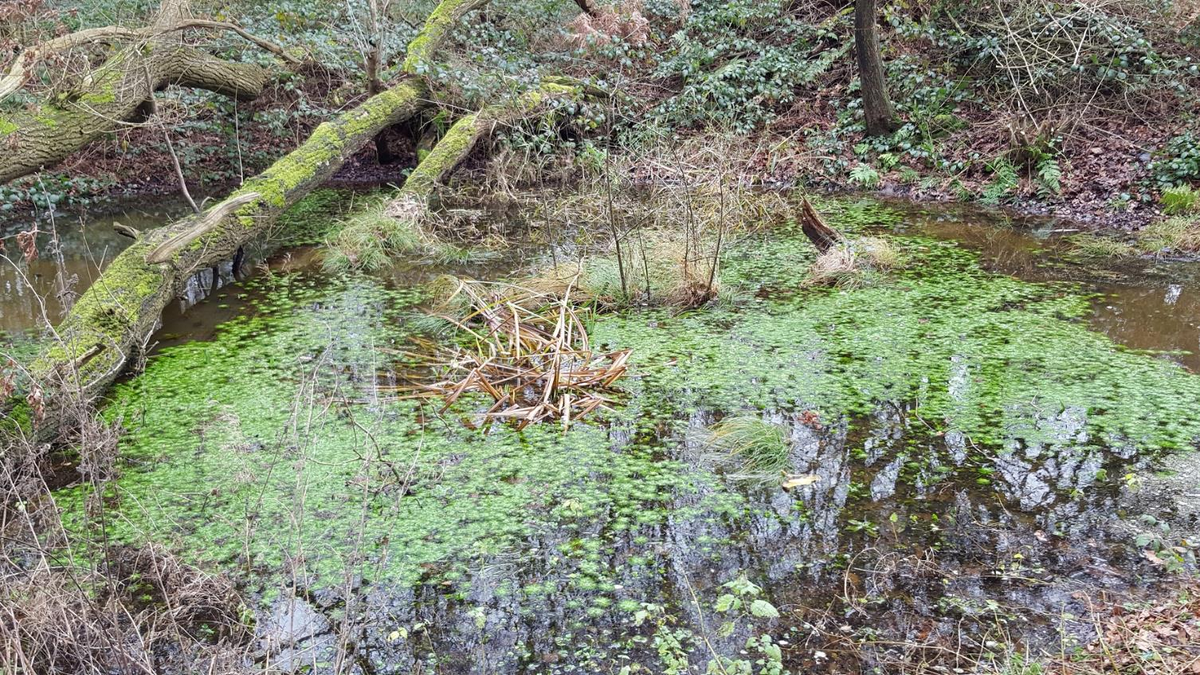
Most of the remaining ponds
Water-violets in Brookheys, old marl pit

Slide 9
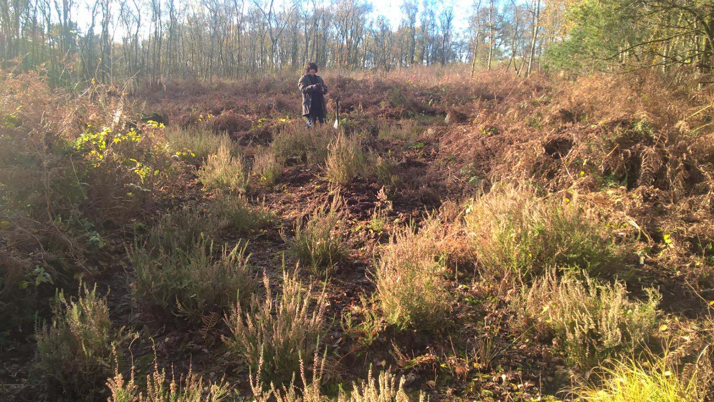
Last fragments of the original Moss
Heather in Birch Moss

Slide 10
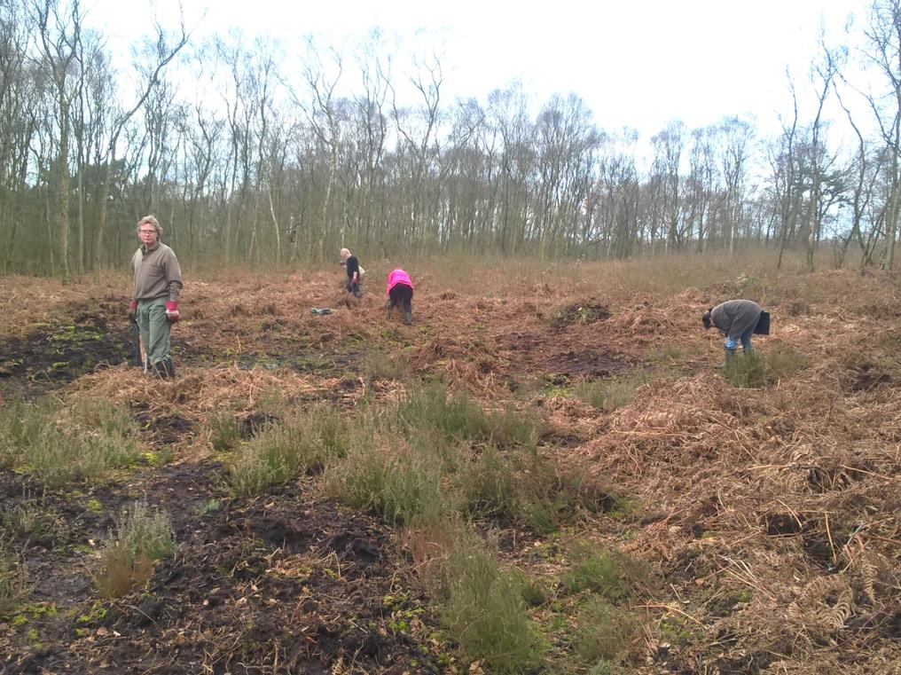
Conservation work

Slide 11
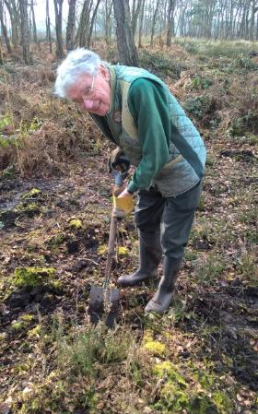
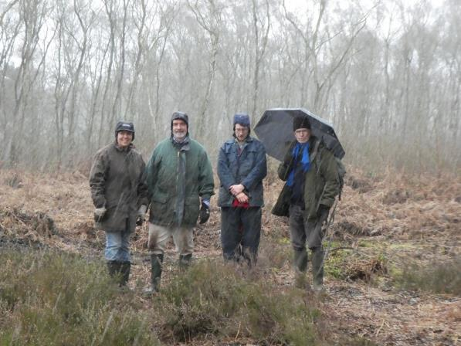
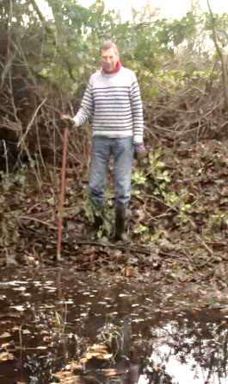
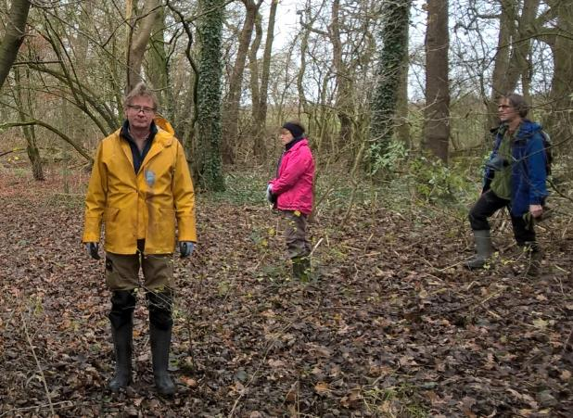
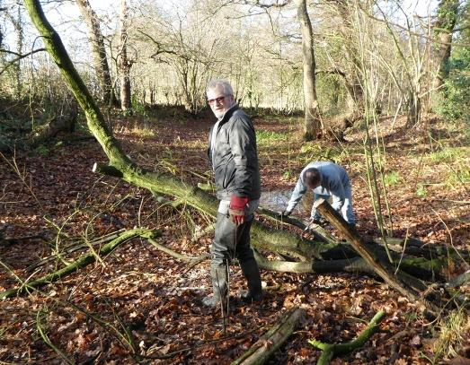
Volunteers

Slide 12
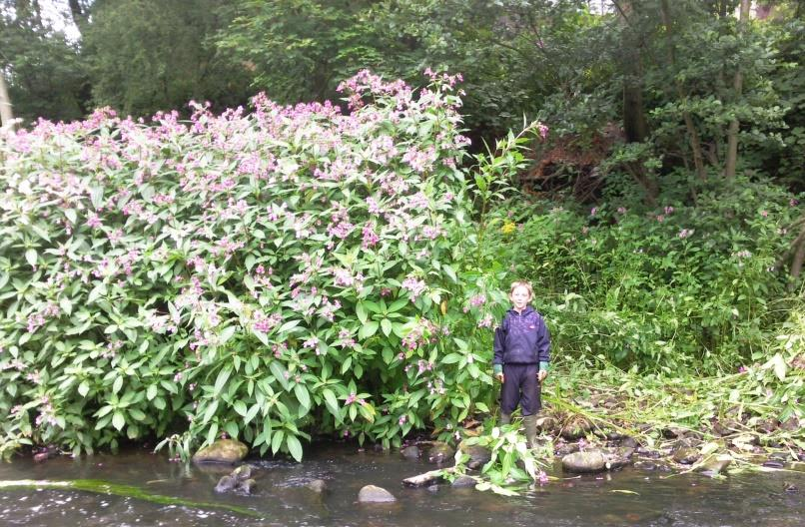
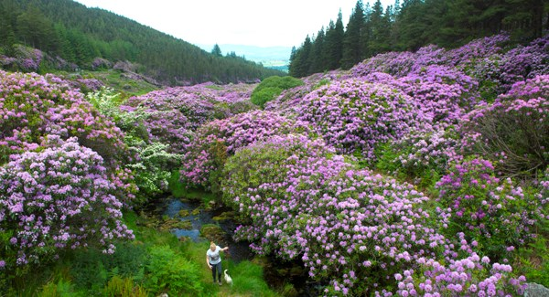
Removing invasives
Himalayan balsam
Rhododendron

Slide 13
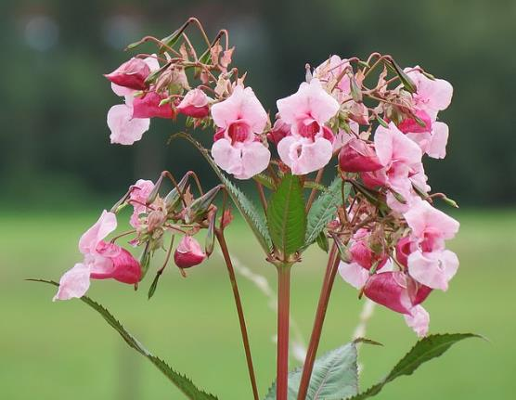
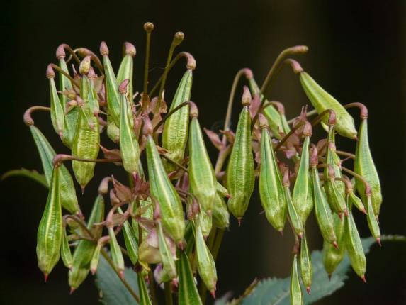
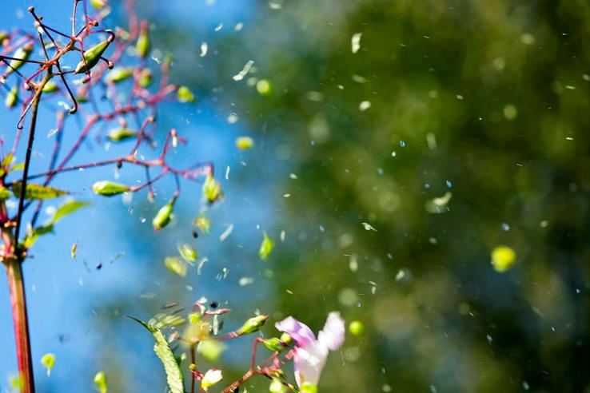
Himalayan balsam – the chain-reaction plant

Slide 14
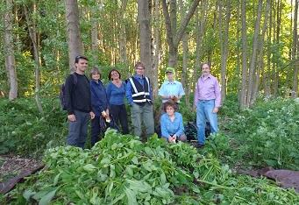
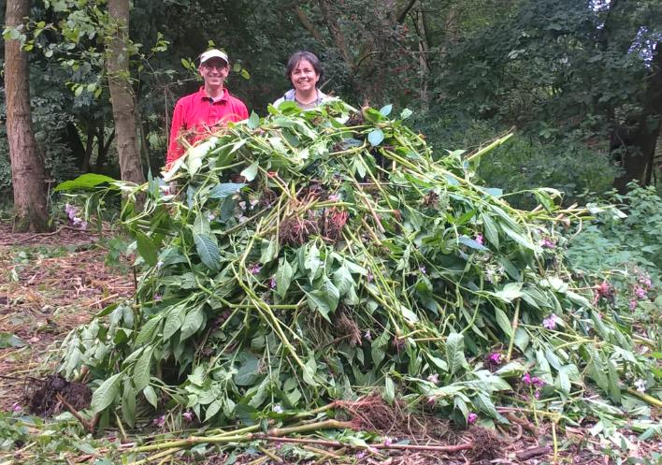
April – August is “balsam-bashing” time!

Slide 15
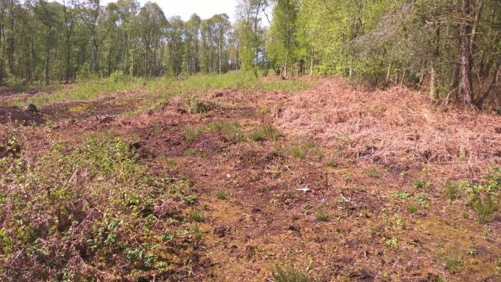
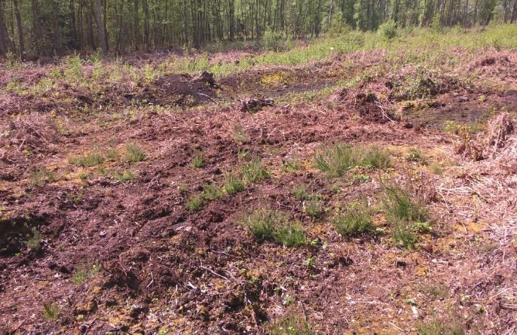
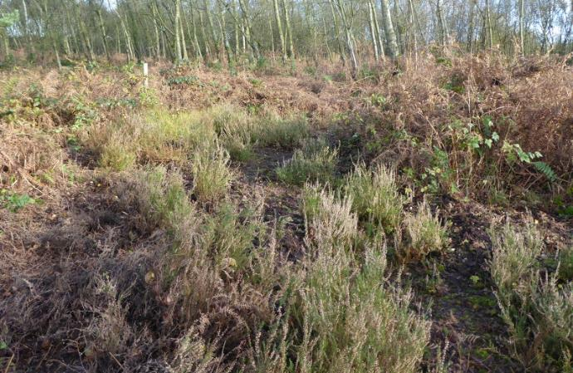
Birch Moss Covert - heather regeneration
Before
After

Slide 16
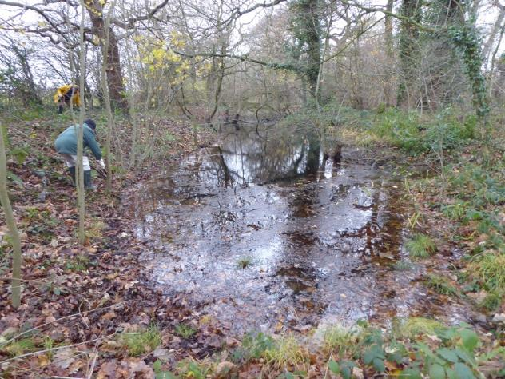
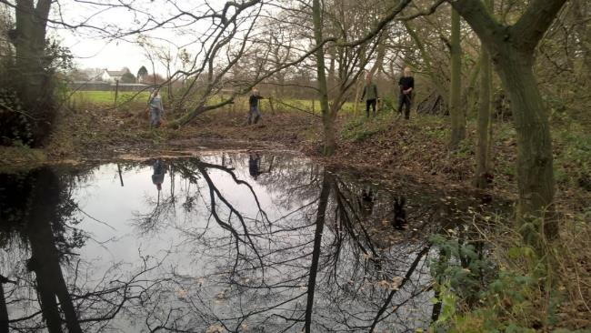
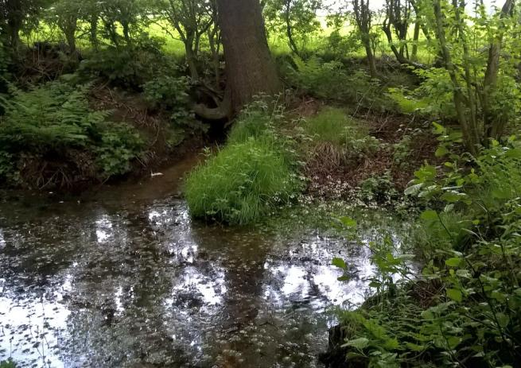
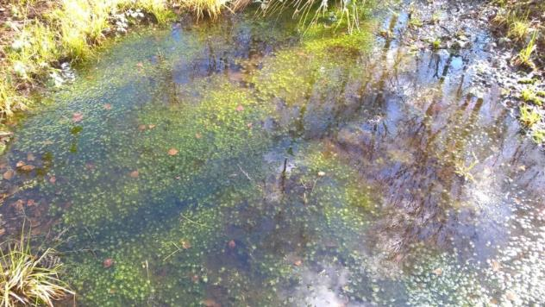
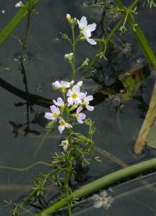
Pond maintenance

Slide 17
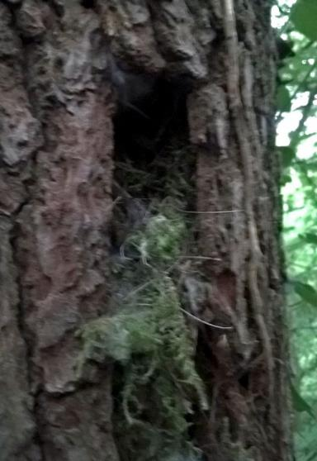
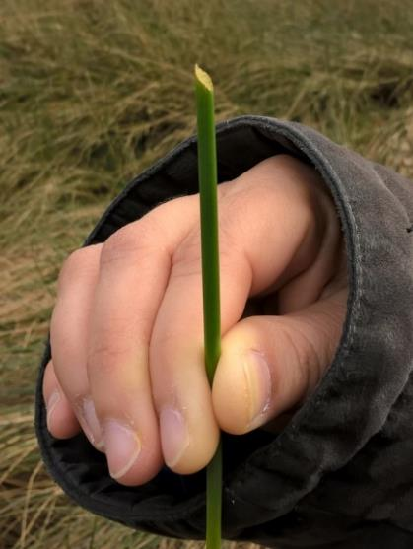
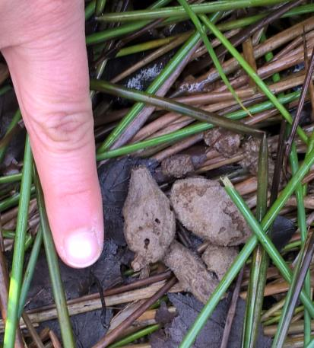
Wildlife
Tend to see signs of wildlife rather than wildlife itself….
Who lives here? Water vole? Who did that?

Slide 18
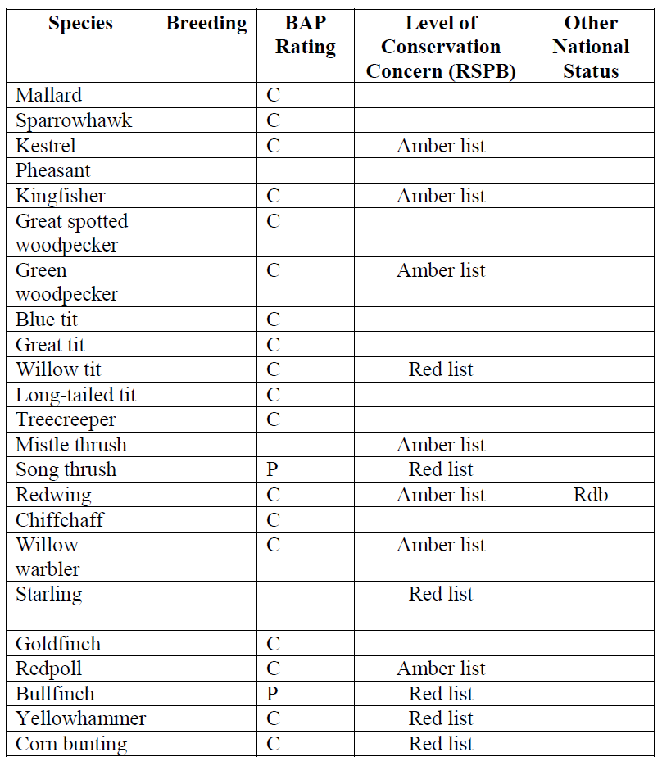
Some birds of conservation concern recorded in Brookheys covert
C = Conservation concern
P = Priority species
Rdb = Red Data Book

Slide 19
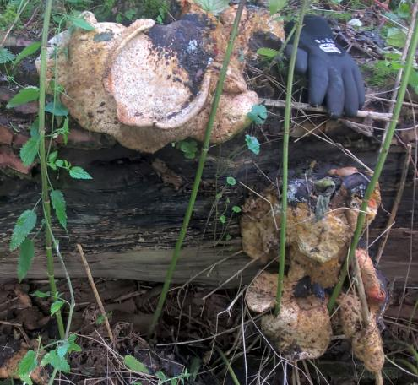
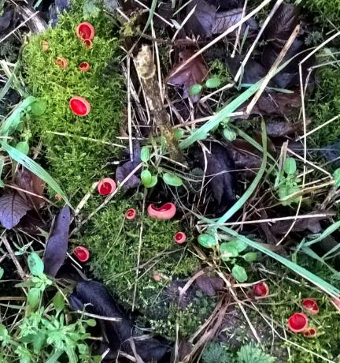
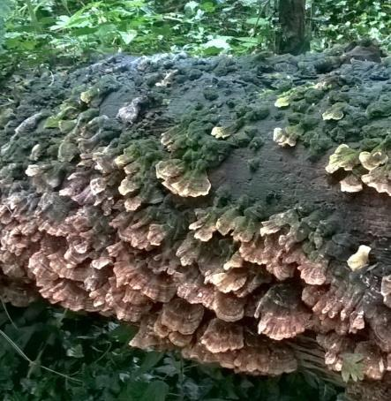
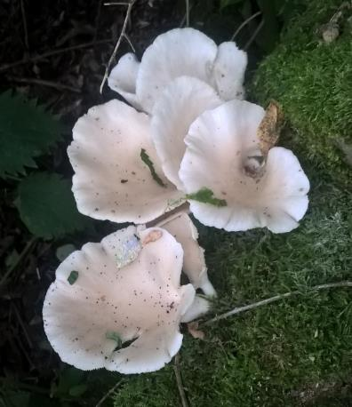
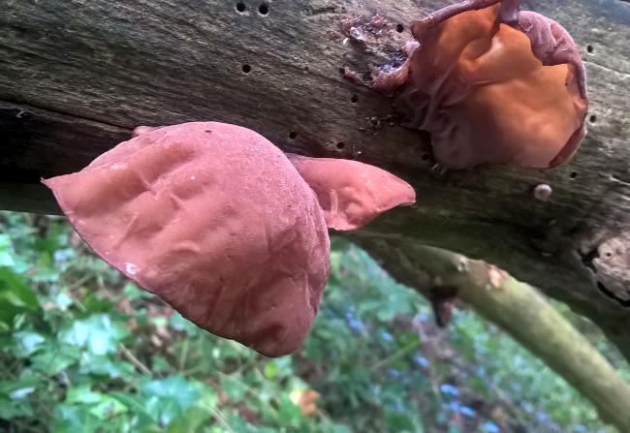
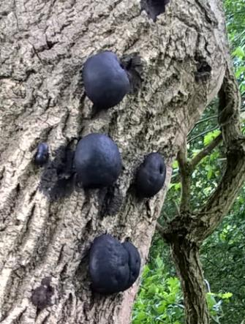
Fun fungus

Slide 20
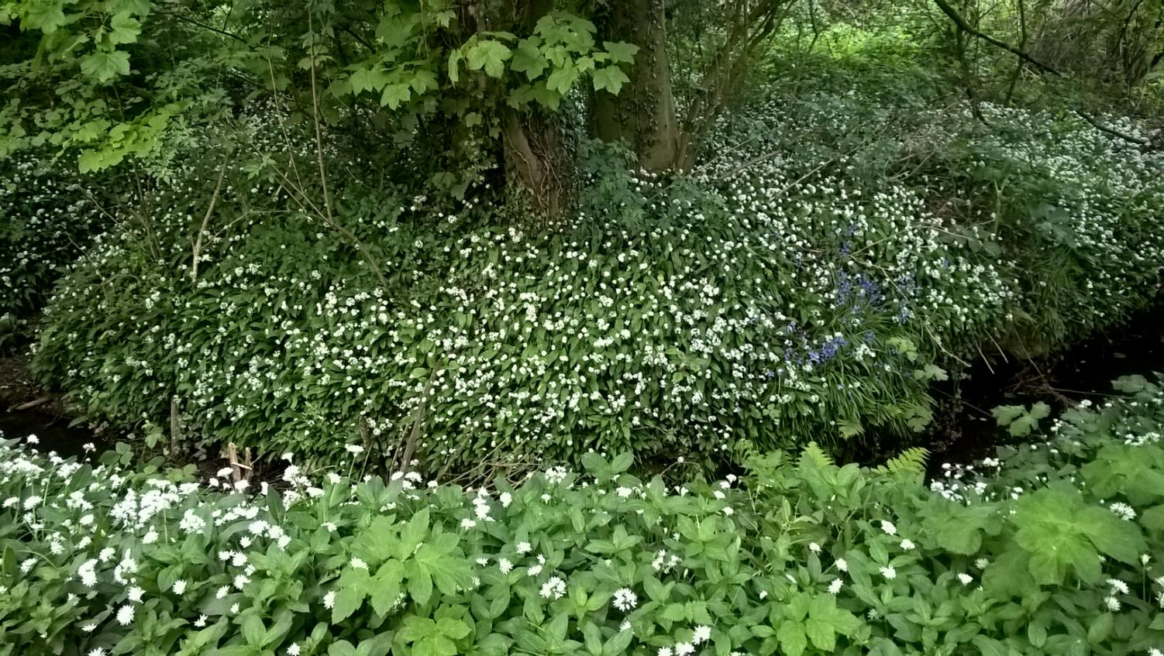
The end
Wild garlic in Sinderland green woods

