Slide 1
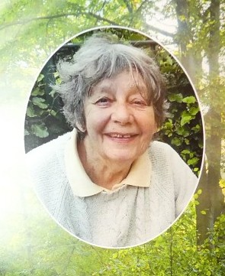
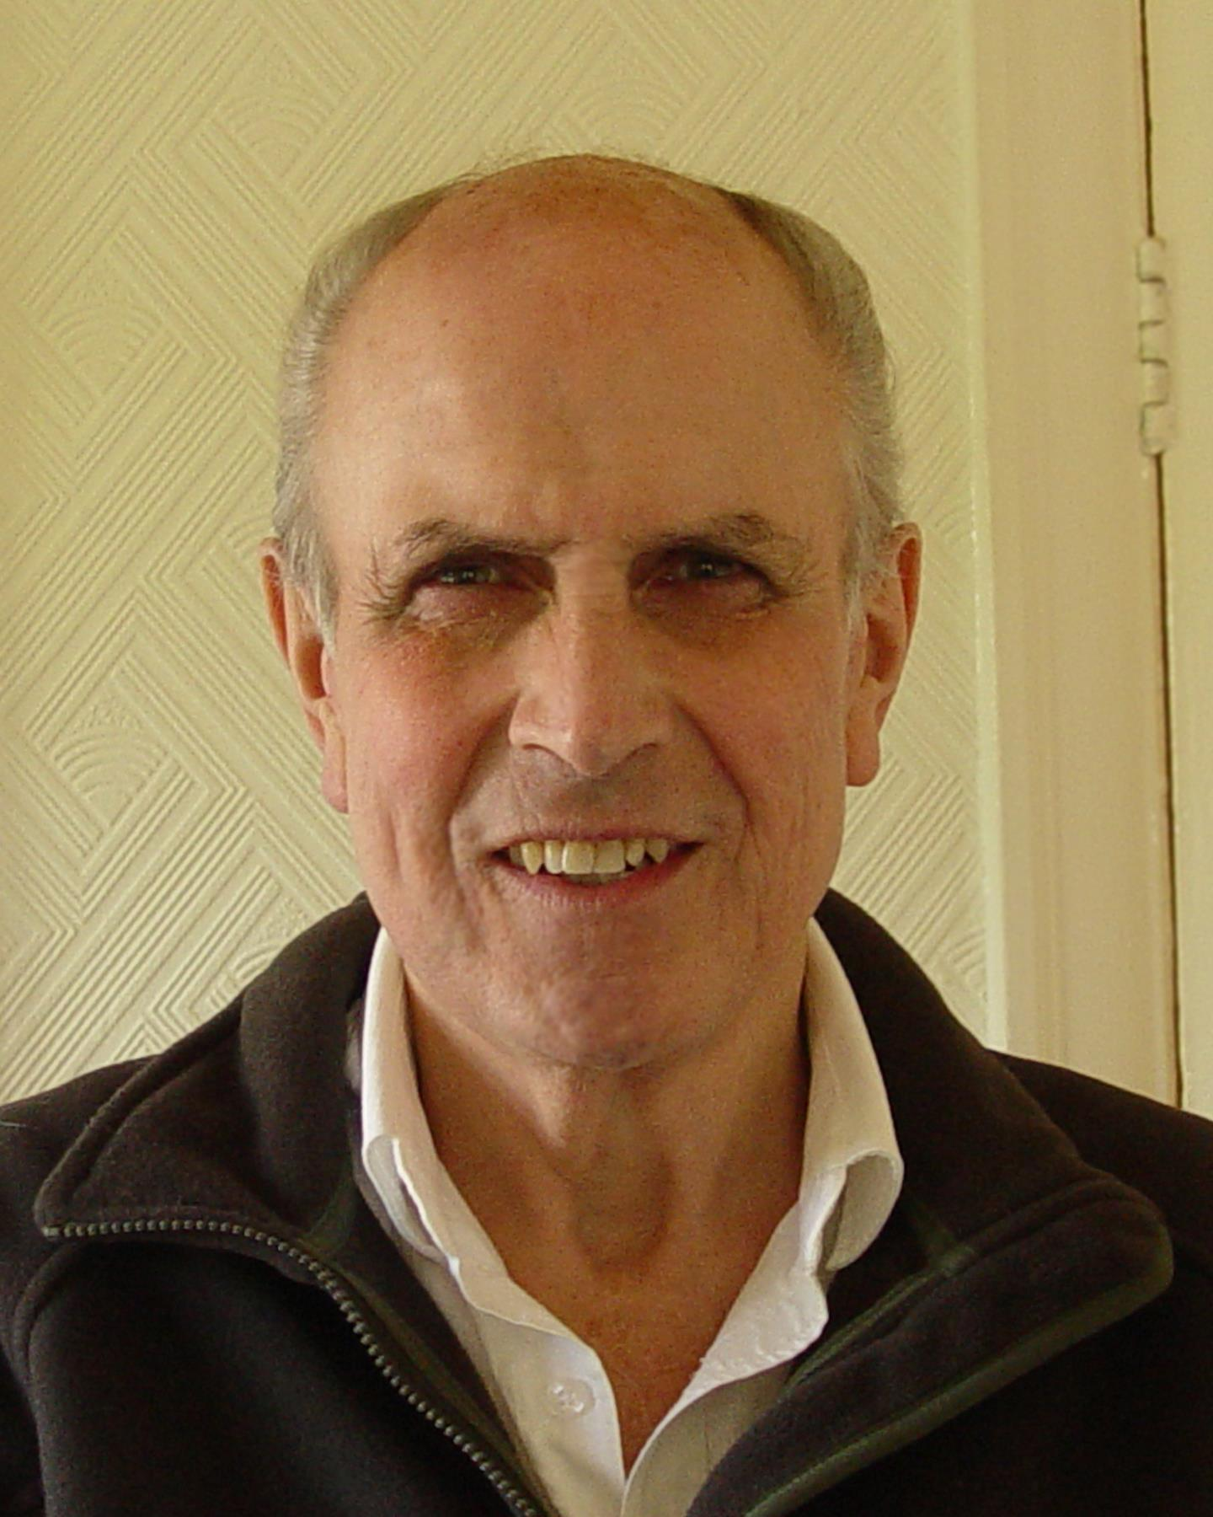
In memorium….
Margaret McCormick
1933 -2023
Manager of Black Moss SBI
John Somerville
1928 -2023
Manager of Brookheys SSSI

