Slide 1
COMMUNICATION PLAN OF THE UBER ORGANATION
BERNETTA REMBERT
AET/560 – Signature Assignment
NOVEMBER 12, 2019
Professor Christine Nortz
Notes:
Title Page.

Slide 2
INTRODUCTION
The PowerPoint presentation emphasis on an effective communication plan for the Uber organization. Unfortunately, the Uber drivers failed in the communication skill to their passengers. In addition, the Uber drivers slack in maintaining a sufficient schedule in transporting passengers to or from their destinations The Uber drivers utilizing the navigating system failed tremendously in the communication field to passengers. Last, the Uber industry implemented one-click chat smart reply. The updated technology displays effective communication for both parties. Remember, the Uber organization’s priority focus on providing safe and adequate transportation through substantial communication.
Notes:
Introduction: The PowerPoint present emphasis on an effective communication plan for the Uber organization. Unfortunately, the Uber drivers failed in the communication skill to their passengers. In addition, the Uber drivers slack in maintaining sufficient schedule in transporting passengers to or from their destinations. The Uber drivers failed tremendously in communication to their passengers about deviating from the navigation system. Last, the Uber industry implemented one-click chat smart reply system. The updated technology displays effective communication for both parties. Remember, the Uber organization’s priority focus in providing a safe and adequate transportation through substantial communication.

Slide 3
CONTENTS
Introduction
The Objectives of a Communication Plan
Target Audience
How will the communication be shared?
How often and what forms will the communication about the change be given?
How was the evaluation regarding communication about the organizational change effective?
Improve Technology
Conclusion
References
Notes:
The overview consist of the following display in the presentation: introduction, objectives of communication plan, target audience, how will the communication be shared?, how often and what forms will the communication about the change be given?, how was the evaluation regarding communication about the organizational change effective?, improve technology, conclusion, and references.

Slide 4
THE OBJECTIVES OF A COMMUNICATION PLAN
Accommodate the passengers
Educate the Uber drivers
Acknowledge the stakeholders
Format an effective communication plan for all parties involved
Notes:
The objectives of a communication plan consist of the following: accommodating the passengers, education the Uber drivers, acknowledge the stakeholders, and formatting an effective communication plan for all parties involve in the process.

Slide 5
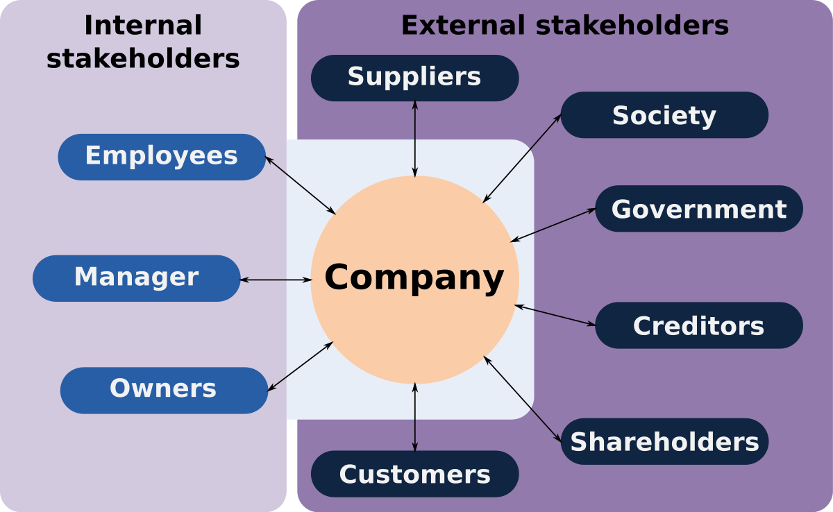
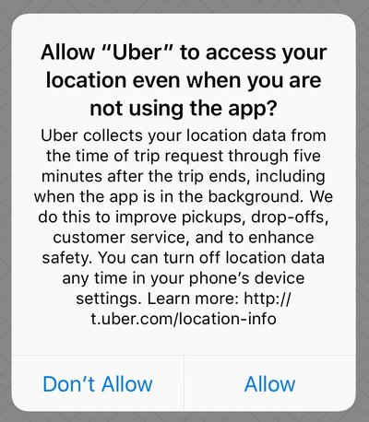
TARGET AUDIENCE
Passengers (Riders)
Uber drivers
Stakeholders (Internal/External)
Uber’s Website
Upper Management
Notes:
The target audience consist of the following: passengers (riders), Uber drivers, stakeholders (internal/external), websites, and upper management. Furthermore, the target audience includes the Uber’s website to communicate to the entire organization, passengers, and onlookers.

Slide 6
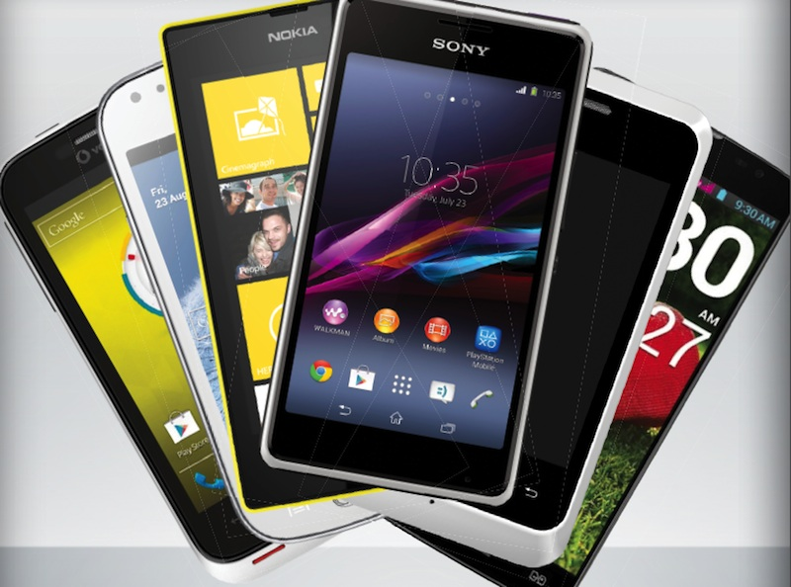
HOW WILL THE COMMUNICATION BE SHARED?
Smart phones
Video Conferencing
Emails
Meetings
Mail
Notes:
How will the communication be shared? The communication is shared through smart phones, video conferencing, emails, meetings, and mail. Remember, communication is a process that formats into a successful plan. The communication plan interacts in various ways that proficient for Uber drivers and the organization to move the process forward.

Slide 7
HOW OFTEN AND IN WHAT FORMS WILL COMMUNICATION ABOUT THE CHANGE BE GIVEN?
Bulletins
Conversation
Weekly
Monthly
Notes:
How often will the forms of communication about the change be given? The forms of communication will be a weekly and monthly given to both parties. Furthermore, the form utilized to transmit the change consist of conversations and bulletins. The bulletins are internal and external (drivers and the company).

Slide 8
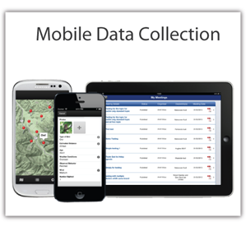
EVALUATE THE EFFECTIVENESS OF THE COMMUNICATION CHANGES?
Evaluations (online)
Surveys
Feedback from stakeholders
employees, and riders.
Data Collection
Notes:
Consequently, the organization considers several steps to evaluate the effectiveness of the communication changes. The steps consist of the following: evaluations, surveys, data collection, feedback from stakeholders, employees, and passengers. The results consist of data collected from the steps to indicate the overall score. The score displays either a negative or positive aspect of the communication change plan.

Slide 9
Improve Technology
1. One-click chat
2. Smart Reply
Notes:
According to Weng, Zheng, Aras, & Bell, (2019) “The result of our efforts is a new smart reply feature called one-click chat (OCC). With OCC pre-trip coordination between riders and driver-partners is faster and more seamless.” (p.1) Therefore, the improved technology provides a timely pick-up at passengers’ location as well as quick response to effective communication.

Slide 10
CONCLUSION
In conclusion, the PowerPoint presentation emphasis on a communication plan for the Uber organization.
The organization’s drivers failed in the communication skill to their passengers.
Passengers complained about the communication from drivers about their travel time to and from their destinations while utilizing the navigation system.
Furthermore, the presentation display the target audience.
How was the communication shared?
How often and what forms will the communication about the change given?
How did the presentation evaluate whether the communication about the organizational change was effective?
Improve Technology – One-click chat…smart reply
Notes:
In conclusion, the PowerPoint presentation illustrates on the communication plan for the Uber organization. The organization’s drivers failed in the communication skill to their passengers. Unfortunately, passengers complained about the communication from drivers about their travel time to and from their destinations while utilizing the navigation system. Furthermore, the presentation displays the target audience. The questions addressed in the presentation consist of the following: How was the communication shared? How often and what forms will the communication about the change given? How did the presentation evaluate whether the communication about the organizational change was effective? Improve technology provided through one-click chat and smart reply.

Slide 11
REFERENCES
Weng, Y., Zheng, H., & Aras, A., & Bell, F. (2019). Improving driver communication through one-click chat, Uber’s smart reply system. Retrieved from: https://eng.uber.com/one-click-chat
/
Notes:
Reference Page.

