Slide 1
Newly Hired Transportation Managers Training Curriculum
Bernetta Rembert
516
Dr. Miller
April 7, 2019
Notes:
Title Page

Slide 2
CURRICULUM CONTENTS
INTRODUCTION – SOUTHEASTERN PENNSYLVANIA TRANSPORTATION AUTHORITY – (SEPTA)
ADDIE MODEL – Analyze, Design, Demonstrate, Implement, and Evaluate.
AUDIENCE
PREREQUISITES – REQUIREMENTS
MATERIALS
TRADITIONAL CLASSROOM SETTING
NONTRADITIONAL CALSSROOM SETTING – FIELD WORK
Notes:
The slide contains the curriculum contents listed throughout the presentation.

Slide 3
CURRICULUM CONTENTS
RADIO CODES – EQUITTEES
ORGANIZATION DOCUMENTS (LEGAL)
CUT-BACKS OF PRORITY ROUTES
TRAINING ON VEHICLE EQUIPMENT –TROLLEYS, ARTIC (60 FT VEHICLES), TRACKLESS VEHICLES
CONTROL CENTER – DISPATCHERS
FEEDBACK – QUIZZES/FINALS/CLASSROOM DISCUSSIONS
EVALUATE
CONCLUSION
REFERENCES
Notes:
The slide contains the curriculum contents listed throughout the presentation.

Slide 4
INTRODUCTION
The Newly Hired Transportation Managers (TM) Training Curriculum address numerous of insufficient training for New TM in the SOUTHEASTERN PENNSYLVANIA TRANSPORTATION AUTHORITY (SEPTA).
Unfortunately, a significant number of veteran TMs will retire from the department.
The veterans along with their skills will vanish from the department leaving the new TMs for replacement.
The curriculum outline several vital phases to educate the TMs to become qualified in the skills which is required by the department.
In addition, the primary training points consist of proper radio protocols
Last, the presentation follows the ADDIE Model in an Instructional Design. The ADDIE Model consist of the following: Analyze, Design, Develop, Implement, and Evaluate.
Notes:
Introduction: The introduction slides emphasis the information listed in the presentation to engage their audience. In addition, the Presentation illustrates the ADDIE Model in an Instructional Design Plan. The ADDIE Model reflects the following: Analyze, Design, Demonstrate, Implement, and Evaluate.

Slide 5
ADDIE MODEL
Analyze – (questions) – ‘What is the point of the training? Why are we doing it? What type of behavioral changes is desired? Will training actually help?”
Design – “Assessments, duration, and feedback”
Develop – (Graphics, No basic errors, and Engagement)
Implement – Collection assessments and feedback. “Was enough time given?”
Evaluate – (“Was the goals meets?” Surveys. (ADDIE. Model. 2019.)
Notes:
In the Newly Hired Transportation Manager Training Curriculum, the training aspects illustrates the ADDIE Model. The ADDIE Model consist of the following: Analyze, Design, Develop, Implement, and Evaluate. Analyze displays several questions regarding the TMs’ training curriculum. The questions portrays the following: What is the point of the TMs’ training? Why is the SEPTA organization doing this type of training? Why type of behavioral changes is desired by the organization? Will the training actually provide help for the newly hired TM’s?

Slide 6
AUDIENCE
NEWLY HIRED TRANSPORTATION MANAGERS
FORMER BUS OPERATORS
FORMER TROLLEY OPERATORS
Notes:
The audience begins with the newly hired Transportation Managers (TM) at SEPTA. The newly hired transportation managers are former bus and trolley operators wanting to enhance their career within the SEPTA Organization

Slide 7
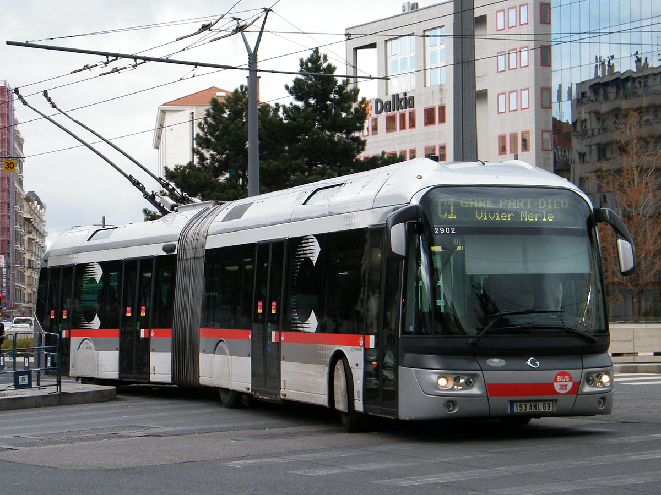
TRAINING PREREQUITIES
Transportation Managers Ages – (ages ranging from 20 to 60 years)
High School Diploma
Associate Degree
Knowledge of Transportation Operations
Notes:
Training Prerequisites: Transportation Managers ages ranging from 20 to 60 years. In addition, individuals needs a high school diploma along with an Associate’s Degree in at least General Studies. Last, the best candidates consist of individuals with knowledge of transportations operations according the to Southeastern Pennsylvania Transportation Authority’s guidelines (SEPTA)

Slide 8
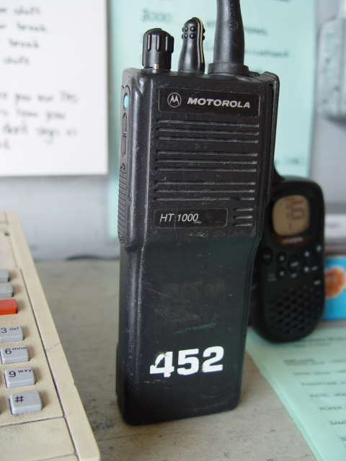
MATERIALS
Hand-held Two-way Radio
Company iPads
Safety Vest
Flash Lights
Access Keys
Company Issues ID
Notes:
The materials listed for the newly hired TMs consist of the following: Hand-held two-way radio, company issues iPads containing documents for various job regulations and requirements, yellow safety vests with reflectors, flash lights issues used in the trolley tunnels that are plastic covers to avoid electric shock while working underground in the tunnels, access keys to numerous buildings as well as offices, and a SEPTA ID utilized through the transportation system.

Slide 9
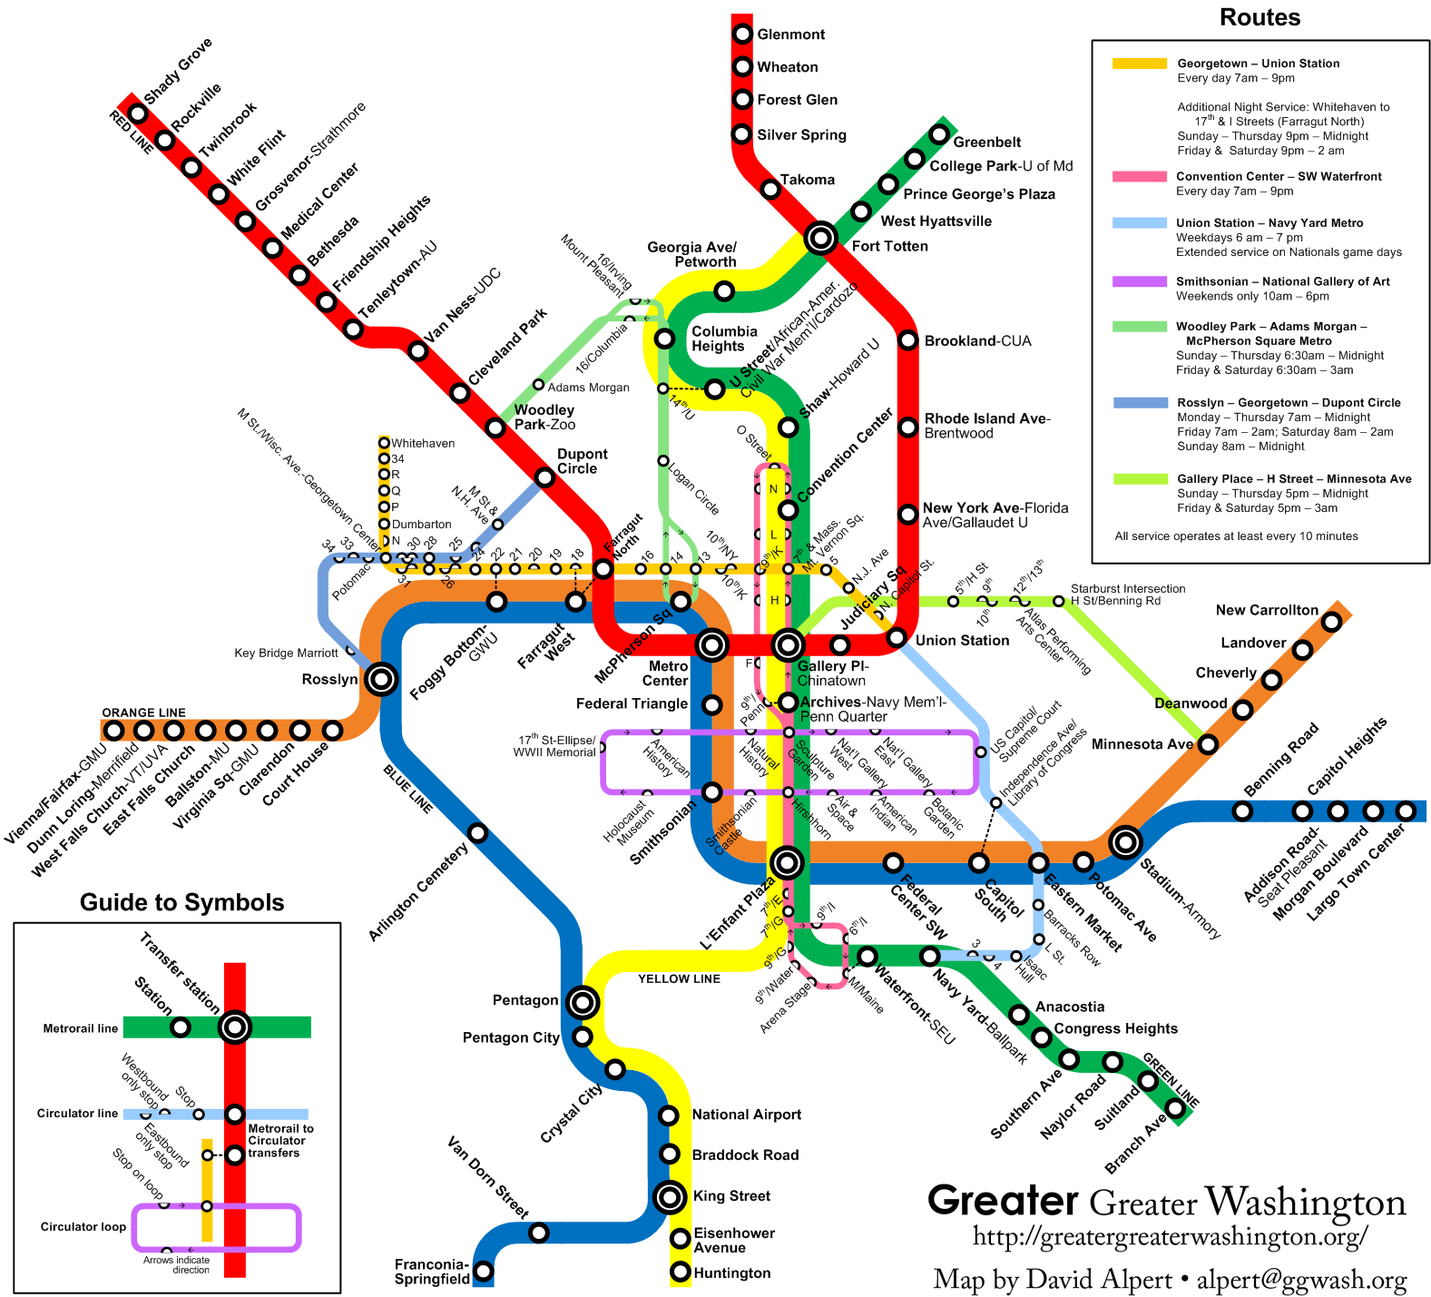
TRADITIONAL CLASSROOM
Trainers
Trainees
Radio Codes
Documents (Legal)
Routes (Cut-backs)
Notes:
In the traditional classroom setting, the trainers or trainers educate trainees in numerous phases regarding the job requirements. The training consist of the following: radio codes for proper radio etiquette, completing the documents which may be display in a court of law, and cuts-backs on numerous of bus routes throughout the Philadelphia Region.

Slide 10
NON-TRADITIONAL CLASSROOM
Field Work – (Riding along veteran Transportation Managers -TMs)
Control Center Training (Mentoring Controllers Communicating with TMs on the two-way radio.
Regional Rail Training (The Newly Hired TMs travel in the Company Van along the numerous Regional Rail Stations for Emergency service)
Group two Newly Hired TMs to work together in the different zones throughout the City
Notes:
In the Non-traditional classroom training, the newly hired TMs will conduct field work riding along side veteran TMs to enhance skills. Furthermore, the trainees receives training sitting along side with controllers in the Radio Control Center to comprehend utilizing the two-way radio. In addition, the trainers will travel along the Regional Rail Routes using the Organization’s van to obtain a visual on the frequent used regional rail system. Last, the trainee consist of two new TMs riding together in several zones to obtain a hands-on experience.

Slide 11
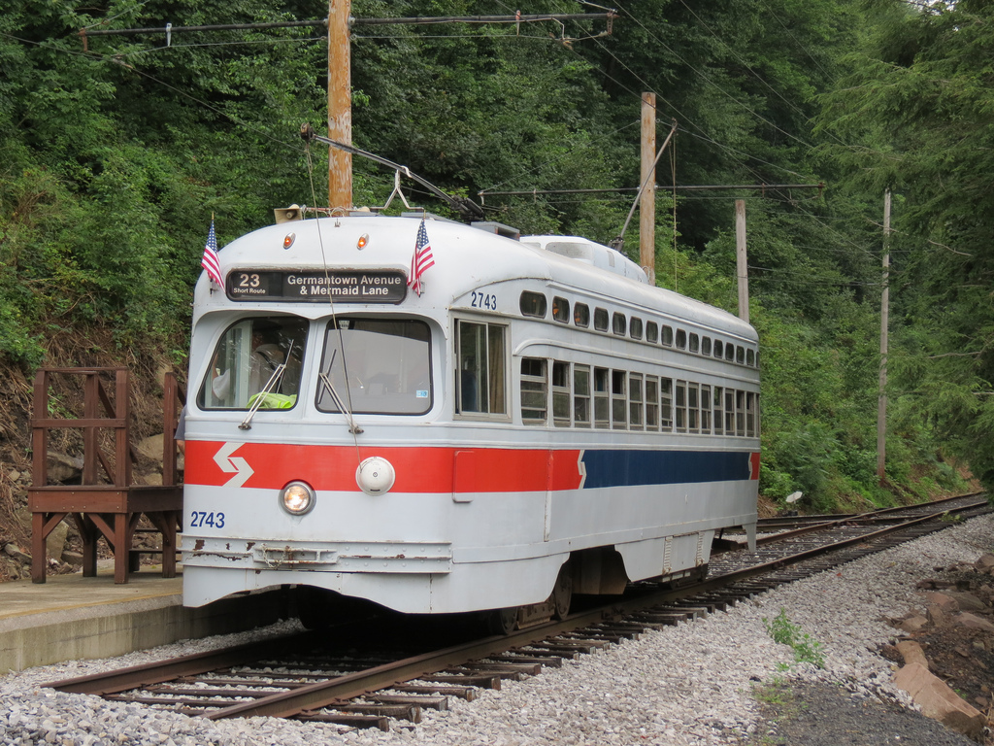
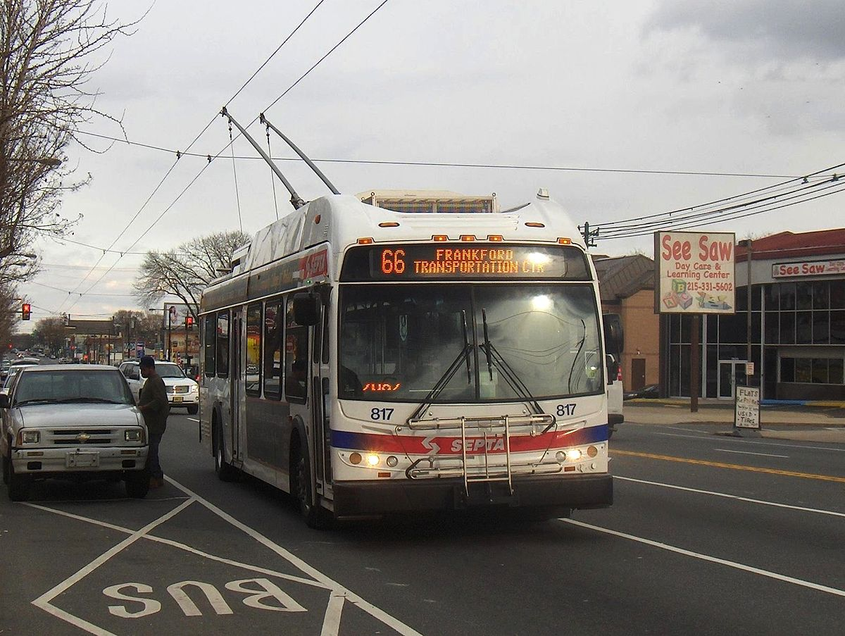
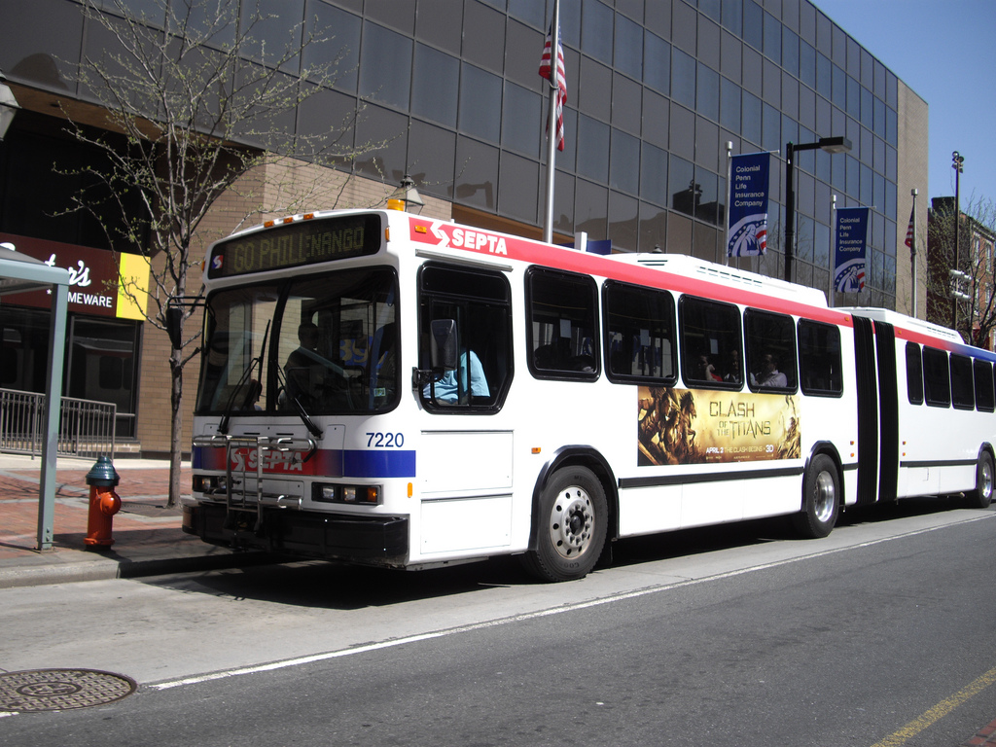
EQUIPMENT TRAINING
KAWASKI TROLLEYS
ARTIC BUSES (60 FT)
PCC TROLLEYS
TRACKLESS BUSES
Notes:
As a newly hired TM, equipment training is essential to operate the different vehicles in an emergency as well as general knowledge. The equipment training consist of the following: Kawasaki Trolleys, Artic Buses (60 Footers), PCC Trolleys -older models utilized on the Historical route 15 trolley lines traveling the Girard Avenue passing by the Philadelphia Zoo, Girard Avenue Bridge across the Schuylkill River, and several neighborhoods along the way.

Slide 12
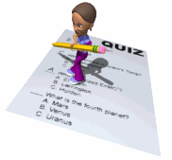
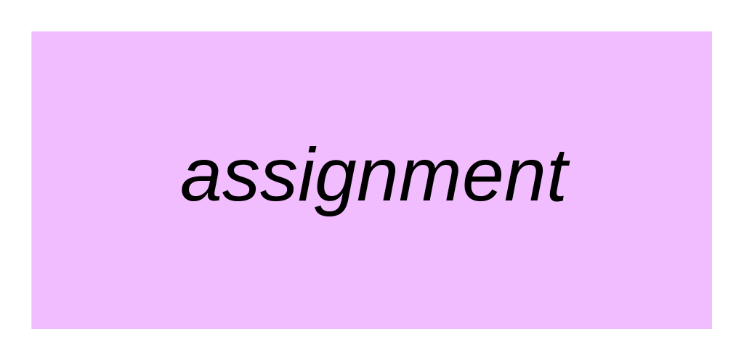
ASSESSMENTS
Weekly Quizzes
Group Discussions (Participation)
Homework Assignments
Final
Notes:
The assessments phase reflects weekly quizzes, group discussions along with participation, homework assignments, and the final to graduate from the training program. The assessments displays the trainees knowledge through the different obstacles.

Slide 13
FEEDBACK
Trainees Perspectives
Percentage of Trainees Passing
65%
Final Test Scores
80%
Numerical Summary
90%
Quiz Scores
Final Scores
Numerical Summary
Percentage Range
Notes:
The feedback consist of the following factors: Quiz and final scores, a numerical average of trainees completing the training curriculum, and overall percentage of trainees passing the entire training.

Slide 14
EVALUATION
Did we meet the goals as set out?
Did we take the essential feedback and place back into analysis phase.
Any possible changes in the approach type?
Trainees Summaries
Notes:
In the ADDIE Model, the last phase consist of evaluation. The main question to address consist of the following: Did we meet the goals as set out? Therefore, if the question is addressed then the goals were meet as portrayed in the beginning phase. Are there any possible changes in the approach type? The approach types divides into two parts of traditional and non-traditional classroom training. Last, the trainees summaries provides insight concerning any aspects of the training that became questionable or confusing to the trainees. The essential goal is engagement between the trainees and trainers.

Slide 15
Conclusion
ADDIE MODEL DESIGN
GOALS
ASSESSMENTS (QUIZZES AND THE FINAL)
EVALUATE
SUMMARIES
NUMERICAL FEEDBACK
Notes:
In conclusion, the Newly Hired Transportation Managers Training Curriculum consist of an Instructional Design Plan following the ADDIE Model Aspects. Furthermore, the training emphasis in traditional and non-traditional classroom training. Consequently, the audience are former bus and trolley operators wanting to enhance their work experience as well as a promotion to the next level. The presentation displays assessments of quizzes, group discussion (participation) and the final to graduate from the training program. In the evaluation aspects, the main quest reflects through the goals accomplished and trainees suggestions or perspectives concerning the entire training process. Last the numerical feedback combines, the percentage of assessments scores, assignments completed, and overall percentage of trainees who graduated with a substantial combination of scores.

Slide 16
REFERENCES
ADDIE Model – Instructional Design.(2019).
Retrieved from: https://www.instructionaldesign.org/models/addie/
Ginsberg, Margery, B. & Wlodkawski, Raymond, J. (2010). Teaching Intensive and Accerated Courses.
Hodell, Chuck, (2016). From ISD From the Ground Up: A Non Nonsense Approach to Instructional Design.
Southeastern Pennsylvania Transportation Authority. (SEPTA).
Retrieved from: https://www.septa.org
Notes:
The references displays the information utilized throughout the presentation.

