Slide 1



Intro to See It Be It & Sector Safari
Cheryl Plant &
Amy Cooke

Slide 2



Improving Life Chances & Career Choices Through Employer Encounters
CV writing
Work based projects
Careers talks
Guess my job
Skills sessions
Networking with students
A chance to learn from employers about what the world of work is like, how to access it, and how to thrive in it.
Work Experience
Practical classroom activity
Site visit
Careers fairs
Workplace visit
Mock interviews
Careers in the curriculum
Mock assessment centre

Slide 3
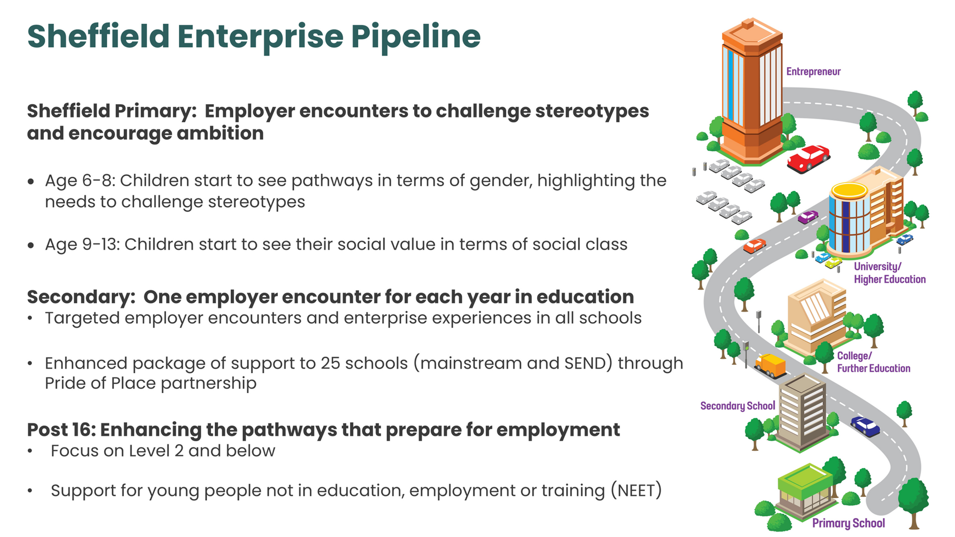

Slide 4
Benefits
Young people
Employer
Research proven:
Improvements whilst in education
  Attendance
  Attainment
  Aspiration
4 or more employer encounters:
  Recognition and visibility for your organisation
  Talent pipeline development:
    Raise awareness of your sector
    Help tackle skills shortages
    A better prepared and informed future workforce
    Improve the quality and diversity
  Support social value objectives
  Help to address social mobility in Sheffield
  Great personal development opportunities for you/staff
    Increase employee engagement
86%
Less likely to be not in education, employment or training
And are likely to earn 18% more than their peers
18%
In Sheffield in 2023/24, only 71% of schools provided these encounters - we want every child to benefit

Slide 5
Our pledge to businesses is to make it as easy as possible for you to get involved

Slide 6

Coming soon...

Slide 7
What is Sector Safari?
  Sector Safari transforms high streets into interactive career trails
  Raises the profile of high-street businesses.
  Creates unique engagement opportunities with the community.
  Inspires young people with insights into different career paths/jobs.
What are the benefits of your business
Participating?
  Increased Footfall
  Community Engagement
  Enhanced Visibility
  Future Talent Development

Slide 8

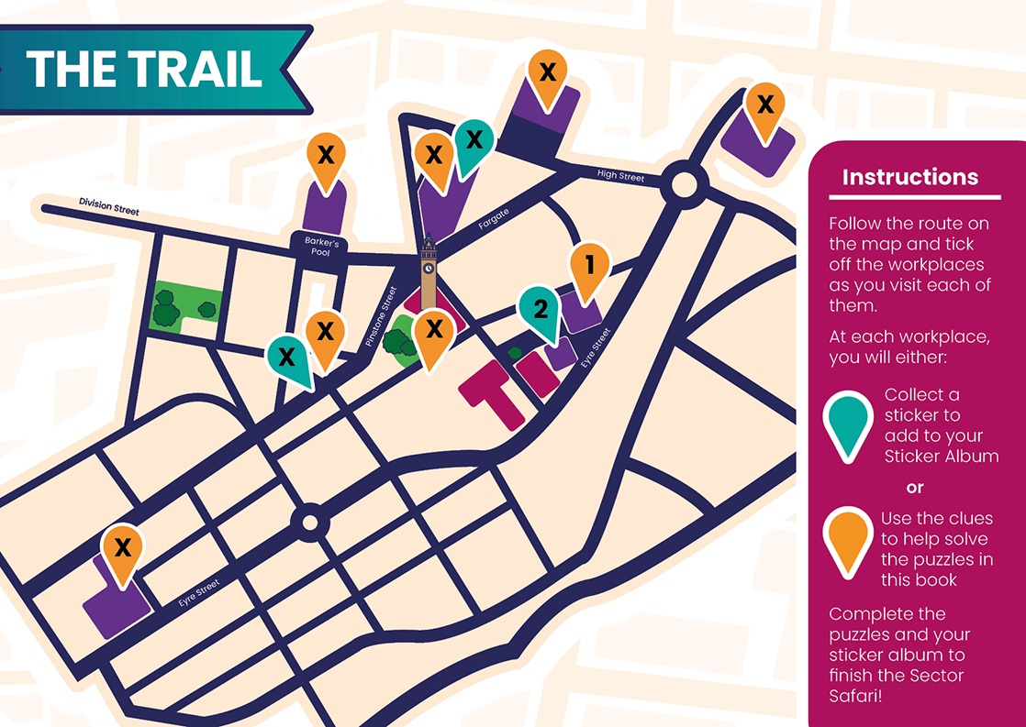

Slide 9


Slide 10

How to get involved in Sector Safari
  Employer information form
  Fill in your job and employer profiles and we will add you to the map!
seeitbeit@sheffield.gov.uk

Slide 11
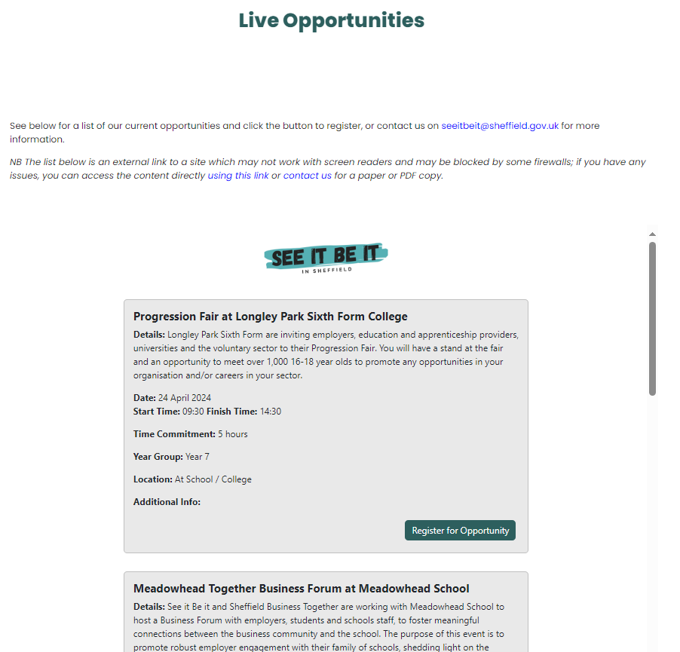







How to get involved
Follow Us - See it Be It
Added to our mailing list
www.sheffield.gov.uk/seeitbeit
Webinars - What to Expect in Schools and Colleges
tinyurl.com/sibisheff
Employer networking
events

Slide 12
Thank you for joining us today and for helping young people to

