Slide 1


Rob Cowley
Monitoring Centre (CCTV) & Business Crime Operations

Slide 2
Sheffield Monitoring Centre
Staffed 24hrs a day, 7 days a week, 365 days a year by a team of 12 Officers working 12 hour shifts.
Staff are all SIA Public Space CCTV Licensed & Police Vetted
200 City cameras monitored
Alarms monitored through for SCC buildings such as schools, libraries, learning centres & Acres Hill. These are a variety of Fire, Intruder, CCTV, Flood & Lone Worker alarms.

Slide 3


CRAC Radio – City Retailers Against Crime
Retail & Evening Economy
Over 200 members
Linked to CCTV & SY Police
Two Dedicated Websites for sharing photographs & info
Also linked to City Centre Ambassadors

Slide 4
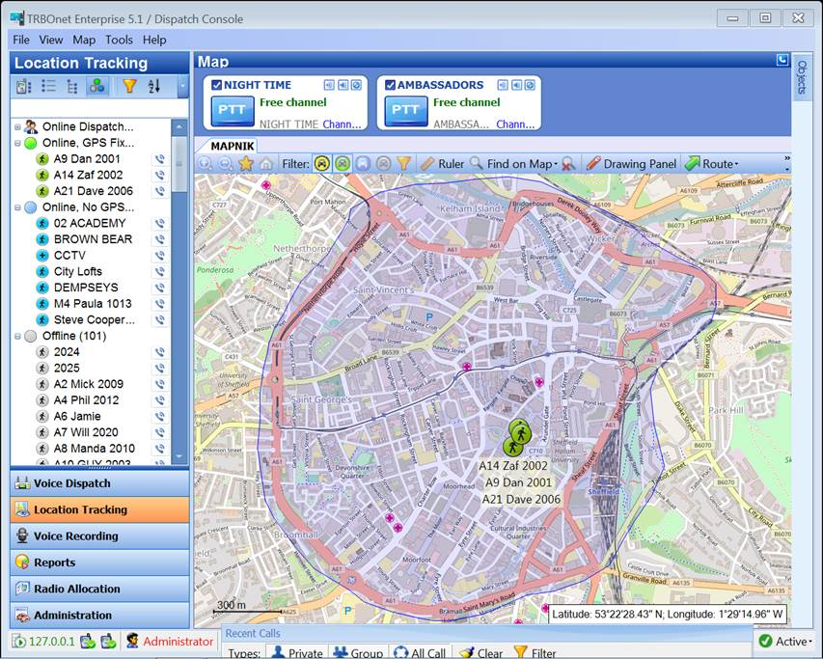

Slide 5
Business Crime Reduction Partnerships (BCRP)
A Business Crime Reduction Partnership (BCRP) is a partnership-based approach to preventing crime and disorder.
It is a subscription based action group working with police and the local authority to tackle and reduce crime and disorder affecting businesses and the wider community.

Slide 6
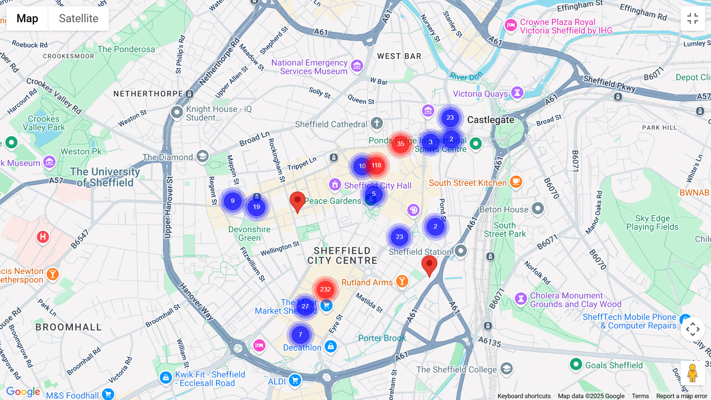

Slide 7
