Slide 1
Getting ready for life as a Junior Doctor in the United Kingdom
Dr Antash Daryanani
Dr Dawood Razzak
Wednesday 11th December 2019
LF1, Charles University in Prague

Slide 2
Aims
Explore the issues and challenges faced by international medical graduates in the United Kingdom
Expand your knowledge about the career pathways and roles of a Junior Doctor
Enhance your CV to put you at par with UK graduates
Walkthrough the application process to get you prepared for the best possible start in professional practice

Slide 3
Outline
Part One (40 minutes)
Break and Q&A (10 minutes)
Part Two (50 minutes)
Break and Q&A (10 minutes)
Close

Slide 4
Part One
Our Story
Explore the current issues faced by IMG’s in the NHS
Junior doctor life
Your Career Pathway
CV building tips
UK Politics and healthcare
UKMLA update
Useful Reading and Resources

Slide 5
Antash
Graduated 2017 from LF1
FY1: North Wales (Anaesthetics, Acute Medicine, General Surgery)
FY2: 2 Year Academic Post (50/50 Clinical and Academic Role-Quality Improvement) at Great Western Hospital, Swindon
Hoping to specialize in Anaesthetics and Intensive Care Medicine with a special interest in medical education

Slide 6
Dawood
Graduated from Medical University of Varna Dec 2016
Completed a 1 month clinical attachment prior to FY1
FY1 in Shrewsbury as a trust grade.
Accepted for stand alone training post in new pilot academic FY2 position.
Taking an FY3

Slide 7
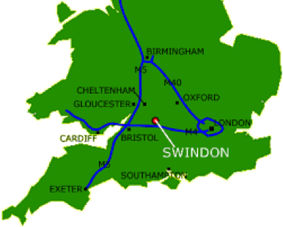
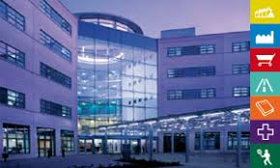
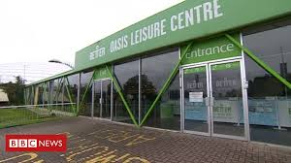
15 International Medical Graduates per year (Mainly from Prague)
Excellent feedback so far
Many have gone on to attain training jobs in a variety of medical and surgical specialties

Slide 8
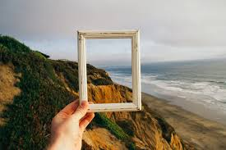
Notes:
Typically these talks are long, over detailed
Not here to tell you to come and work at swindon
The bigger picture. Easy to loose sight of the light at the end of the tunnel
Feel isolated, out of touch and uncertain about life beyond Prague.
Graduates have come out and done very well (Giannis)
Exciting time due to increasing number of initiatives to help with your transition back to the Uk (brizzman, our mentorship )
How we can help

Slide 9
Notes:
2. Compare notes. Use our personal experiences to help you start streamlining your education to put you in good stead to start your job safely. Help you show that you are proactive students who take the initiative.
What I wish I knew
Break the sterotypes and stigmas
Interview preparation

Slide 10
Current situation for International Medical Graduates
37% of the medical register are international medical graduates
50% in the last decade who joined are IMG’s
Less likely to pass membership exams first time
Less likely to gain specialty training posts
More likely to be called to fitness to practice hearings, referred to the GMC and receive complaints
https://www.bmj.com/content/359/bmj.j5230
Notes:
Not here to scare you
Real problem
How you can get ahead of the curve

Slide 11
Challenges for International Medical Graduates
Theory heavy learning and assessment curriculum
Hierarchal organization vs Flat
Remit of a junior doctor
Implicit Bias “Where did you go to medical school?”
Less confident with communication and practical skills
Wide variation in knowledge
Cultural differences-Reactive vs Proactive
Notes:
Doctors have autonomy
Less regulated
In the UK we have guidelines which
Not about knowledge and training, more mindset based

Slide 12
Current situation for doctors in the NHS
7% Vacancy rate for doctors in the UK
5 new medical schools opening by 2025
Increase uptake of medical schools by 25%
Burnout is on the rise due to many rota gaps
Decline in doctors entering specialty training
NHS budget £129 Billion-shift resources towards Primary Care to reduce bed pressures in hospitals
Mass recruitment schemes around the country (Swindon, Plymouth, Merseyside)
Notes:
Means that we are struggling to recruit doctors

Slide 13
Notes:
Don’t Worry, its an exciting time to be a medical student
Lots of job opportunities
More important than ever to build your CV

Slide 15
Foundation Programme
2 years standardized postgraduate training for all new graduates (FY1, FY2)
3x4 month rotations, mixed between surgical and medical specialties
Develop transferrable clinical, procedural and communication skills
Holistic Approach to patient care
Help you choose what you want to do (or what you definitely don’t want to )

Slide 16
Roles of a Junior doctor
Clinical (ward rounds, admissions, medical emergencies, procedures, )
Educational (teaching medical students and nurses, professional exams, conferences)
Academic (Research, Quality Improvement, Postgraduate Degrees, Publications)
Leadership (Difficult conversations, multidisciplinary team meetings, Morbidity and Mortality Meetings)

Slide 17
Typical Day
0845-Preparing the patient list
0900-Handover from the night team (SBAR)
0930-1330-Ward round
1330-1400-Lunch/teaching
1300-1700-Jobs, Board round (referrals, booking scans, discharge letters, procedures)
Free time-Clinics, Theatre, quality improvement
On-calls Days/Nights (12 hour shift-Ward cover, admissions and post-take)

Slide 18
FAQ’s
Take home pay-£2000 (2373 euros, or 60,000 CZK) after Tax/National Insurance
Social Life-Doctors Mess, Department Parties
Holidays? 9-10 days Annual Leave per rotation (excluding Bank holidays and weekends)
Who can I ask for help?-Educational Supervisors, Clinical Supervisors, Pastoral leads, Occupational Health-You’re never alone!

Slide 19
Thinking about your specialty
Time in Training
Location (Avoid big city hospitals in the early stages of your training)
Work-life balance
Competition Ratios
Role models-speak to people, are they happy? Would they choose it again?
Always keep an open mind
Notes:
https://specialtytraining.hee.nhs.uk/Portals/1/Content/Resource%20Bank/Competition%20Ratio%27s/Competition%20Ratios%202018.pdf

Slide 20
CV building
Catalogue your evidence for everything (Certificates, letters, photographs etc, Reflect)
Start yesterday
Look at recruitment websites for specialties and start working on it right now!
Create an online document you can constantly update
Send it to two people you trust

Slide 21
Clinical
Clinical Attachments in the UK-what are the local medical students doing?
Case based discussions
Attend UK based Conferences and Courses
Immediate life support (ILS)
Keep a log book of procedures/interesting cases
Letters of recommendation
UK question banks-medical student finals (PASS TEST, PASS MEDICINE)

Slide 22
Academic
Departmental Research projects
Book Chapters
Quality improvement Projects in the UK
Teaching-Anatomy, Histology, Physio etc
There is ALWAYS something going on which you can get involved in

Slide 23
Leadership/Management
MEDSOC
Organizing university events
Sports Teams
Courses
Difficult situations (unfair exams, departments)-Reflect (Gibbs Cycle)

Slide 24
Personal Development and Interests
Expat communities
Volunteering
Make the most of this amazing city whilst you can. You will come across as an interesting candidate to your interviewers.

Slide 25
UK POLITICS/BREXIT
All parties want to improve overseas recruitment, increase the NHS budget and streamline services towards primary care.
Conservative Party: 6 New hospitals, fast track NHS visa for IMG’s
Labour Party: Free prescriptions, Free hospital parking, increase spending for education of healthcare professionals
Liberal Democrats: streamline arrangements for registering overseas doctors
Brexit: Still a Grey Area

Slide 26
UK Medical Licensing Assessment (UKMLA)
Approved in 2017, to be piloted in 2021
2 Part Examination completed prior for registration for GMC:
AKT (Applied Knowledge Test), online MCQ-style exam
CPSA (Clinical and Professional Skills Assessment) OSCE-style exam
£1000 fee (TBC)

Slide 27
Useful Reading and Websites
GMC: Good Medical Practice (Must Read)
https://www.gmc-uk.org/ethical-guidance/ethical-guidance-for-doctors/good-medical-practice
GMC: Outcomes for graduates
https://www.gmc-uk.org/education/standards-guidance-and-curricula/standards-and-outcomes/outcomes-for-graduates/introduction
Royal College Websites-(Essays, Competitions, conferences etc)
British Medical Association (BMJ Podcasts, courses)
Medical Defence Union (courses, updates, cases)
Specialty Recruitment Websites
NICE Guidelines-Correlate this with your studies for state exams
Royal Society of Medicine(OSCE Skills courses)

Slide 28
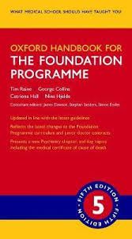

Slide 29
Take Home Points
Start building your CV early
Streamline your education towards UK based initiatives
Get as much clinical experience in the UK as possible

Slide 30
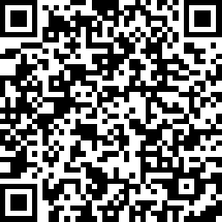
Feedback

