Slide 1
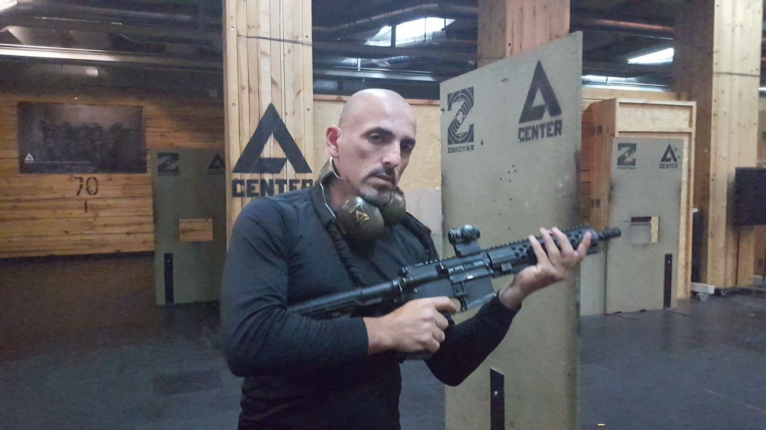
Shadow
MASTER DAVID HALIVA

Slide 2
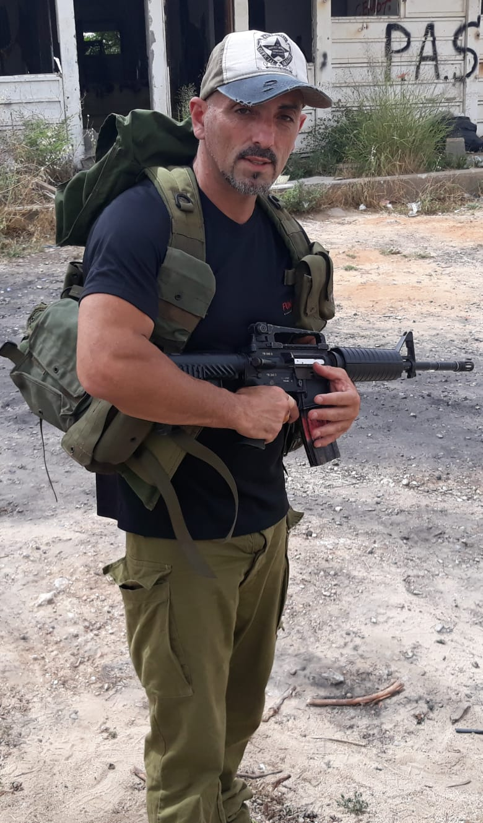
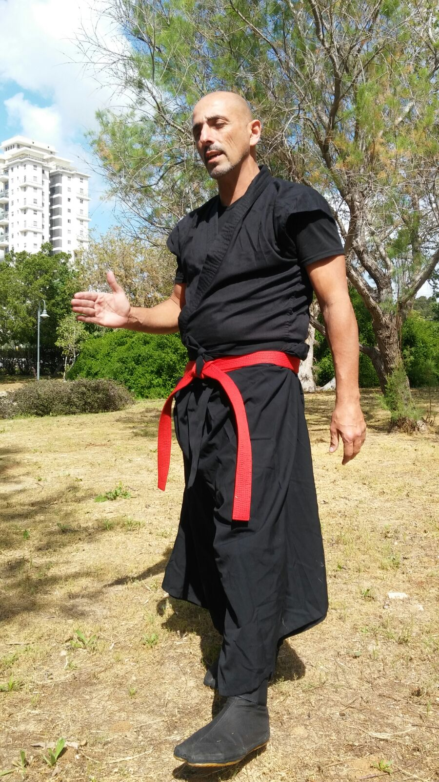
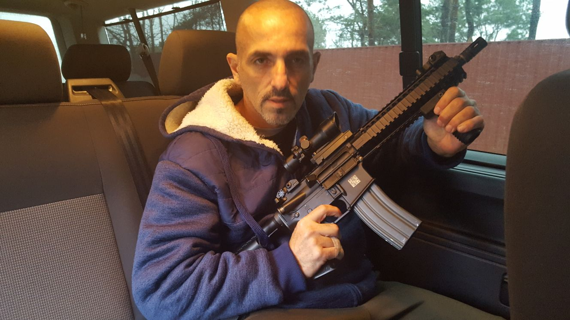
About the Instructor

Slide 3
Guidelines
All participants are responsible for meeting the guidelines
There will be coordination between the staff and the students
Meeting the schedule is a must
Logistics – with staff
Creating a list of participants
It is the participants responsibility to let the staff know anything that can affect the course
Making a list of lessons learned
Leave the classroom clean
No cell-phones during instruction

Slide 4
Guidelines – Cont’d
Safety – only practice what being told, stay hydrated
Discipline – respect, honor, schedule
Uniform – long pants, belt, close shoes
Injuries
Emergencies
No photography/video unless permitted by the instructor

Slide 5
The “ten commandments”
Security is a profession
Security is 24/7
Personal security is a specialization in the general security world
The price of failure – human life
Security is against possible and potential enemy
Seeing the aggressor is the basis of the security
Thwart is already a failure
Investing in prevention will win the enemy
Good preparation and organization improve the quality of performance
Personal security – self-confidence and assertiveness

Slide 6
Good Luck!
Master David Haliva

