Slide 1
www.ranjithsliterature.com

Slide 2
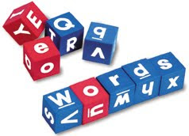
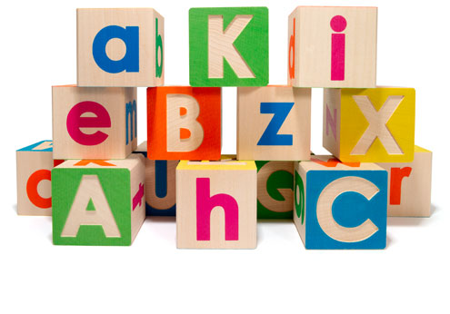
Word Formation
Or
Growth of vocabulary
Dr Ranjith Krishnan K R
Assistant Professor
Department of English
NSS College, Pandalam

Slide 3
Language
It can be defined as the method of human communication, either spoken or written, consisting of the use of words in a structured and conventional way.
A language is a structured system of communication.
The scientific study of language is called Linguistics.

Slide 4
Word
A single distinct meaningful element of speech or writing, used with others (or sometimes alone) to form a sentence or convey an idea.

Slide 5
TWO
Ways
Two ways for the increase of Vocabulary
Borrowing Words from Foreign Languages
Formation of New Words

Slide 6
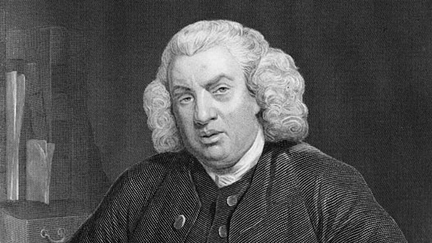
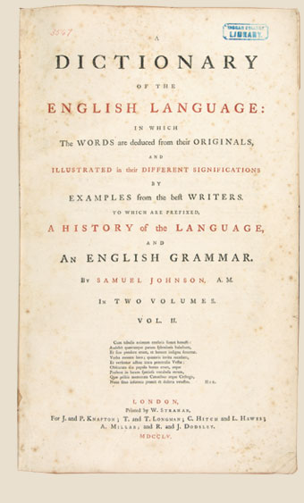
Dr. Samuel Johnson
(1709 – 1784)
Poet, Essayist, Literary Critic,
Biographer, Editor and a
Lexicographer Dictionary published in 1755
40,000 Words

Slide 7
Oxford English Dictionary (OED)
Published by the Oxford University Press
Numerous additions

Slide 8
Different Processes of Word Formation
Compounding / Composition
Affixation / Derivation
Shortening / Clipping / Abbreviations
Acronymy / From Initials
Old Words put into New Use
Autonomasia / From Names
Syncopation
Telescoping
Metanalysis
Portmanteau Words
Back Formation
Deliberate Coinages
Imitation / Onomatopoeia
False Etymology
Slang Terms

Slide 9
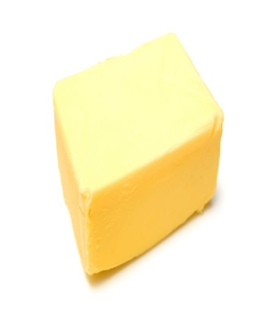
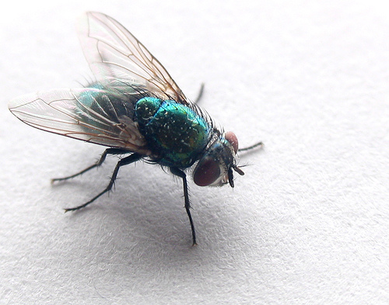
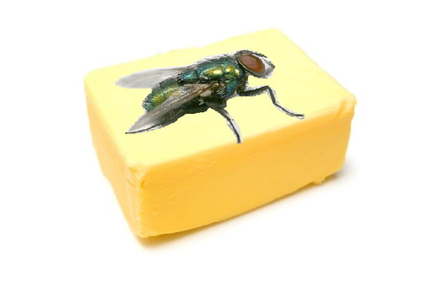
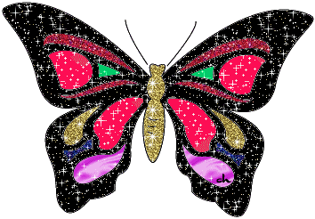
Compounding / Composition
Two or more words are combined to produce a new word (meaning)
The Compound word expresses its meaning from that of any of its components
Butter
Fly

Slide 10
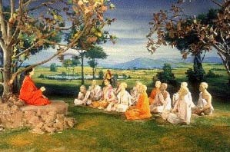
Class Room

Slide 11
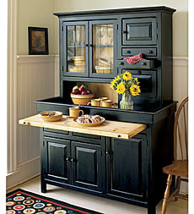
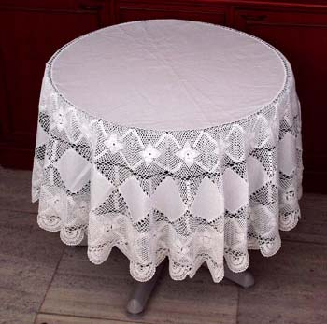
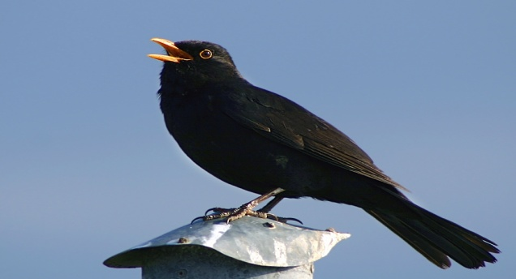
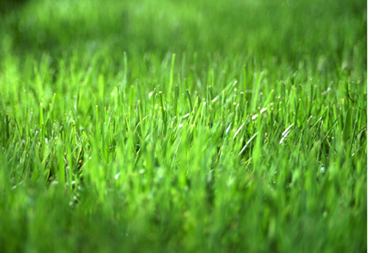
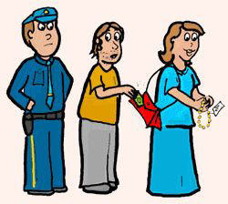
Different Types of Compounding
Noun + Noun – Cupboard, Railway, Bookcase, Waterproof
Adjective + Noun – Black Bird, Hotbed,
Tablecloth, Colorblind
Noun + Adjective – Grass Green
Verb + Noun – Pickpocket

Slide 12
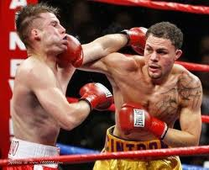
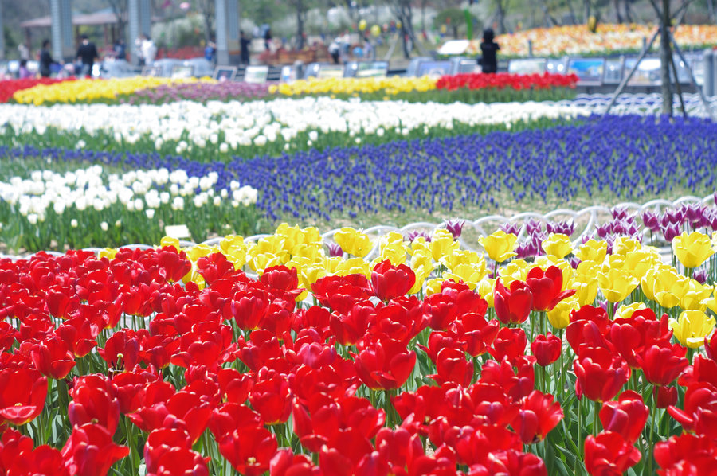
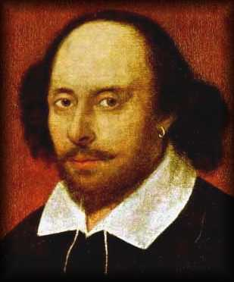
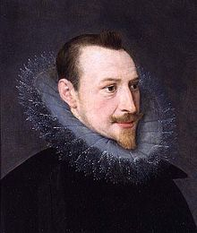
Verb + Adverb – Runaway, Makeup, Knockout
Adverb + Verb – Outlive
Meaning is derived from one of the components –
‘Flower garden’ and ‘Garden flower’
Shakespeare’s contribution – ‘heaven-kissing hill’ (Hamlet)
Spenser’s contribution – ‘silver-dropping tears’ (Ruines of Time)

Slide 13
Affixation / Derivation
New words are formed by adding suffixes or prefixes to the root of the word
Started from the Anglo-Saxon times
Many suffixes are of French origin

Slide 14
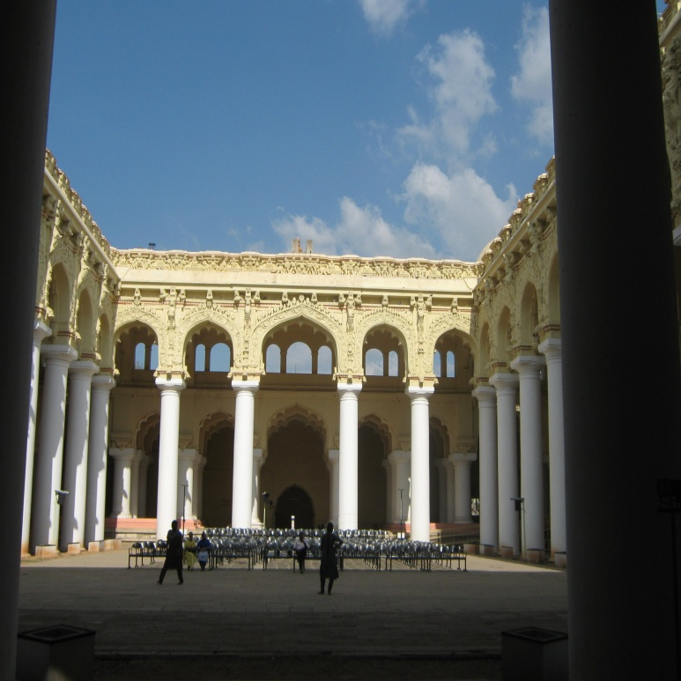
dom (freedom, kingdom)
ship (worship, friendship)
less (careless, useless)
- ness (loneliness, kindness)
- ism (socialism, Marxism, Fascism)
ment (government, movement)

Slide 15
Prefixes
pre - , post - , extra - ,
super - , inter –

Slide 16
Men always seek for comfort and ease in every sphere of life and the same happens in communication also
Long words and phrases are reduced to promote quick utterances
Shortening / Clipping / Abbreviations

Slide 17
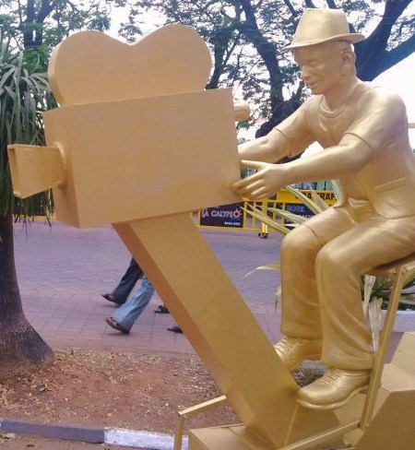
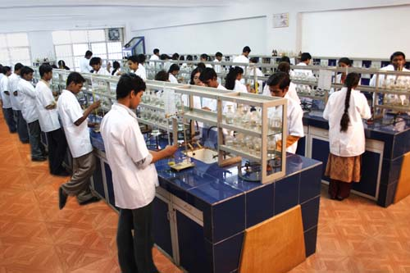
Photograph to ‘Photo’
Laboratory to ‘Lab’
Examination to ‘Exam’

Slide 18
Acronymy / From Initials
Free use of initials
Long and Frequent phrase is represented by the initial letters of each word in the phrase
United Nations
International Children’s
Emergency
Fund

Slide 19
Other Examples
MP, MLA, BA, MA

Slide 20
Old Words put into New Use
Words with certain meaning undergo a change as time moves on evolving new meanings
‘ Pedant’ – meant ‘a school master’ (at the time of Shakespeare) but now it means ‘a person who shows his learning’
‘Literary’ meant ‘something related to alphabet’ (at the time of Dr. Johnson) but now it means ‘anything related to literature’

Slide 21
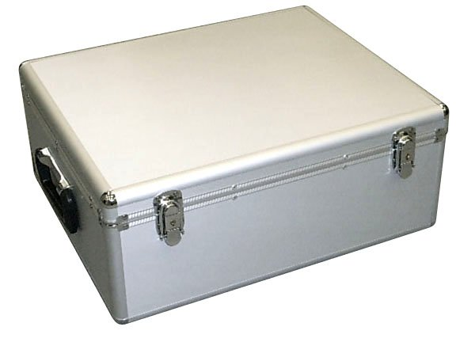
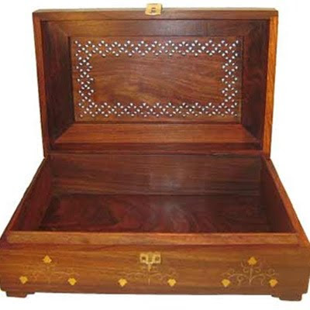
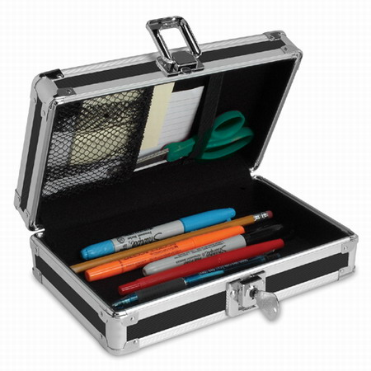
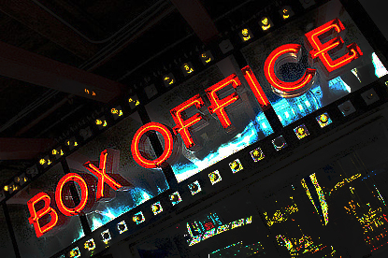
‘Board’
‘Box’

Slide 22
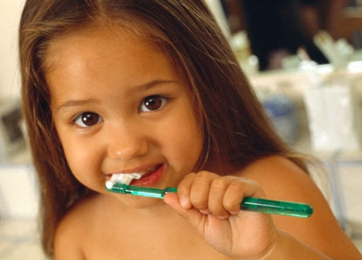
Brush
to brush
Smoking
“Let us have a smoke”

Slide 23
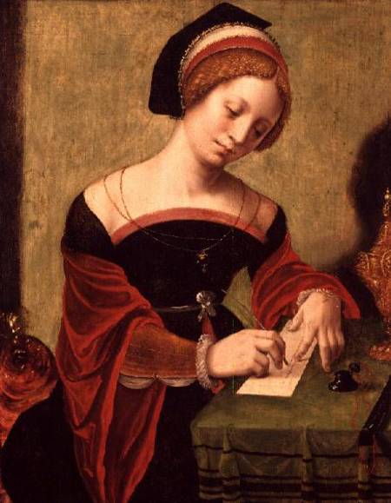
Autonomasia / From Names
Origin of words related to certain names and titles
‘maudlin’ – means ‘self-pityingly or tearfully sentimental’ Mary Magdalene
(female disciple of Jesus Jesus)

Slide 24
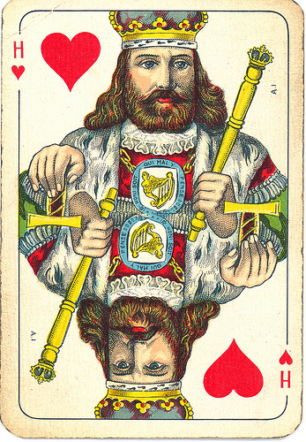
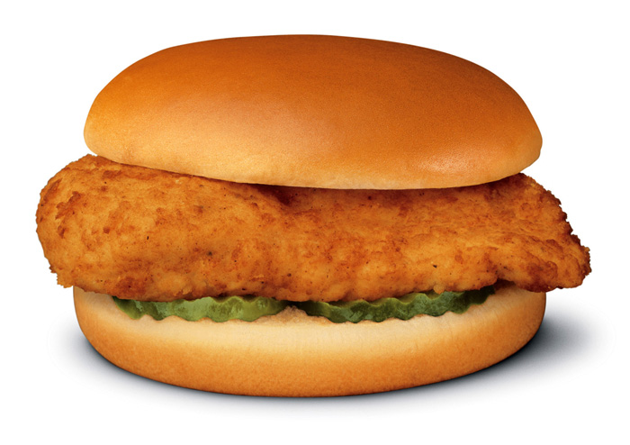
Earl of Sandwich, a devoted gambler who was lost in the game of cards

Slide 25
Captain Boycott, an English
agent for Irish Estates –
Tenants organized a strike
Thomas More and his Utopia
‘Utopian’ – a thing which is tough to be implemented
Another example: Romeo

Slide 26
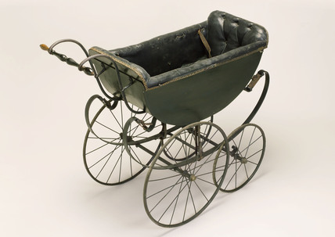
Syncopation
Elision of Vowels or Consonants in rapid speech resulting in the formation of new terms
Perambulator
Prambulator
Pram

Slide 27
Telescoping
Extension of Compounding
Two or more words are combined to form a new word but with the elision of a few sounds
“to do on” becomes “to don”
“to do off becomes “to doff”

Slide 28
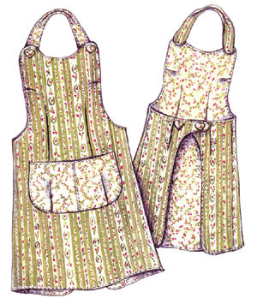
Metanalysis
Extended form of ‘Telescoping’/reanalysis
Happens due to careless pronunciation
Consonant of one word gets attached to the vowel at the beginning of the next word
‘a nickname was evolved from ‘an ickname’
‘an apron’ from ‘a napron’
‘an umpire’ from ‘a numpire’

Slide 29
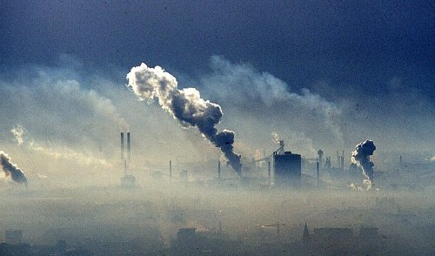
Portmanteau Words / Blending
a word created as a result of blending the meaning (or terms) of two different words
a part of one word is attached to the part of another word
new word carries the meaning of both the words
Smoke + Fog = Smog

Slide 30
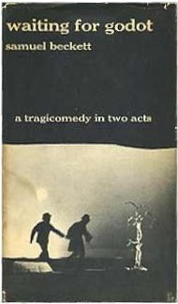
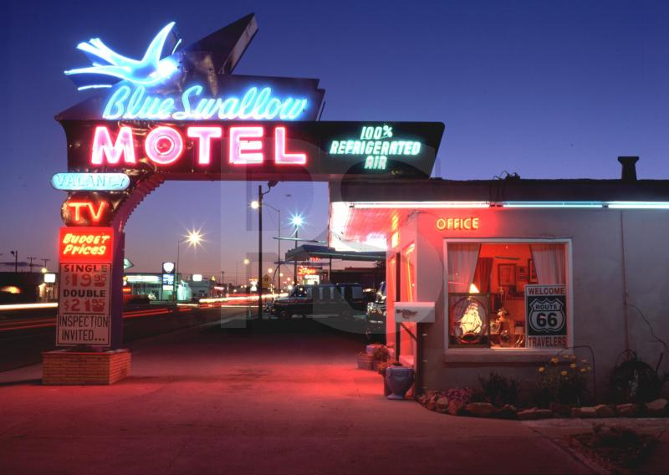
Melos + Drama =
Melodrama
Motor + Hotel = Motel
Tragedy + Comedy
Tragicomedy

Slide 31
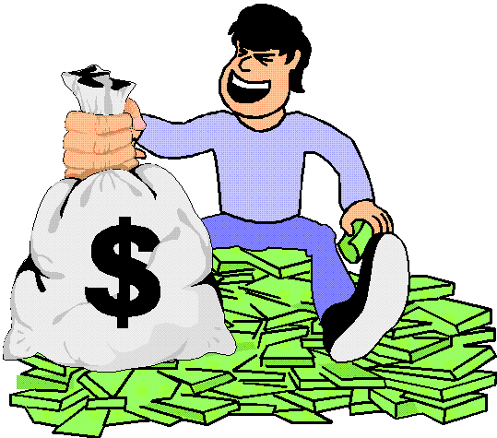
Back Formation
English words with false appearances – words ending with well-known suffixes
New Words are formed by removing the supposed suffixes
Greedy – ‘y’ = ‘Greed’
Gloomy – ‘y’ = ‘Gloom’

Slide 32
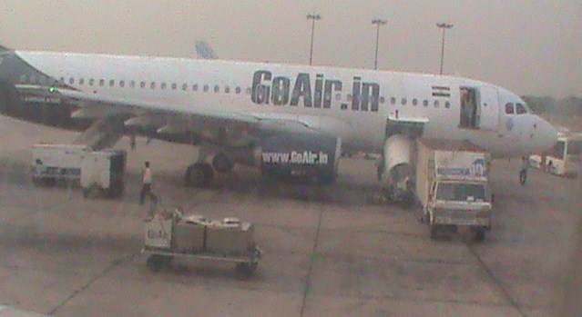
Deliberate Coinages
New words were created with the growth of civilization and its needs
New words replace the older ones
‘Flying Machine’ became ‘Aeroplane’

Slide 33
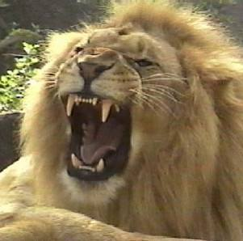
Imitation / Onomatopoeia
Oldest method of word formation
Existed in all languages
A word that imitates or suggests the source of the sound that it describes
croak, flash, click, roar, cuckoo

Slide 34
Combination of vowels are also suggestive
‘fl’ – suggesting hurry, quickness (flash, flicker, flame, flight, flow, flew)
‘st’ – suggesting stability, stoppage (still, stop, stay, stationary, station, stone)
‘bl’ – suggesting the movement of the mouth and passage of air (blow, blew)

Slide 35
False Etymology
New words formed through mistaken notions regarding their etymology
Anglo-Saxon ‘Igland’ became ‘Island’ after 1546 (not from French isle)
"picnic" - not an abbreviation of "pick a nigger", (French piquenique)
"buck" to mean "dollar" - not from referring to African slaves as "bucks" (male deer) when trading. "Buck" was originally short for "buckskin”
"Woman" - not from "woven from man". It came from the old English "wiffmann"

Slide 36
Slang Terms
Term was first used in 1756
Use of informal words and expressions that are not considered standard in the speaker's language (believed to be used by thieves, smugglers and the underworld)
Never gained social acceptance until the 18th century
‘chap’ (dealer in stolen goods) “kidnabbing”
‘pinch’ (to steal)
‘shabby’ (poor clothes)

Slide 37
Different Processes of Word Formation
Compounding / Composition
Affixation / Derivation
Shortening / Clipping / Abbreviations
Acronymy / From Initials
Old Words put into New Use
Autonomasia / From Names
Syncopation
Telescoping
Metanalysis
Portmanteau Words
Back Formation
Deliberate Coinages
Imitation / Onomatopoeia
False Etymology
Slang Terms

Slide 38
Hope you have understood!

Slide 39
Thank You
www.ranjithsliterature.com

