Slide 1
Semantics
(Changes in Meaning)
Dr. Ranjith Krishnan K R
Asst. Professor
PG Dept. of English, NSS College, Pandalam

Slide 2
Semantics
Derived from Greek term sēmantikós
It refers to the study of meaning
Part of Linguistics
Highly significant along with the Growth of Vocabulary
Semantics looks upon and records the changes which have taken place in the meanings of many words in the language

Slide 3
Different Processes of Meaning Change in English
Generalisation
Specialisation
Extension or Transference followed by Differentiation of Meaning
Association of Ideas
Polarisation / Colouring
Euphemism
Prudery
Reversal of Meaning
Proper names become ordinary Parts of Speech
Degeneration of Meaning or Catachresis or Pejoration

Slide 4
Generalisation
We often find that when the resemblances, which have caused a word to acquire various new senses, are all of the same kind, or have something in common, the meaning of the word undergoes a generalisation

Slide 5
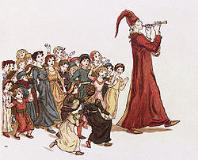
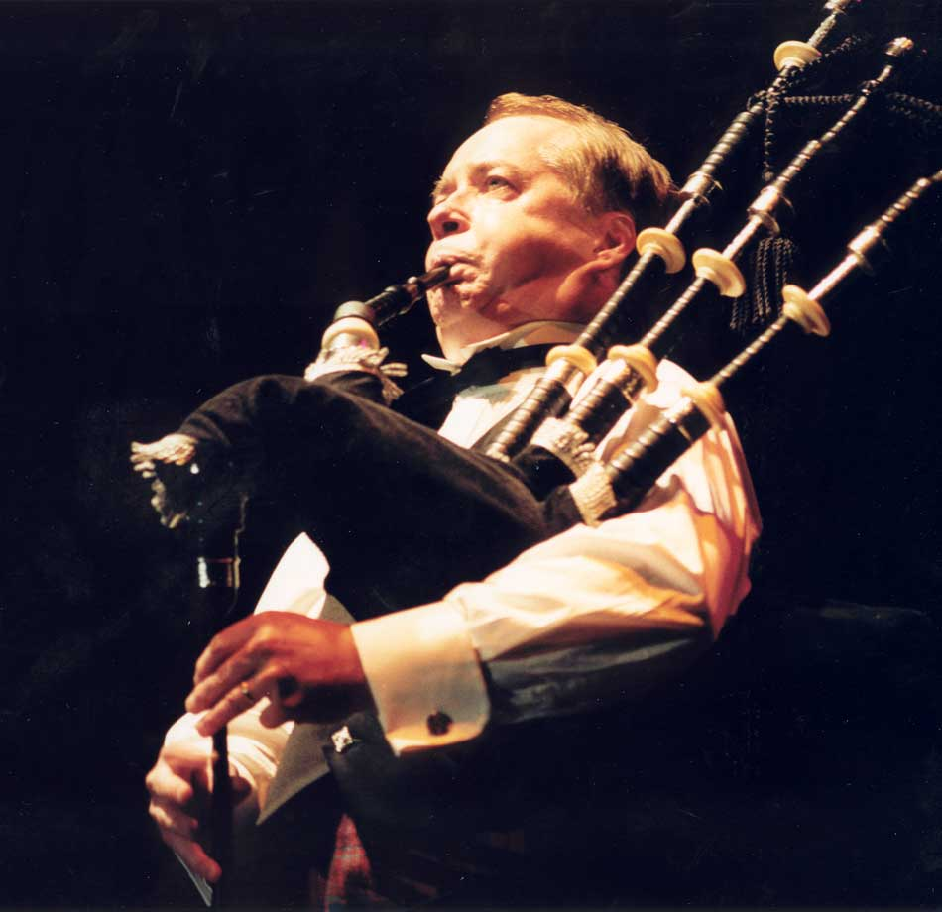
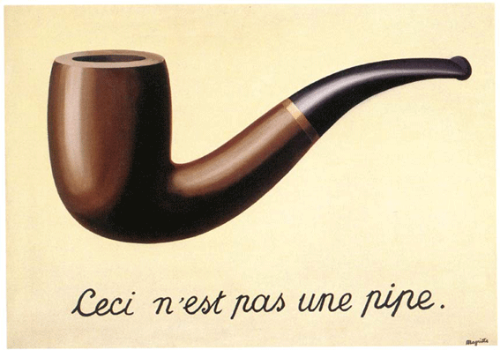
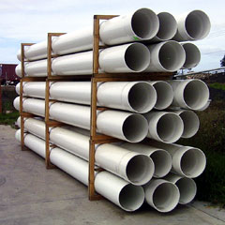
‘Pipe’ originally meant a musical instrument

Slide 6
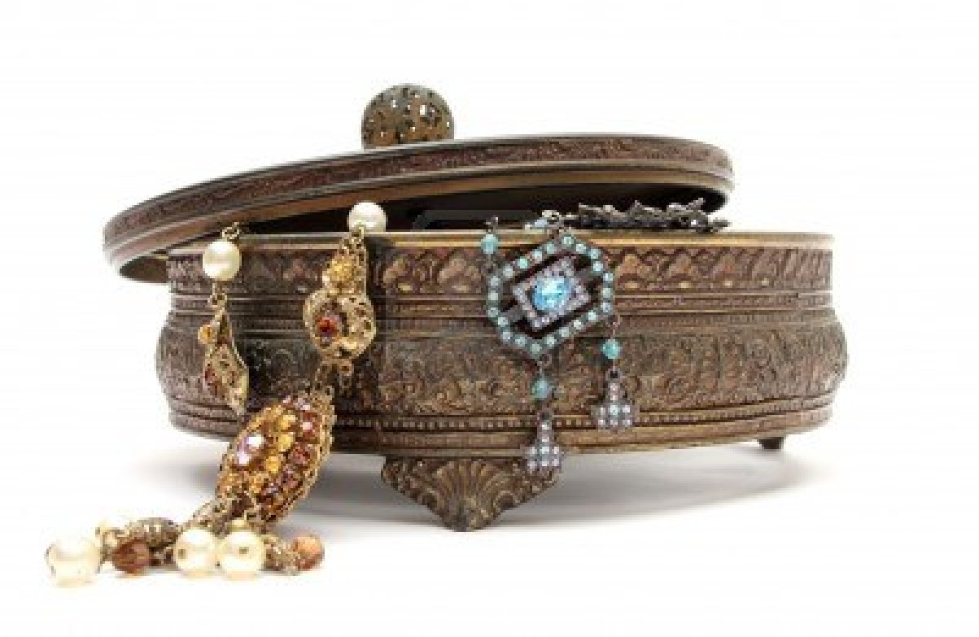
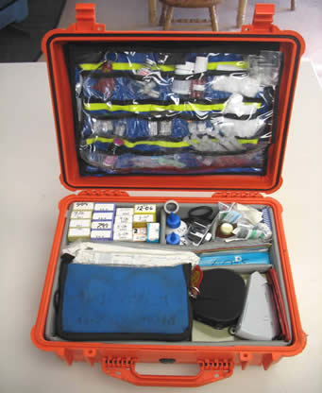
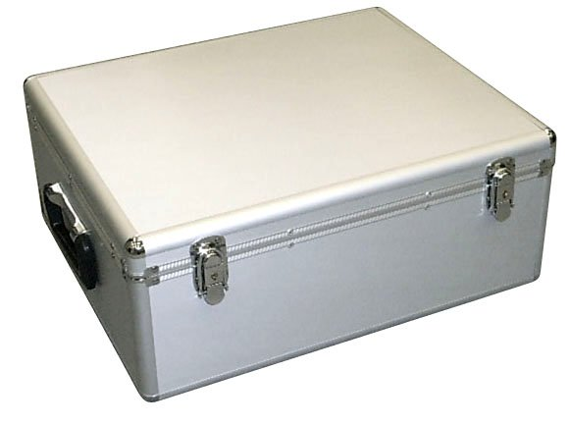
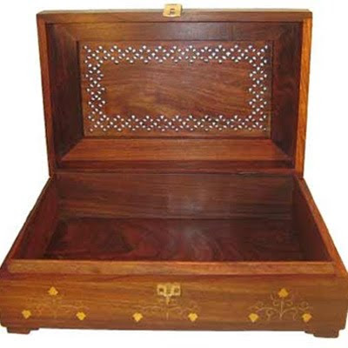
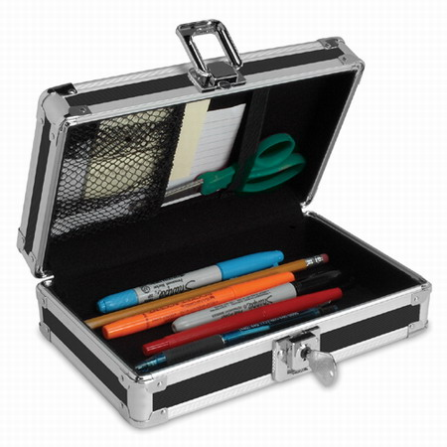
‘Box’ (name of a tree
and wood from it)

Slide 7
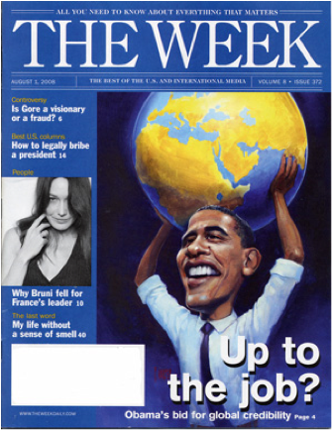
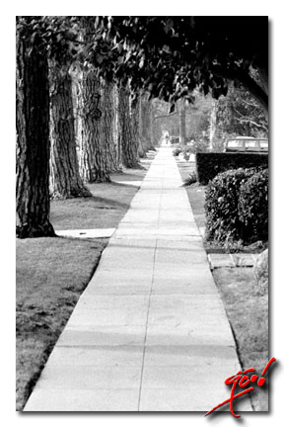
Words ‘journey’ and ‘journal’ - derived from the French ‘Jour’(day)
Journey meant a day’s walk and Journal meant a daily record of events.
Now we say – ‘a journey of several weeks’ and a ‘monthly journal’.

Slide 8
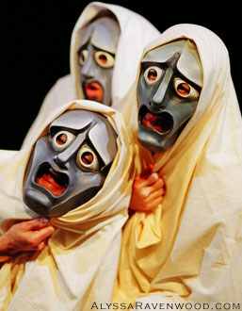
‘Companion’ and ‘Comrade’ lost its original meanings
Companion - one who eats bread with another person
Comrade - one who shares a room.
In both cases, the root meaning has been lost
‘Comrade’ has got a political colour.
‘Tragedy’ once had got a dramatic sense and now it is used to mention unhappy incidents.

Slide 9
Specialisation
A type of restriction of meaning.
A word, which originally had a wide meaning, comes to be used later in a narrower or specialised meaning.
Old English words ‘stench’ (N) and ‘stink’ (V) meant pleasant and unpleasant smells. Now it describes only unpleasant smells.
‘Meat’ meant ‘food in general’ but now it has been restricted to ‘flesh food’.
‘Prohibition’ derived from the verb ‘to prohibit’ actually means ‘the act of forbidding or prohibiting something’. Now, it denotes the prohibition of alcoholic drinks and other such items.

Slide 10
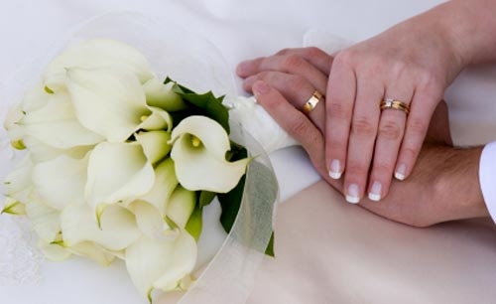
Old English ‘wed’ meant pledge of or promise but now, it refers to a matrimonial pledge.
‘Wife’ meant any woman but now – woman of a particular status.
‘Doctor’ meant a learned person but now – a person in medical profession.

Slide 11
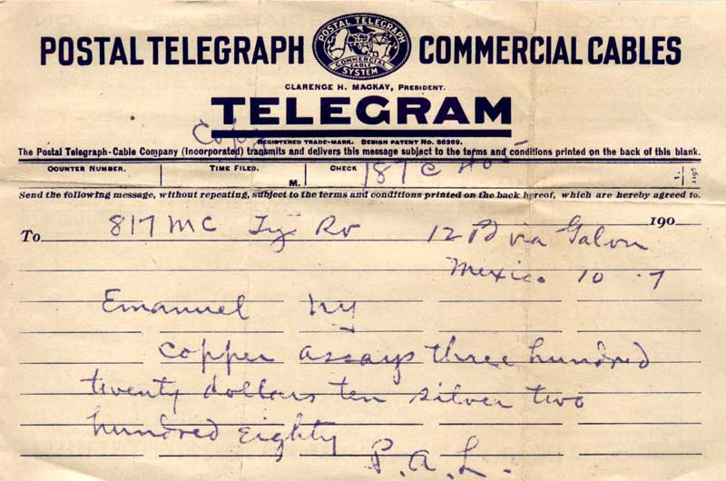
Extension or Transference followed by Differentiation of Meaning
A combination of the generalisation and specialisation but differs from them both.
Even though it is used in a general sense, the earlier and the basic meaning remains the same.
‘A man will send as a wire’ –means a telegram and not a length of metallic filament - Telegrams are sent by means of wire.

Slide 12
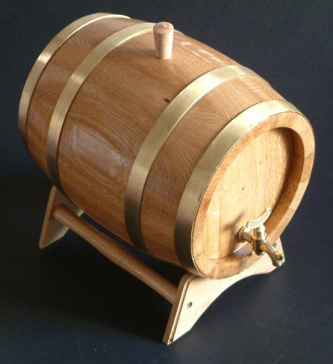
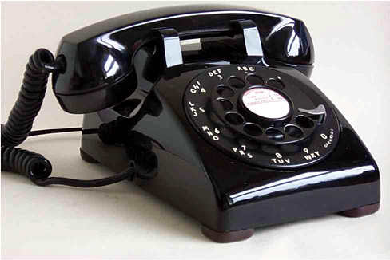
Words ‘fine’ and ‘brand’ now signify the quality of a thing.
‘Fine’ actually means ‘finished’ and ‘brand’ was from the verb ‘to burn’.
It was a piece of red-hot iron used for making or branding wine cask to indicate the quality of liquor.
“To give a ring” means ‘to telephone someone’

Slide 13
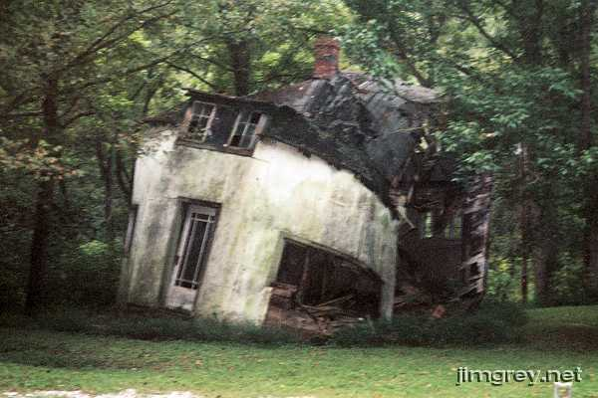
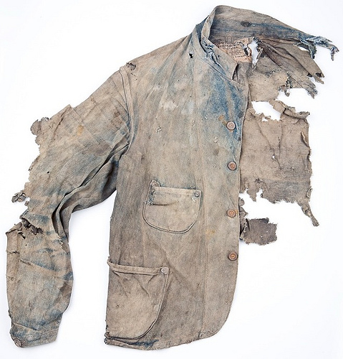
Association of Ideas
A gradual shifting of emphasis from the original sense (meaning) to some other characteristics associated with the sense.
Word‘dilapidated’ is etymologically connected with the Latin word ‘Lapides’ (stone) - to a stone building which is in a state of decay. Now - we can speak of a ‘dilapidated book’, ‘dilapidated cloth’ and even a ‘dilapidated man’.
Vulgarity (Latin ‘vulgus’ means crowd), Traffic (trade), Panel (piece of cloth for preparing a list), etc

Slide 14
Polarisation or Colouring
It is a semantic change by which words in course of time acquire an emotional significance, which is in no way connected with their etymology.
‘Nationalism’ and ‘Patriotism’ - without any emotional tone but now – a devotion to a national cause.
Gothic (Goths), Amateur (person who does something out of sheer passion)

Slide 15
Euphemism
A process by which unpleasant things are referred to by a less offensive term.
Words ‘passing’ and ‘decease’ have both become synonyms for death
‘to pass away’ , ‘to fall asleep’ are commonly used instead of the word ‘to die’.
The word ‘insane’ expresses the idea of ‘madness’ is also euphemistic device as it literally means ‘unhealthy’.
‘Executed’ for ‘hanged’.

Slide 16
Prudery
Another variety of Euphemism
Expressing ideas with an element of snobbery or refinement or with a false delicacy.
A‘borderer’ as ‘a paying guest’
A‘moneylender’ as ‘a financier’.
‘Plumbers’ of today are mainly known as ‘sanitary engineers’.
‘Toilets’ as ‘Comfort Stations’
In press language, an ‘approaching birth’ is referred to as an ‘interesting event’ and pregnancy as a ‘certain condition’.

Slide 17
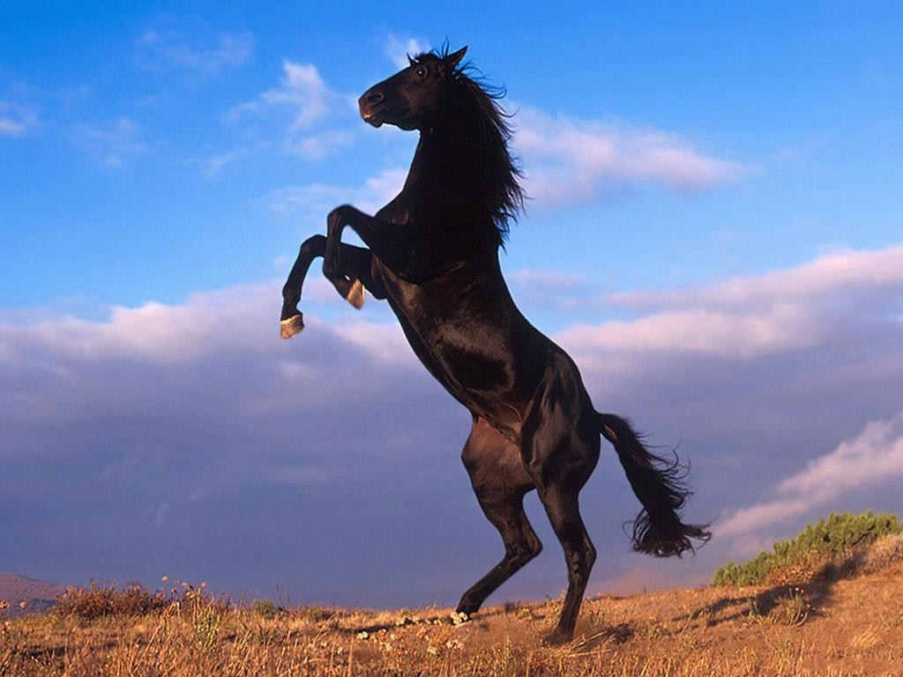
Reversal of Meaning
Words undergo an entire reversal of meaning in course of time
‘Grocer’ originally meant a ‘wholesale dealer’ who dealt ‘engross’ (in bulk). Now grocer refers to the smaller tradesman who has got engross though he sells to customers over the counter in small quantities.
Word ‘restive’ originally meant a ‘troublesome horse’, which refused to move from where it stood but now, it means to be ‘impatient’.

Slide 18
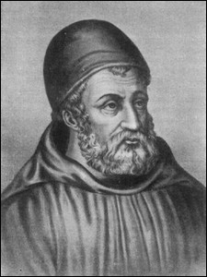
Proper names become ordinary Parts of speech
Names of persons and places have also in course of time come to acquire new meanings by being used as regular parts of speech.
Word ‘dunce’ (a slow learner, a child) is derived from the name of the Medieval philosopher ‘Duns Scotus’.

Slide 19
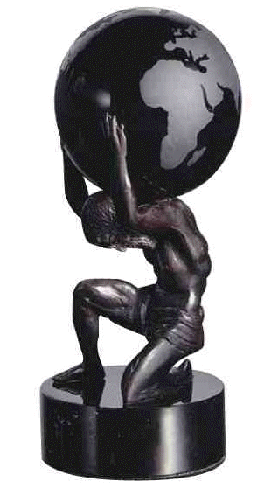
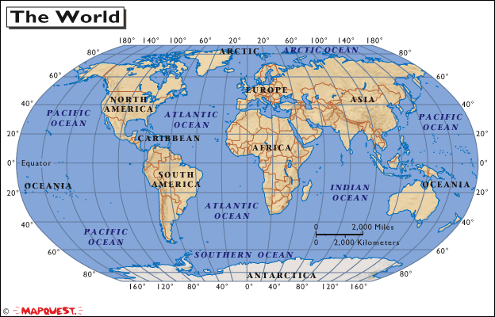
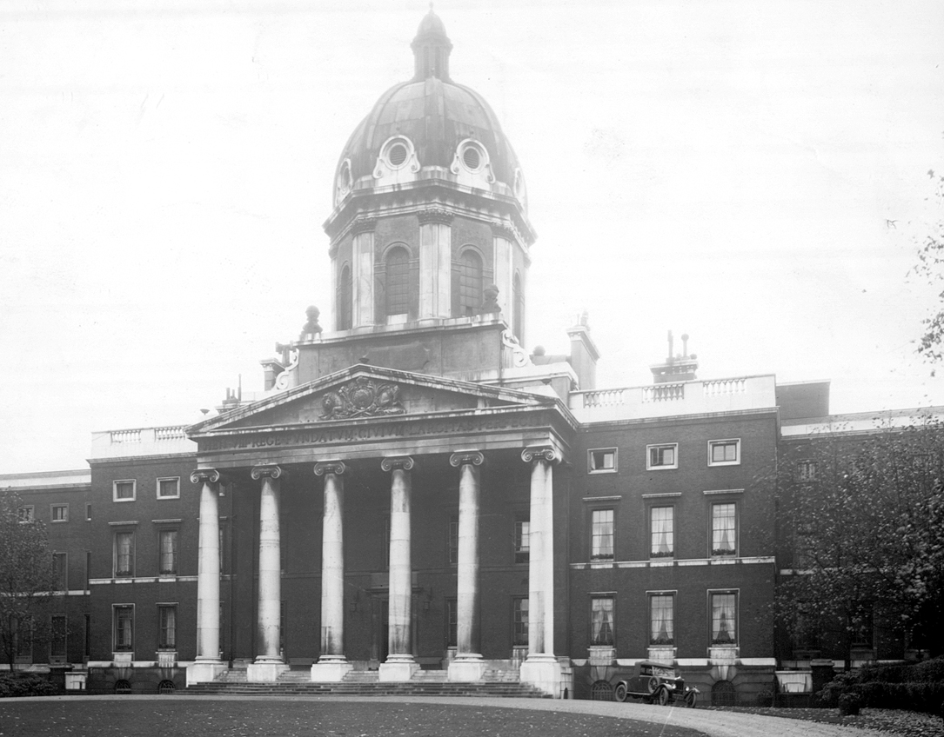
An ‘atlas’ is from the figure of ‘Atlas’ who carries the world on his shoulders.
‘Bedlam’ is an abbreviation of ‘Bethlehem Hospital’, the famous lunatic asylum of London.
We get the word ‘Hooligan’ from the Irish family ‘Hooligans’, notorious for rowdiness and riotous behaviour.

Slide 20
Degeneration of Meaning or Catachresis or Pejoration
A process by which a word's meaning worsens or degenerates, coming to represent something less favourable than it originally did.
Words ‘Lewed’ (Lewd), ‘Wantowne’, ‘Villeyenye’ were used by Chaucer in a good sense. A ‘lewed fellow’ was an ‘ignorant member’; ‘wantowne’ meant a ‘gay fellow’ and ‘villain’ represented a ‘man who lives in a villa or a farmhouse’.
All the words underwent degeneration in meaning and now are used in an ugly sense.
Notorious which now means troublesome originally meant well-known and was used in a good sense.

Slide 21
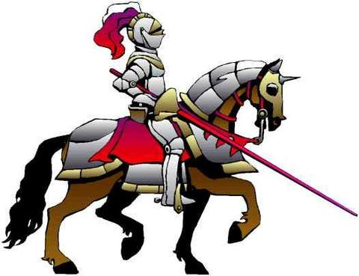
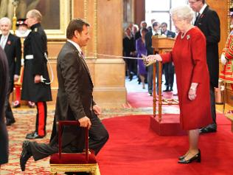
Along with degeneration, Elevation also happens at times.
‘Fond’ originally meant ‘foolish’, is now having the sense of affection
‘knight’ was once ‘a servant’ has been undergone elevation of meaning and now it is used to indicate a noble man.

Slide 22
Different Processes of Meaning Change in English
Generalisation
Specialisation
Extension or Transference followed by Differentiation of Meaning
Association of Ideas
Polarisation / Colouring
Euphemism
Prudery
Reversal of Meaning
Proper names become ordinary Parts of Speech
Degeneration of Meaning or Catachresis or Pejoration

Slide 23
www.ranjithsliterature.com

