Slide 1
Phonetics
Ranjith Krishnan K. R.
Asst. Professor
Dept. of English
N.S.S. College, Pandalam

Slide 2
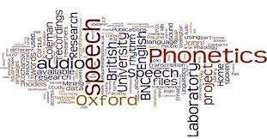
Definition
Phonetics – The Study and Classification of Speech Sounds

Slide 3
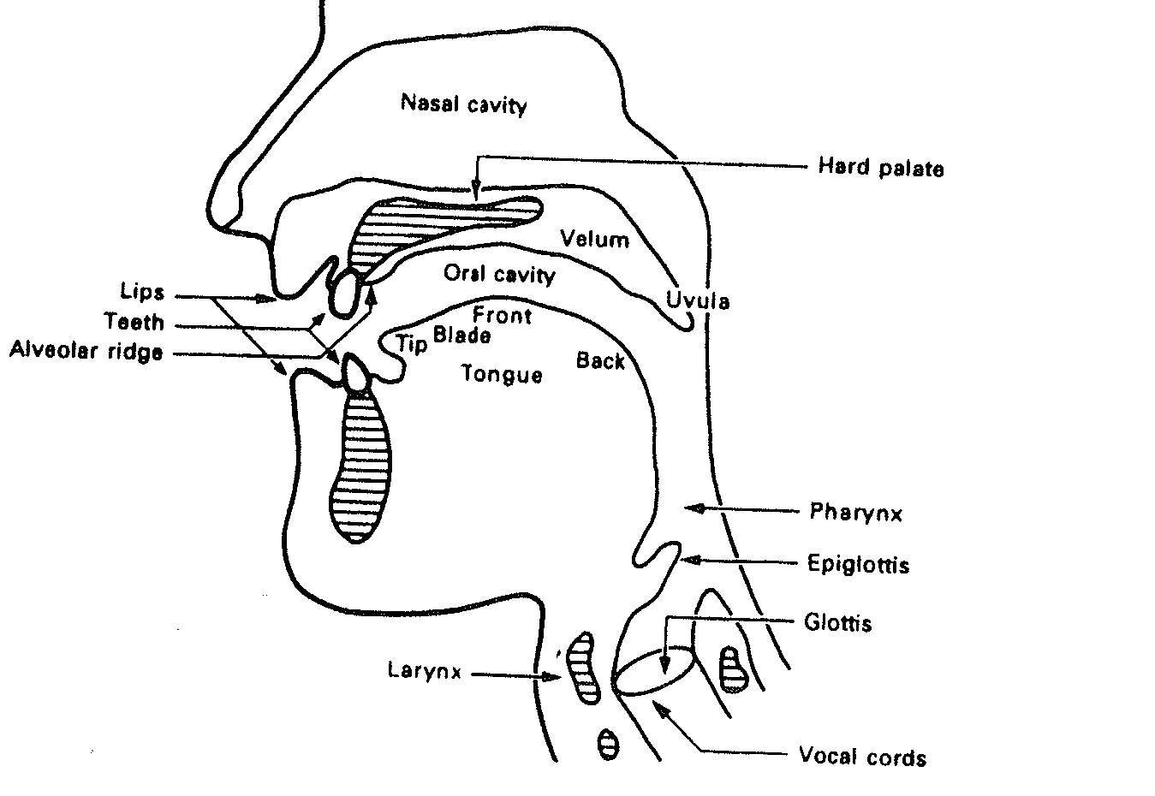
Organs of Speech

Slide 4
Different Types
Acoustic phonetics: focuses on the physical properties of the sounds of language
Auditory phonetics: focuses on how listeners perceive the sounds of language
Articulatory phonetics: focuses on how the vocal tract produces the sounds of language

Slide 5
English is not a phonetic language
Importance of Phonetics
Sounds in English
44 sounds in English
Consonants and Vowels
24 Consonants
20 Vowels (7 short vowels, 5 long vowels and 8 Diphthongs)

Slide 6
International Phonetic Alphabet (IPA)
Formulated by the International Phonetic Association to have a system in which there was a one-to-one correspondence between each sound in language and each phonetic symbol

Slide 7
Vowels
Monophthongs (Pure Vowels) – 12
7 short vowels: ɪ, e, æ, ʌ , ɒ, ʊ, ә
and
5 long vowels: i: , ɑ: , ɔ: , з: , u:
/pin/ /pet/ /mæn/ /kʌp/ /hɒt/ /wʊd/ /әbʌv/
/pi:l/ /fɑ:m/ /sɔ:/ /gз:l/ /sku:l/

Slide 8
Vowels
Diphthongs (Vowel Glides) – 8
closing: eɪ, aɪ, ɔɪ, aʊ, әʊ
and
centring: eә, ɪә, ʊә
/pei/ /hai/ /bɔɪ/ /haʊ/ /nәʊ/
/heә/ /hɪә/ /pʊә/

Slide 9
Consonants
Plosives
/p, b, t, d, k, g/
/pin/ /bit/ /tin/ /din/ /kin/ /geɪm/
Affricates
/ʧ, ʤ/
/ʧin/ /ʤin/

Slide 10
Consonants
Fricatives
/f, v, θ, ð, s, z, ʃ, ʒ, h/
/fit/ /væn/ /θin/ /fa:ðә/ /sin/ /zip/
/ʃeim/ /meʒә/ /hai/
Nasals
/m, n, ŋ/
/mæn/ /nain/ /kiŋ/

Slide 11
Consonants
Lateral
/l/
/li:f/
Approximants
/r, j, w/
/ræn/ /nju:/ /win/

Slide 12
Thank You

