Slide 1
Aesthetics: An Indian Perspective
Dr Ranjith Krishnan K R
Assistant Professor
Department of English
N.S.S. College, Pandalam

Slide 2
Indian Aesthetics and Rasa Theory
1.General Introduction
Natya Sasthra
Major Personalities
Rasa and Bhava
2. The Theory of Rasa – S.N. Das Gupta
3. The Highways of Literary Criticism in Sanskri –
S. Kuppuswami Sastri
4. Use and Abuse of Alamkara – V. Raghavan

Slide 3
Indian aesthetics – a unique philosophical and spiritual point of view on art, architecture and literature
The concept of “Rasa” is the fundamental part of Indian art (dance, music, theatre, cinema, literature)
Bharata Muni and his Natya Shastra
Considered as a “Treatise on Hindu Dramaturgy and Histrionics

Slide 4
Natya Sastra
Bharata Muni and his Natya Sastra
A Sanskrit treatise
36 Chapters and around 6000 shlokas
Regarding dramatic composition and structure, different methods of acting, make up and costumes, music, etc.

Slide 5
Major Personalities
Tholkappiyar and the text Tholkappiyam
Dandin’s Kavyadarsa (concept of ‘Sargabandha’)
Anandavardhana and his critical treatise Dhvanyaloka (concept of ‘Dhvani’)
Dhananjaya and the text Dasarupa (on drama)
Kuntaka (concept of ‘Vakrokti’)
Abhinavagupta and the popular treatise Abhinavabharati (acknowledged for adding the 9th Rasa, that is ‘Santarasa’)
Jnanesvara and his text Bhavarthadipika
Ananda Coomaraswamy, Rabindranath Tagore and Sri Aurobindo

Slide 6
Major Concepts
Bhava and Rasa
Bhava as the state of mind and Rasa as the juice or essence
Sthayi Bhava (permanent mood)
Vibhava, Anubhava, Sanchari/Vyabhichari Bhava
Alambana and Uddipana

Slide 7
Natya and Rasa
Natya as depiction (drama)
Eight Rasas plus ONE
Rasa is a cumulative result of vibhava (stimulus/cause), anubhava (involuntary action/reaction) and vyabhichari bhava (voluntary reaction/catalyst) (three stages of Natya Rasa)
Rasa as the essence of performative art

Slide 8
Rasa Sutra
Vibhavanubhava – Vyabhicari – Samyogad Rasa-Nispattih
Rasa is accomplished as a result of the conjunction of Vibhava, Anubhava and Vyabhicaribhava

Slide 9
The Nine Rasas (Navarasa)
Śṛingāram
Hāsyam
Raudram
Kāruṇyam
Bībhatsam
Bhayānakam
Vīram
Adbhutam
Santam

Slide 10
Colours/Deities
Sringaram | Erotica/Love | Green | Lord Vishnu
Hasyam | Comic/Laughter | White | Lord Ganesh
Raudram | Anger/Fury | Red | Rudra
Karunyam | Compassion | White | Yama
Bibhatsam | Disgust/Aversion | Blue | Lord Siva
Bhayanakam | Horror | Black | Kala
Viram | Valour | Brown | Indra
Adbhutham | Wonder | Yellow | Lord Brahma
Santham | Peace | White | Lord Vishnu

Slide 11
Bhavas
Rati (Love)
Hasya (Mirth)
Soka (Sorrow)
Krodha (Anger)
Utsaha (Energy)
Bhaya (Terror)
Jugupsa (Disgust)
Vismaya (Astonishment)

Slide 12
Four Kinds of Abhinaya
Natya – Physical gestures, expressions and movements (‘angika’)
Vachika – voice modulation in dramatic speeches
Aharya – costumes, make-up, props and drapery
Sattvika – physical reactions of inner emotional states

Slide 13
Dharmi-mode
The lokadharmi, or realistic theatre – with natural presentation of human behaviour and properties
The natyadharmi, or stylized drama – uses gesture language and symbols, was considered more artistic

Slide 14
The Theory of Rasa – S.N. Das Gupta
Rasa as the corner stone of Indian Aesthetics
An aesthetic emotion.
Rasa is the product of the combination of the Vibhavas, Anubhavas and the Vyabhicharibhavas
“Vibhava-Anubhava-Vyabhichari-Samyogat-Rasa Nispatti”

Slide 15
‘Vibhava’ is the objective condition or state which excites or produces an emotion
Two kinds of ‘Vibhavas’.
‘Alambana’ which means the person or the persons with reference to whom the emotion is manifested
‘Uddipana’, which means the circumstances that have excited the emotion.

Slide 16
‘Vibhava’ is the objective condition or state which excites or produces an emotion
Two kinds of ‘Vibhavas’
Vibhava
Alambana
Uddipana

Slide 17
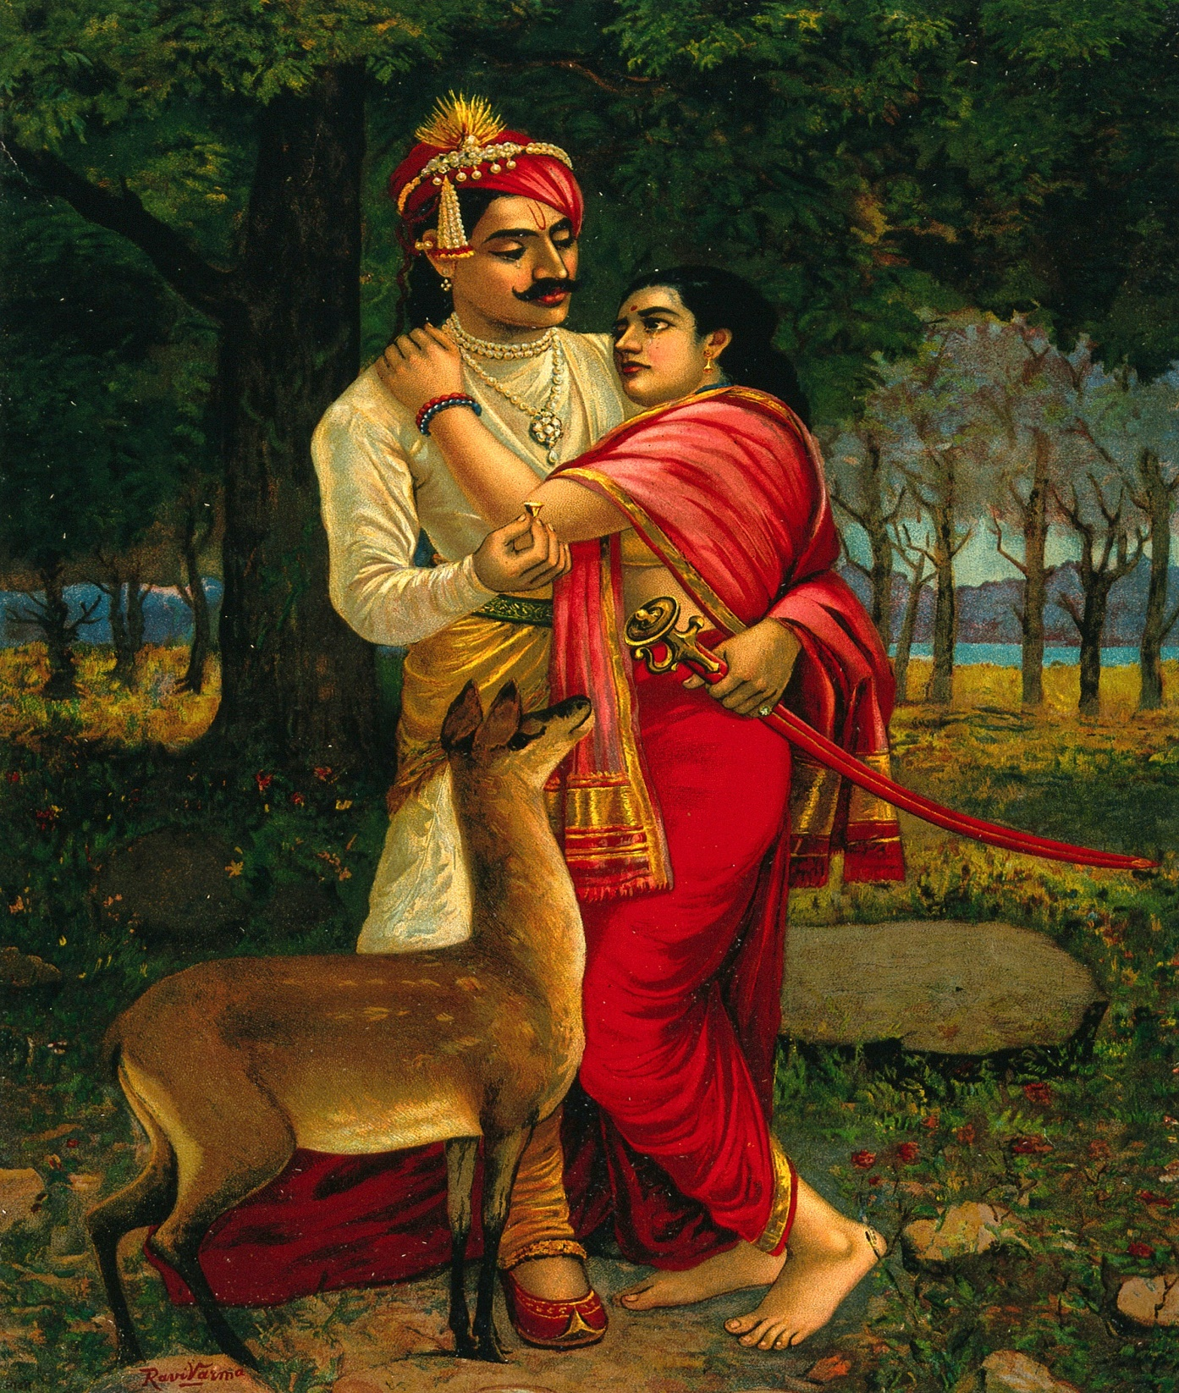
Vibhava
Kalidasa’s Abhijñānaśākuntalam

Slide 18
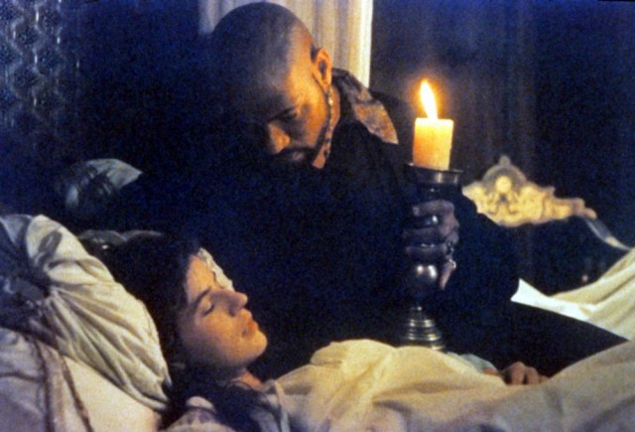
Anubhava is the bodily expression
Shakespeare’s Othello

Slide 19
‘Vyabhicari’ is the series of diverse emotions that feed on the dormant emotion

Slide 20
Samyoga (conjunction) and Rasa-nispatti (manifestation of Rasa)
Rasa is connected with the primary emotions
Permanent/Dominant emotions known as ‘Sthayibhava’
The dominant emotions are connected with the emotional states and the emotion becomes ‘Rasa’ when it is aesthetically excited.

Slide 21
Different Versions regarding the creation of Rasa
Mammata Bhatta, believes that ‘Rasa’ happens through a ‘cause’ (effective causes) or ‘nimitta karana’.
Samsuka discusses the relationship between the ‘real’ and the ‘unreal’ and the blending of these two worlds can create ‘Rasa’.
Bhatta Nayaka and Abhinavagupta (Sadharanikarana)

Slide 22
Different Versions regarding the creation of Rasa
Bhatta Tauta – the audience are in the midway between ‘pure actuality’ and ‘pure identity’

Slide 23
Universalization of ‘poetic art’
Aesthetic composition creates an aesthetic situation leading to an emotion.
Artistic enlightenment is universal and therefore ‘transcendental’ (‘Camatkara’) and it provides aesthetic pleasure universally.

Slide 24
The Highways of Literary Criticism in Sanskrit
S. Kuppuswami Sastri
synthesis between literary law and literary freedom, which is mainly achieved through Vyanjana (suggestion)
Concepts like ‘Literary Law’ and ‘Literary Freedom’

Slide 25
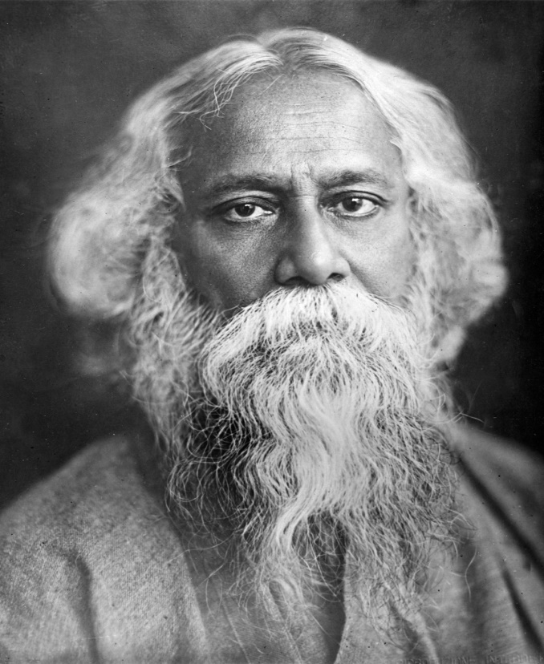
According to Rabindranath Tagore, “Literature conforms to the rules of grammar but still it is joy and freedom. A poem is of course law bound but it transcends. Law is the wings. Form is in law but spirit is in beauty”.

Slide 26
Significance of the principle of ‘Vyanjana’ (suggestiveness or suggestion or suggestive quality)
‘Vyanjana’ is the core of poetry

Slide 27
The “trio” of Poetry
Artist’s mind Aesthetic sense of Expression Reader
Poetic Expression
Kavi Sahrudaya
“suggestion”

Slide 28
“shabda” and “artha” – word and meaning
Creation of ‘Genuine Potery’

Slide 29
Other Aspects
Form and Content
Form is the ‘vakyartha’
‘guna’, the quality or merit of the collocation,
alamkaras are the decorative devices, ‘Riti’ (style); ‘Rudhi’, the usage and all these factors constitute the literary form
Important schools of thought
Dhvani, Rasa and Anumana/Unnaya (result or the inference). Dhvani is Vyanjana, Rasa, the highway of criticism and Auchithya (adaptation or the synthesis of Rasa, Dhvani and Anumana)
Vakrokti
Eccentric expression or deviation in expression from the common place.

Slide 30
Significance of ‘Vjanjana’
It is artistic because it involves suppression
It gives an impression because it provides artistic thrill
It can remind the readers about ‘Alamkara Sasthra’ and the various genres.

Slide 31
Contributions of Anandavardhana
The concept of ‘Dhvani’
Classification of poetic expression – As ‘Uttama’ (the best or the first rate); ‘Madhyama’ (second rate) and ‘Adhama’ (inferior).

Slide 32
Use and Abuse of Alamkara – V. Raghavan
What is ‘Alamkara’?
Deviation from the normal through the striking use of words and ideas, which constitute the poetic form
‘Alamkara’ is the ‘beautiful’ in poetry or the poetic form.

Slide 33
Different Versions
Anandavardhana says, “Though Alamkaras are the ‘sarira’ (outer body), they can be made the ‘sariri’ (the soul)”.
Abhinavagupta believes that, “Alamkaras are external ornaments but can be like the ‘kumkuma’ (saffron) smeared for the beauty of the body, when they are organic and structural”.

Slide 34
Anandavardhana on the use of ‘Alamkara’
Alamkara should be subordinated to Rasa
It should suit the Bhava
It should be natural

Slide 35
Anandavardhana’s principles for the use of Alamkaras
Alamkaras must be ancillary (Angabhuta)
They must never become the centre (Pradhana)
The main theme should get the significance supported by the Alamkaras
They must not be too much elaborated or overworked
Even if they are elaborate, the poet must restrict them to Anga (an ancillary)

