Slide 1
“Shakespeare:
Life and Works”
Dr Ranjith Krishnan K R
Assistant Professor of English
N.S.S. College, Pandalam

Slide 2
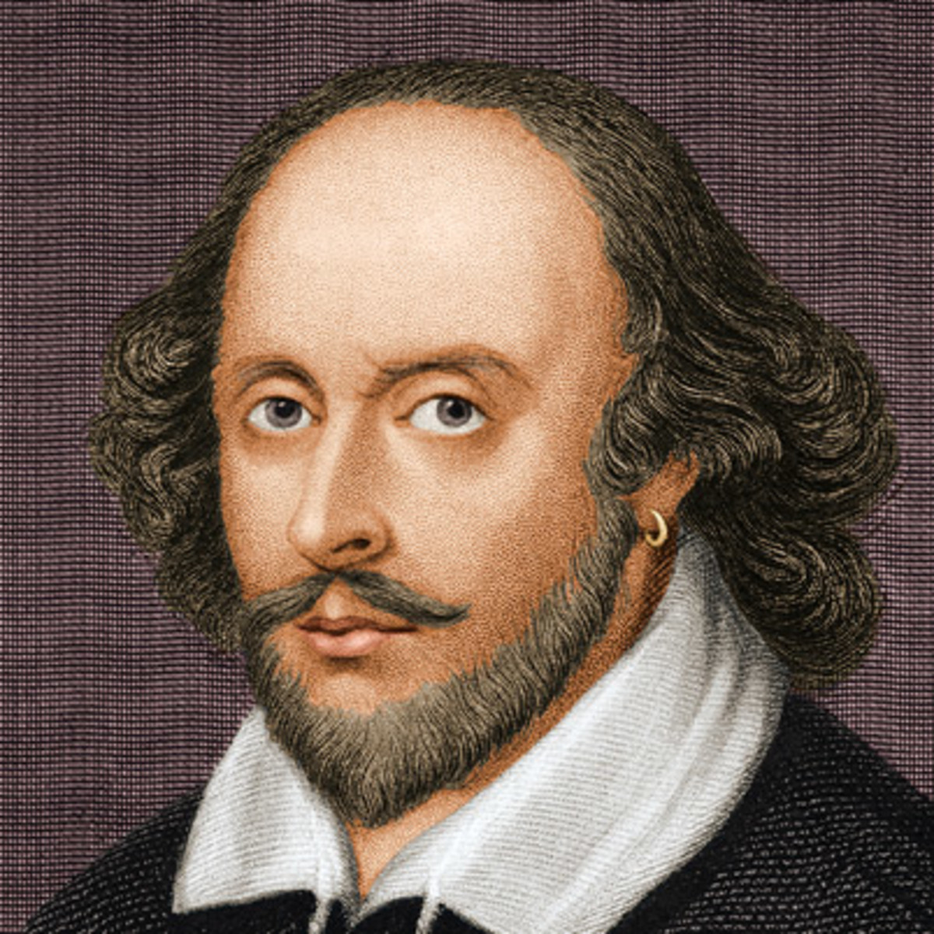
William Shakespeare
26 April 1564 –
23 April 1616
As the son of John Shakespeare and Mary Arden
Born at
Stratford-upon-Avon

Slide 3
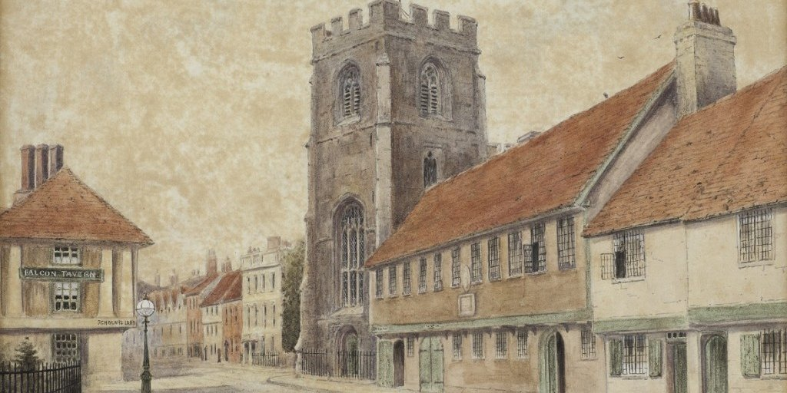
King’s New School in Stratford

Slide 4
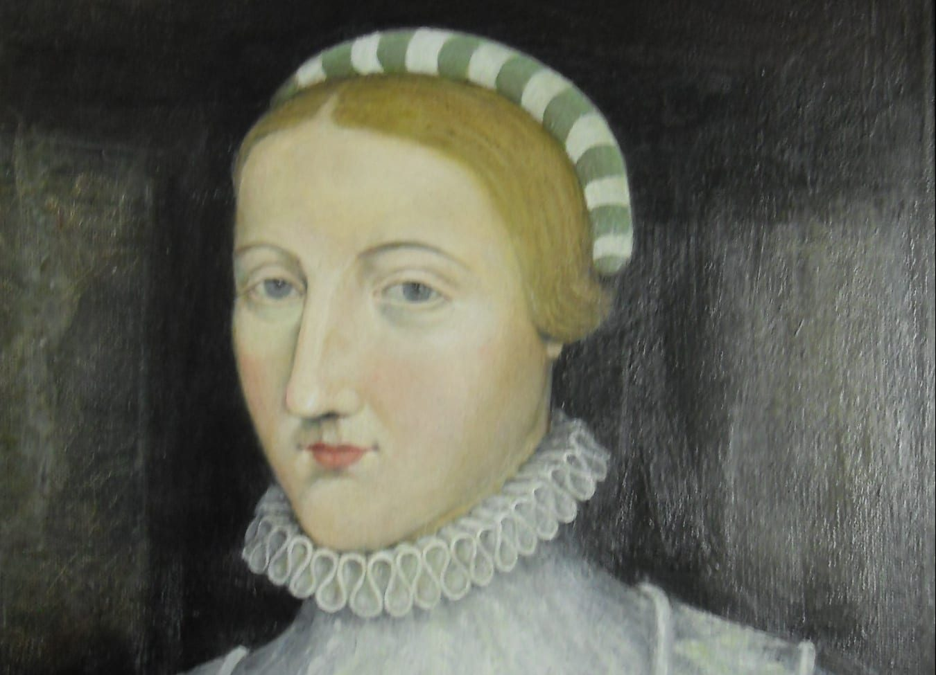
Shakespeare married
26-year-old
Anne Hathaway in 1582
Had three children – Susanna in 1583 and later twins in 1585 – son Hamnet and daughter Judith

Slide 5
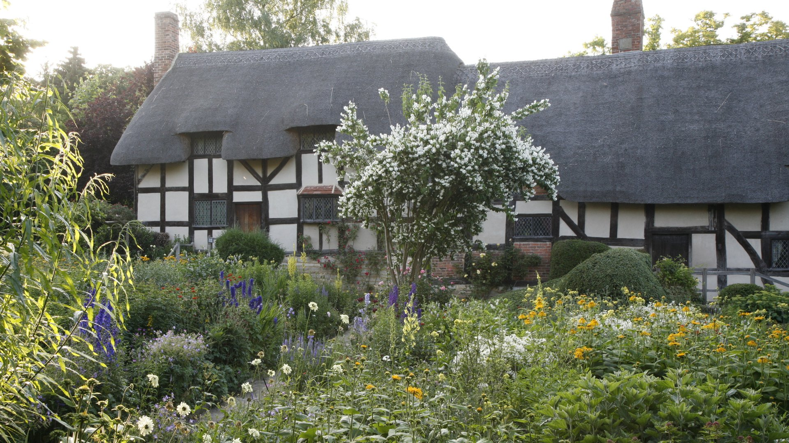
Anne Hathaway’s Cottage

Slide 6
1585 – 1592, Shakespeare moved to London and began working in theatre
Different roles – As a Poet, Playwright, Actor, etc.
England during the 1590s was under the rule of Queen Elizabeth I
Christopher Marlowe, Thomas Kyd, etc. as the major playwrights

Slide 7
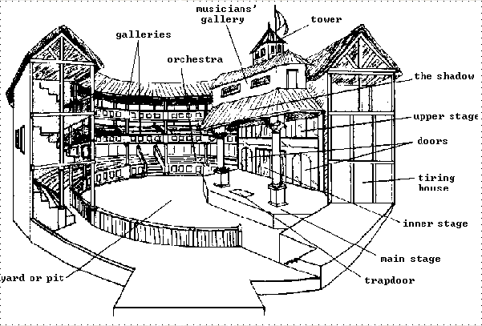
The Globe Theatre

Slide 8
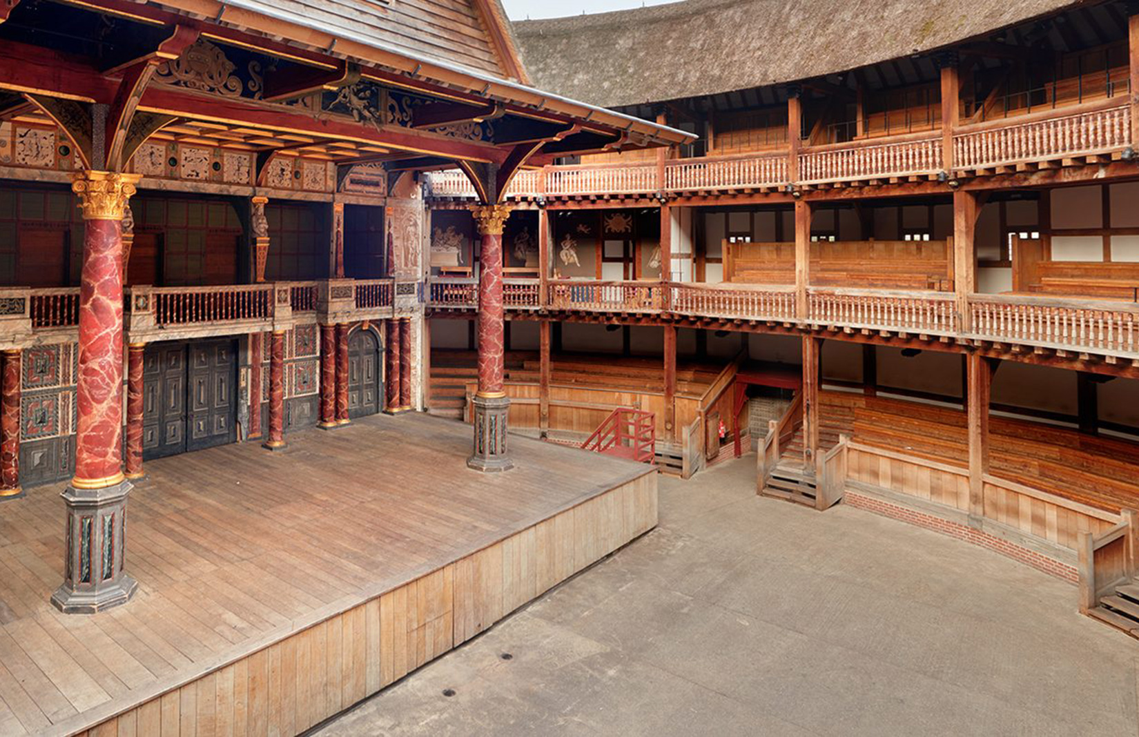

Slide 9
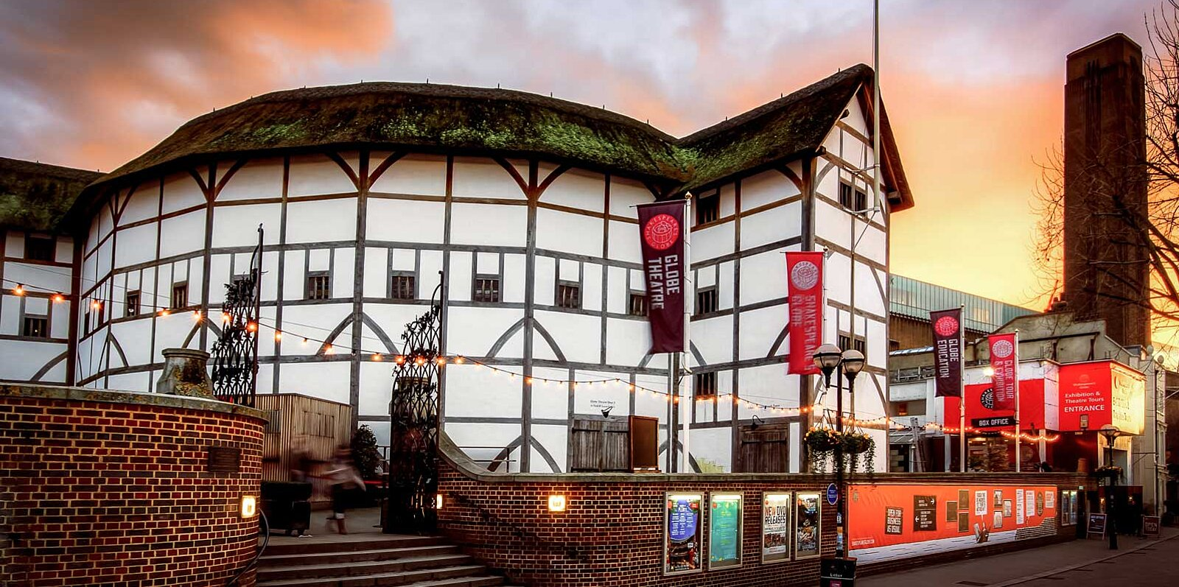
The reconstructed Globe Theatre

Slide 10
Theatrical Conventions
No electricity
Women were forbidden to act on stage
Contemporary costumes
Minimal scenery
Use of Soliloquies and Aside
Bloodshed/Violence – Duels and Adventures
Use of the Supernatural
Use of disguises/mistaken identities
Multiple murders and multiple weddings
Use of music/songs

Slide 11
Shakespeare’s Works
37 Plays
154 Sonnets
2 Long Poems
(“Venus and Adonis” and “The Rape of Lucrece”)
Tragedies, Comedies, Historical Plays and Romances

Slide 12
14 Comedies
10 Historical Plays
10 Tragedies
03 Romances

Slide 13
Shakespeare’s Major Comedies
All’s Well That Ends Well
As You Like It
Comedy of Errors
The Winter’s Tale
Midsummer Night’s Dream
The Taming of the Shrew
Much Ado About Nothing
Twelfth Night
Merchant of Venice
Love’s Labour Lost

Slide 14
Shakespeare’s Major Tragedies
Julius Caesar
Hamlet
Macbeth The Four ‘Great Tragedies’
Othello
King Lear
Romeo and Juliet
Antony and Cleopatra

Slide 15
Shakespeare’s Major Historical Plays
Henry IV (Part I and II)
King John
Richard II
Richard III
Henry V
Henry VI (Parts I, II and III)
Henry VIII

Slide 16
Shakespeare’s Other Major Plays
The Tempest
Measure for Measure
Troilus and Cressida
Cymbeline
Coriolanus

Slide 17
Shakespeare’s Contribution to Language
Shakespeare introduced many new words (1,700) and expressions into English language
Use of blank verse – as an inspiration to many

Slide 18
Universality of Shakespeare
His extraordinary facility for language, memorable characters, and amazing stories with a universal appeal
Variety of themes and characters representing diverse individuals
Adaptability

Slide 19
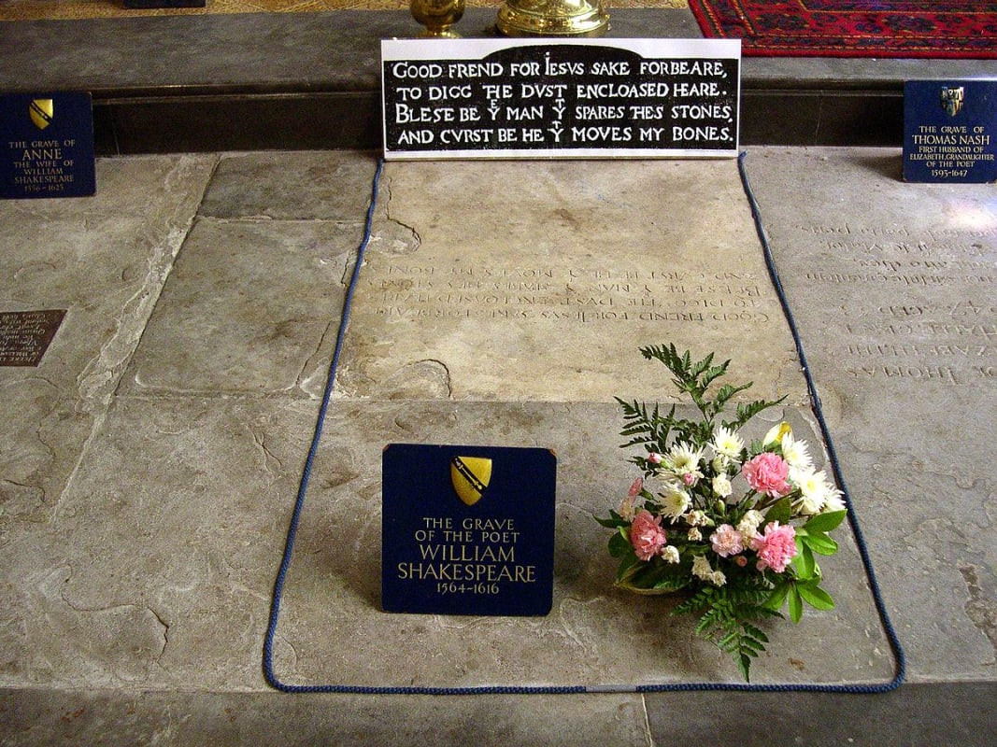
"Good Friends, for Jesus' sake forbear,
To dig the bones enclosed here!
Blest be the man that spares these stones,
And curst be he that moves my bones."

Slide 20
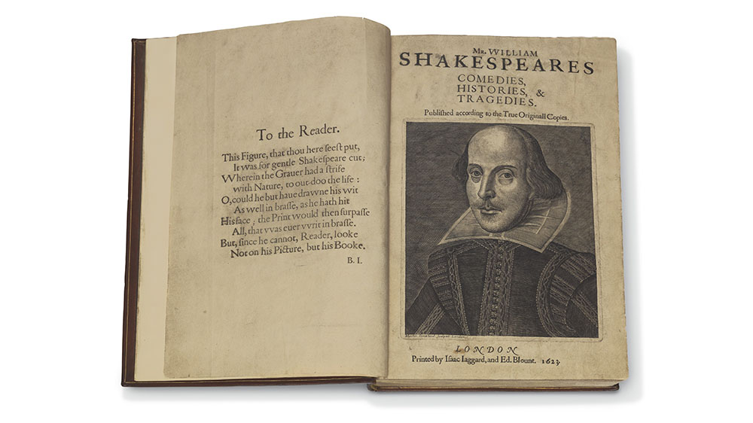
We are such stuff As dreams are made on; and our little life Is rounded with a sleep.

