Slide 1
Tips to keep your kids safe online
Doc Nyarai

Slide 2
As parents, we generally do everything we can to keep our children safe and well
Let’s face it, the internet is here to stay - it’s time, if you haven’t started already, to introduce some cyber safety know how to your parenting toolkit.
it’s time, if you haven’t already, to introduce some cyber safety know how to your parenting toolkit. Here’s ten tips to get you started. Here’s ten tips to get you started.

Slide 3
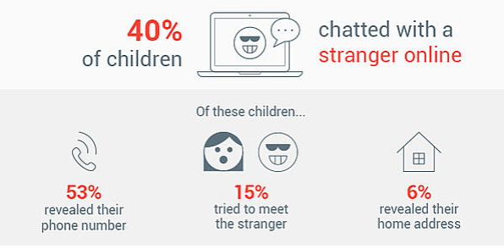
Source: https://iamcybersafe.org/parent-research/

Slide 4
Digital natives doing all-new things parents wouldn’t approve of
29% are using the internet in ways their parents won’t approve
21% visit sites where they can chat with strangers
17% are visiting sites with sexual photos or adult videos
11% are visiting sites with instructions for cheating on schoolwork
4% are visiting gambling sites (little Timmy can count cards??)

Slide 5
How are kids getting online?
70% of kids in grades 4-8 have a cellphone,
64% have a tablet,
48% have a computer in their bedroom.
So our CE & Youth have quite a few opportunities to go online without adult supervision.

Slide 6
Parents not talking to their kids
Recent global survey of 9,485 parents and guardians
43% of parents/guardians talk to their children on a regular basis about their kids’ online behavior.
despite the increasingly digital lifestyle we’re living, it seems that internet safety is still not a regular topic of conversation for families.

Slide 7
“In order for the internet to be a safer place, adults and children need to be able to discuss what is appropriate online behavior and what to do if a child sees or becomes engaged with an activity that makes them uncomfortable.” Jas Dhaliwal, Consumer Security Expert at AVG
In other words, skip the birds-and-bees conversations and talk to your kids about how to stay safe online.
Notes:
https://www.avg.com/en/signal/how-to-keep-your-children-safe-online

Slide 8
Scary stuff, right?
So please, sit your children down and explain to them the dangers
Remind your kids that if they wouldn’t trust a stranger on the street, they definitely shouldn’t trust them online.

Slide 9
Talk openly with your child about their online activity
Keep screens and devices where you can see them - Keep your computer in a common area of the house
Know your parental controls
Know who your children’s online friends are - Know your children's passwords
Watch for changes in your children’s behavior
Keep control of your family’s digital footprint
Teach your children to keep their location private

Slide 10
Keep track of online time - Check your children’s browsing history
Be #Social Network Savvy
Lead by example - Make internet time family time
Set rules — and stick to them
Ultimately, you don’t want to instill fear in your child or prevent them from experiencing the many educational, entertainment, social and other benefits of the internet, but rather give them the skills and knowledge they need to know how to make the most of it and avoid the dangers.

Slide 11
References
https://www.childrens.health.qld.gov.au/blog-10-things-keep-kids-safe-online/
https://www.avg.com/en/signal/how-to-keep-your-children-safe-online
https://www.unicef.org/coronavirus/keep-your-child-safe-online-at-home-covid-19
https://www.avg.com/en/signal/how-to-keep-your-children-safe-online

