Slide 1
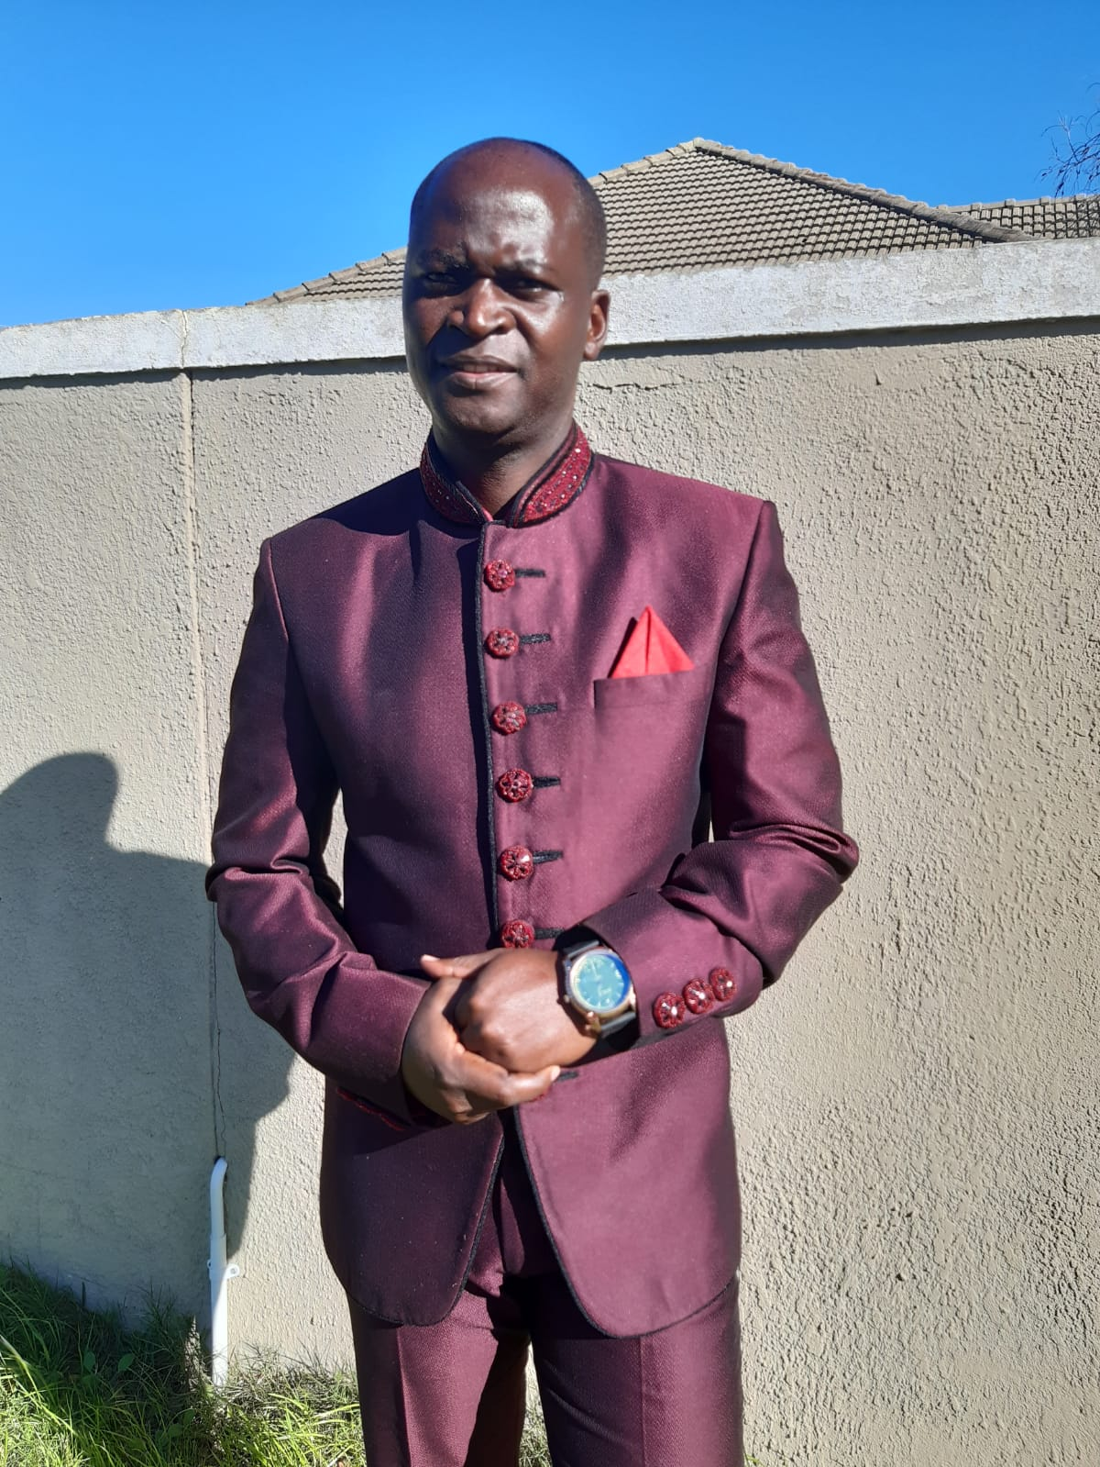
Embracing change in today`s world
BY
LIFE DEVELOPMENT OFFICER
PASTOR TIM NJAVHA

Slide 2
INTRODUCTION TO CHANGE
“ A human being can not change without pressure”
Dr E H Guti

Slide 3
What is change?
Change is both a verb and a noun
As a verb ( change is making or becoming differently). Moving from one to another, eg engaging another gear in a motor vehicle. Put clean nappy on a baby or young child.
As a noun ( change is an act or process through which something becomes different, eg the substitution of one thing for another

Slide 4
Why should people embrace change
“No matter who or where you are—regardless of your country,
race, ethnicity, language, and disposition—time and change
will affect you. Life is continually handing us personal, family,
community, and national changes.
You may feel more trepidation than trust regarding the
inevitability of change. Yet you can learn to embrace change
with a positive attitude and use it to benefit your life, as well as
others’ lives”. Dr Myles Munroe

Slide 5
Embrace change
God is the author of change. He initiated it when created time and seasons.
Eccelesiast 3 tells us that the time for everything. This tells us to prepare for change when things change.
Naturally man is subject to change. When you breath you eat and grow that’s change. When you grow you become old and you die. That’s change.
Man is a redeemable creature, he can repent , be revived and adapt respond and react to change.
Are you ready for change?

Slide 6
Embrace the change
Change is hard because people over estimate the value of what they have and underestimate the value of what they may gain by given a chance to change.
Are satisfied with status?
Are happy with your salary ?
Is there anything in your life that is draining much of your energy?
Do see any area that needs improvement?
Its time to embrace change because you are not a machine. You have the ability to change.
Change is inevitable.
If you can not change , change will change you.

Slide 7
How to foster change
define
align
manage
Define your mental picture of the term change.
Change means different to different people. What it mean to you.
Clarify the vision
Clarify the values and expected behaviours
Team work is the ability to work together towards a common goal.
Involve people who within your circle , because can not happen without affecting other people around. When you want to do personal development your family will be affected and friends as well. So alignment is needed
Align well with people of the same goals with you.
You need the ability to manage change
Develop resilience
Quickly fail to reduce the curve of learning
Be disciplined
NB- Successful people should be ready to lose friends, bad habits , fear and laziness

Slide 8
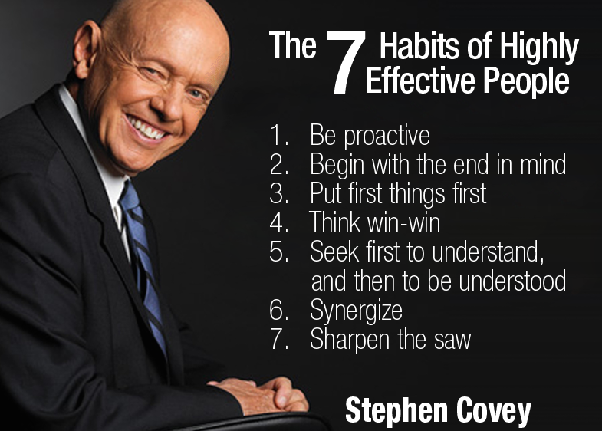
Fostering change
For a successful change , begin with the end in the mind”
Stephen Covey

Slide 9
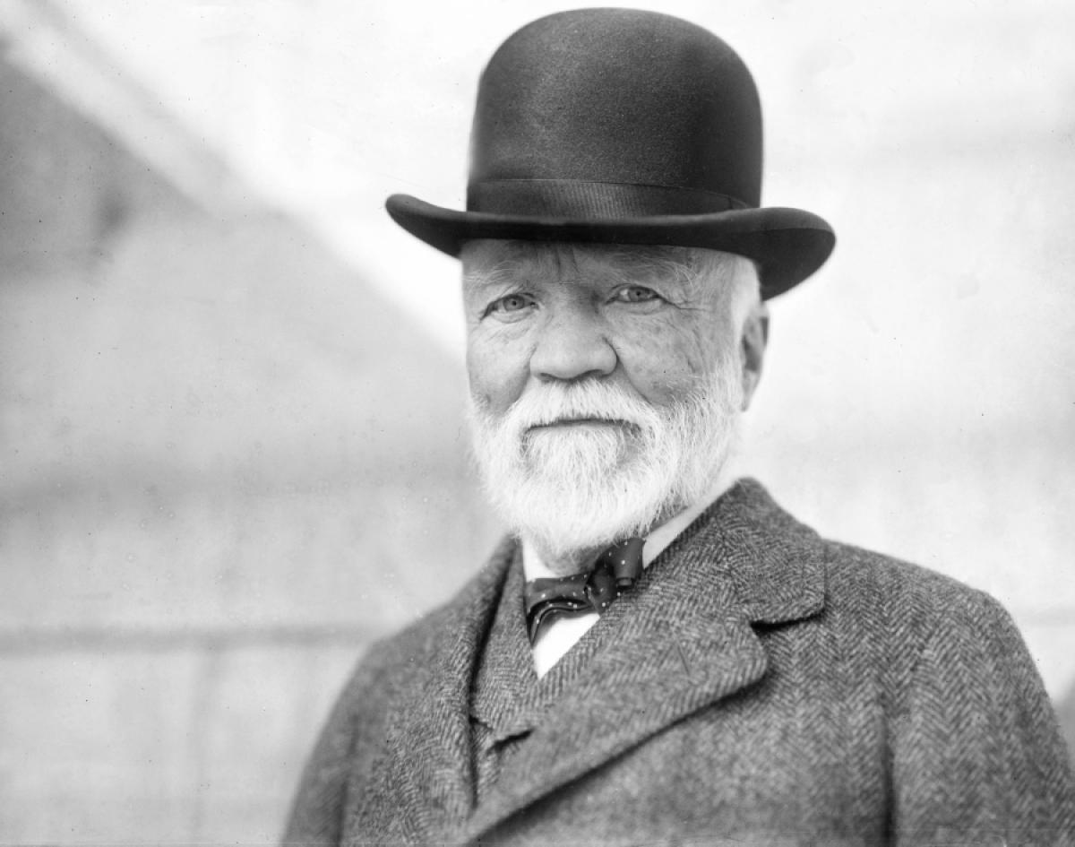
Fostering change
Team work is the ability to work together towards a common vision
ANDREW CARNEGIE

Slide 10
Fostering change
A culture of discipline is not a principle of business, it is a principle of greatness.
JIM COLLINS

Slide 11
How to handle yourself through change
Keep visualizing- write in detail what the improved self culture will look like and feel when you achieve the goal of your change.
Stay positive-your strength is seen in cultivating positive thinking and optimism
Deal with obstacles- identify roadblocks that impede progress so they can be surpassed with skill.
Pleasure over pain-your achievements or positive behaviour associated with your changed culture should be connected to your mind with having a greater pleasure than pain.
Start walking-At some point you have to start taking those first steps. Like small baby not fear to fail. Fall and rise with a new skill to walk.
Embrace change-Understand and show humility and desire to improve (kaisen kaisen)

Slide 12
Think before you change
Change your thoughts and you change your world

Slide 13
WHAT DO WE NEED TO DO BEFORE WE TACKEL CHANGE
Do you think you can change?
A growth mindset against a fixed mindset
I believe (motivator)
Be inspired yourself
Do you want to change?( decision)
What and how could you do to change?( action plan and commitment)

Slide 14
FoundationAL principles for change
Five foundational principles of change are:
(1) nothing on earth is as permanent as change
(2) change is continual
(3)everything changes
(4) change is inevitable
(5) change is a principle of life and creation.

